Slide 1
Hemostatic resuscitation effects: an in silico exploration
Jansen N Seheult, MB BCh BAO, MSc, MD
Special Coagulation Fellow,
Department of Laboratory Medicine and Pathology,
Mayo Clinic

Slide 2

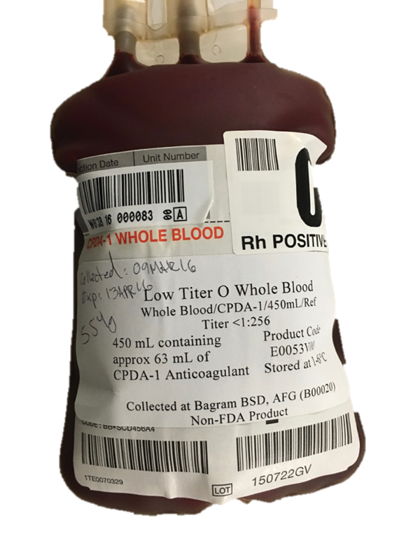
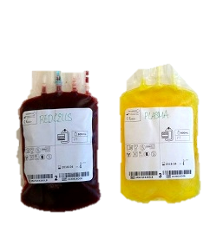
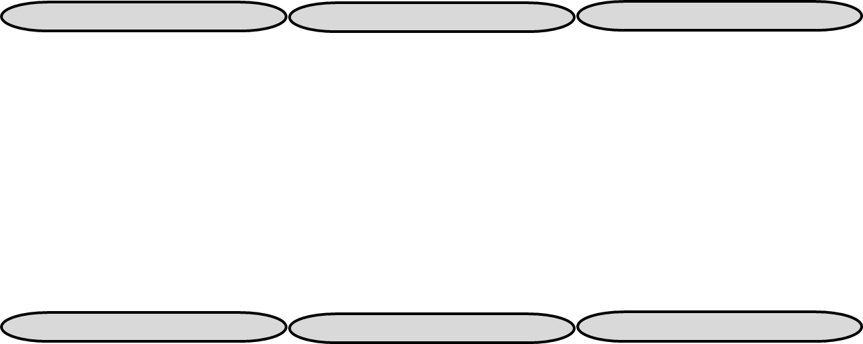
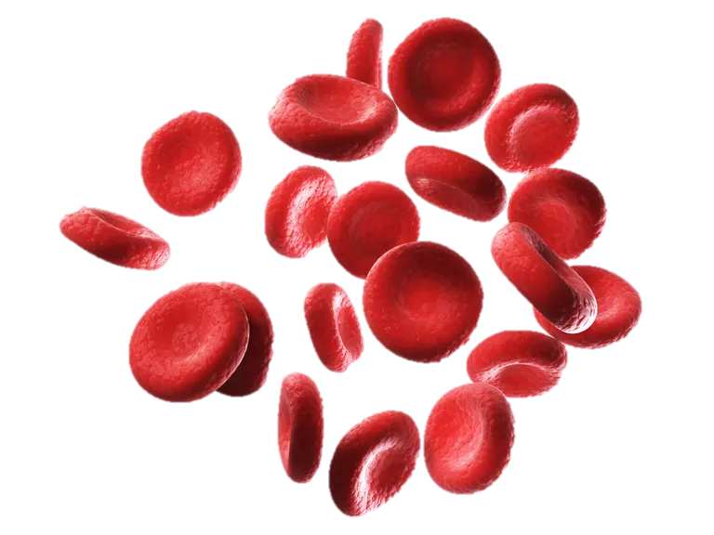
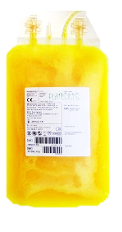

Question
WB + CCT
WB
LTOWB
570 mL total volume
  228 mL of red cells
  75 g of hemoglobin
  272 mL of plasma
  1.0x10¹¹ PLTs
  70 mL of citrate-phosphate-dextrose (CPD)
AS-1 RBC
378 mL total volume
  228 mL of red cells
  75 g of hemoglobin
  32 mL of plasma
  8 mL of CPD
  110 mL of additive solution
Plasma
234 mL total volume
  186 mL of plasma
  48 mL of CPD
Whole blood derived (WBD) PLT unit (equivalent to one-fifth of a units of apheresis PLTs)
68 mL total volume
  1.0 x 10¹¹ PLTs
  54 mL of plasma
  14 mL of CPD
  A transfused dose of PLTs consisted of 5 WBD PLT units
CCT

Slide 3
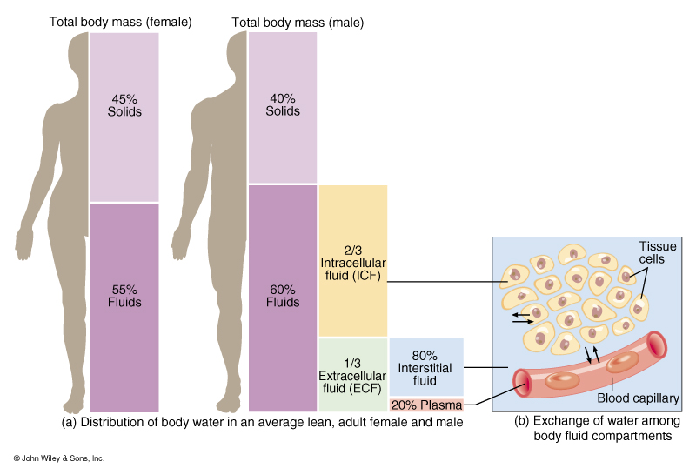

Assumptions
Total blood volume
Weight = 83.5 kg
TBV = 70 * weight

Slide 4
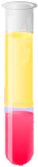
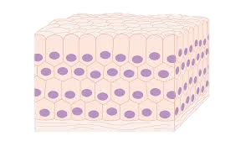
Assumptions
Constituents of blood
Hematocrit = 45%
Hemoglobin = 15 g/dL
PT = 10.4 s, INR = 1.0
Fibrinogen = 300 mg/dL
PLT count = 230 x 10⁹/L

Slide 5
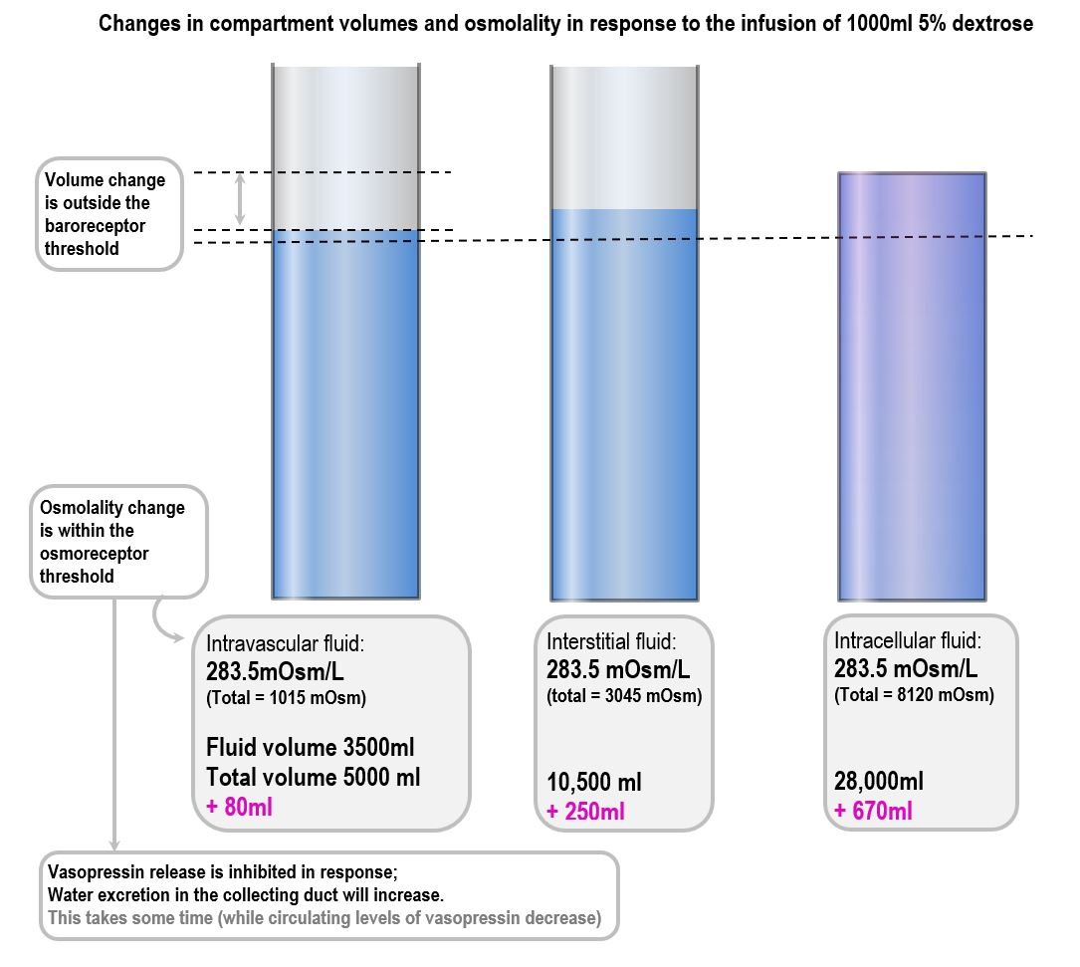

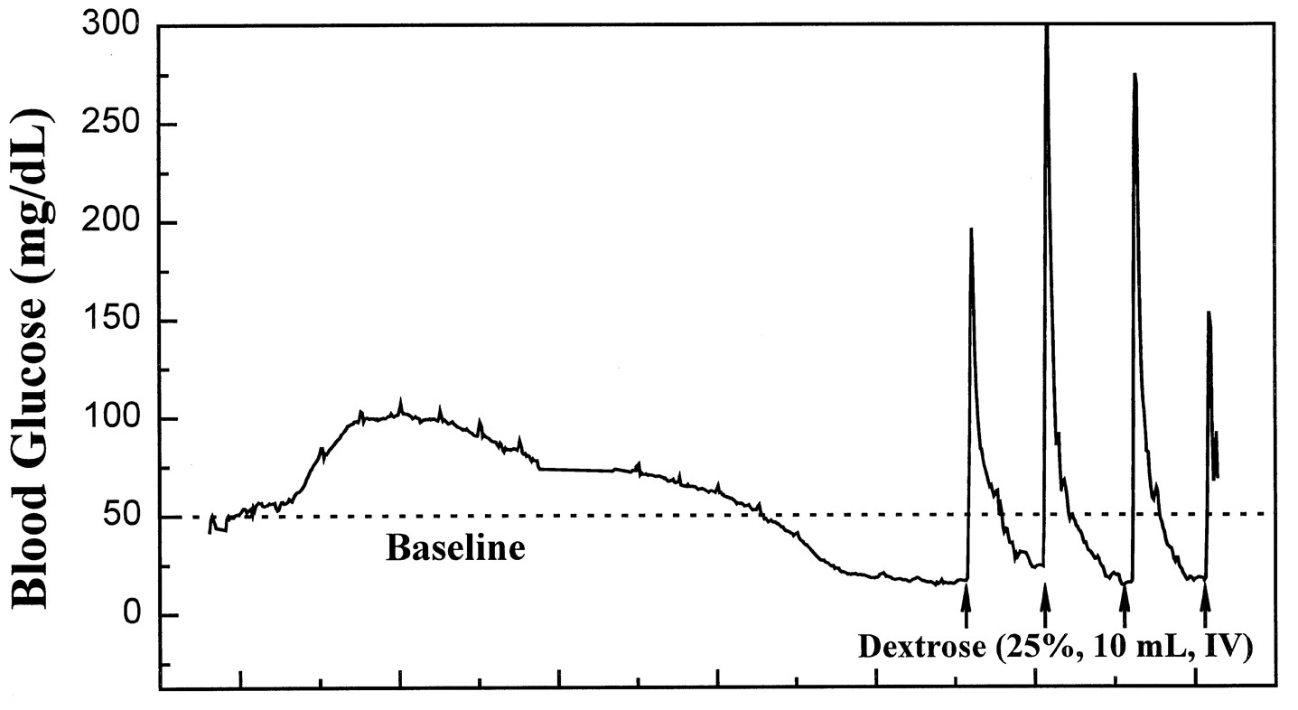
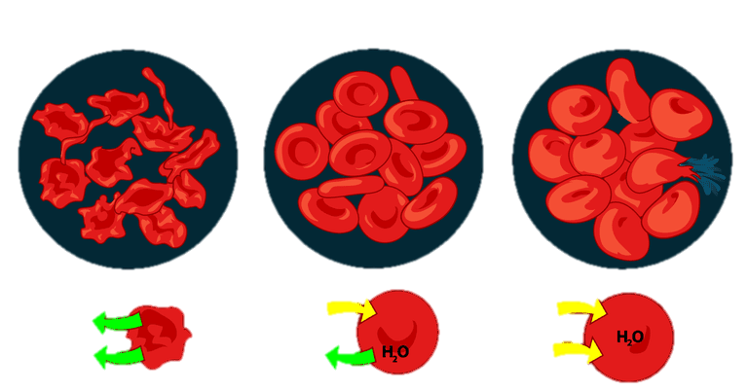
Assumptions
Body fluid compartments
traditional estimates of body fluid compartment volumes based on weight
changes in osmolarity and fluid volumes in the various compartments based on the osmolarity gradients
distribution and metabolism of infused dextrose
  CPD: 9.0 mOsmoles in 70 mL
  AS-1: 12.2 mOsmoles in 110 mL
distribution but not metabolism of other infused fluids (half-life > 200 minutes)
transcapillary diffusion of free water based on Starling’s law for the transcapillary pressure gradient
refilling of the PV from the ISF compartment via the lymphatic circulation
solute-solvent coupling, whereby solute transfer from the PV to the ISF was accompanied by free water movement
2/3
ICF
80%
ISF
1/3
ECF
https://derangedphysiology.com/main/core-topics-intensive-care/manipulation-fluids-and-electrolytes/Chapter%202.3.2/response-1l-5-dextrose
20% Plasma
Compartment | Assigned value
TBW (L) = 0.6*weight*1000 | 50.1
ICF (L) = 2/3*TBW | 33.4
RBCF (mL) = 70*weight*hematocrit | 2,630
NRBCF (L) = ICF – RBCF | 30.8
ECF (L) = 1/3*TBW | 16.7
PV (mL) = 70*weight*[1-hematocrit] | 3,215
PC (mL) = 70*weight*[1-hematocrit] | 3,215
ISF (L) = ECF – PV | 13.5
Osmolarity (mOsmoles/mL) | 0.3
PV dextrose osmoles (mOsmoles) = 80mg/dL*PV/(100*MW of dextrose) | 13.0
Journal of Pharmacology and Experimental Therapeutics August 1998, 286 (2) 959-966

Slide 6
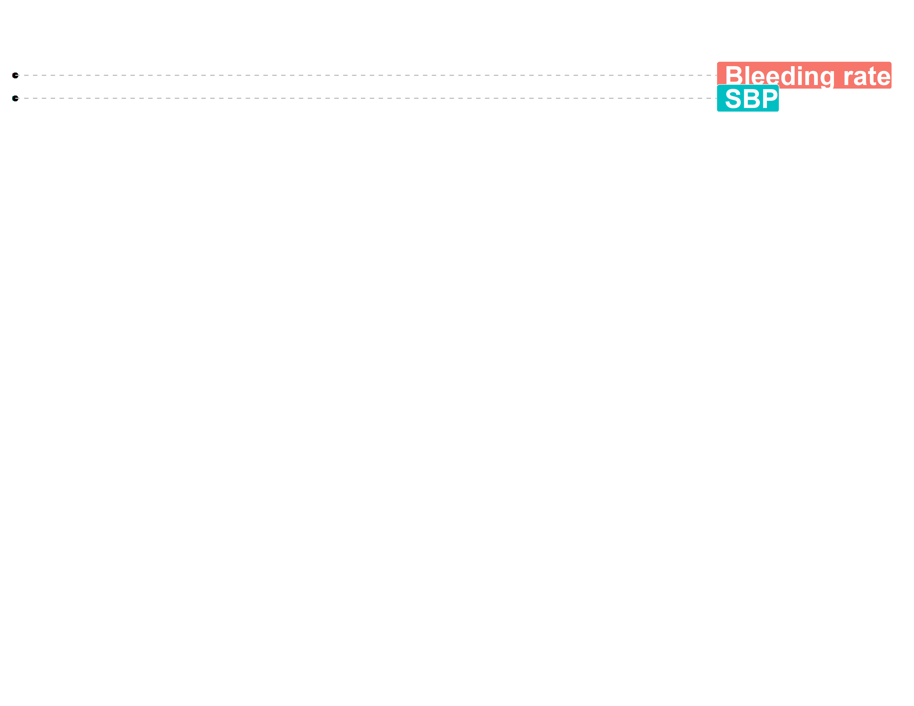
Assumptions
Bleeding rate
bleeding was arterial
vascular defect remained constant and was not reduced by clot formation or vasoconstriction
effects of changes in blood viscosity on the rate of bleeding and on arterial pressure were not accounted for
sympathetic response did not account for any effects of pain or drugs
bleeding rate was not affected by the platelet count, fibrinogen concentration, hematocrit or INR
Systolic blood pressure (SBP)
initial SBP of 130 mmHg
nonlinear function of intravascular volume
empiric hemostatic mechanism to account for vasoconstriction and increased total vascular resistance, which curtailed bleeding during severe hypotension in order to avoid unrealistic SBPs
Initial injury
Pre-hospital resuscitation
ED resuscitation
OR resuscitation
Recovery phase

Slide 7
Assumptions
Target admission (ED) values
SBP = 98 mmHg
Hematocrit = 31.8%
Hemoglobin = 10.6 g/dL
INR = 1.7
Fibrinogen = 158 mg/dL
PLT count = 122 x 10⁹/L

Slide 8
Assumptions
Crystalloid models
WB
1 L of crystalloid
20 units of LTOWB
CCT
1 L of crystalloid
20 units of RBCs
20 units of plasma
20 units of PLTs
WB + CCT
1 L of crystalloid
10 units of LTOWB
10 units of RBCs
10 units of plasma
10 units of PLTs

Slide 9
Assumptions
Prehospital transfusion models
WB
No crystalloid
22 units of LTOWB
CCT
No crystalloid
22 units of RBCs
20 units of plasma
20 units of PLTs
WB + CCT
No crystalloid
10 units of LTOWB
12 units of RBCs
12 units of plasma
10 units of PLTs

Slide 10
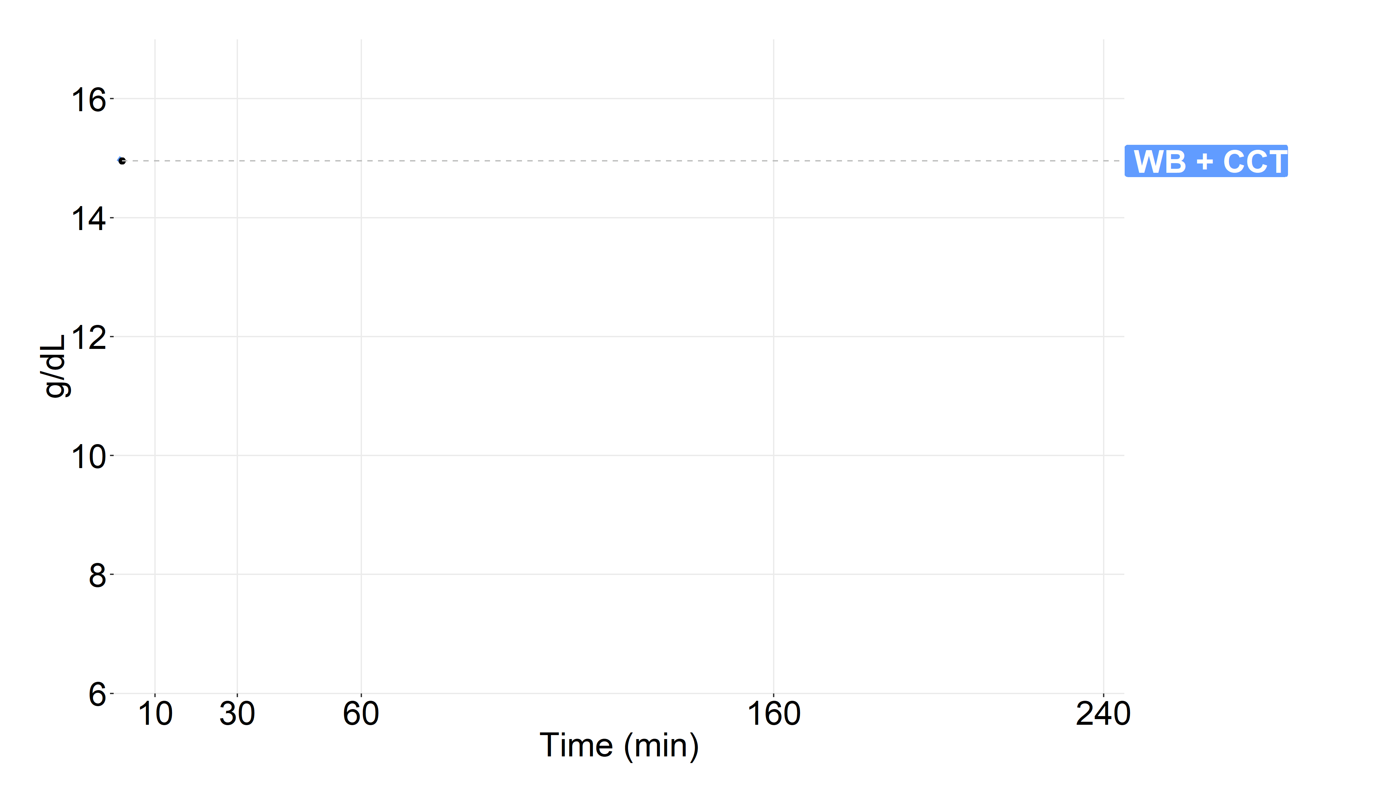
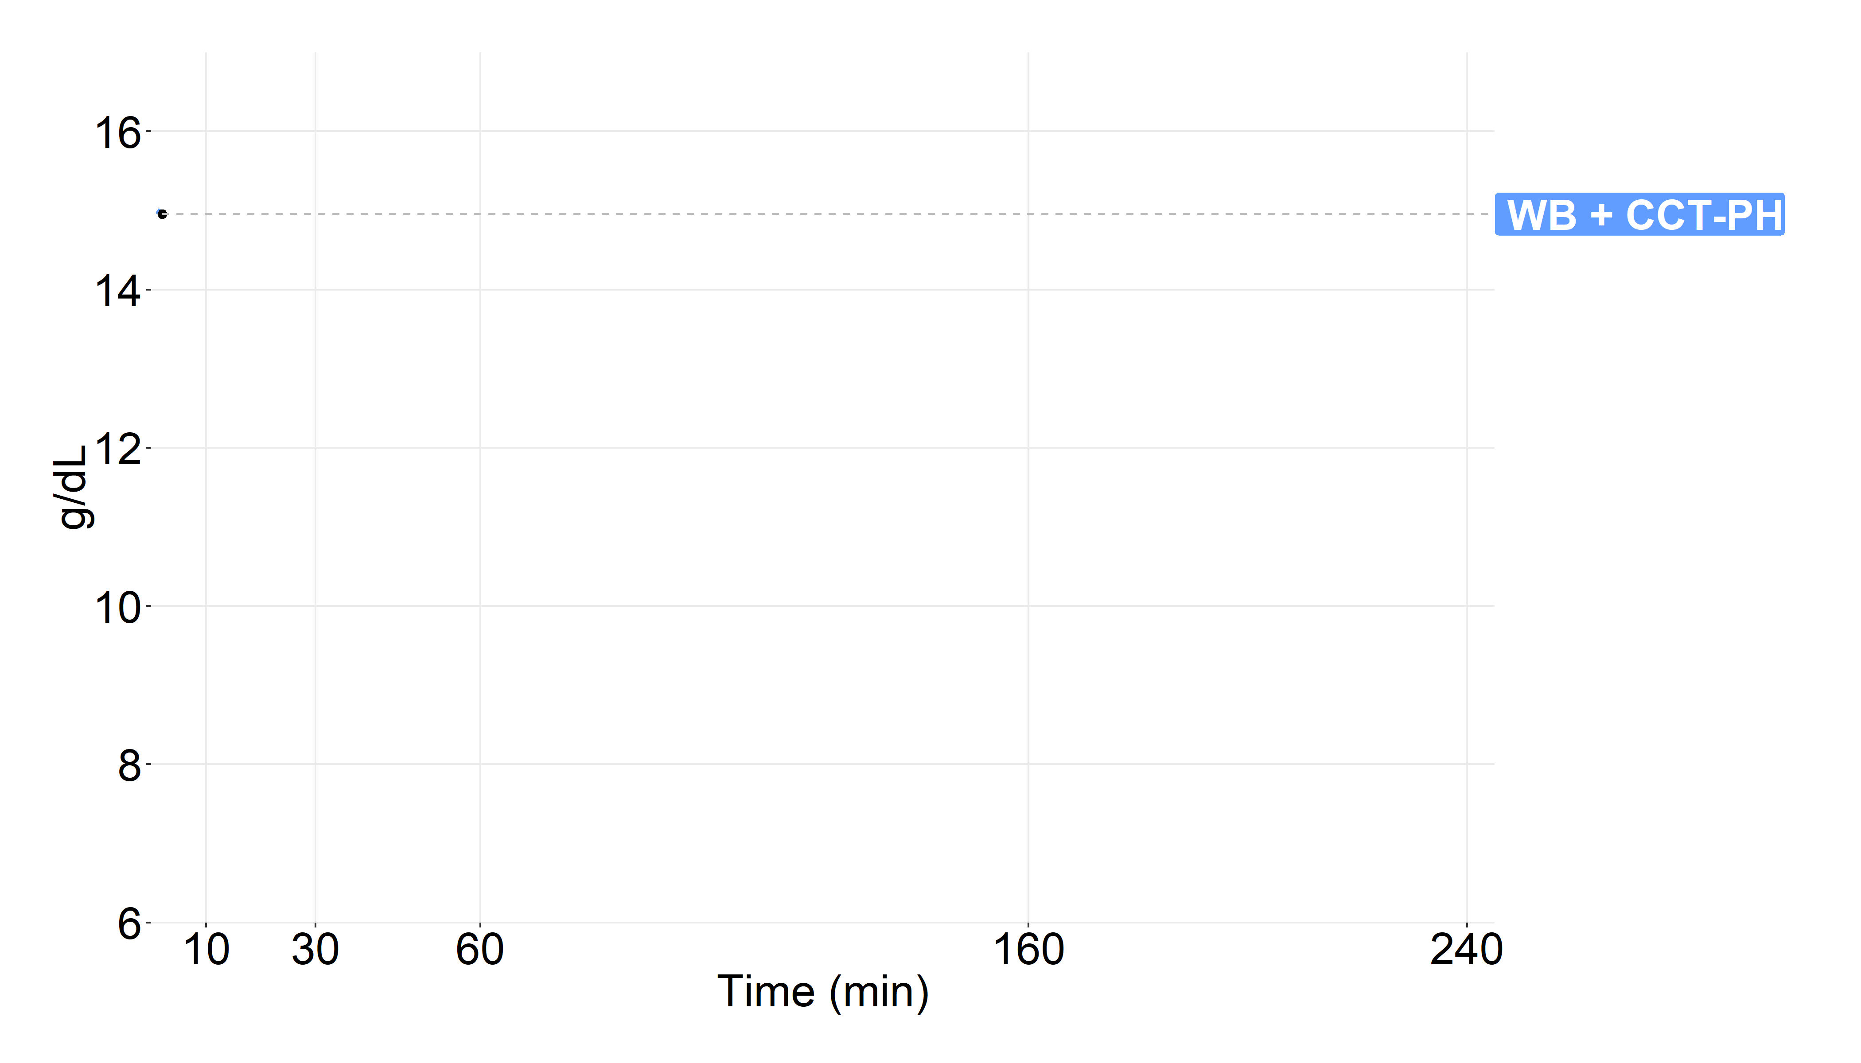
Hemoglobin
Crystalloid models
PH transfusion models
Seheult JN, Stram MN, Sperry J, Spinella PC, Triulzi DJ, Yazer MH. In silico model of the dilutional effects of conventional component therapy versus whole blood in the management of massively bleeding adult trauma patients. Transfusion. 2019 Jan;59(1):146-58.

Slide 11
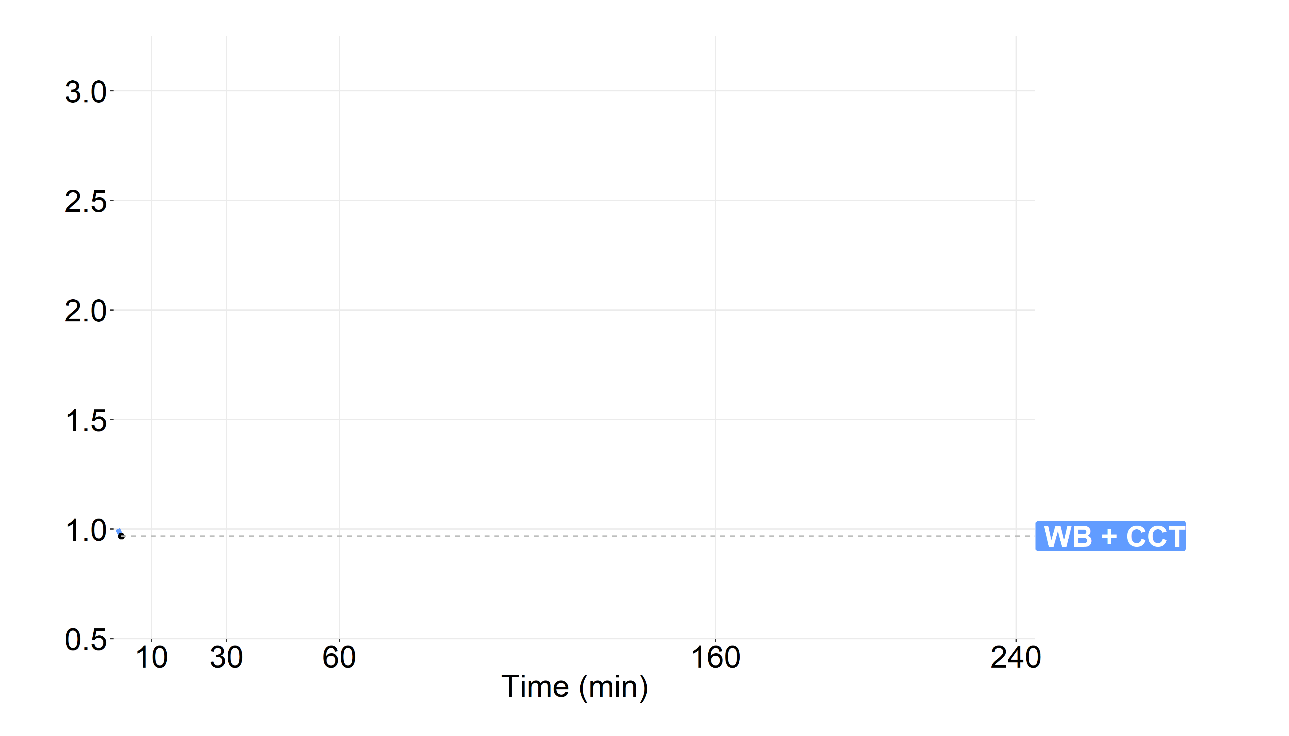
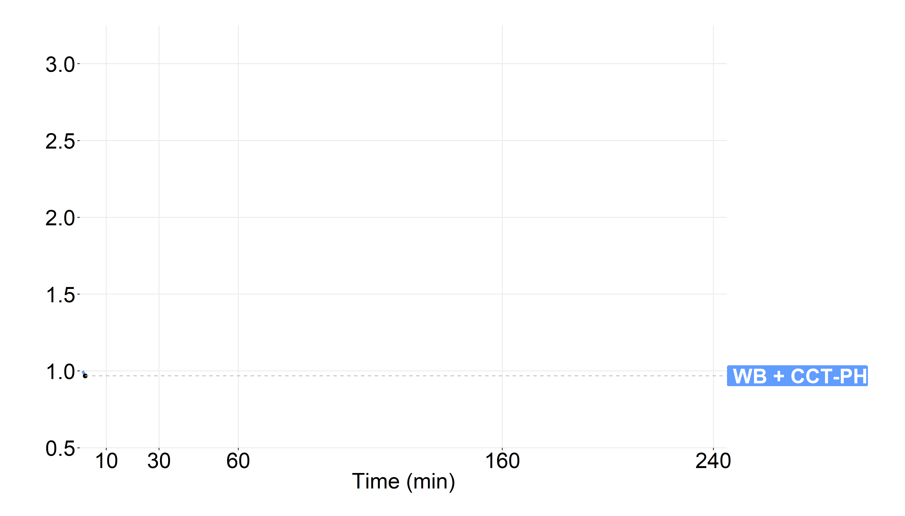
INR
Crystalloid models
PH transfusion models
Seheult JN, Stram MN, Sperry J, Spinella PC, Triulzi DJ, Yazer MH. In silico model of the dilutional effects of conventional component therapy versus whole blood in the management of massively bleeding adult trauma patients. Transfusion. 2019 Jan;59(1):146-58.

Slide 12
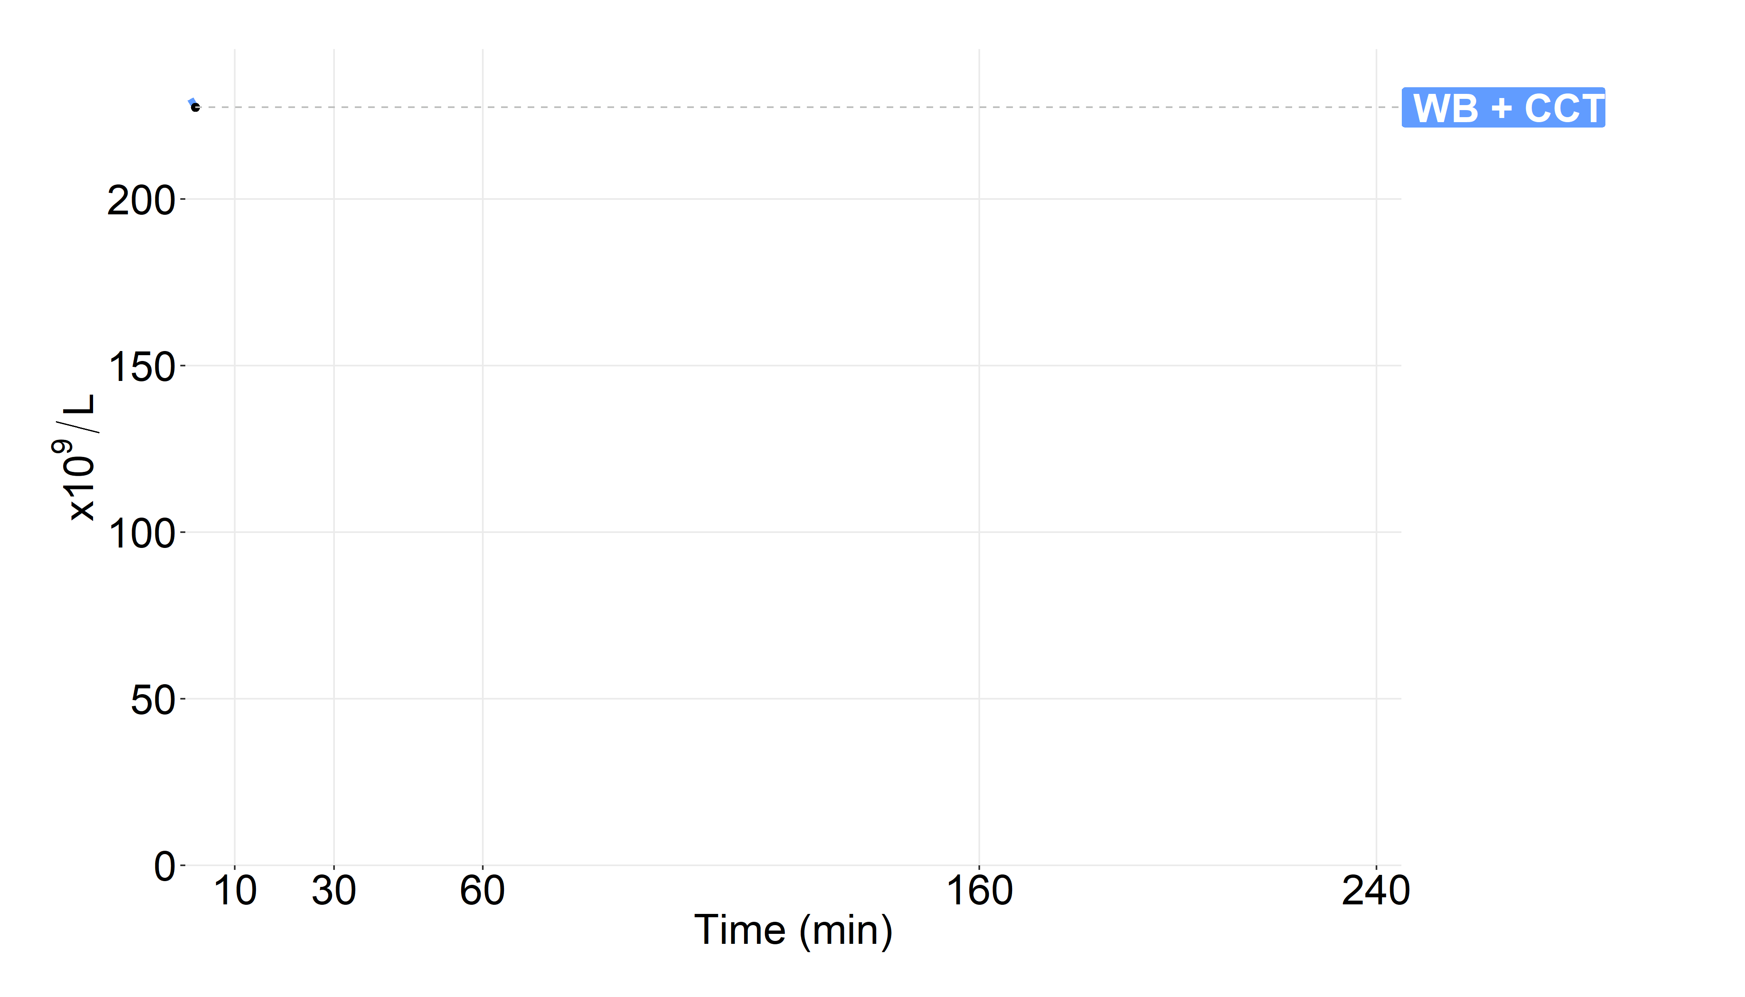
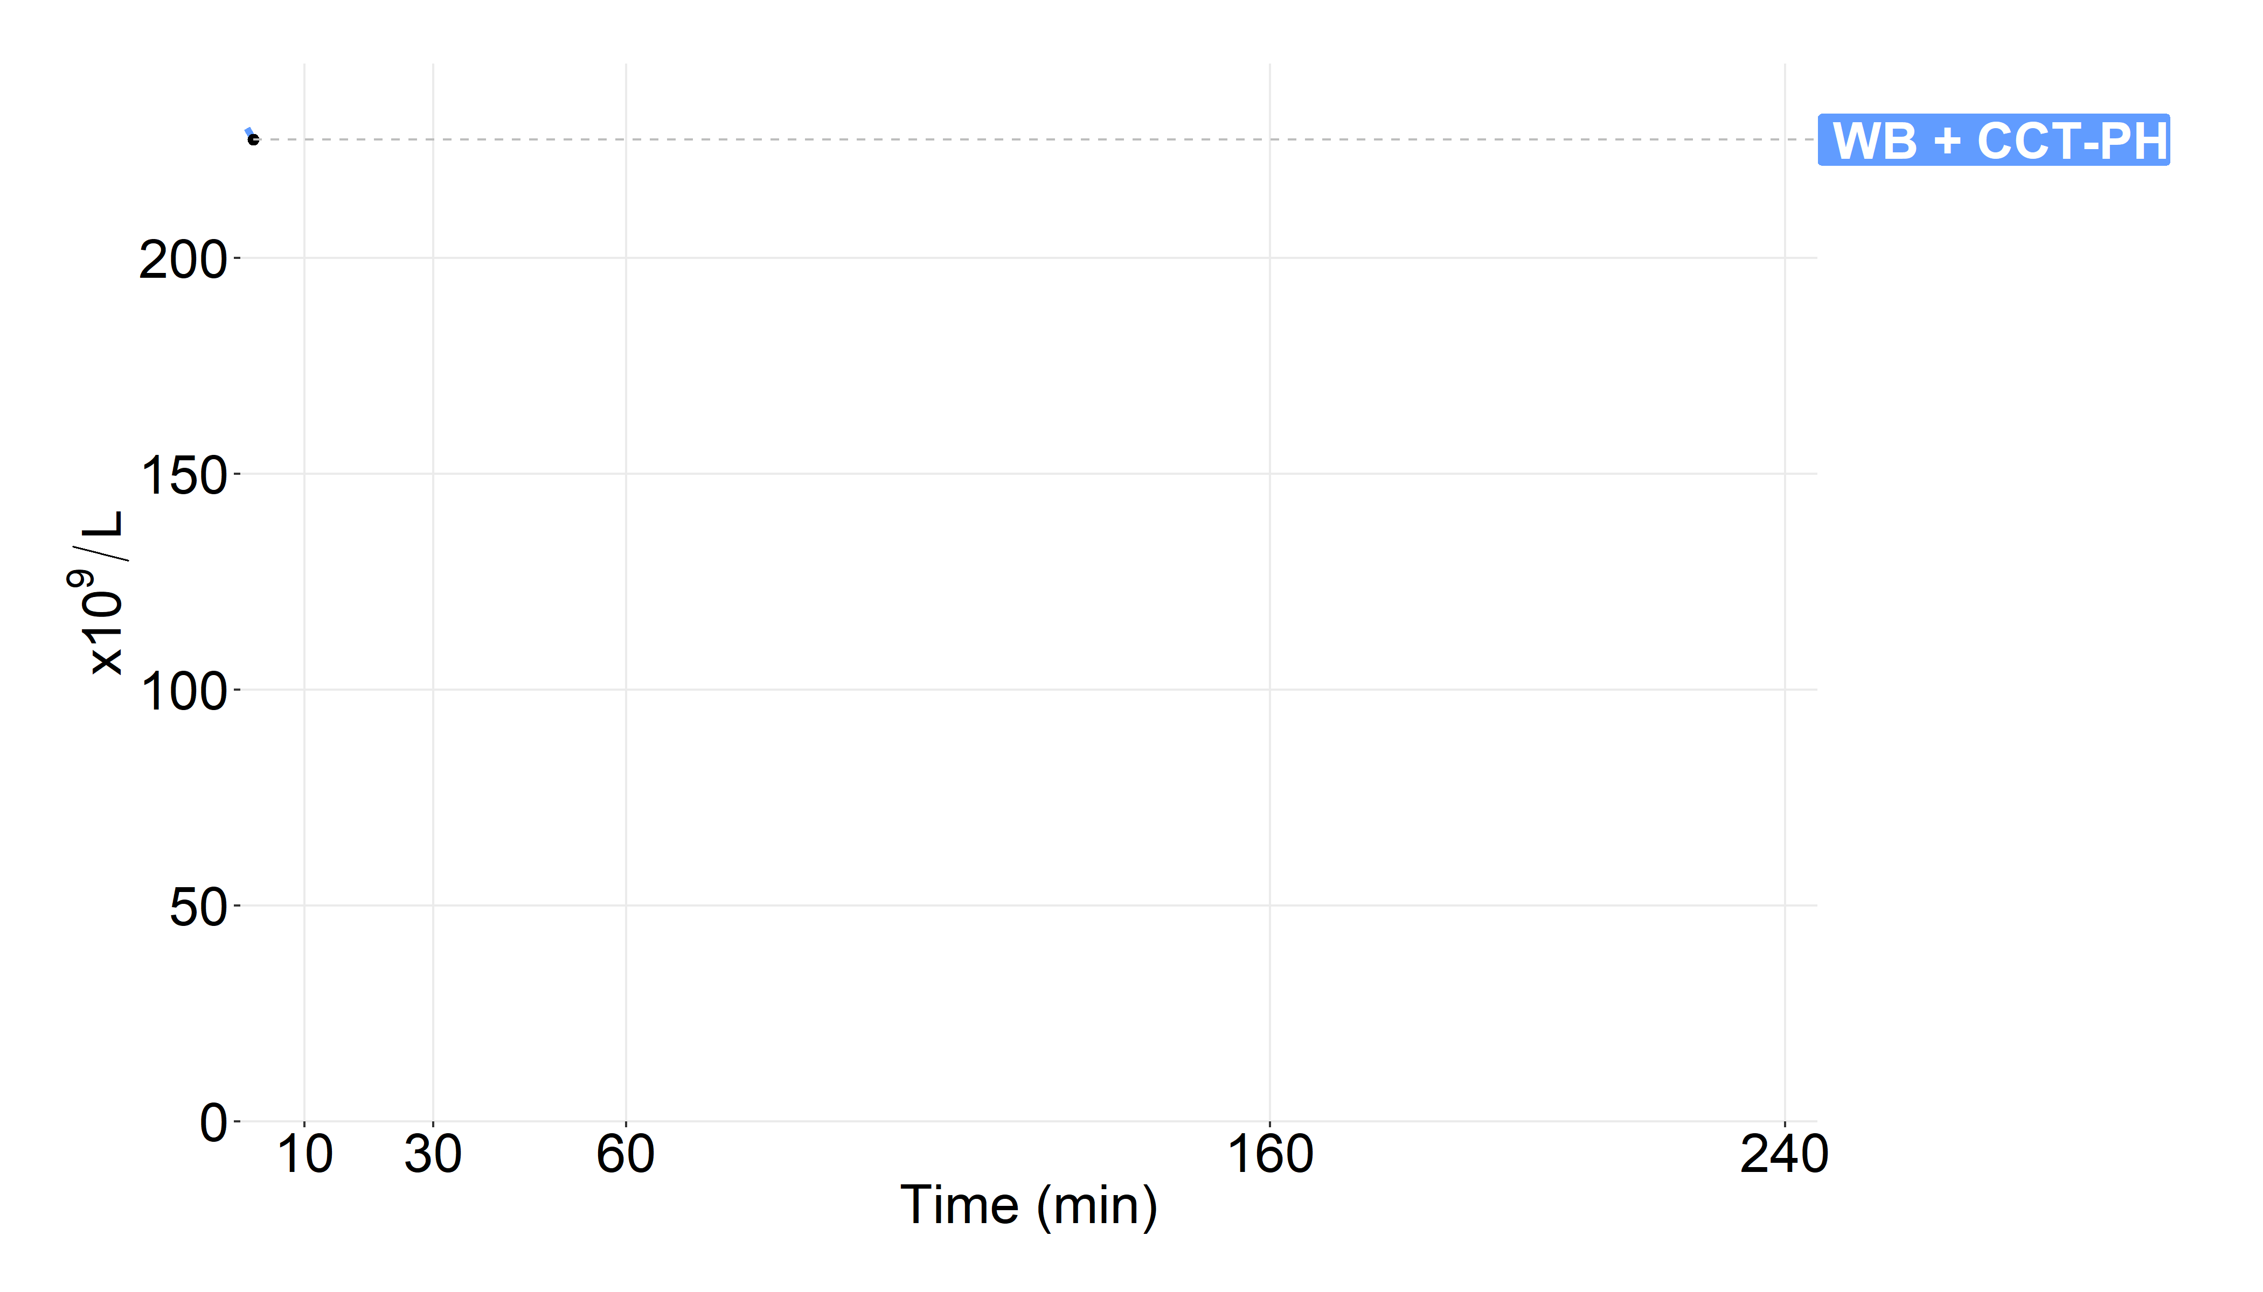
PLT count
Crystalloid models
PH transfusion models
Seheult JN, Stram MN, Sperry J, Spinella PC, Triulzi DJ, Yazer MH. In silico model of the dilutional effects of conventional component therapy versus whole blood in the management of massively bleeding adult trauma patients. Transfusion. 2019 Jan;59(1):146-58.

Slide 13
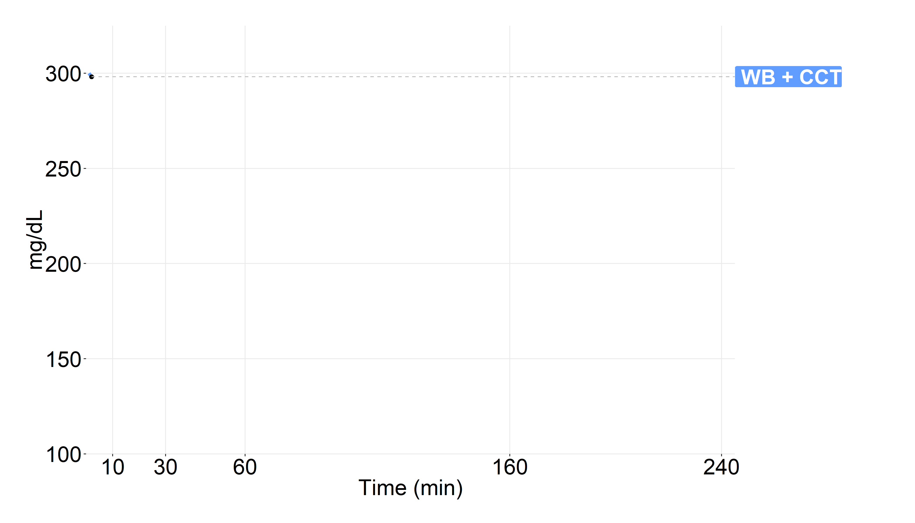
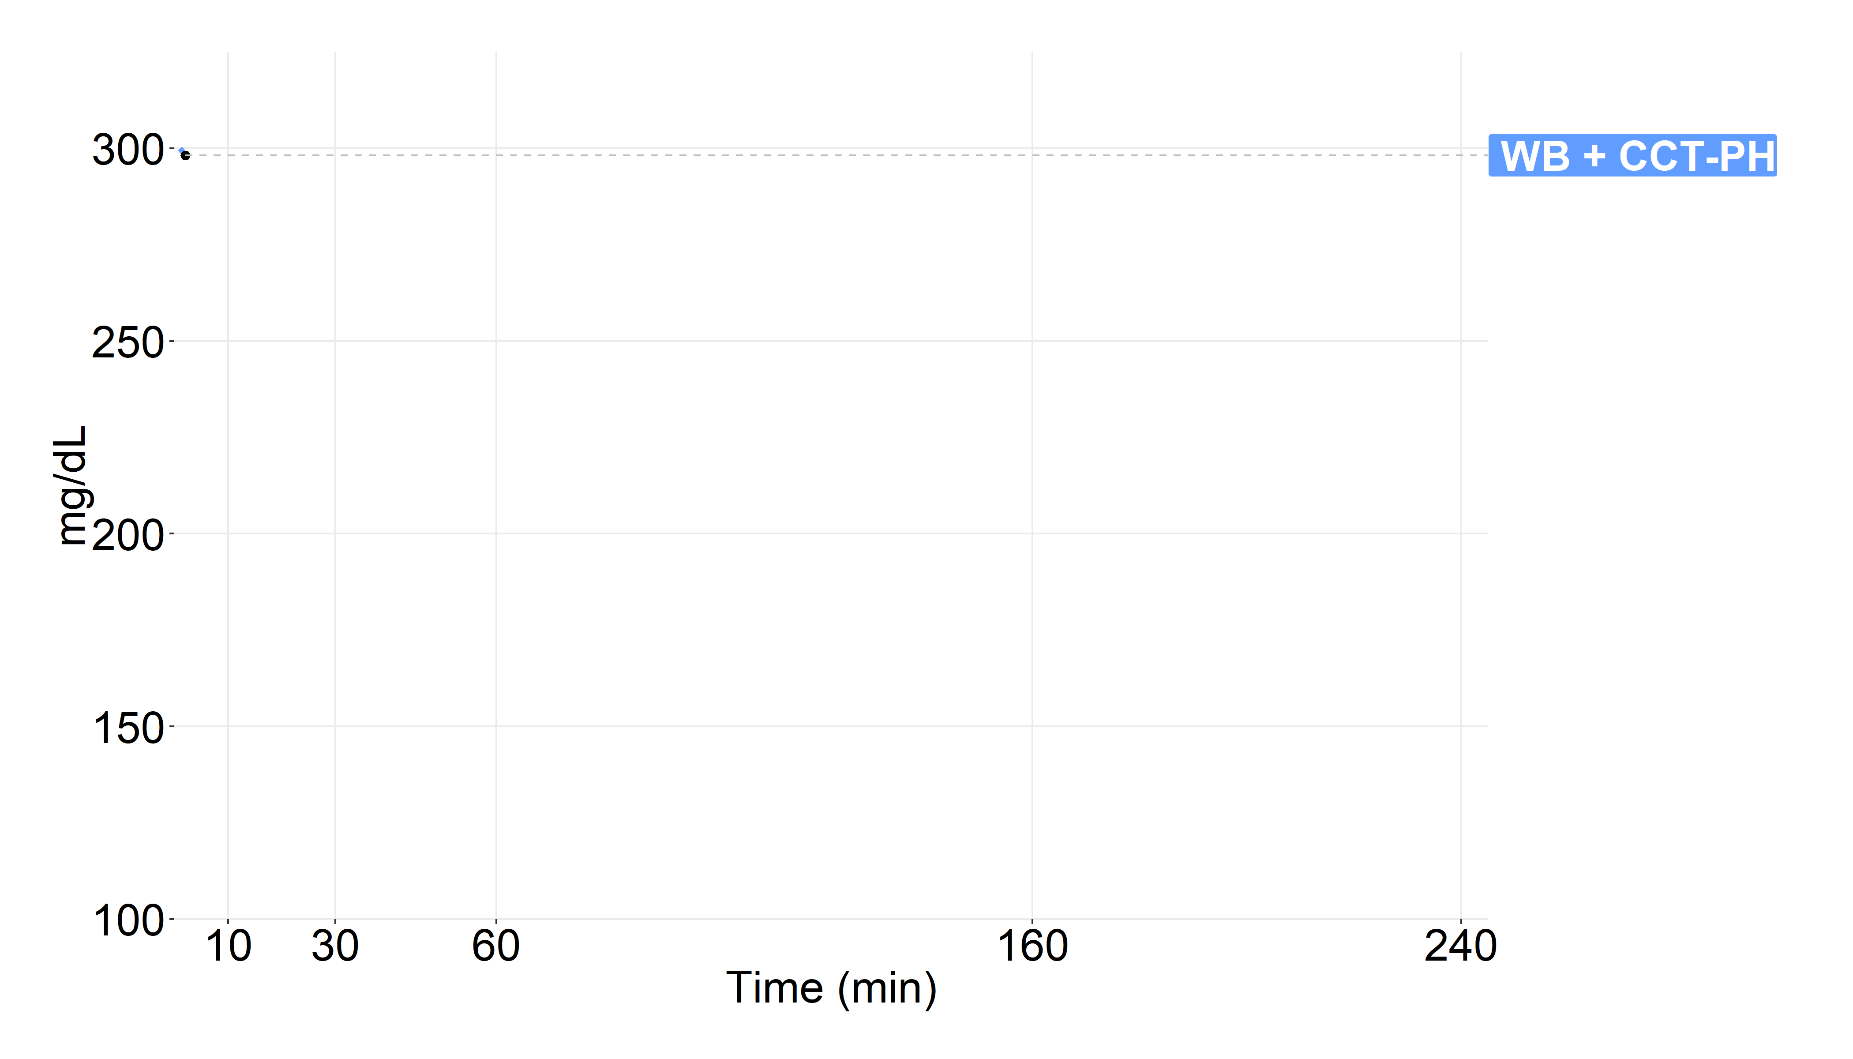
Fibrinogen
Crystalloid models
PH transfusion models
Seheult JN, Stram MN, Sperry J, Spinella PC, Triulzi DJ, Yazer MH. In silico model of the dilutional effects of conventional component therapy versus whole blood in the management of massively bleeding adult trauma patients. Transfusion. 2019 Jan;59(1):146-58.

Slide 14
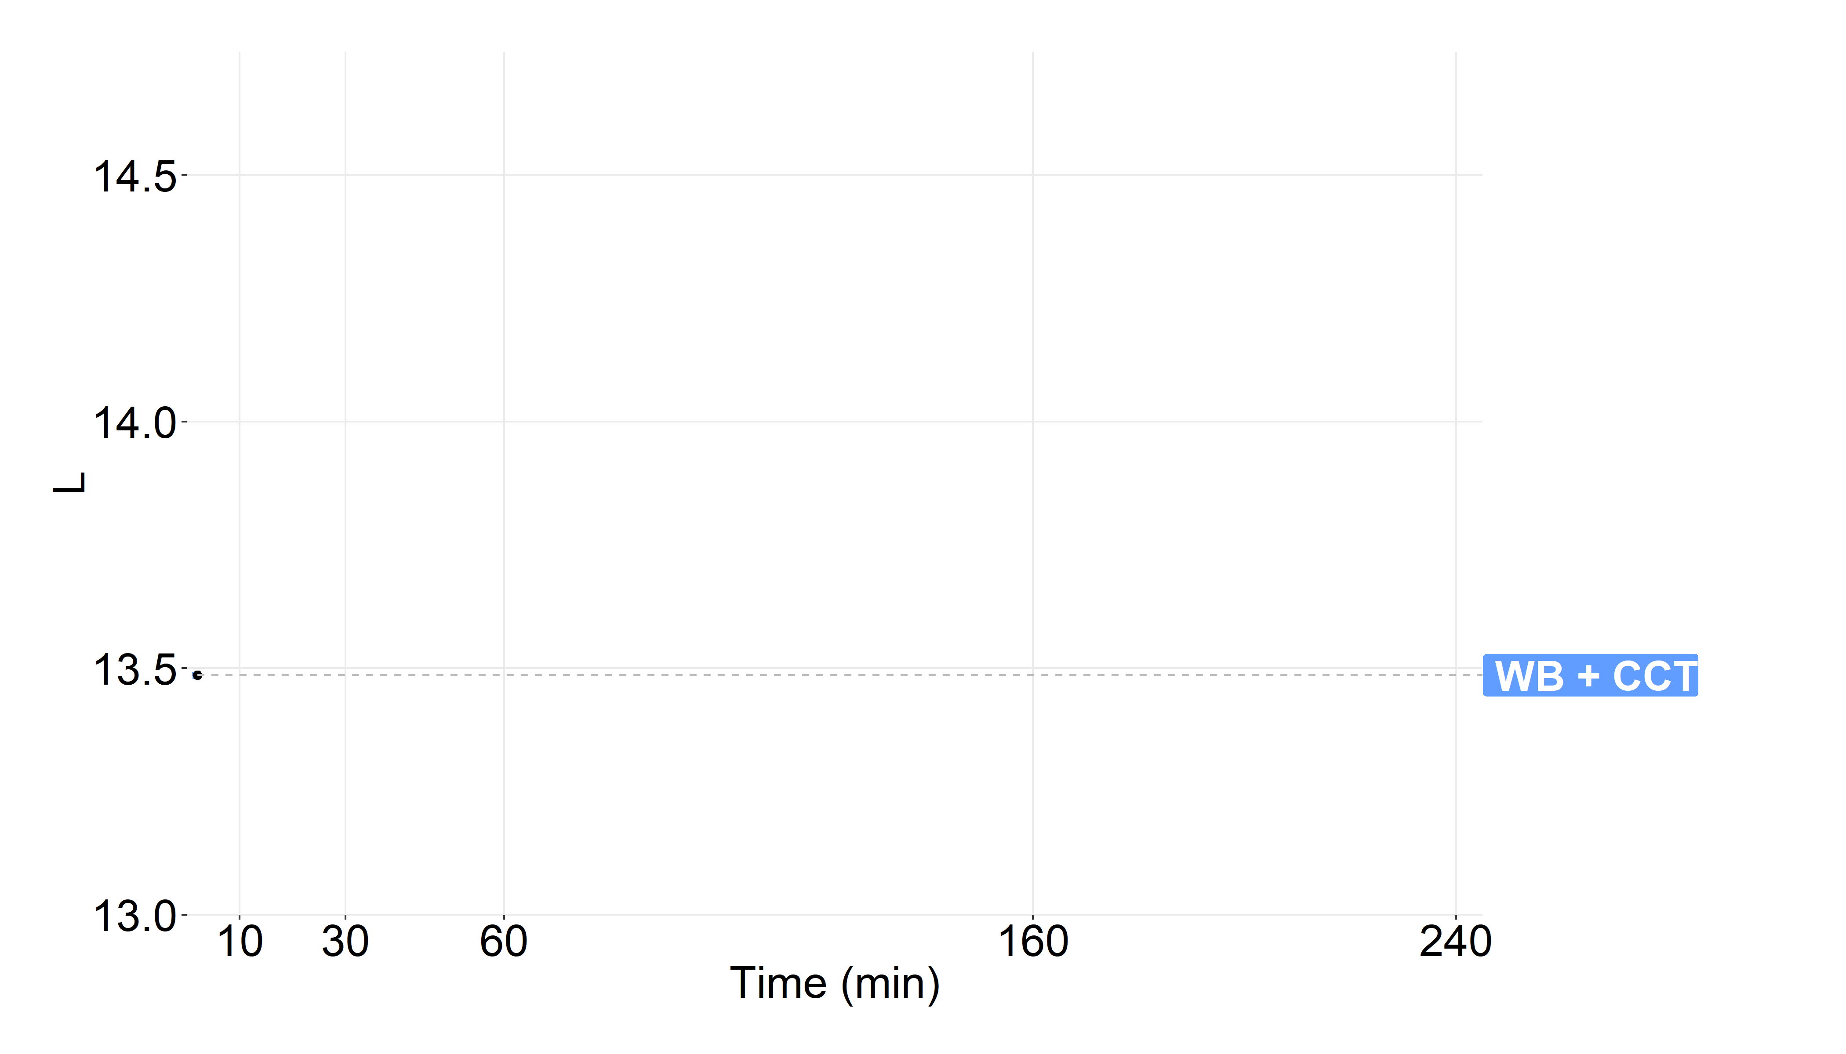
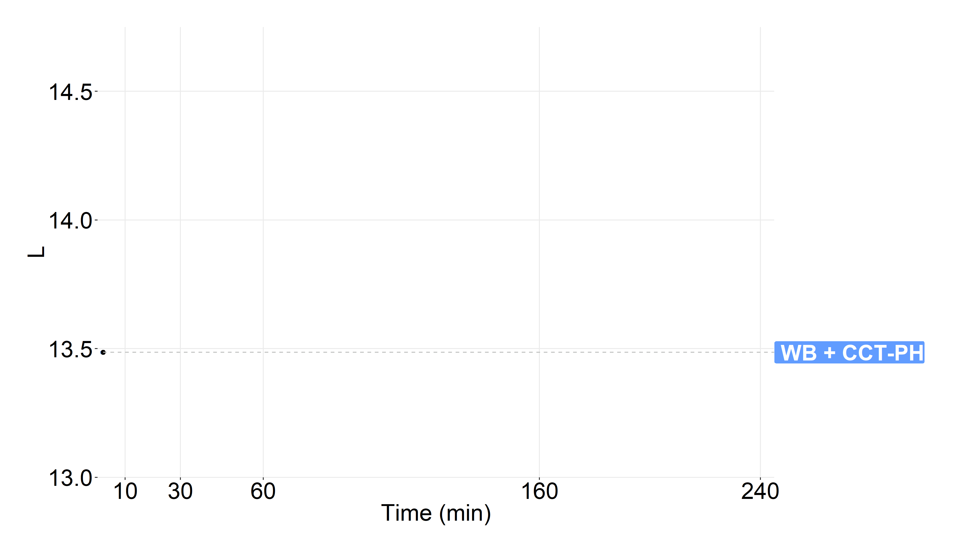
ISF
Crystalloid models
PH transfusion models

Slide 15
Assumptions
ATLS → GDCT
1 L of crystalloid pre-hospital
2 L of crystalloid in ED
Goal-directed components
Conventional coagulation tests done every:
  10 minutes in ED
  15 minutes in OR
  30 minutes in recovery
Wait 10 minutes for laboratory results
RBCs:
  If SBP < 90 | Hb < 10
Plasma:
  If INR > 1.6
PLTs:
  If PLT count < 50 x10^9/L

Slide 16
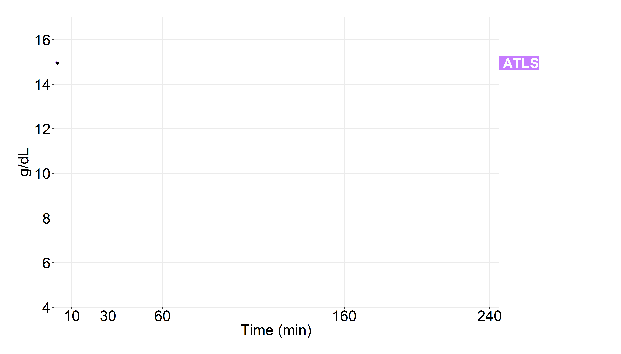
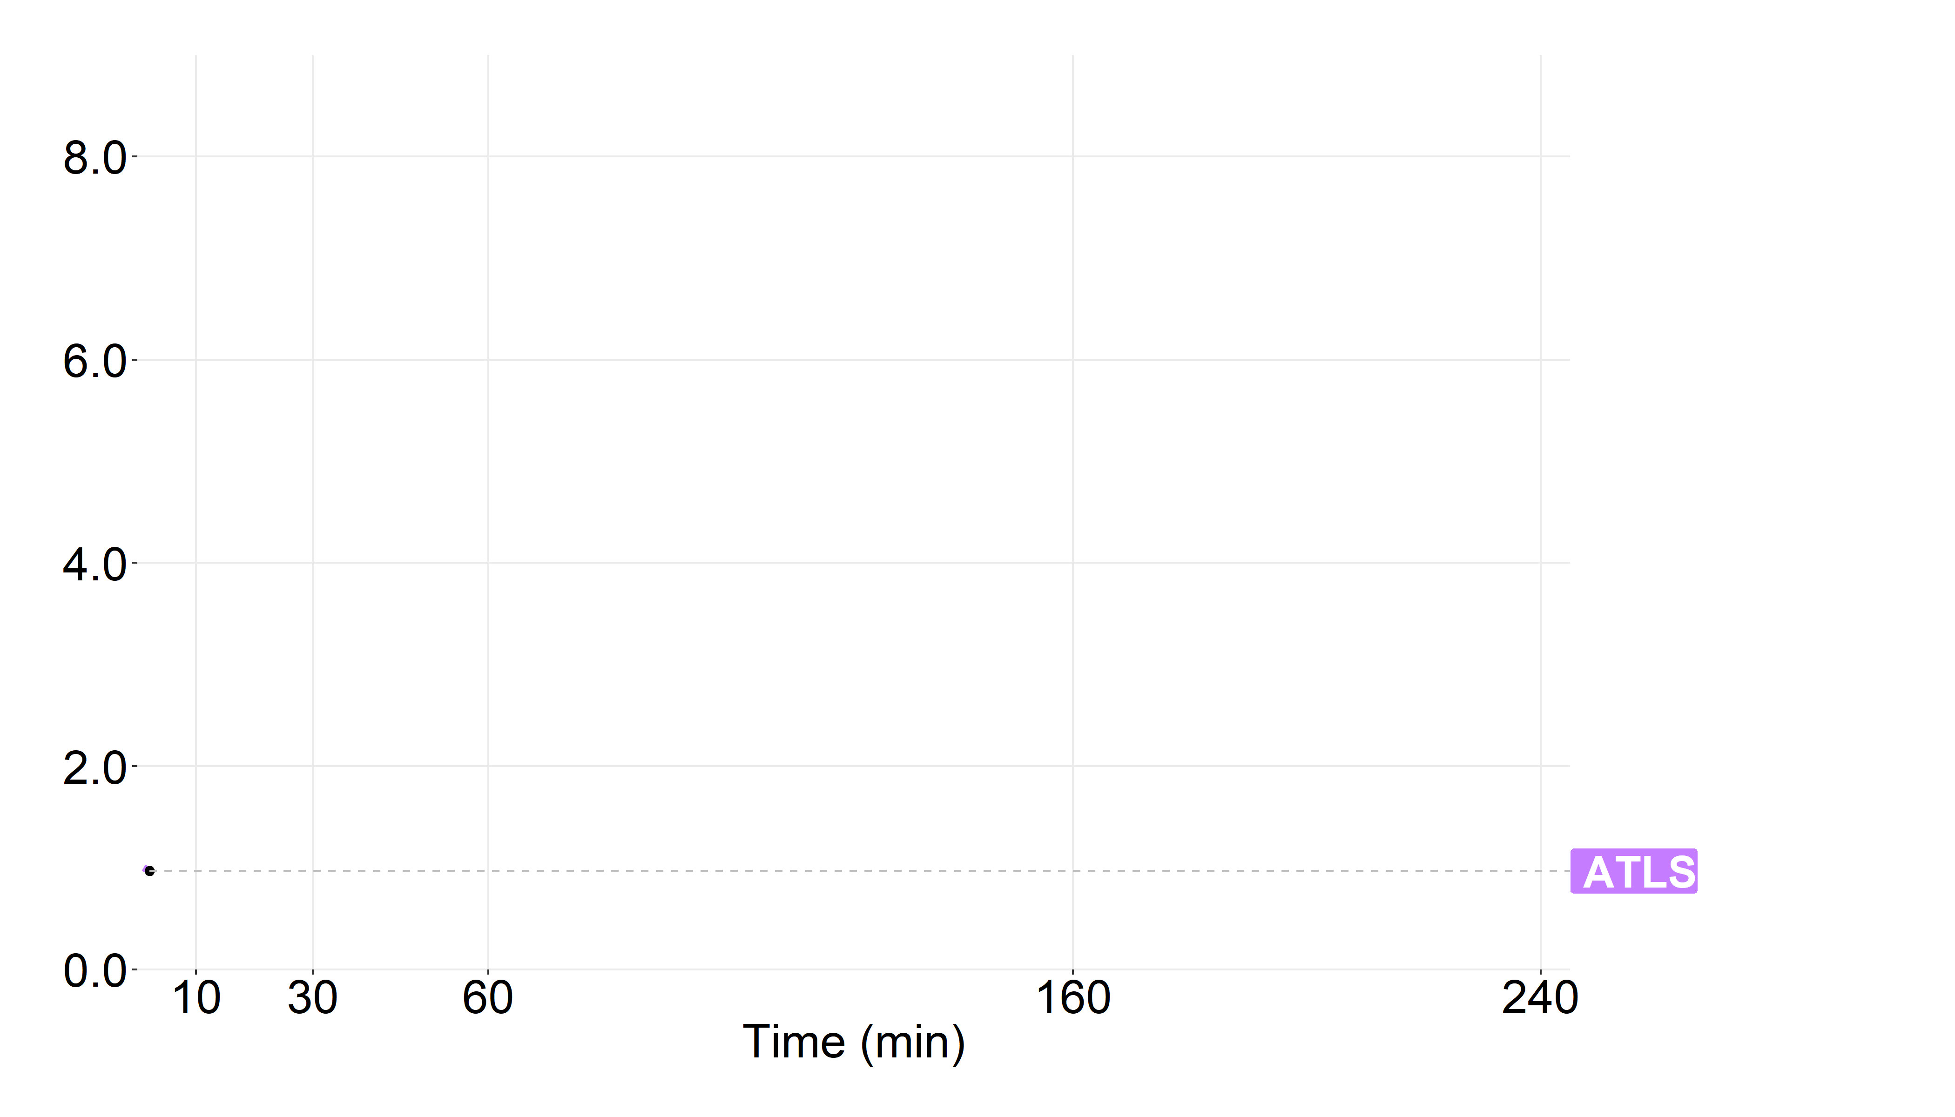
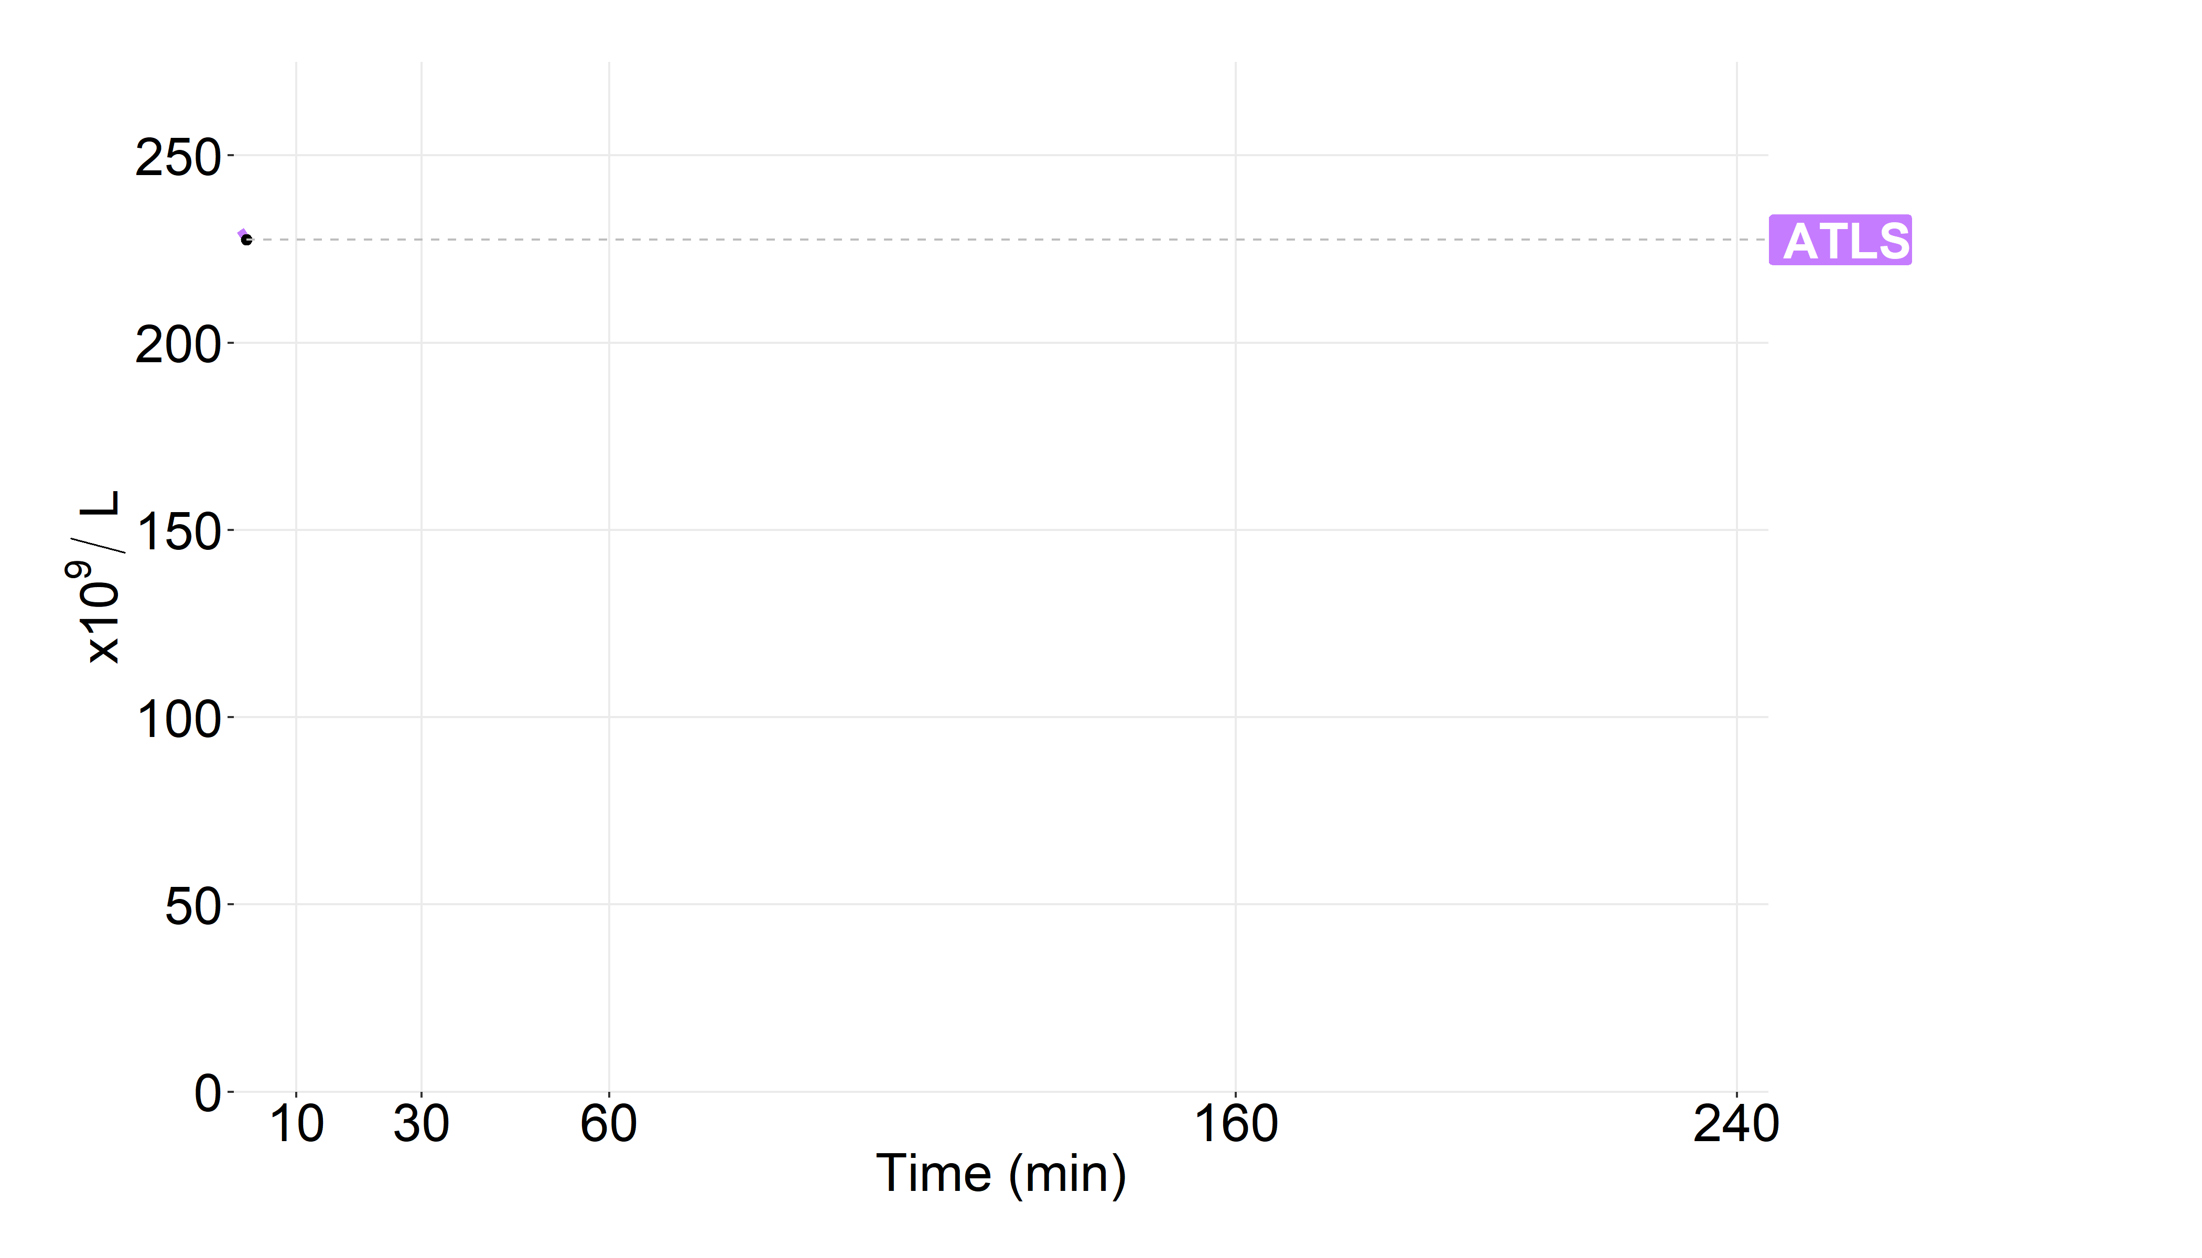
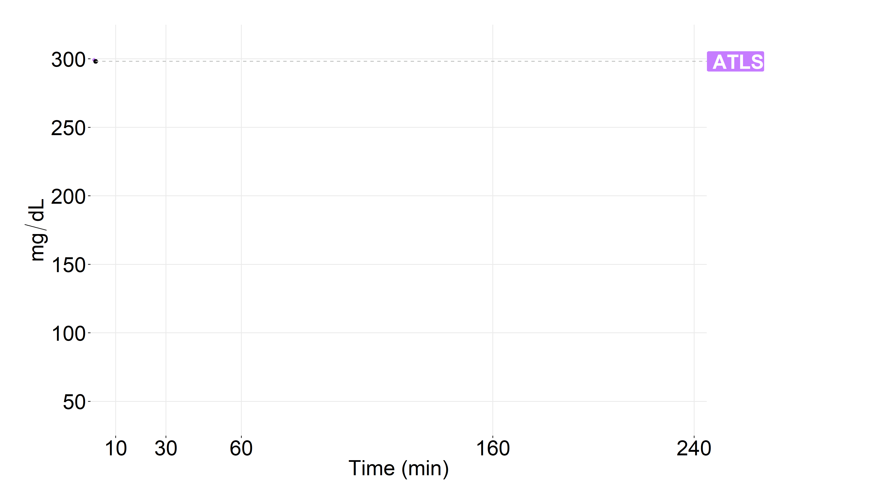
Assumptions
Hemoglobin
INR
ATLS → GDCT
1 L of crystalloid pre-hospital
2 L of crystalloid in ED
Goal-directed components
Conventional coagulation tests done every:
  10 minutes in ED
  15 minutes in OR
  30 minutes in recovery
Wait 10 minutes for laboratory results
RBCs:
  If SBP < 90 | Hb < 10
Plasma:
  If INR > 1.6
PLTs:
  If PLT count < 50 x10^9/L
PLT count
Fibrinogen

Slide 17
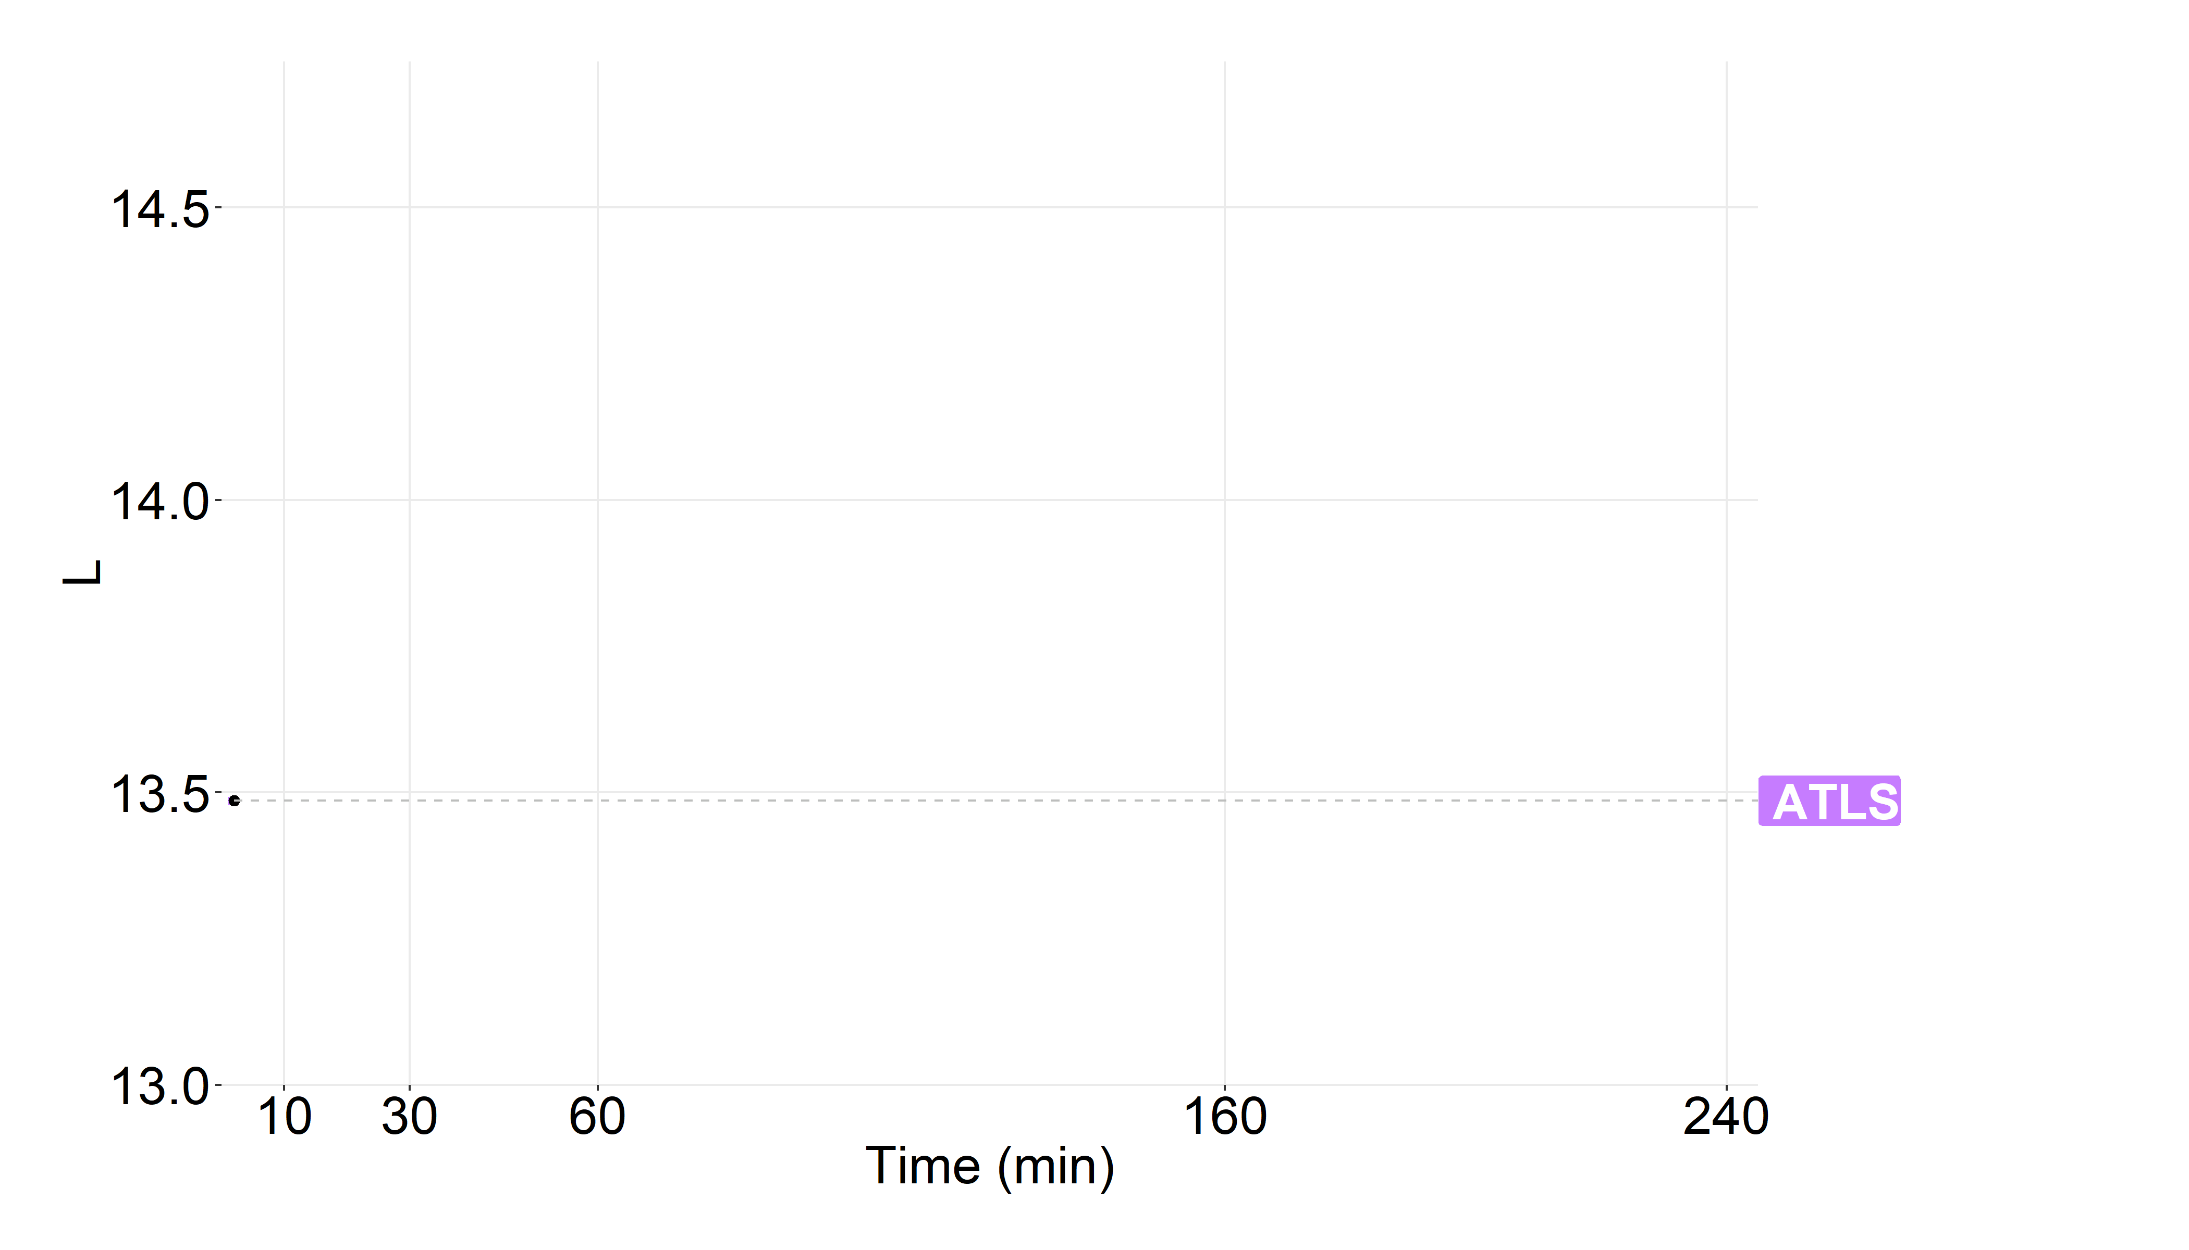
Assumptions
ATLS → GDCT
ISF
1 L of crystalloid pre-hospital
2 L of crystalloid in ED
Goal-directed components
Conventional coagulation tests done every:
  10 minutes in ED
  15 minutes in OR
  30 minutes in recovery
Wait 10 minutes for laboratory results
RBCs:
  If SBP < 90 | Hb < 10
Plasma:
  If INR > 1.6
PLTs:
  If PLT count < 50 x10^9/L

Slide 18
From deterministic to stochastic

Slide 19
In silico clinical trials

Slide 21
Time in critical intervals

Slide 22
Tissue oxygenation

Slide 23
Siam J, Mandel Y, Barnea O. Optimization of oxygen delivery in fluid resuscitation for hemorrhagic shock: a computer simulation study. Cardiovascular Engineering and Technology. 2014 Mar 1;5(1):82-95.

Slide 24
Siam J, Mandel Y, Barnea O. Optimization of oxygen delivery in fluid resuscitation for hemorrhagic shock: a computer simulation study. Cardiovascular Engineering and Technology. 2014 Mar 1;5(1):82-95.

Slide 25
Other areas for improvement
model could not account for the following effects on bleeding rate and time in critical interval:
  sub-hemostatic concentrations of fibrinogen, plasma coagulation factors and PLTs
  low hematocrit, acidosis, hypothermia, the potentially enhanced hemostatic effect of the cold stored PLTs in the WB, or PLT inhibition in trauma
limited data available to inform the consumption rates of the various hemostatic factors
redistribution half-life of the various fluids was based on data from healthy volunteers and it is possible that the half-life of redistribution is different in trauma patients
model did not account for the elimination of osmoles and fluid from the kidneys, gastro-intestinal tract and skin

Slide 26
A bit of blood banking

Slide 27
Assumptions
AB RhD(-) recipient of O RhD(+) RBCs
Different quantities of O RhD(+) RBCs transfused before switching to type specific:
  1, 2, 3, 4, 5, 10 units
Modeled the ratio of O RhD(+) RBCs in circulation to non-O RhD(-) RBCs
How does the ratio correlate with laboratory blood grouping?

Slide 28
LTOWB inventory simulation

Slide 29
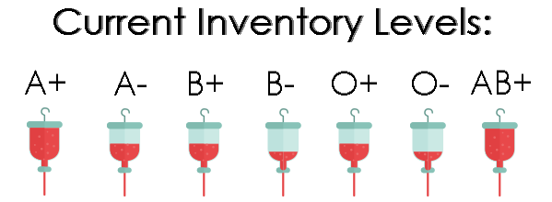
Based on data from CBB, Pittsburgh
Local daily collection and distribution data were scaled using the z-score method to vary the expected
  number of collections
  apheresis-to-WB collection ratio
  collection-to-import ratio
Four parameters determined the daily number of LTOWB units distributed
  expected patient frequency
  expected average number of units transfused per patient
  maximum number of LTOWB that can be transfused to a single patient
  seasonality scaling factor, which accounted for variations in trauma patient volumes by month which varies based on climatic and other considerations
PSE with LHS: 48,600 simulations

Slide 30
Pittsburgh LTOWB ARIMA model
Observed
Trend
Seasonal
Random

Slide 31
Setting LTOWB par
#set par thresholds for WB units
minwb <- round(par_factor*freqpt*min(maxu,aveu)*scale(ltowb_seasonal, center=FALSE, scale=seasonality_scale)[day])
parwb <- 2 * minwb

Slide 34
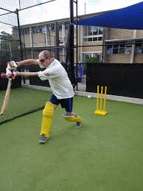


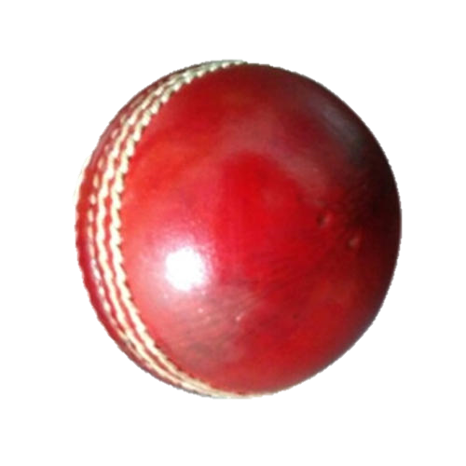

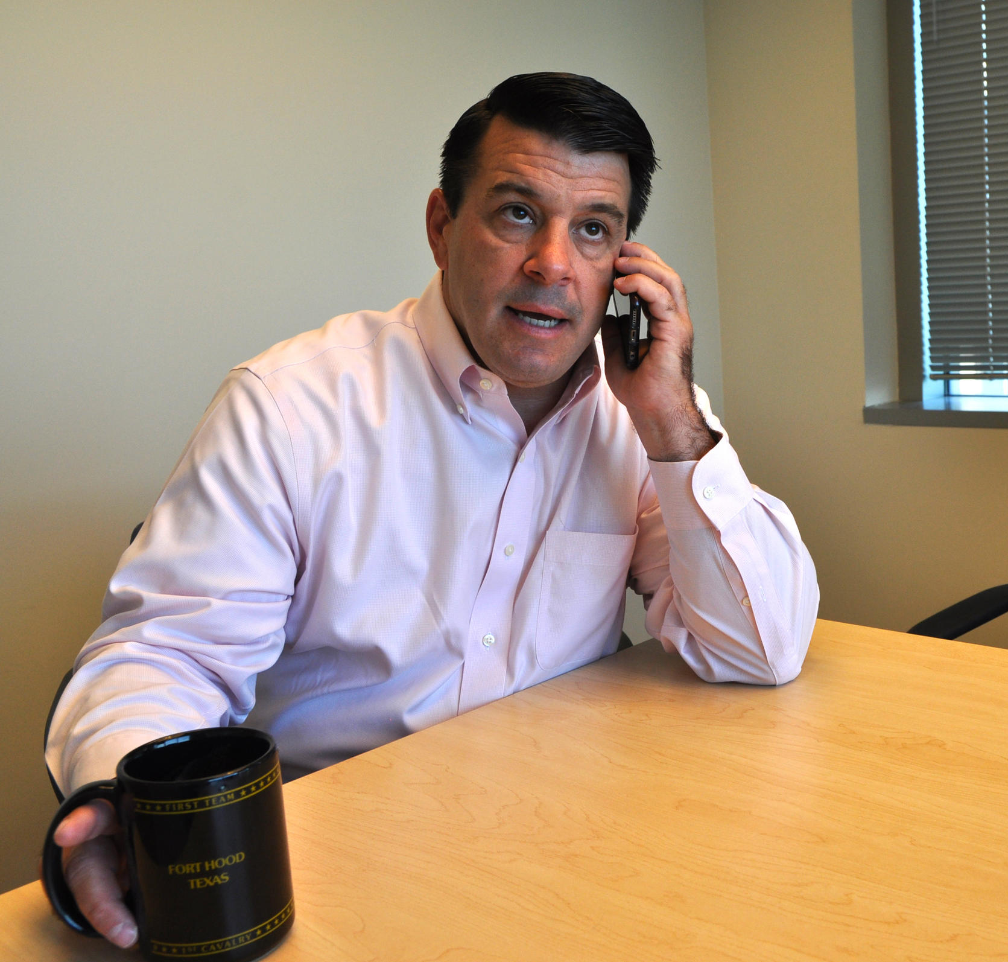

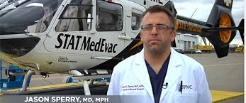

Slide 35
Misc

Slide 36
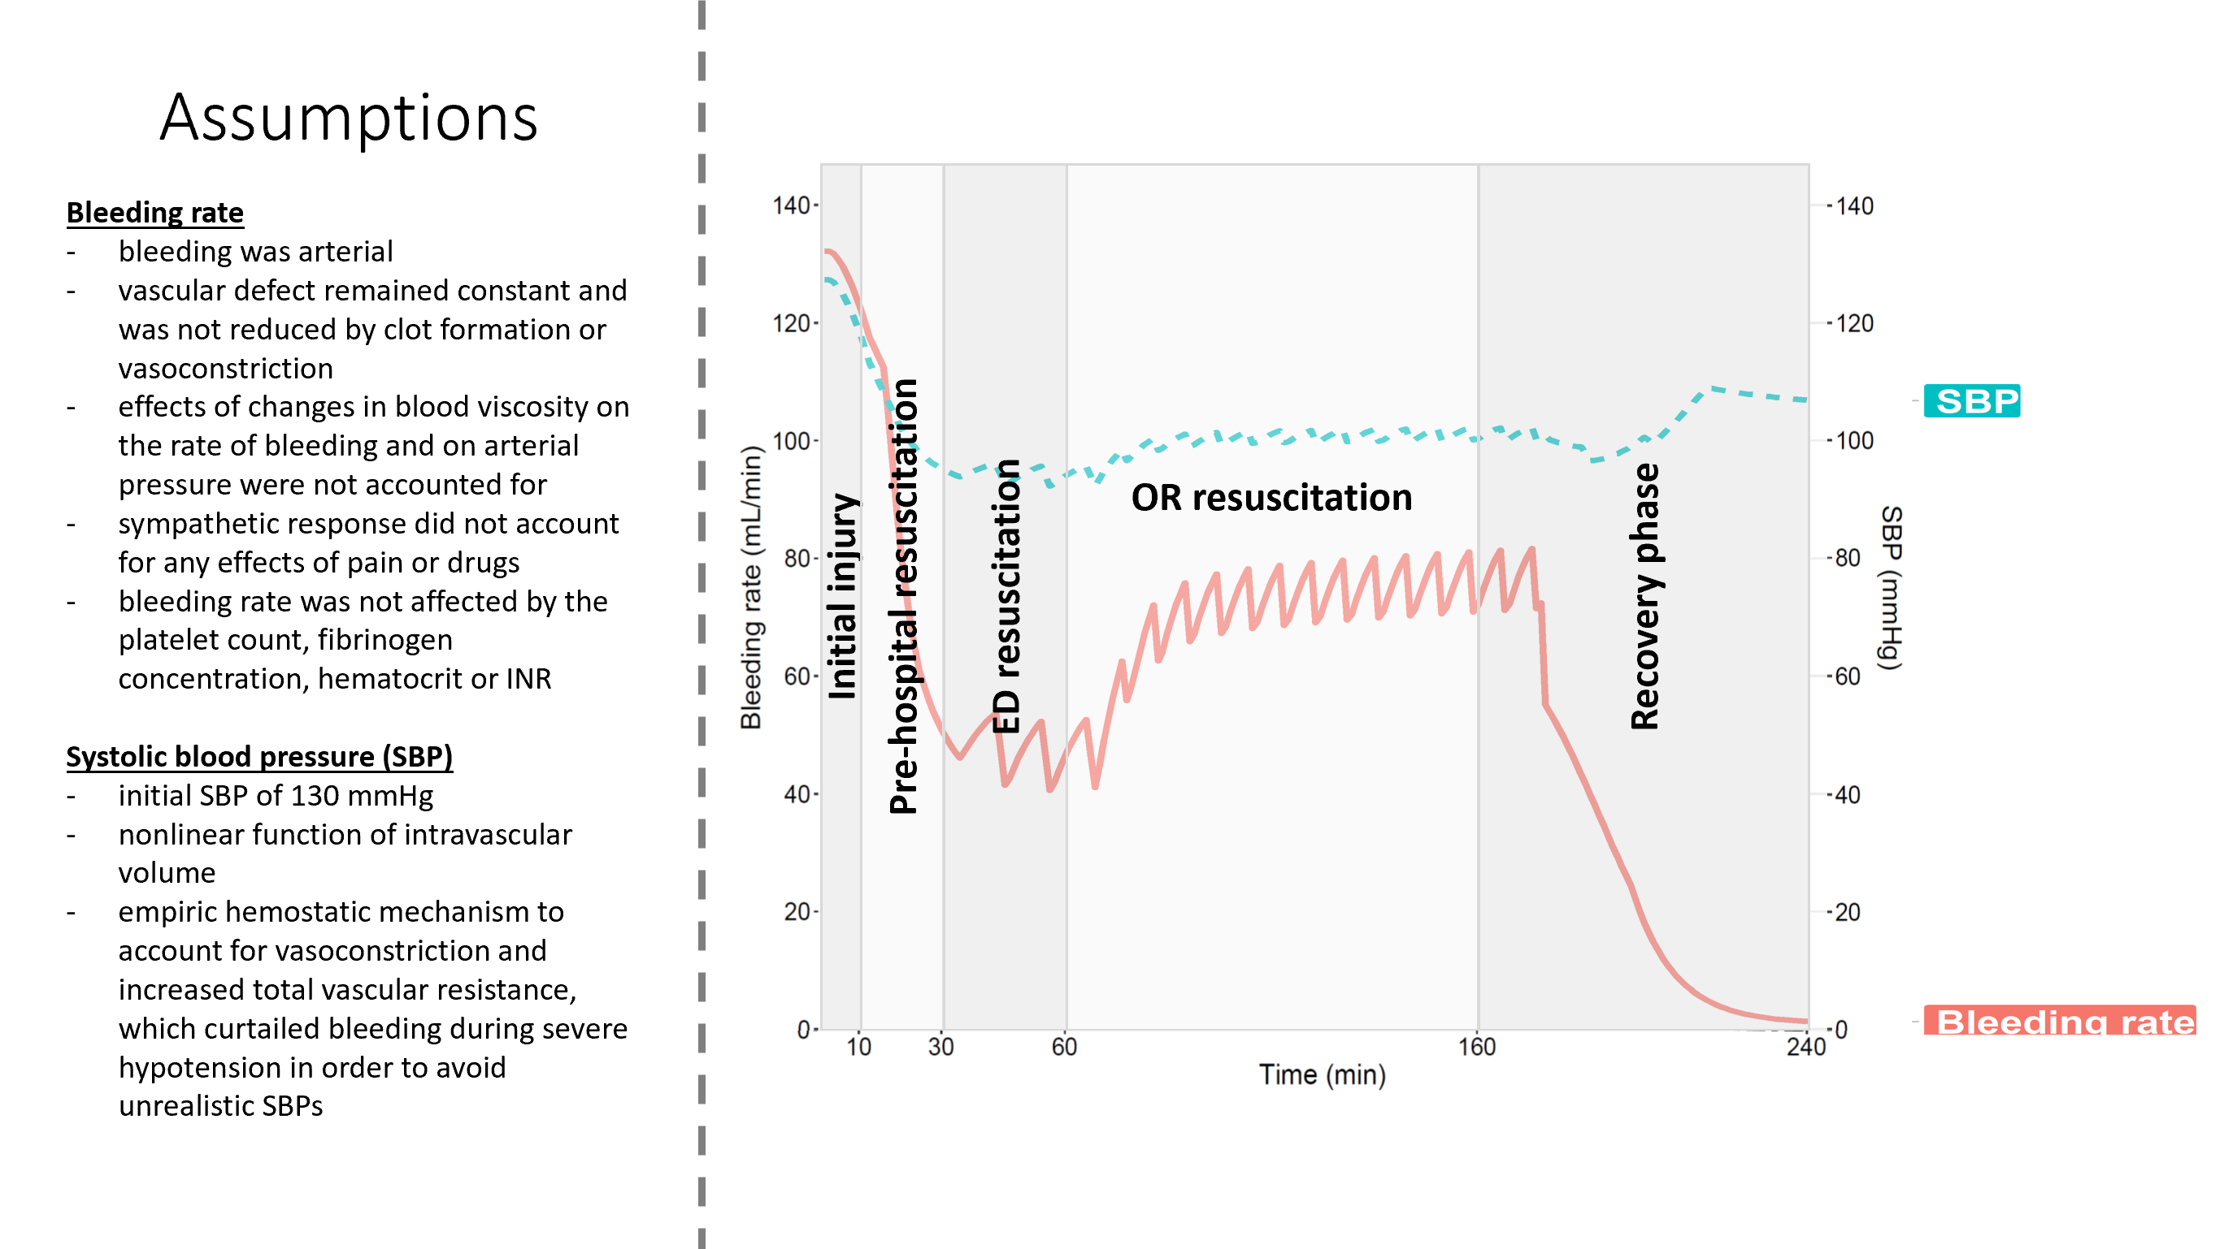

Slide 37
Assumptions
Target admission (ED) values
SBP = 98 mmHg
Hematocrit = 31.8%
Hemoglobin = 10.6 g/dL
INR = 1.7
Fibrinogen = 158 mg/dL
PLT count = 122 x 10⁹/L

Slide 38
Assumptions
Crystalloid models
WB
1 L of crystalloid
20 units of LTOWB
CCT
1 L of crystalloid
20 units of RBCs
20 units of plasma
20 units of PLTs
WB + CCT
1 L of crystalloid
10 units of LTOWB
10 units of RBCs
10 units of plasma
10 units of PLTs

Slide 39
Assumptions
Prehospital transfusion models
WB
No crystalloid
22 units of LTOWB
CCT
No crystalloid
22 units of RBCs
20 units of plasma
20 units of PLTs
WB + CCT
No crystalloid
10 units of LTOWB
12 units of RBCs
12 units of plasma
10 units of PLTs

Slide 40
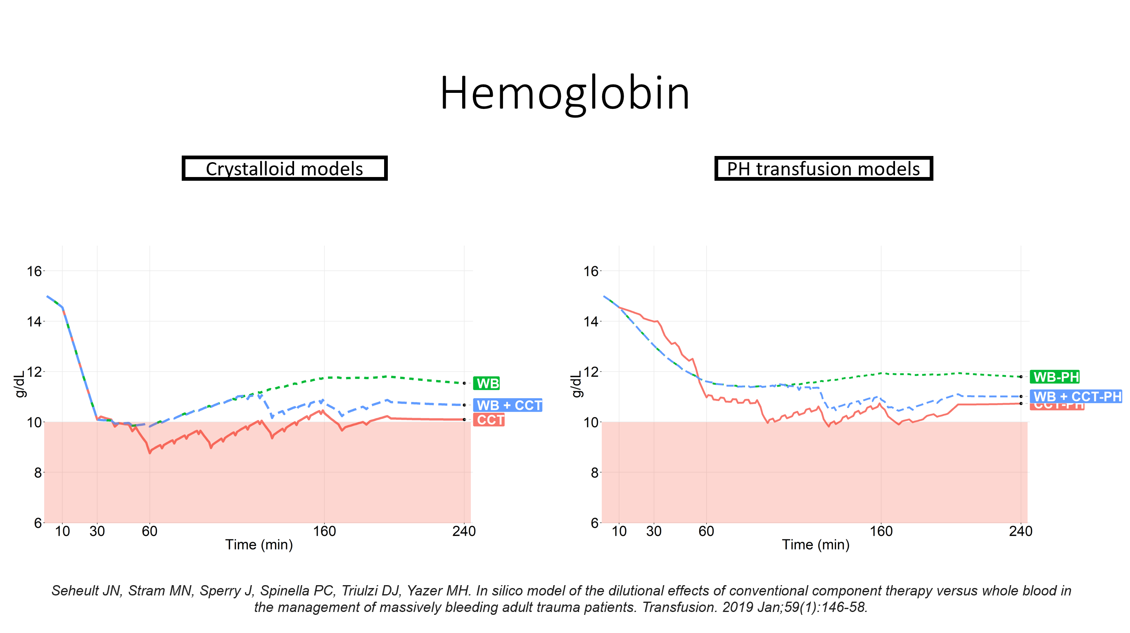

Slide 41
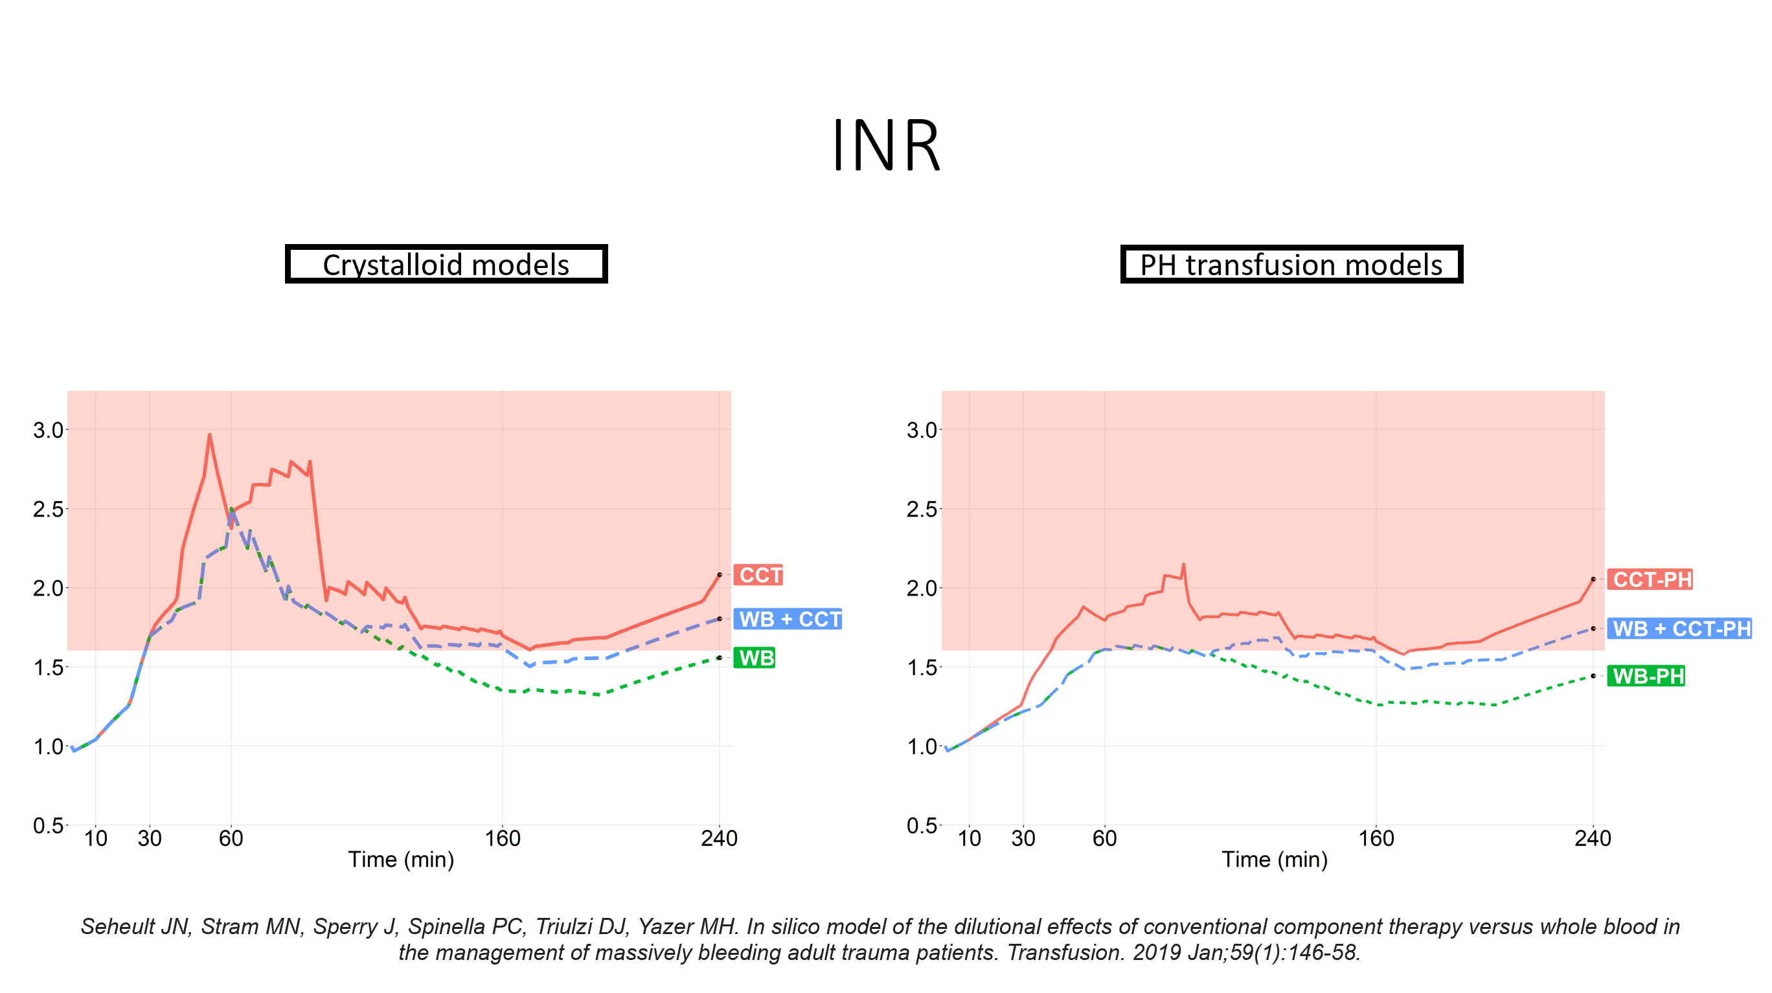

Slide 42
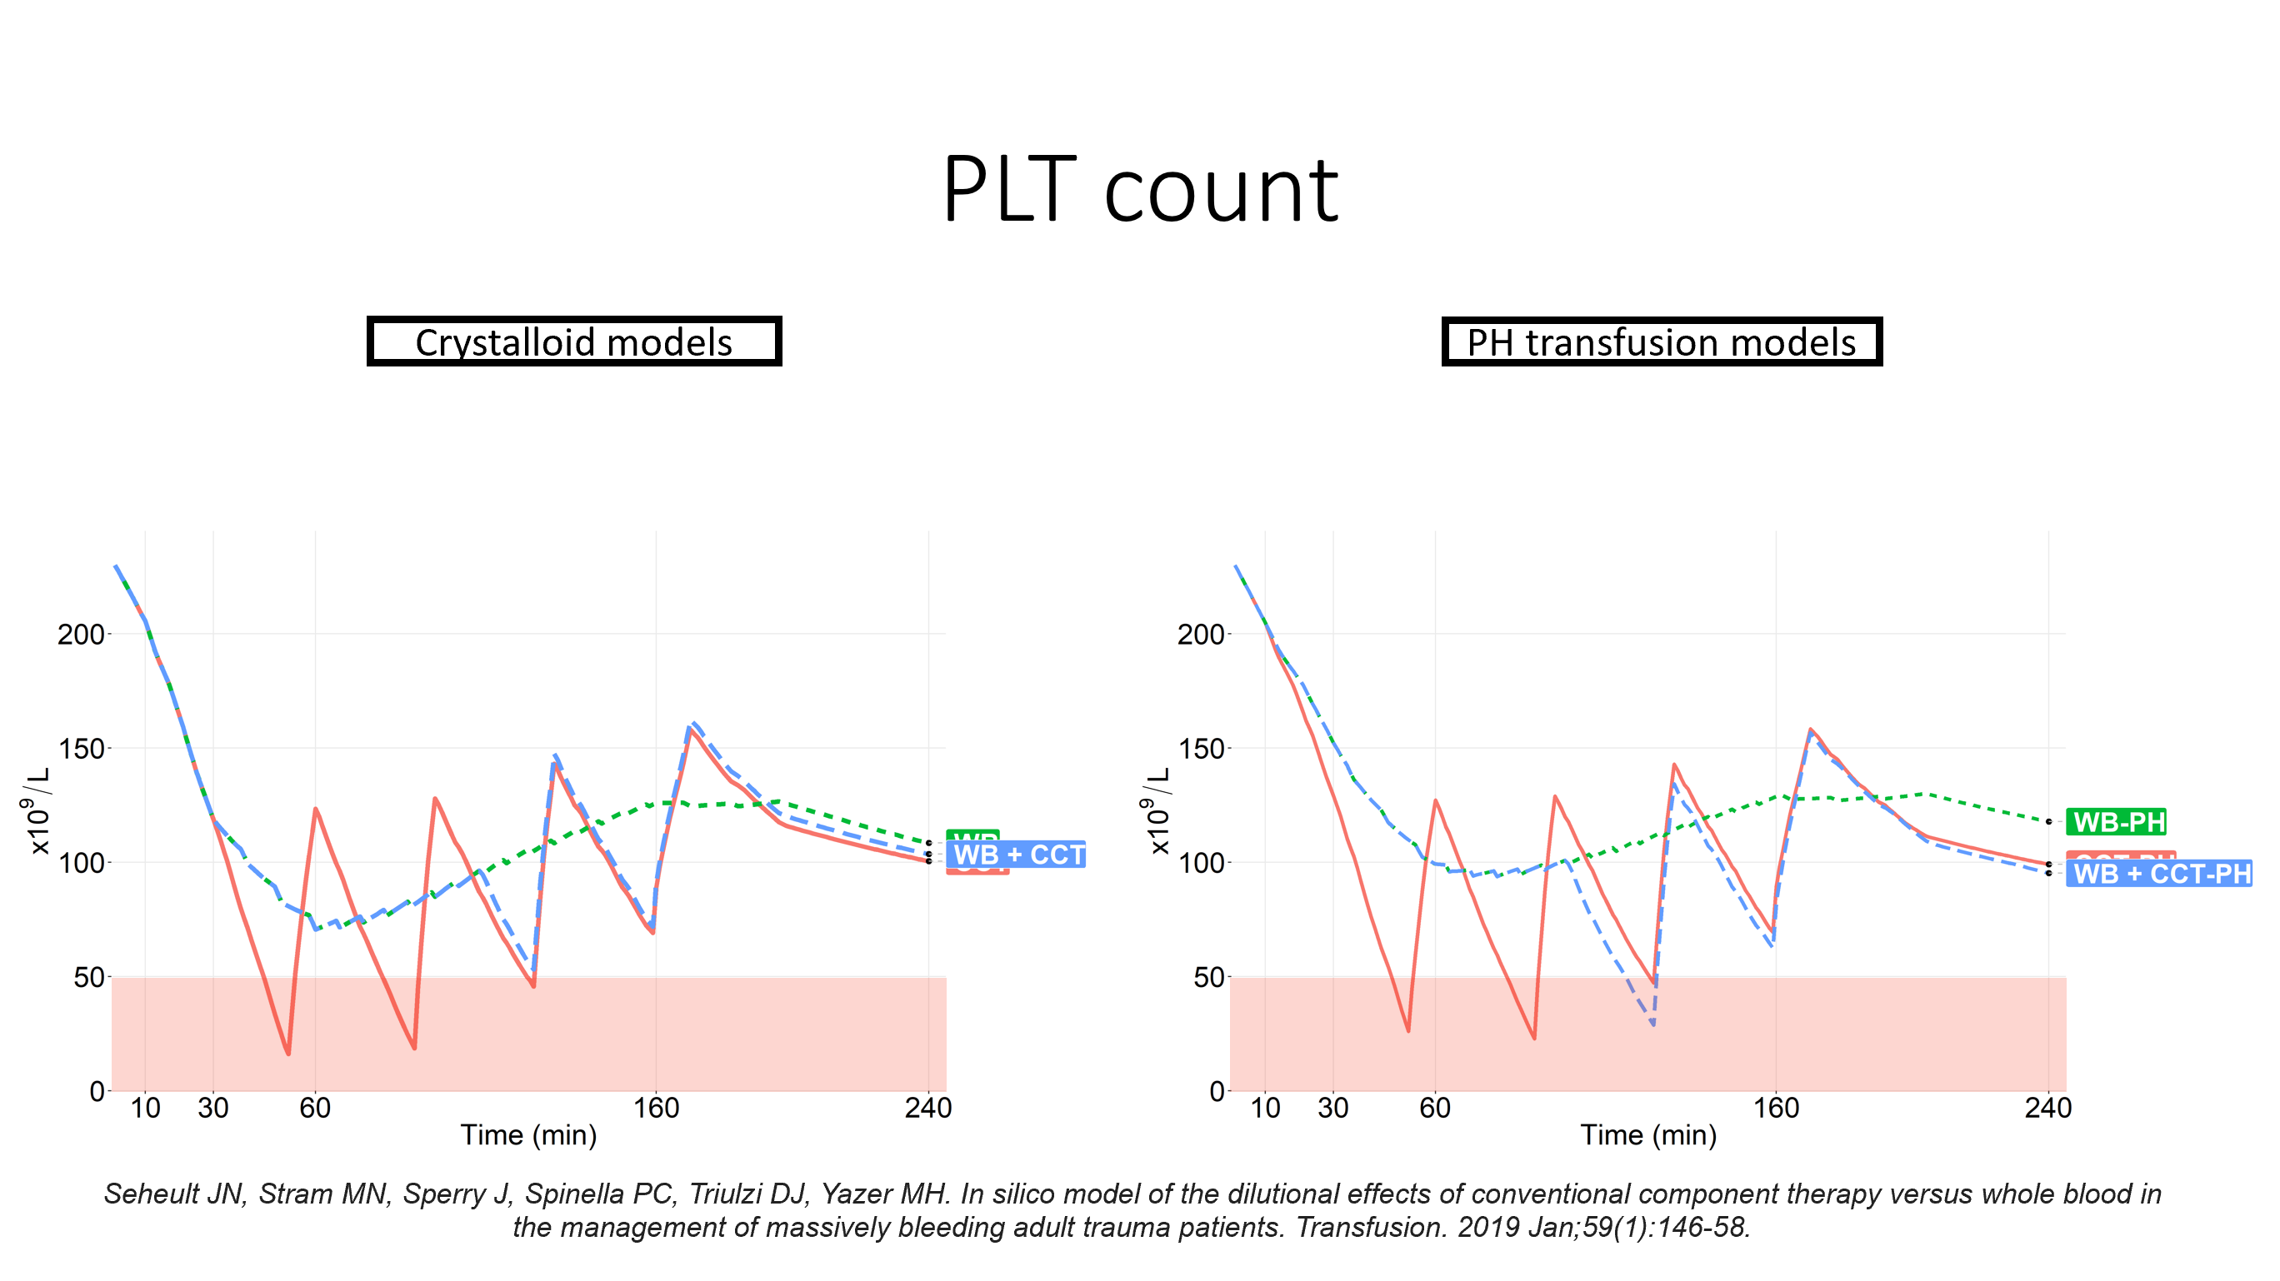

Slide 43
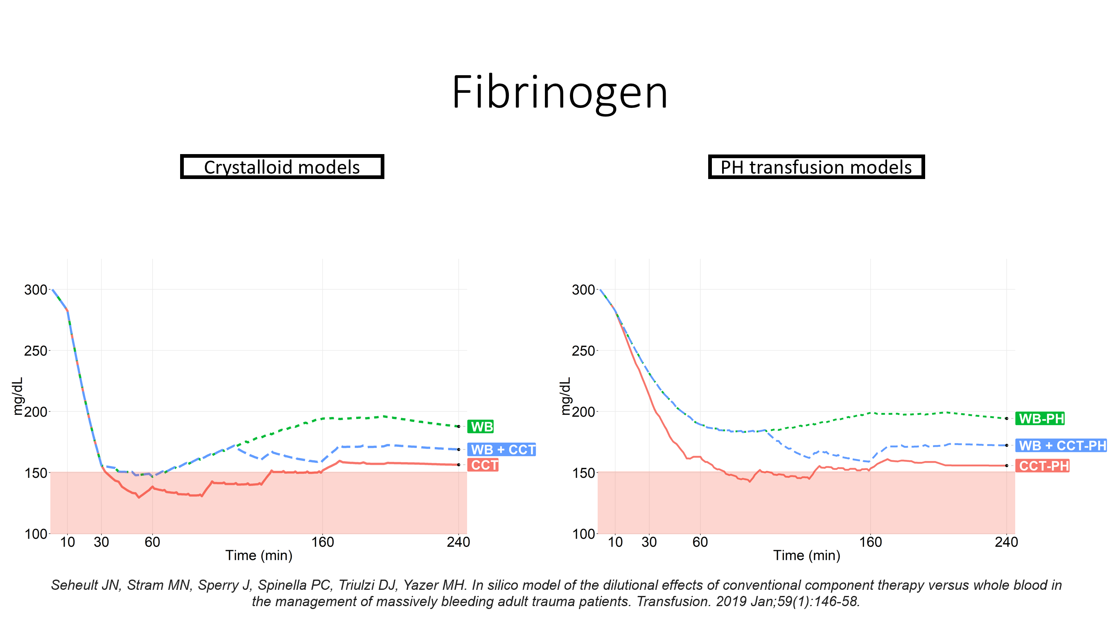

Slide 44
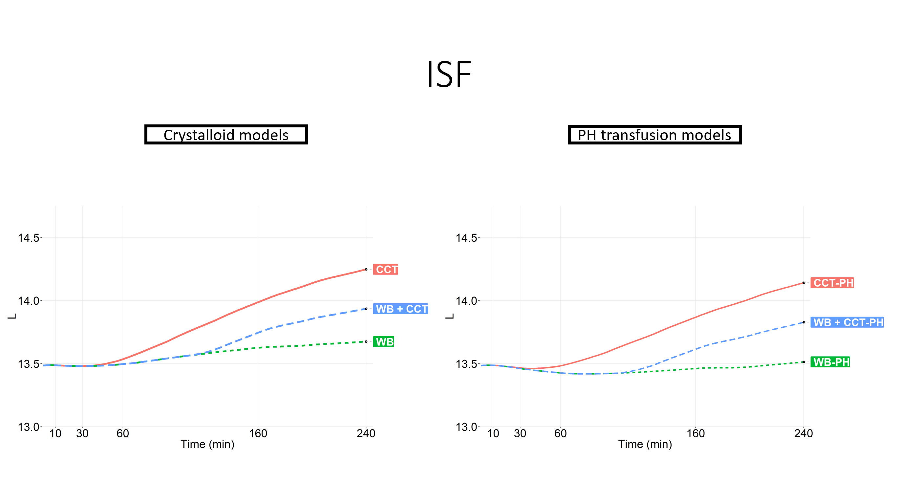

Slide 45
