Slide 1
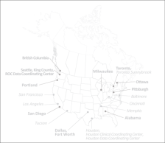


Resuscitation Outcomes Consortium
A Two Gram Bolus of Tranexamic Acid Improves Survival After Traumatic Brain Injury in Patients with Intracranial Hemorrhage
Martin A. Schreiber MD FACS
COL, MC, USAR
Professor of Surgery
Oregon Health & Science University

Slide 2
Conflicts of Interest
I have no relevant conflicts of interest
The views presented are our own and do not represent the US Army

Slide 3
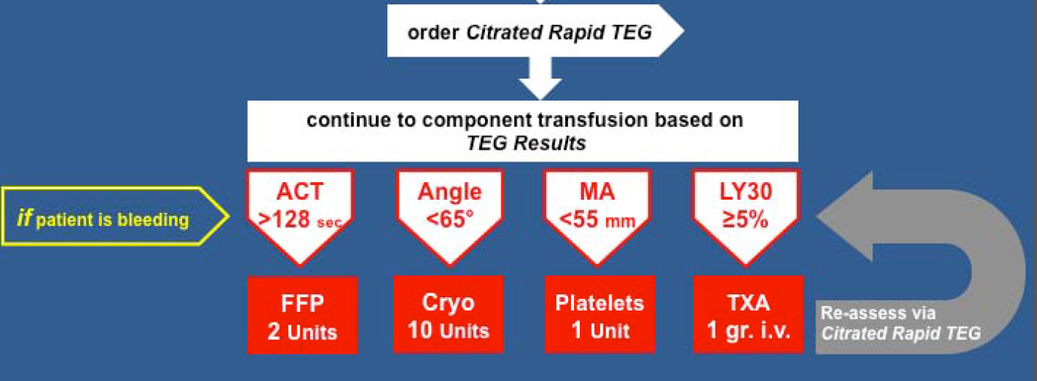
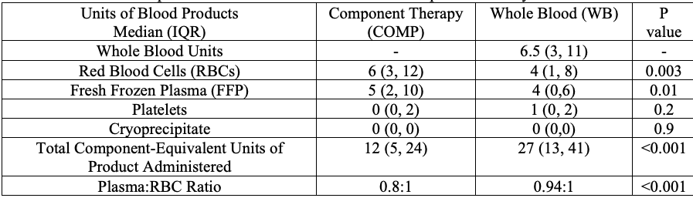

Slide 4
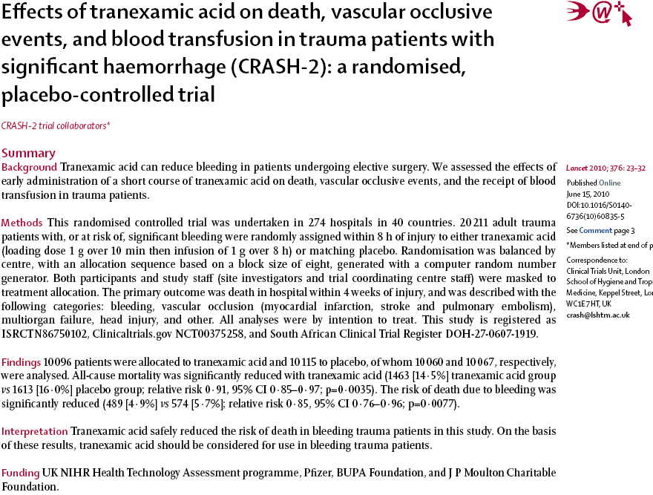

Slide 5
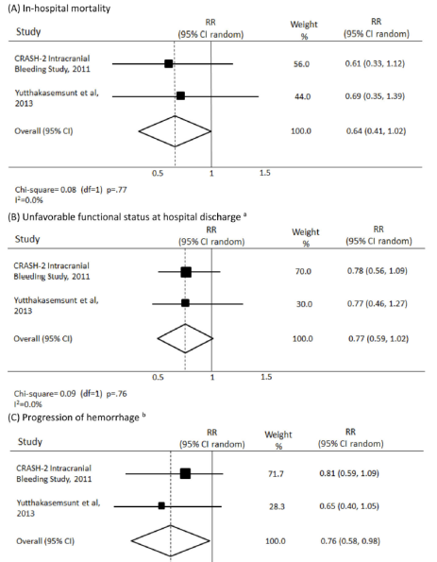
Meta–analysis (2 Studies)
patients overall
1 gram bolus, 1 gram infusion
Favors TXA
Zehtabchi et al.
Am J Emerg Med 2014;32:1503 –1509.

Slide 6
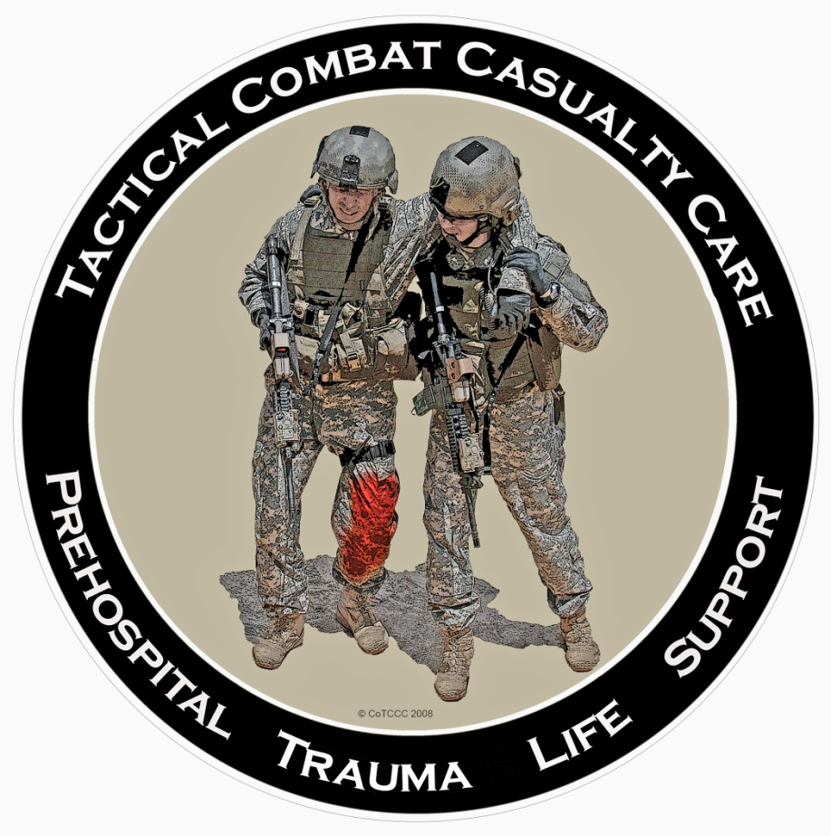
TCCC Guidelines
Casualty anticipated to need significant transfusion
Administer 1 gram ASAP
Administer 1 gram infusion after initial resuscitation
No indication for TBI

Slide 7
Methods
3-arm randomized trial (1:1:1)
Multi-center, multi-national
Double-blinded
Key coded kits placed on rigs and replaced at trauma center when used

Slide 8
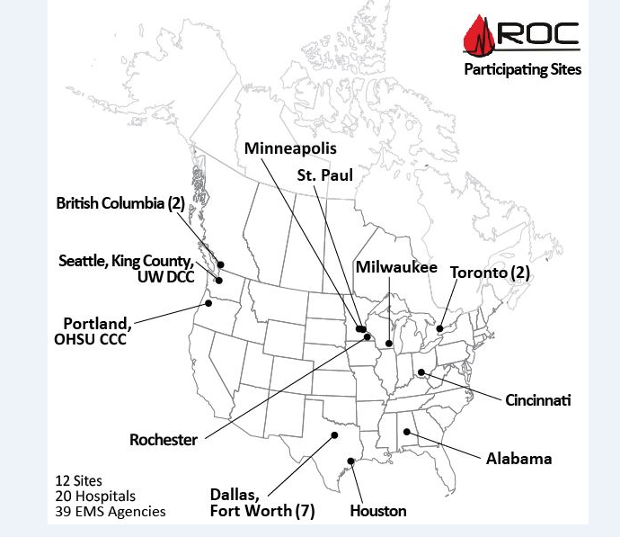
ROC TXA Locations Map

Slide 9
Primary Aim
  To determine the effects of two dosing strategies of TXA on outcome following moderate to severe TBI

Slide 10
Null Hypotheses
No difference in favorable neurologic outcome at 6 months (primary)
No difference in 28 day survival
No difference in morbidity
Comparing patients who received 2 dosing strategies of TXA to those who did not receive TXA

Slide 11
Subject Selection
Inclusion Criteria
Exclusion Criteria
Blunt or penetrating TBI
GCS = 3 - 12
Prehospital SBP > 90 mmHg
Age ≥15 y/o, or ≥50 kg, if age unknown
IV placed
Planned transport to participating hospital
GCS = 3 with no reactive pupil
> 2 hours from time of injury or time unknown
Any prehospital CPR
Seizures, MI, stroke, dialysis
Known or suspected prisoners
Known/suspected pregnancy
Drowning or hanging
Burns >20% TBSA
TXA or pro-coagulant drug
Opt out

Slide 12
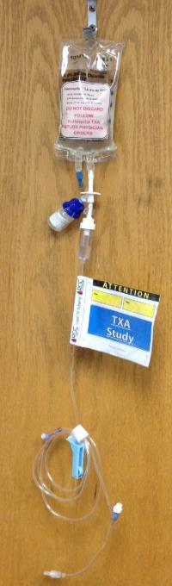
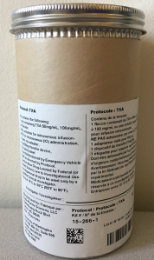
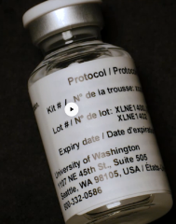
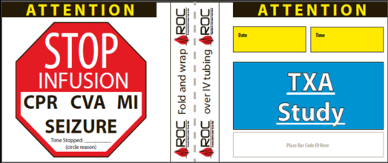
Double Blind Trial

Slide 13

Randomization Groups
2 gram PH bolus, 8 hour IH placebo infusion
  BO
1 gram PH bolus, 8 hour IH 1 gram infusion
  BM
Placebo PH bolus, 8 hour IH placebo infusion
  PB

Slide 14
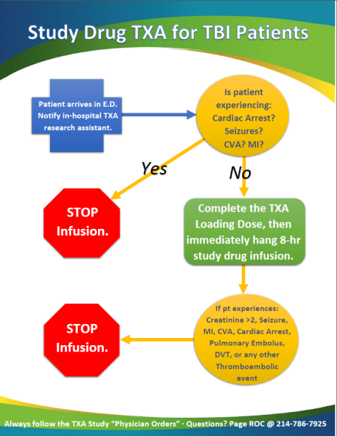
In - Hospital Procedure

Slide 15
Results
Enrollment from May 2015 – Mar 2017
967 patients randomized and received drug
  346* BO
  312 BM
  309 PB
  * 1 excluded from analysis because enrolled while in police custody

Slide 16
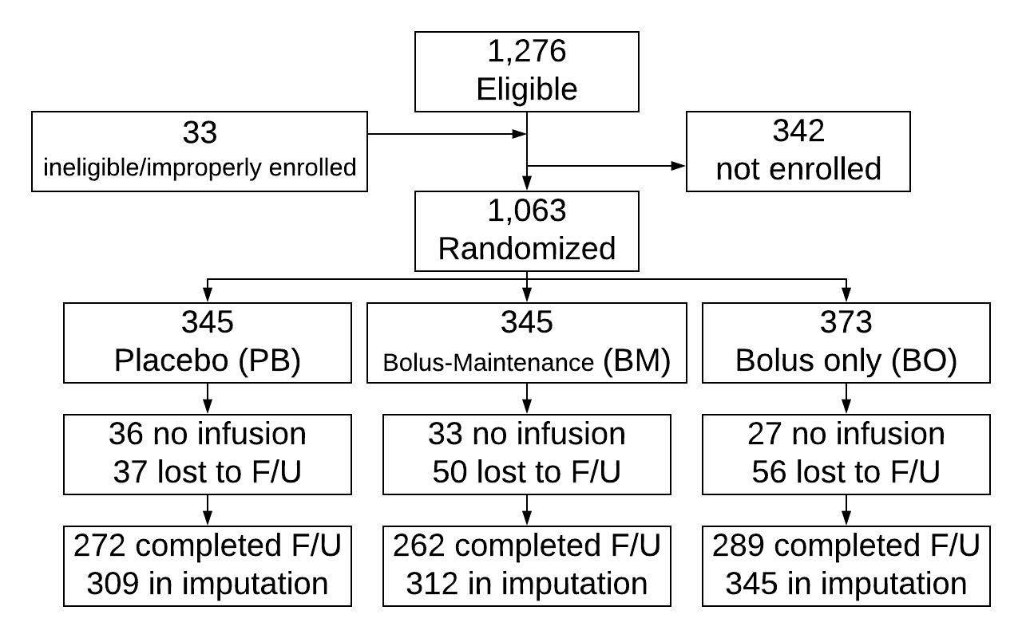
Enrollment

Slide 17
Statistical Analysis
Multiply imputed outcomes
Primary analysis adjusts for site only
Other analyses adjust for site, age, gender, blunt/penetrating, GCS, ISS, and head AIS
Multiple logistic regression (GOSE ≤ 4, DRS > 6, 28-day mortality)
Notes:
Rates of outcomes are on the imputed data.

Slide 18
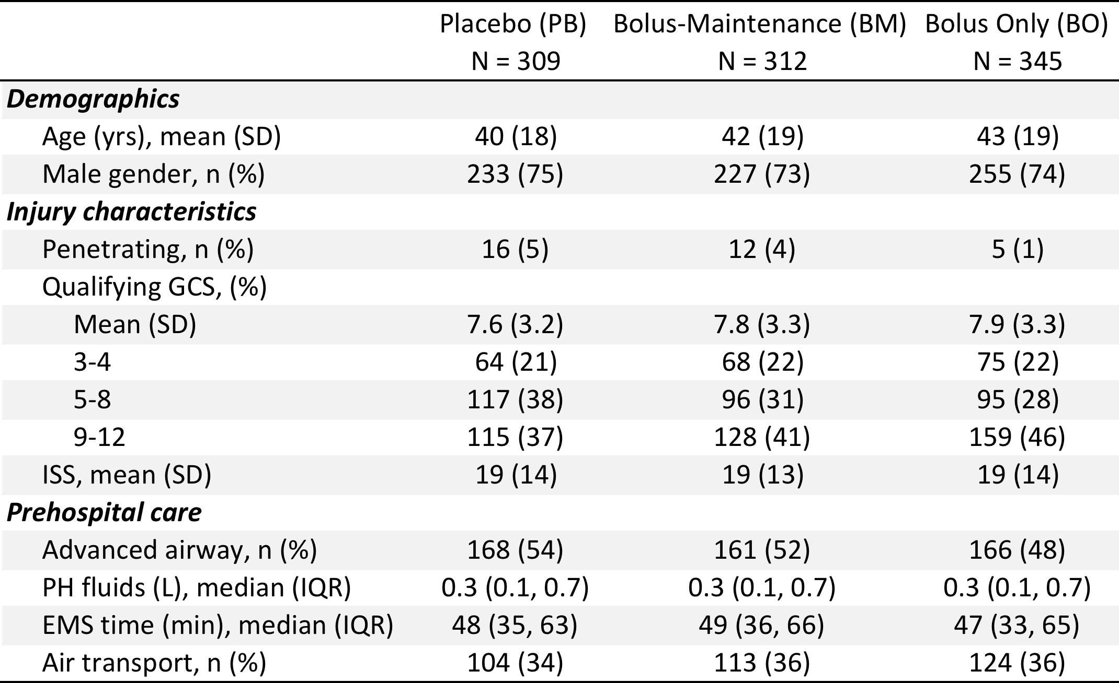
Patient Characteristics

Slide 19
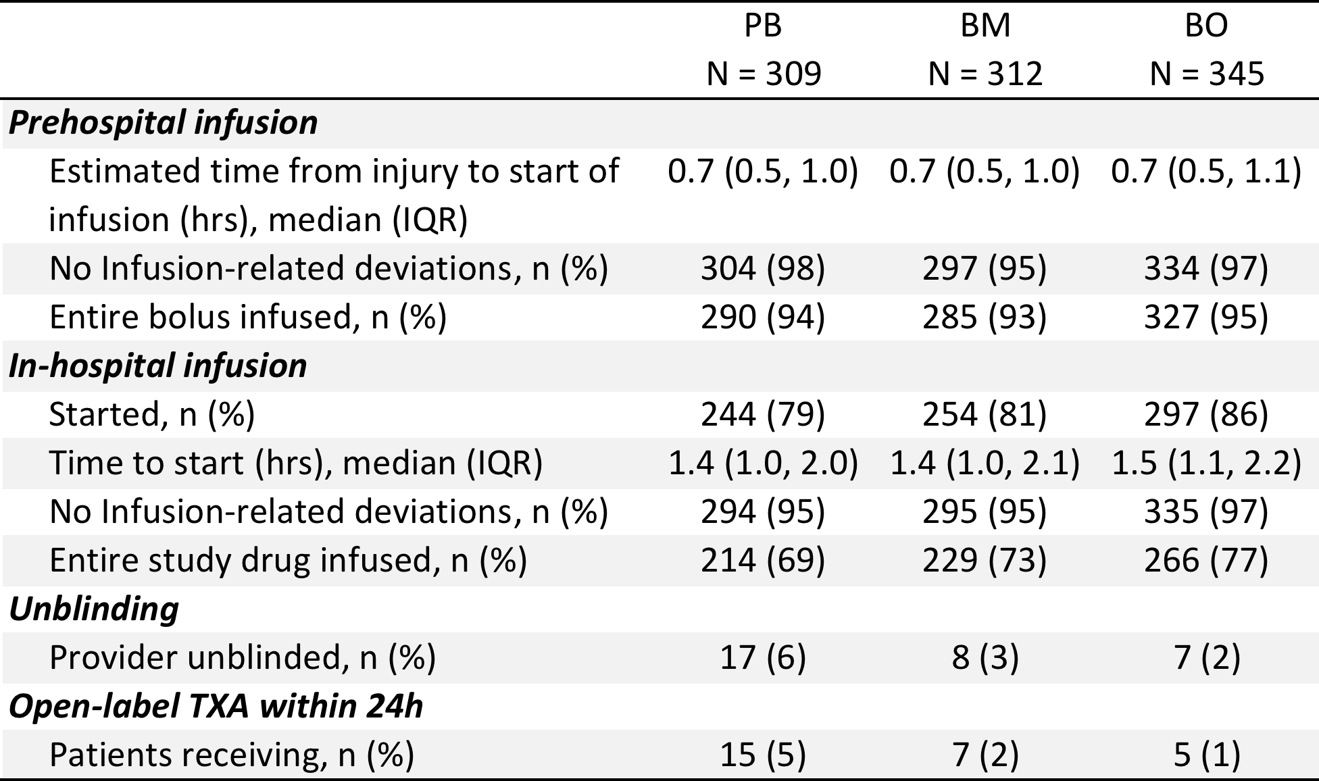
Drug Infusion

Slide 20
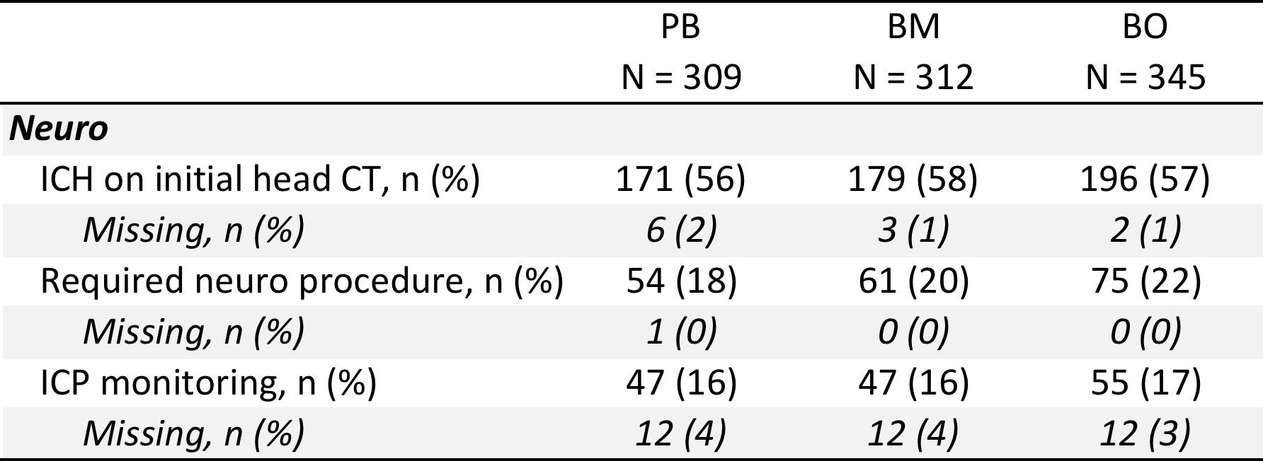
Neurologic Measures

Slide 21
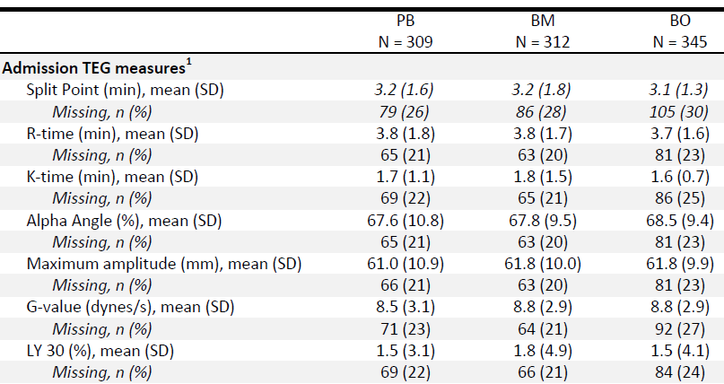
Admission TEG

Slide 22
LY30 Breakdown

Slide 23
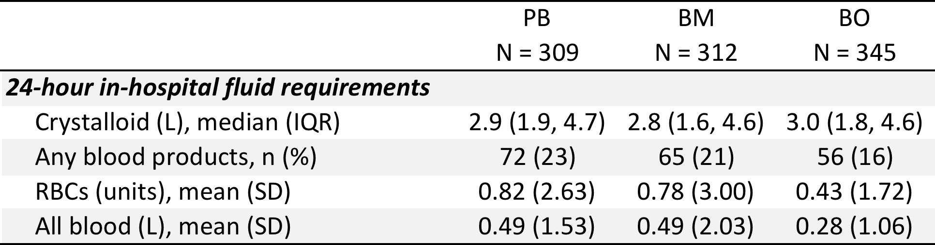
Resuscitation

Slide 24
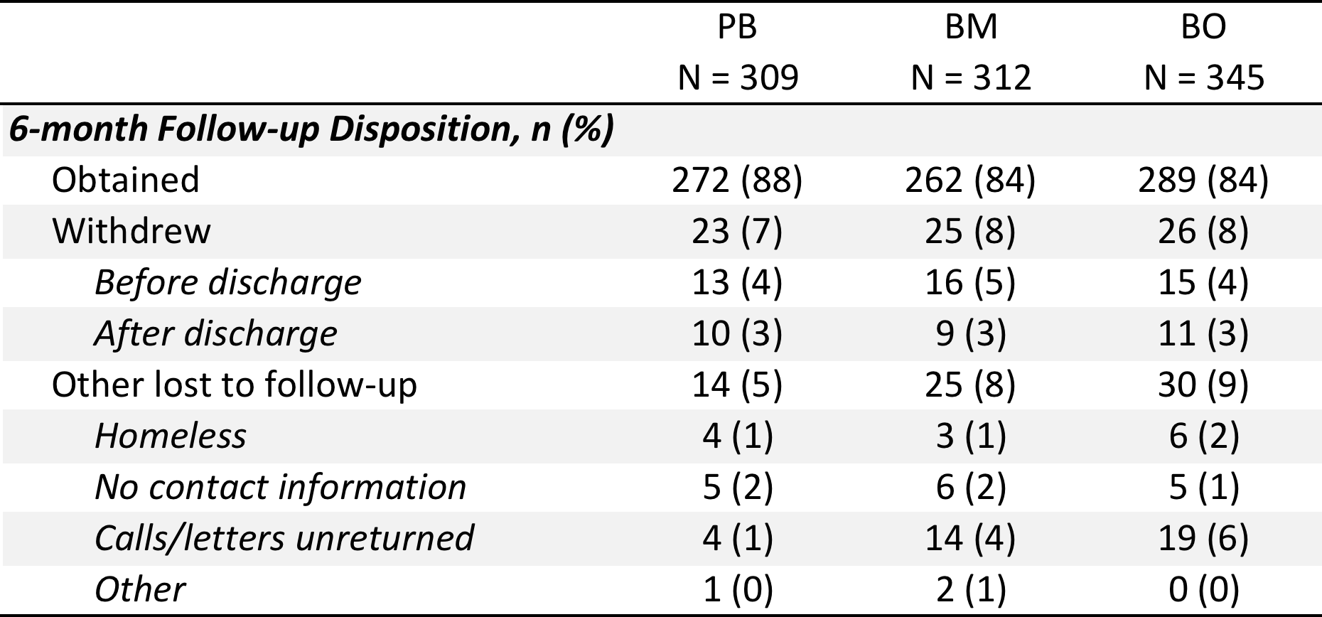
6 Month Follow-up

Slide 25
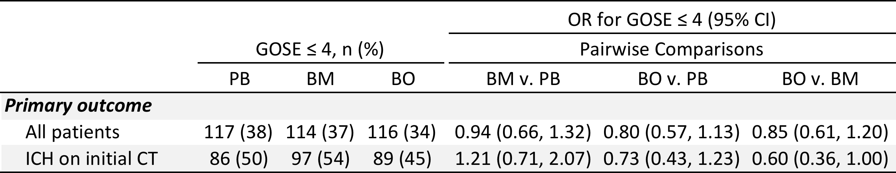
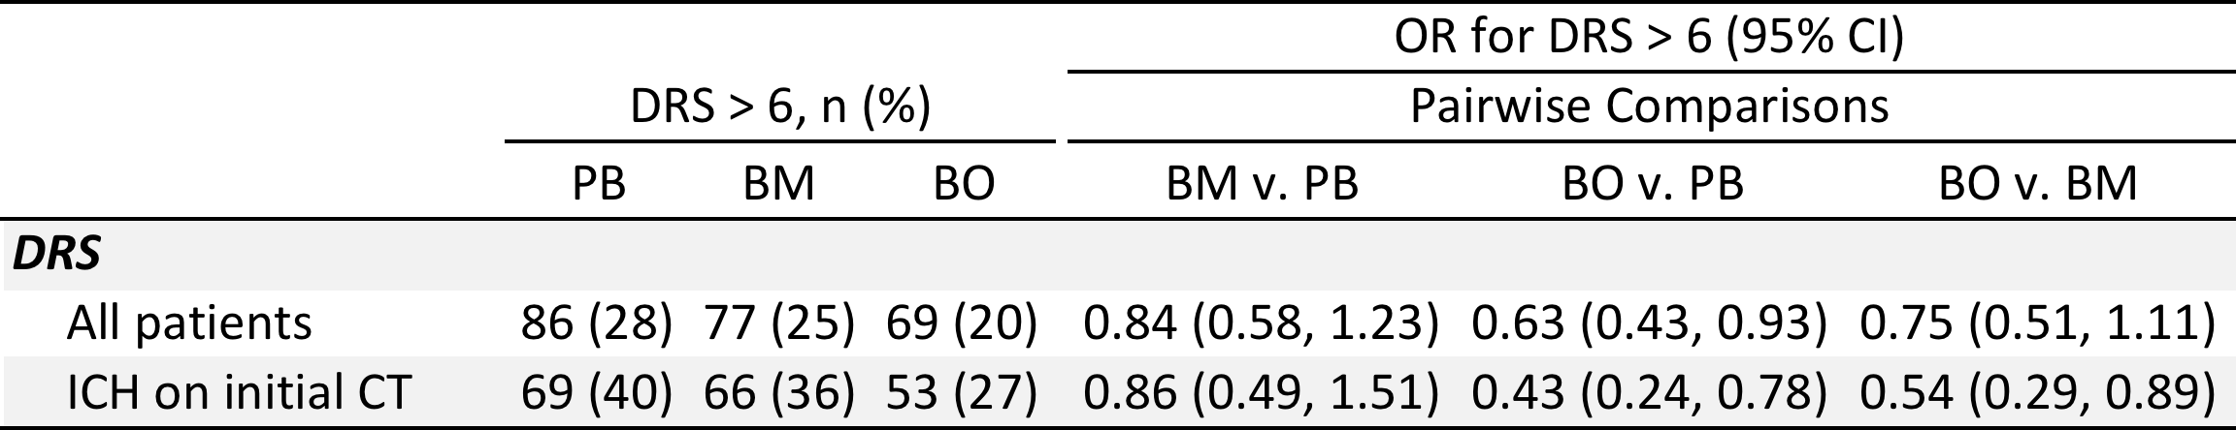
Outcomes
6 months following injury
Notes:
Rates of outcomes are on the imputed data.

Slide 26
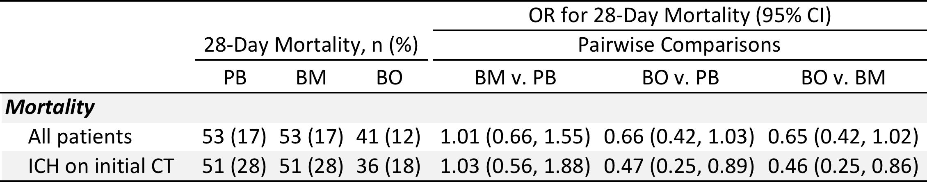
Mortality

Slide 27
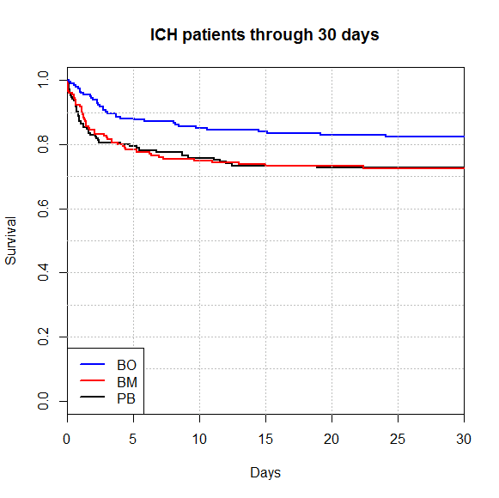
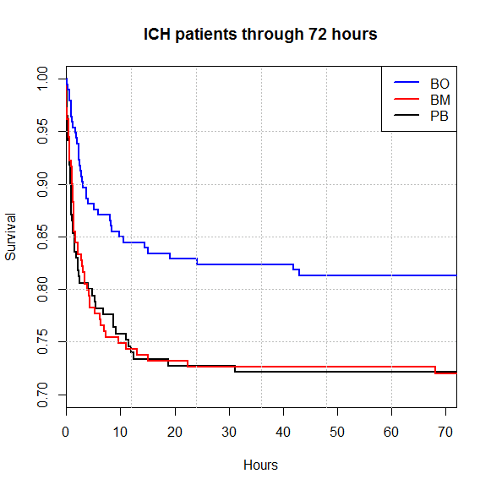
Mortality

Slide 28
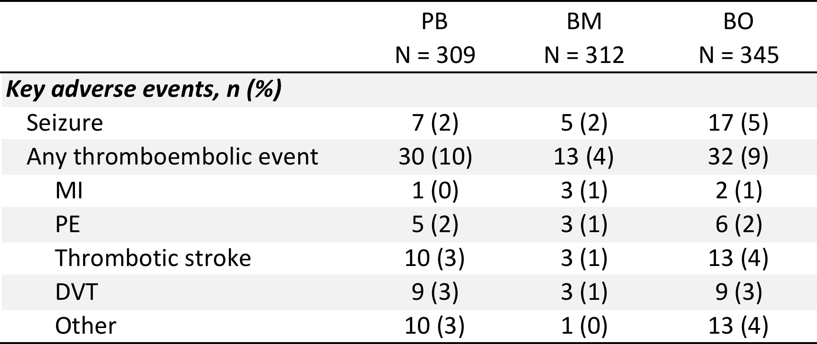
Major Adverse Events

Slide 29
Conclusions
Prehospital TXA use is feasible
Does not result in favorable GOSE at 6 months
Does not affect TEG on admit
2 grams prehospital TXA results in improved 28 day survival in patients with ICH
1st therapeutic with evidence for benefit in acute TBI
What about hemorrhagic shock?

Slide 30
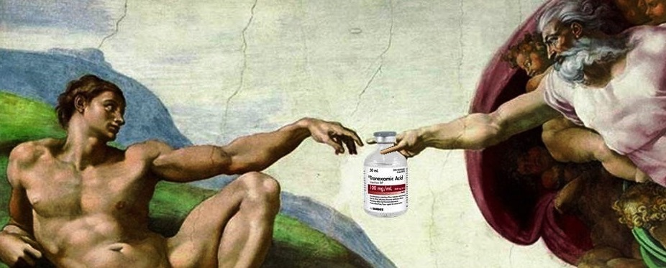
More Than I Thought

Slide 31
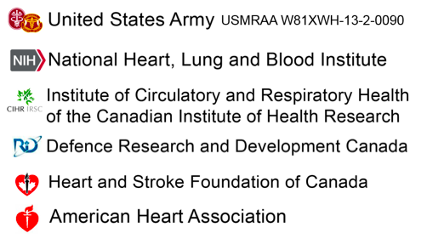
ROC Funding Partners

Slide 32
Authors
Martin A. Schreiber MD
Susan E. Rowell MD
Eric N. Meier MS
Barbara McKnight, PhD
Susanne May, PhD
Delores Kannas, RN, MS, MHA
Kellie Sheehan, BSN
Jun Hwang, MS
Patrick L. Bosarge, MD
Carolyn Williams, RN
Rob Schlamp, CCP
John Tallon, MD
Jim Christenson, MD
Jay Johannigman, MD
Jason McMullan, MD
Ahamed H. Idris, MD
Rajesh R. Gandhi, MD, PhD
Mark Gamber, DO
Neal J. Richmond, MD
William Witham, MD
Robert Simonson, DO
John S. Garrett, MD
Brian Tibbs, MD
Bryan A. Cotton, MD
Laura E. Vincent, RN
Martin D. Zielinski, MD
Michael Ferrara
M. Riccardo Colella, DO, MPH
Tom P. Aufderheide, MD
Audrey Hendrickson, MPH, CCRP
Lauren Klein, MD, MS
George Sopko, MD
Myron L. Weisfeldt, MD
Ralph J. Frascone, MD
David J. Dries, MD
Eileen M. Bulger, MD
Bryce R. H. Robinson, MD
Patricia Klotz, RN
Laurie J. Morrison, MD
Jeannie Callum, MD
Sandro Rizoli, MD
The ROC Investigators

Slide 33
