Slide 1
Not Just For Trauma: A Case for Non-Trauma Patient Whole Blood Transfusion, Blood Supply Shortages and Innovative Solutions During the COVID Pandemic
Donald Jenkins, MD
Department of Surgery, Division of Trauma/Critical Care
June 2022 THOR

Slide 2
Disclosures
No financial disclosures or conflicts of interest

Slide 3
Acknowledgements
Alison A. Smith, MD, PhD
Rahaf Alkhateb, MD, MSc
Maxwell Braverman, DO
Charles Patrick Shahan, MD
Benjamin Axtman, MD
Susannah Nicholson, MD
Leslie Greebon, MD
Brian Eastridge, MD
Rachelle Babbitt Jonas, RN, BSN
Ronald Stewart, MD
South Texas Blood and Tissue Center
STRAC Whole Blood Consortium
Brothers in Arms donors

Slide 4

Regional Whole Blood Committee
Committee Chair: Dr. Don Jenkins
Notes:
Dr J

Slide 5




San Antonio Whole Blood Consortium
Notes:
Dr J

Slide 6
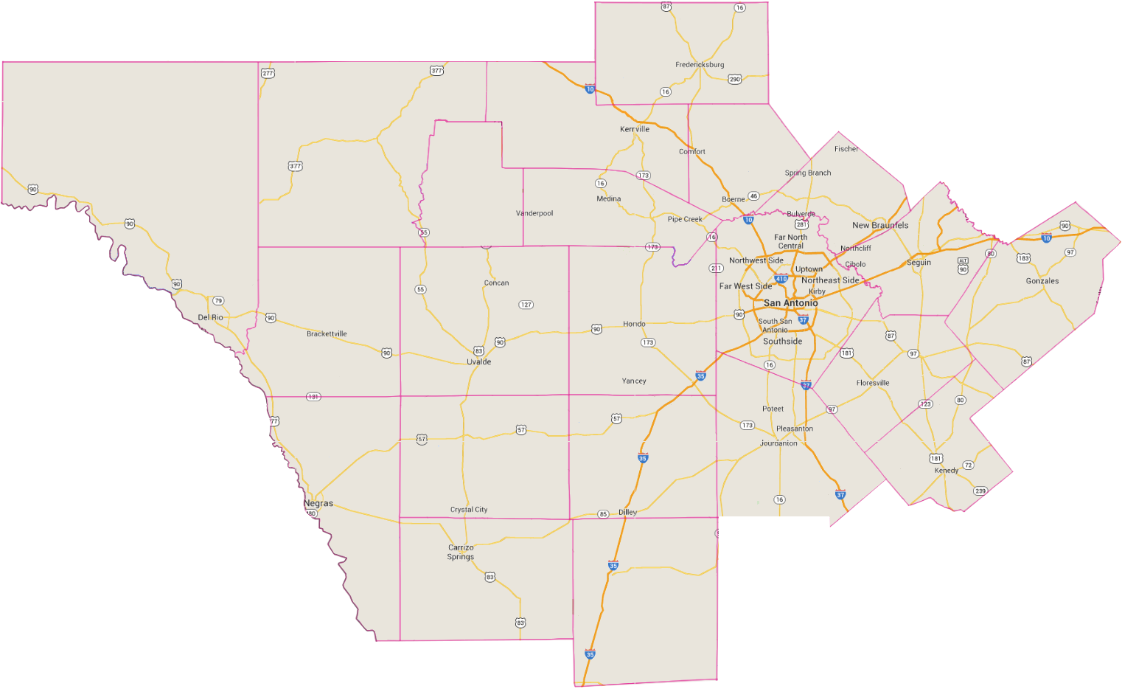
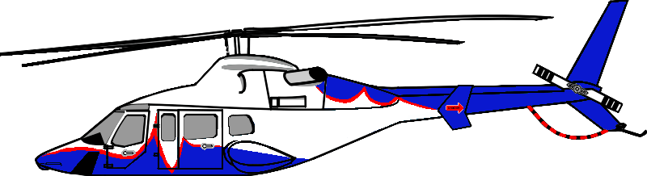
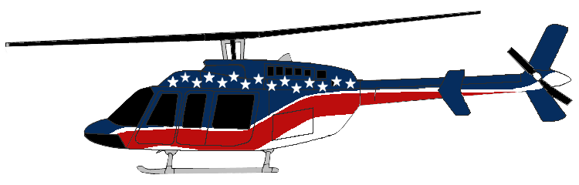
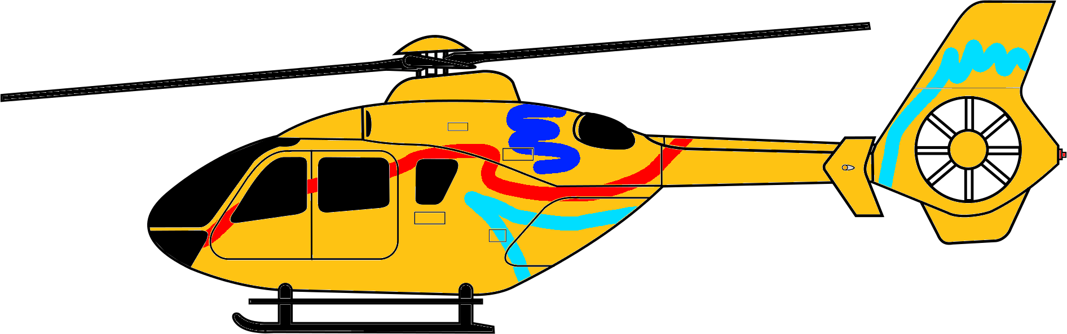

Air and Ground Regional Distribution as of July 1, 2020:
GILLESPIE
Map is not to scale
VAL VERDE
EDWARDS
AirLife 3
KERR
KENDALL
AirEvac 48
REAL
COMAL
BANDERA
GUADALUPE
MEDINA
AirCare 5
KINNEY
UVALDE
GONZALES
AirLife 5
BEXAR
WILSON
MAVERICK
KARNES
AirCare 2
AirLife 4
Level IV
Trauma Centers
Level I Trauma Centers
ZAVALA
FRIO
ATASCOSA
Rotation Sites:
AirLife (x4)
AirEvac/MAC (x6)
New Braunfels EMS
La Salle County EMS
Schertz EMS
Acadian Ambulance (x2)
Wilson County ESD 2 EMS
Allegiance EMS
Gonzales County ESD 1 EMS
Seguin EMS
AirEvac 57
Rotation Centers:
University Hospital (LV I)
Christus Santa Rosa New Braunfels (LV IV)
Other Regional Hospitals with LTOWB:
Brooke Army Medical Center (LV I)
Frio Regional Hospital (LV IV)
Rotation Sites:
San Antonio Fire Department EMS (x8)
Bexar County Emergency Services District (ESD) 7 EMS
Wilson Country ESD 3 EMS
Karnes County EMS
Bulverde-Spring Branch EMS
Bandera EMS
Canyon Lake EMS
Bexar County ESD 2 EMS
AirEvac 71
DIMMIT
LA SALLE
Notes:
Dr J

Slide 7

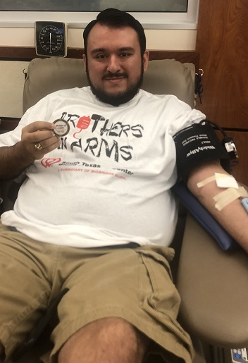
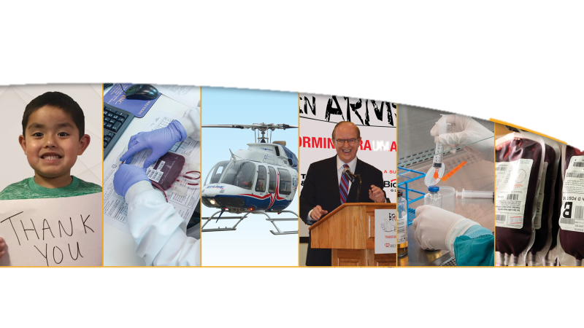

2020 Preliminary Results
Donors tested low titer 3,105
Active BIA donors 2,324
Units shipped to STRAC 1,335
New donors tested daily 9
Current collection goal 20 units daily
Appointment show rate 73%
Units expired 36
Notes:
John will briefly speak

Slide 8
2022 Preliminary Results
Donors tested low titer 4005
Active BIA donors 3500
Units shipped to STRAC 11,000
New donors tested daily 9
Current collection goal 25 units daily
Appointment show rate 89%
Units expired 50
Notes:
John will briefly speak

Slide 9
Background
Hemorrhagic shock results in a high mortality rate without adequate resuscitation and interventions to control bleeding
Whole blood transfusion for trauma patients with severe hemorrhage demonstrated early successful outcomes
Etiologies of hemorrhagic shock in the non-trauma population are also lethal

Slide 10
Background
Non-trauma patient population is distinct
Older with co-morbid conditions, take anti-coagulants/anti-platelet agents, and often do not require a procedure to control bleeding
No previous study has specifically investigated transfusion of whole blood in non-trauma patients

Slide 11
To provide evidence in support of whole blood transfusion to the non-trauma patient
Study Objective

Slide 12
Hypothesis
Given the promising early results with trauma patients, whole blood can be safely and effectively administered to the non-trauma population

Slide 13
Methods
Consecutive adult patients receiving whole blood at a single institution from Feb 2018-Jan 2020
Whole blood given for pre-specified transfusion triggers
Primary outcome measured was mortality
Secondary outcomes: pre-hospital blood, component therapy, transfusion-related reactions

Slide 14
(STRAC, 2020)

Slide 15
Results
Whole blood transfusion
n=237 patients
Trauma
n=182 patients
Non-Trauma
n=55 patients

Slide 16
Results
Etiology of Hemorrhage, n (%)
Gastrointestinal bleeding | 23 (41.8)
Gynecologic | 11 (20.0)
Ruptured AAA/dissection | 8 (14.5)
Acute care surgery | 5 (9.1)
Advanced malignancy | 4 (7.3)
Dialysis access | 3 (5.5)
Acute cardiovascular disease | 1 (1.8)

Slide 17
Results
 | Non-Trauma n=55 | Trauma n=182 | p value
Age, mean yrs (SEM) | 54.3 (2.2) | 40.8 (1.3) | <0.001
Pre-hospital whole blood, n (%) | 8 (14.5) | 95 (52.2) | <0.001
Whole blood, mean units (SEM) | 2.7 (0.2) | 3.5 (0.2) | 0.04
Mortality, n (%) | 17 (30.9) | 56 (30.8) | 1.0
Transfusion-related event, n (%) | 3 (5.5) | 6 (3.3) | 0.44
Component therapy, n (%) | 28 (50.9) | 93 (51.1) | 1.0
PRBC, mean units (SEM) | 2.1 (0.7) | 3.5 (0.2) | <0.001
FFP, mean units (SEM) | 1.3 (0.7) | 2.0 (0.5) | 0.5
Platelets, mean units (SEM) | 0.7 (0.2) | 0.3 (0.8) | 0.8

Slide 18
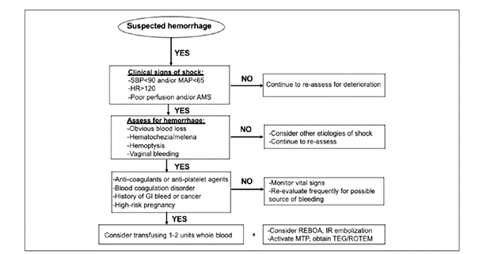

Slide 19
Efficacy and Safety of Whole Blood Transfusion in Non-Trauma Patients
Alison A. Smith, MD, PhD, Rahaf Alkhateb MD, Maxwell Braverman, MD,
Charles P. Shahan, MD, Benjamin Axtman, MD, Leslie Greebon, MD,
Brian Eastridge, MD, Rachelle B. Jonas, RN, BSN, Ronald Stewart, MD
Randi Schaefer, MSN, RN, PhD, Mark Foster, MD,
Donald Jenkins, MD
First Published September 30, 2021 Brief Report The American Surgeon
https://doi.org/10.1177/00031348211048831

Slide 20
COVID related inventory shortages as a substitute for components
Leslie Greebon, MD UHS/UT Blood Bank

Slide 21
LTOWB during COVID
Amid severe inventory shortages, LTO+WB has been a steady resource
Utilized as preferential product in trauma patients
Utilized as component substitute in during inventory shortages
Has enabled continued care and minimal disruption to resuscitation of all patient populations at UHS by triaging LOTWB and other components

Slide 22
COVID-19 Related Blood Inventory Shortages
Utilize LTO+WB as alternative product
  Eligible bleeding patients requiring O+ RBC or platelets when inventory is not available or very limited
  Considerations for eligibility
    Active bleeding or disease requiring multi component therapy (RBC/Plasma/PLT)
    Population does not require leukoreduction or irradiation
  We don’t currently have a metric for tracking platelet shortages due to inventory volatility
  Whole blood when given for trauma are in multiples of 4. We use orders and transfusions <4 as a surrogate to track WB usage during shortages

Slide 23
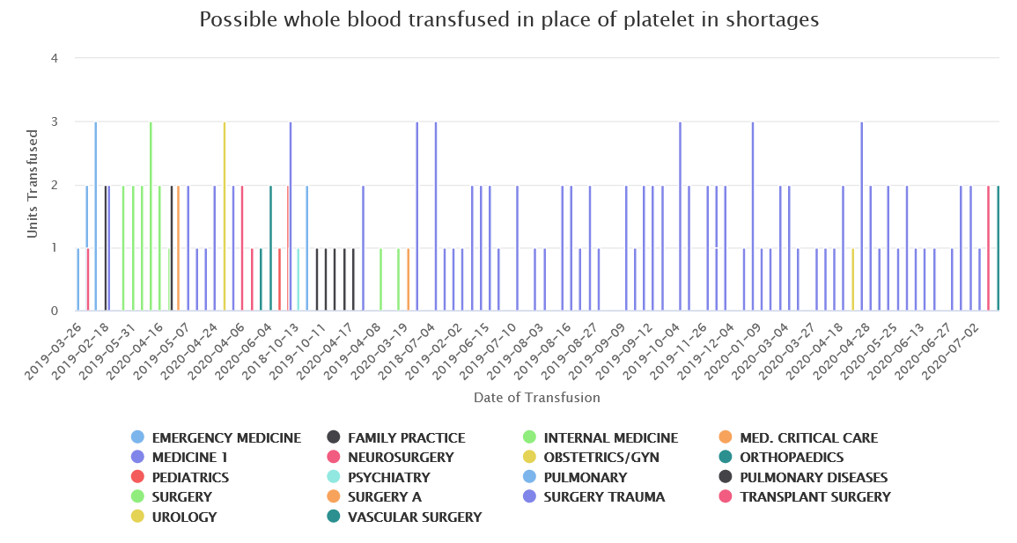

Slide 24
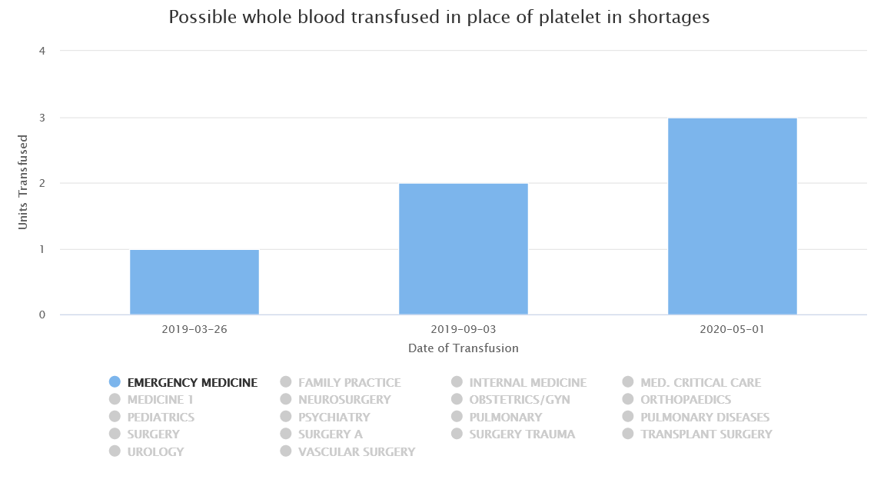

Slide 25
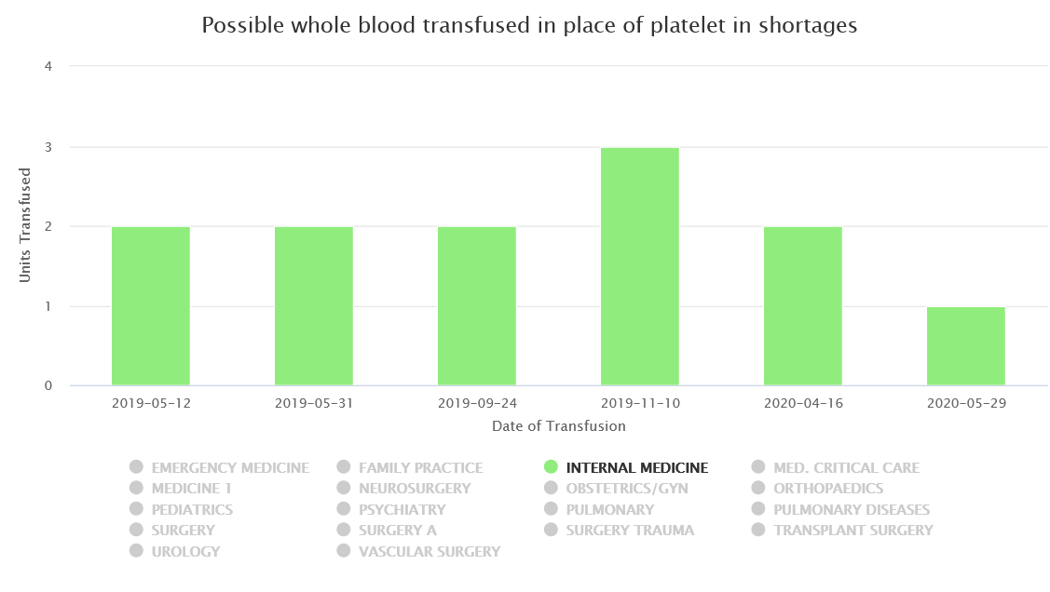

Slide 26
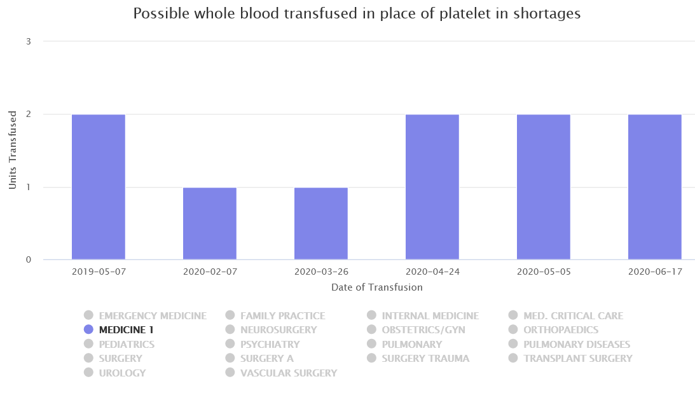

Slide 27
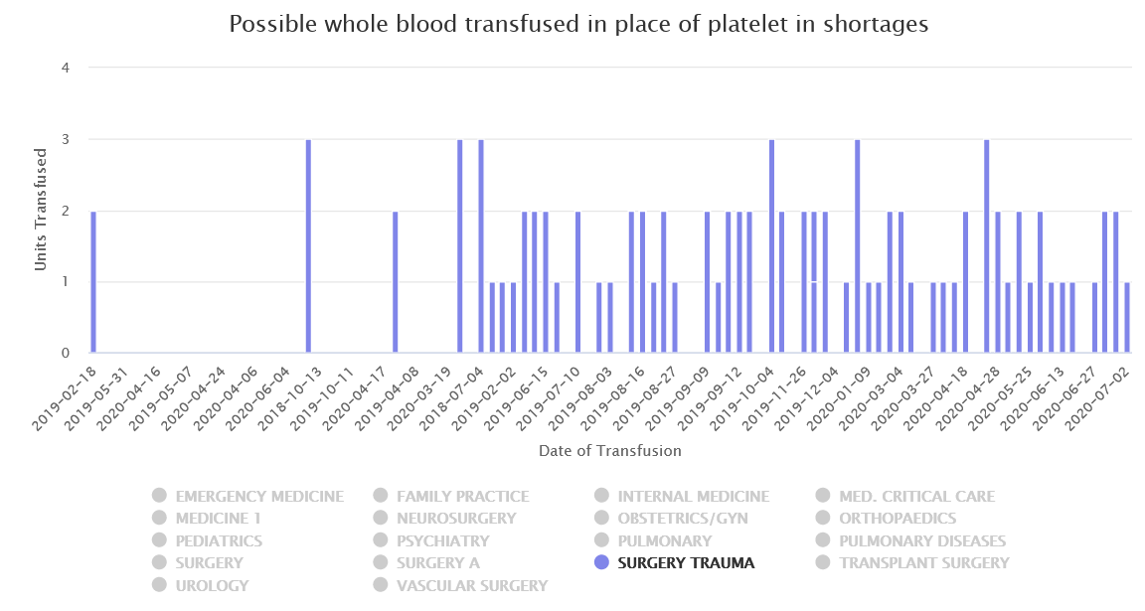

Slide 28
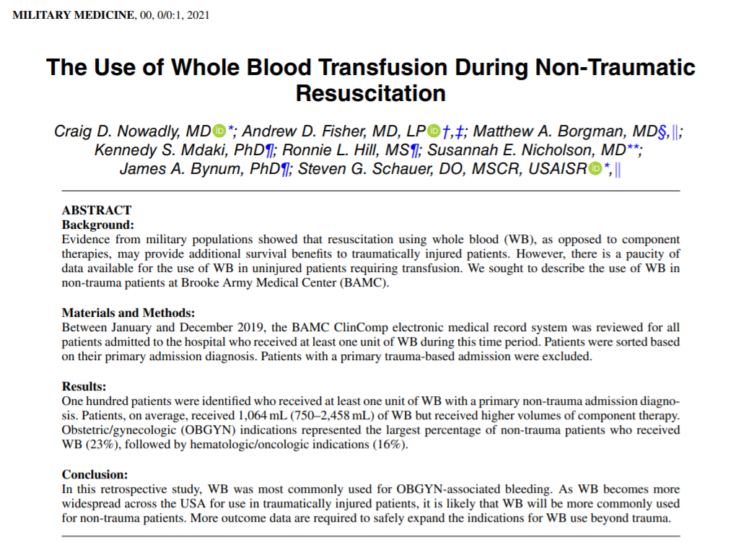
The use of whole blood in non-trauma patients

Slide 29
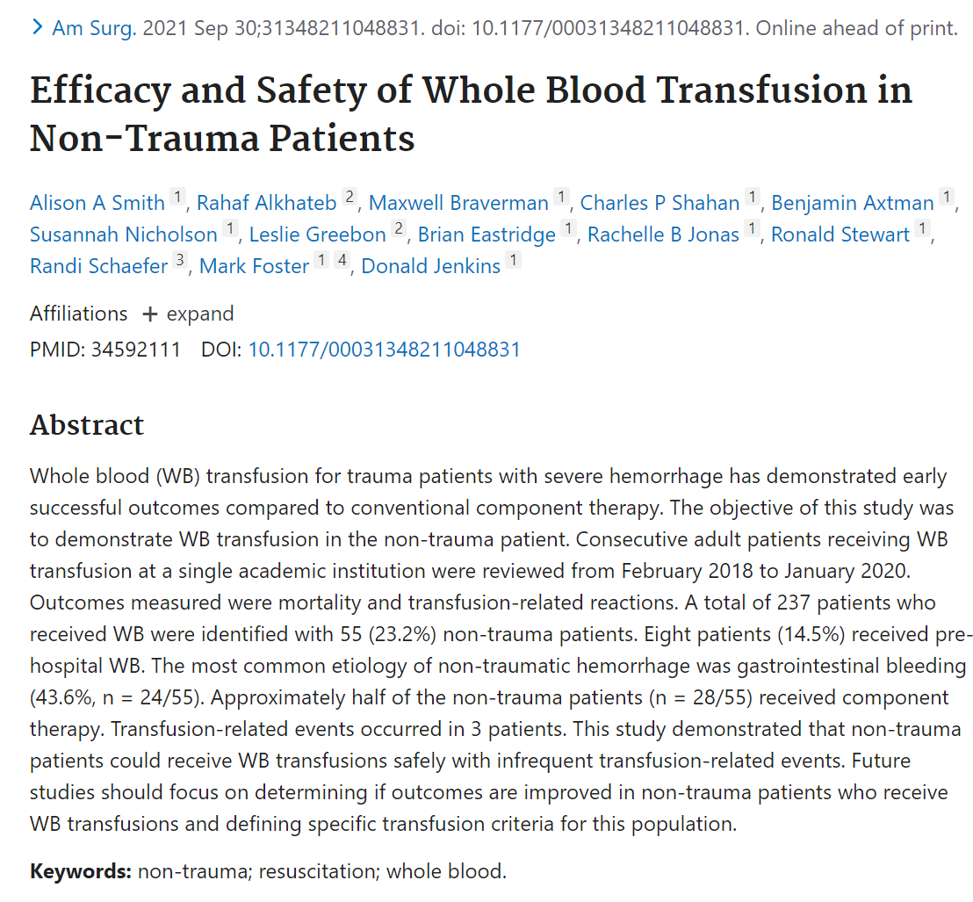
The use of whole blood in non-trauma patients

Slide 30
Latest Update on Non-trauma Whole Blood Transfusion
Total patients = 117
Bleeding source:
  Abnormal placentation
  GI bleeding
  Cardiothoracic surgery
  Transplant surgery
  Other
Mortality = 45 (38.5%)
Working actively to determine causation, associated factors, cause of death and complications related to transfusion

Slide 31
Detailed Breakdown of 99 Non-trauma Whole Blood Recipients and Outcome
OB/GYN: 22 patients (4.5%mortality)
Gastrointestinal Bleeding:20 patients (45%)
Sepsis: 13 (61.5%)
CT/ Vascular: 11 (27.2%)
Cirrhotics: 9 (11%)
ARDS: 7 (42.8%)
Cardiac arrest in the ED: 7(100%)
GU malignancy:2 (0%)
Sepsis of the Newborn:1 (100%)
Other: 7 (14.3%)
Total mean mortality: 45%
Detailed outcomes for remainder still under investigation

Slide 32
Adverse Events
To date no hemolytic transfusion reactions due to anti-A & anti-B
Similar rates of alloimmunization and transfusion reactions compared to component based therapy
Transfusion Reactions Reported
    mild allergic
    severe allergic
    TACO
    Underlying medical condition
    delayed hemolytic/serologic transfusion reaction (Anti-D)

Slide 33
Discussion
Resurgence of interest in whole blood
Non-trauma patients received whole blood safely with infrequent transfusion-related events
Future studies should focus refining transfusion triggers, appropriate control group, multi-institutional prospective studies of clinically diverse populations

Slide 34
South Texas Regional Whole Blood Deployment Program for Mass Casualty Incidents
¹University of Texas Health Science Center at San Antonio
²Southwest Texas Regional Advisory Council (STRAC)
³STRAC Whole Blood Consortium

Slide 35
Background
Prior to Southerland Springs mass shooting (2017)
  No plan to respond to mass casualty incident with blood to site of MCI
Big Falls, TX – 14-person MCI secondary to motor vehicle collision
  First use of prehospital whole blood in response to MCI (3 patients)
Southerland Springs mass shooting (Nov 2017)
  Federal review of response/events: send people, supplies and blood in the future for such events; plan development initiated
Mass Shootings (2019) – El Paso and Midland, TX
  No blood deployed but considered and program developed in concept
  Shortly after this El Paso MCI → WB deployment protocol adopted by Texas EMTF

Slide 36
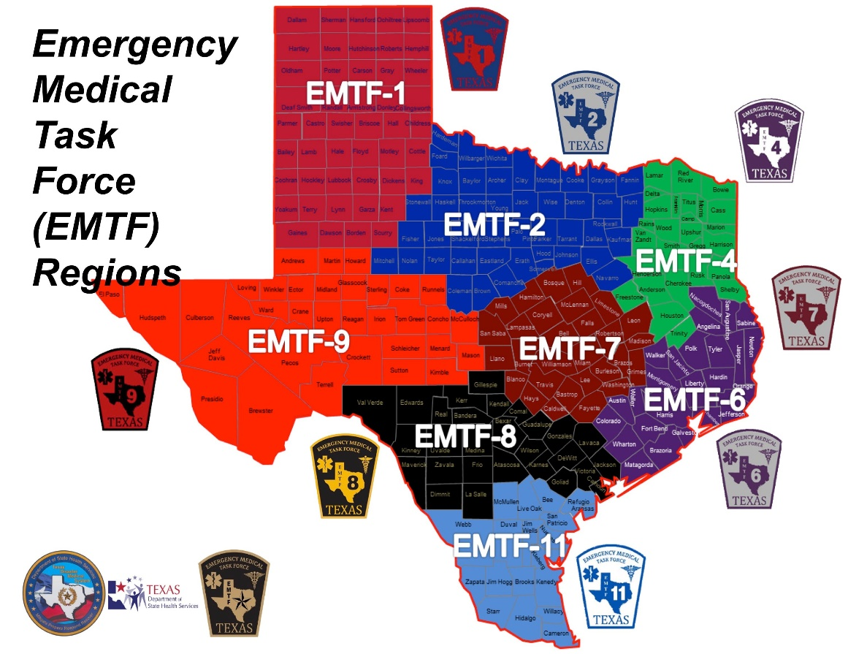
STRAC and the EMTF
Texas Emergency Medical Task Force (EMTF)
  8 multi-RAC geographic regions
STRAC is lead RAC for EMTF-8
  Designated as the State Coordination Office (SCO) for entire Texas EMTF program
Statewide collaboration for rapid response to MCIs and regional emergencies
WB deployment adopted by EMTF

Slide 37
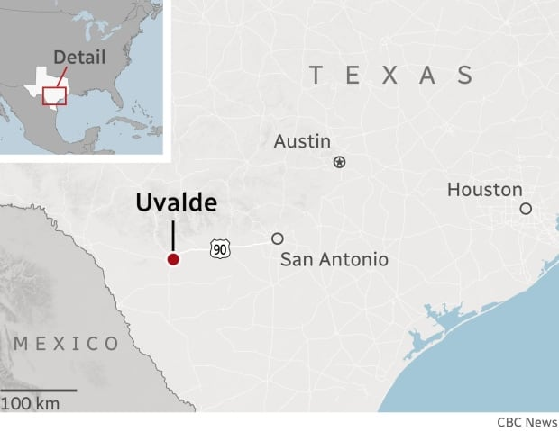
Uvalde, TX – May 24th, 2022
Located approximately 80 miles from San Antonio, TX
Mass casualty incident occurred resulting in 22 deaths (19 children, 3 adults)
WB package: 15 units LTO+WB and 10 units LPC
  1 child received 2 units LPC
  1 adult received 1 unit LTO+WB

Slide 38
Timeline of Events
UVALDE, TX MASS CASUALTY INCIDENT - BLOOD DEPLOYMENT TIMELINE
67 minutes
Notes:
15 units whole blood and 10 units LPC arrived in Uvalde in 67 minutes from time of notification at STBTC
Additional 20 units available on ground in Uvlade from neigboring communities
45 units to augment the blood bank supply
At baseline → ~55 units of pRBCs and ~50 units of FFP → NO PLATELETS

Slide 39
Additional Whole Blood Available
We did not account for this in our plan
3 ambulances from San Antonio responded = 3 units WB
2 HEMS organizations with 9 aircraft = 17 units WB
Total of 20 additional WB units on the scene within 75 minutes of the notification of the active shooter MCI
15 units South Texas Blood and Tissue and 20 from responding EMS agencies = 35 units WB + 10 units O- RBC’s = 45 units of blood products
2 patients got blood and sent to San Antonio
  One adult got 1 u WB
  One child got 2 u O- RBC’s (got 9 units WB after arrival and during surgery)
  All 6 patients transported to San Antonio alive and recovering

Slide 40
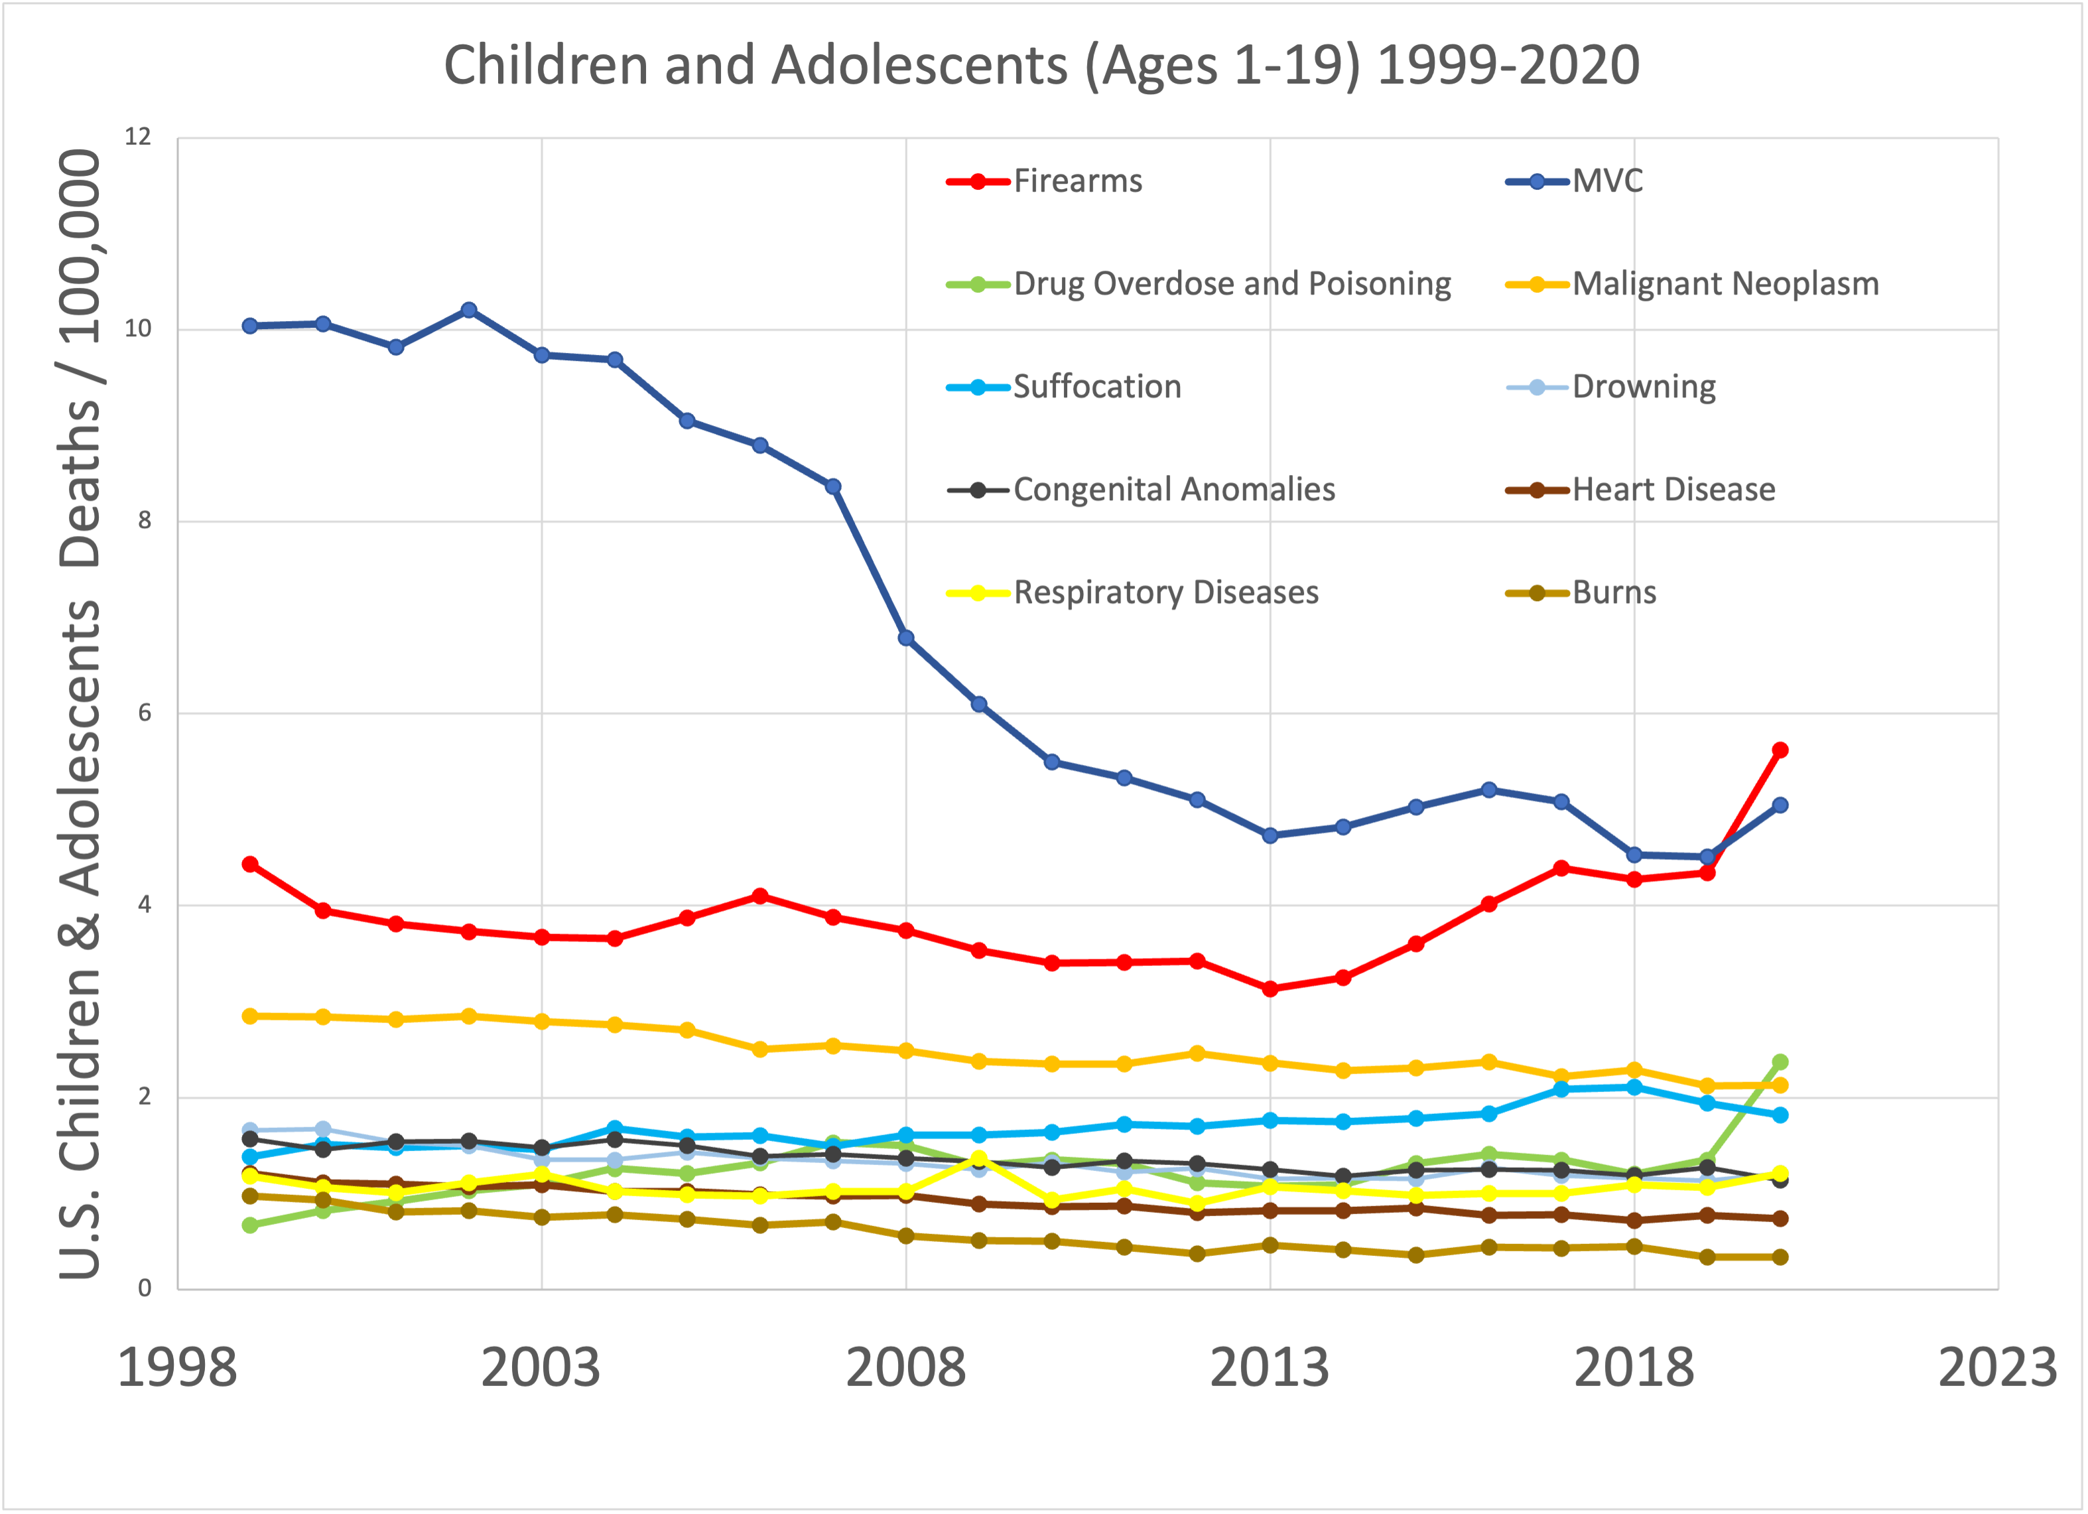
Clinical Importance and Future Directions
Firearm injury now leading cause of death for children and adolescents
Rapid response of deployment of blood from urban to rural environment
Model for adoption of similar programs throughout the country

Slide 41
Questions?
Donald Jenkins, MD
jenkinsd4@uthscsa.edu

