Slide 1

What’s New in hemostatic Resuscitation: Military Perspective
Jennifer Gurney, MD FACS
COL, MC, US Army
Joint Trauma System / USAISR

Slide 2


Disclosures
The following are the private views of the author and are not intended as official policy of the Department of the Army or the Department of Defense.
No financial disclosures.

Slide 3
What’s New In Hemostatic Resuscitation
DCR CPG
Blood use in Combat Zone
Fresh Whole Blood outcomes
It’s (all) about time
Notes:
AND DEATH OCCURS EARLY

Slide 4
What’s New In Hemostatic Resuscitation
DCR CPG
Blood use in Combat Zone
Fresh Whole Blood outcomes
It’s (all) about time
Notes:
AND DEATH OCCURS EARLY

Slide 5


Slide 6
Critical CPG Updates
Greater emphasis on the use of LTOWB
Risk factors for MT: INR threshold > 1.5
Earlier calcium use recommended
  1 gm Ca⁺⁺ given during first unit of blood & after every 4 units
  Ionized Ca⁺⁺should be monitored; Ca given for ionized Ca⁺⁺ less than 1.2mmol/L.
Blood pressure goals: SBP 100 mmHg (110mmHg in TBI)
Hextend / Hespan is NO LONGER RECOMMENDED
The use of recombinant human activated factor VII (rhFVIIa) is no longer recommended
Notes:
Greater emphasis on the use of LTOWB as the optimal strategy to deliver a balanced and maximally hemostatic resuscitation, with platelet functionality, safely.
1 gm calcium (30 ml of 10% calcium gluconate or 10 ml of 10% calcium chloride) IV/IO should be given to patients in hemorrhagic shock during or immediately after transfusion of the first unit of blood product and with ongoing resuscitation after every 4 units of blood products. Ideally, ionized calcium should be monitored and calcium should be given for ionized calcium less than 1.2mmol/L. ³⁻⁷
Blood pressure goals for DCR have been adjusted to a target systolic blood pressure (SBP) goal of 100 mmHg (110mmHg for traumatic brain injury (TBI)).
Resuscitative Endovascular Balloon Occlusion of the Aorta (REBOA) updated as a fielded option for the control of non-compressible torso hemorrhage. REBOA continues to be recommended for designated resuscitation teams and NOT intended to be used by the combat medic or corpsman.
The use of hydroxyethyl starch (Hextend, Hespan) as a resuscitation fluid is NO LONGER RECOMMENDED and has been removed from the guideline.
The use of recombinant human activated factor VII (rhFVIIa) is no longer recommended.

Slide 7
Critical CPG Updates: CSP
Approved in CENTCOM for use up to 14 days
Negotiations ongoing with FDA for variance for US use
USAMDA will fund trials aimed at licensing platelets
Notes:
Greater emphasis on the use of LTOWB as the optimal strategy to deliver a balanced and maximally hemostatic resuscitation, with platelet functionality, safely.
1 gm calcium (30 ml of 10% calcium gluconate or 10 ml of 10% calcium chloride) IV/IO should be given to patients in hemorrhagic shock during or immediately after transfusion of the first unit of blood product and with ongoing resuscitation after every 4 units of blood products. Ideally, ionized calcium should be monitored and calcium should be given for ionized calcium less than 1.2mmol/L. ³⁻⁷
Blood pressure goals for DCR have been adjusted to a target systolic blood pressure (SBP) goal of 100 mmHg (110mmHg for traumatic brain injury (TBI)).
Resuscitative Endovascular Balloon Occlusion of the Aorta (REBOA) updated as a fielded option for the control of non-compressible torso hemorrhage. REBOA continues to be recommended for designated resuscitation teams and NOT intended to be used by the combat medic or corpsman.
The use of hydroxyethyl starch (Hextend, Hespan) as a resuscitation fluid is NO LONGER RECOMMENDED and has been removed from the guideline.
The use of recombinant human activated factor VII (rhFVIIa) is no longer recommended.

Slide 8
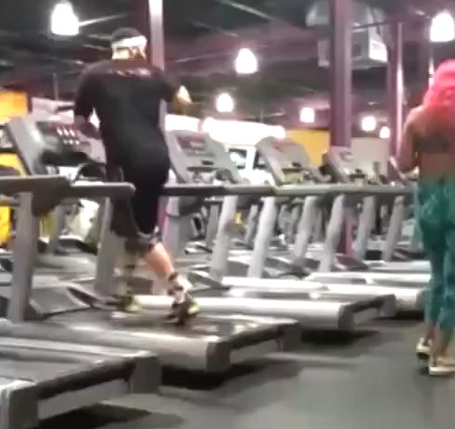

Critical CPG Updates: CSP
Thank you Andre, it’s only been 10 years…
…as long as there is a plan, thank you FDA
Notes:
AS LONG AS THERE IS A PLAN…..THANK YOU ANDRE!!

Slide 9
What’s New In Hemostatic Resuscitation
DCR CPG
Blood use in Combat Zone
Fresh Whole Blood outcomes
It’s (all) about time
Notes:
AND DEATH OCCURS EARLY

Slide 10
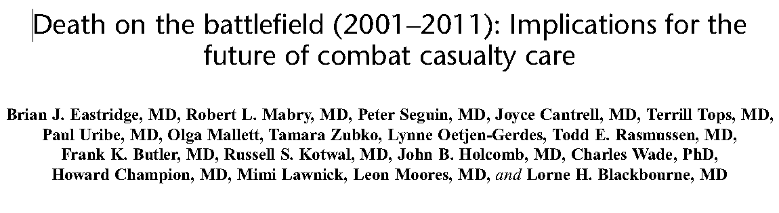
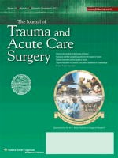
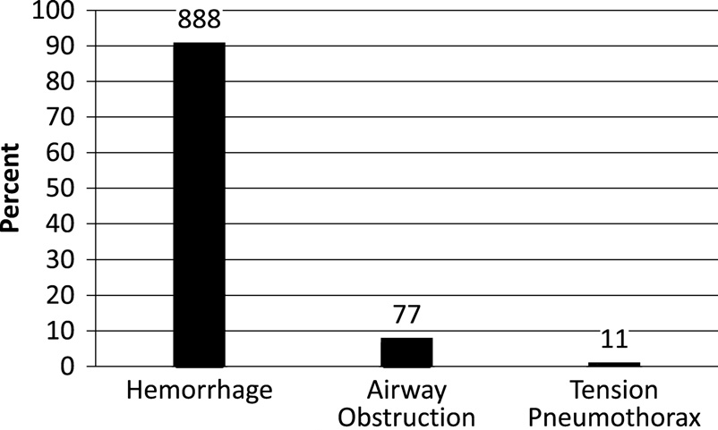
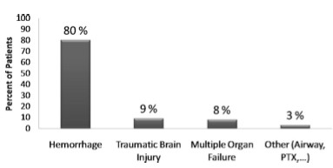
J Trauma 2012
4,596 “KIA”=
Pre-Hospital 976 (24%)
Potentially Survivable
>1000
Preventable Deaths from BLEEDING ALONE!
558 “DOW”=
In-Hospital 287 (51%) PS

Slide 11
What we know…
Hemorrhage #1 cause of death from trauma
Minutes matter → early transfusion saves live
Ratio matters
Bleeding results in blood failure
Notes:
Abdominal bleeding and time to Laparotomy
Extremity bleeding and time to tourniquets
Time to transfusion in bleeding patients
Time to resuscitation in septic patients
Time to IR in pelvic hemorrhage
Time to craniotomy
Time to laboratory dx
Time to antibiotics in sepsis
Time to culture results and focused antibiotics
Duration of Antibiotics
Time to accurate diagnosis and treatment (eg, lysis for stroke and MI)
Rapid radiology reports…. Sent around the world, why not AI
Who enjoys waiting for anything in the healthcare space?
Why should we?
Faster is almost always better
Transparency of information
Process engineering to reduce delays in actionable information and improve quality of care
Time is important…..minutes matter!!!

Slide 12
Trauma-Induced Blood Failure

Slide 13
Trauma-Induced Blood Failure
Does a therapy for blood failure exist?

Slide 14
L – Logistically feasible
T – Time tested
O – Organized (pre-screened donors)
W – Walking Blood Bank
B – Better Outcomes

Slide 15
L – Logistically feasible
T – Time tested
O – Organized (pre-screened donors)
W – Walking Blood Bank
B – Better Outcomes

Slide 16
L – Logistically feasible
T – Time tested
O – Organized (pre-screened donors)
W – Walking Blood Bank
B – Better Outcomes

Slide 17
L – Logistically feasible
T – Time tested
O – Organized (pre-screened donors)
W – Walking Blood Bank
B – Better Outcomes

Slide 18
L – Logistically feasible
T – Time tested
O – Organized (pre-screened donors)
W – Walking Blood Bank
B – Better Outcomes

Slide 19
L – Logistically feasible
T – Time tested
O – Organized (pre-screened donors)
W – Walking Blood Bank
B – Better Outcomes

Slide 20
Of Historical Interest…
“The vital role which whole blood played in the care of the wounded in World War II has been adequately dealt with elsewhere, but the essential planning that made possible the provision of over 385,000 pints of whole blood for the treatment of the greater portion of the 386,075 wounded in the European theater of operations is a story that needs to be told ”
- COL James B. Mason, June 1948

Slide 21
Of Historical Interest…
“The vital role which whole blood played in the care of the wounded in World War II has been adequately dealt with elsewhere, but the essential planning that made possible the provision of over 385,000 pints of whole blood for the treatment of the greater portion of the 386,075 wounded in the European theater of operations is a story that needs to be told ”
- COL James B. Mason, June 1948
Notes:
Background and Objectives
Planning transfusion needs in mass casualty events (MCE) is critical for disaster preparedness. Published data on blood component usage were analysed to seek correlative factors and usage rates.
Materials and Methods
English‐language medical publications since 1980 were searched for MCEs with numbers of patient admissions and transfused RBCs. Reports were excluded from natural disasters or with total RBC use <50 units. Statistical analysis employed Mann–Whitney U‐tests and Spearman's rank correlations.
Results
In 24 reports, the average units per admission were 3·06 RBCs, 2·13 plasmas and 0·37 platelet doses. Five RBCs per admission would have sufficed for 87% of events. Transfusion needs involving bombings correlated with admissions (P ≤ 0·03). In the formula (massive‐transfusion patients in MCE) times X = (total units for all MCE patients), the average X was 35 for RBCs (correlation P = 0·01), 17 for plasma (P = 0·10) and five for platelet doses (P = 0·06). From 67% to 84% of all components used were given in the first 24 h (event medians).
Conclusions
Blood component use in MCEs correlated with numbers of patients admitted or receiving massive transfusion. More current data are needed to better reflect emerging trauma care practices and refine predictive models of transfusion needs.

Slide 22



Slide 23
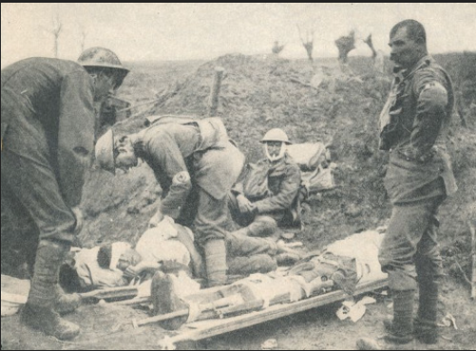
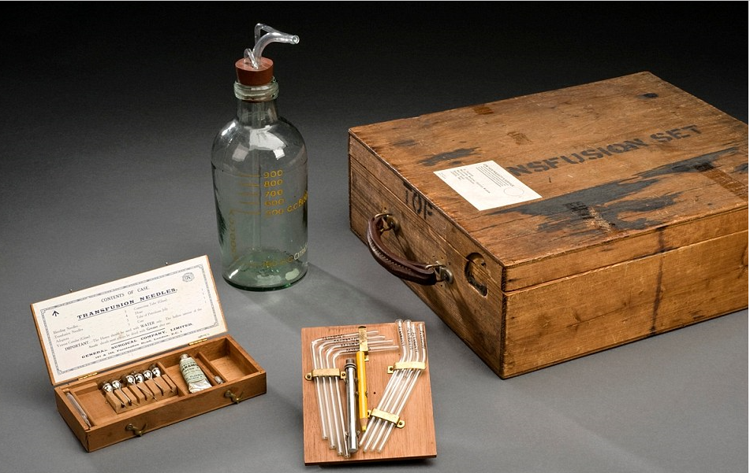
HISTORY OF BLOOD AND WAR
WWI

Slide 24
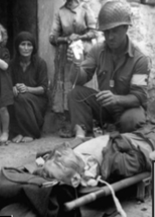
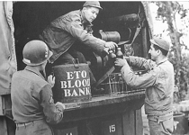
HISTORY OF BLOOD AND WAR
WWII

Slide 25
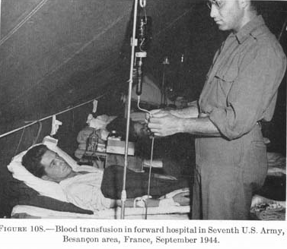
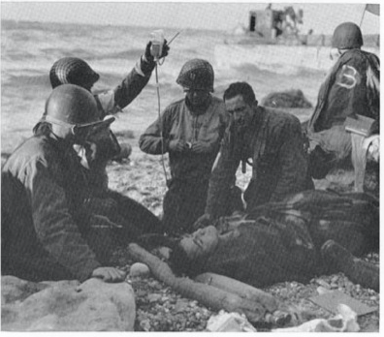
HISTORY OF BLOOD AND WAR
WWII

Slide 26
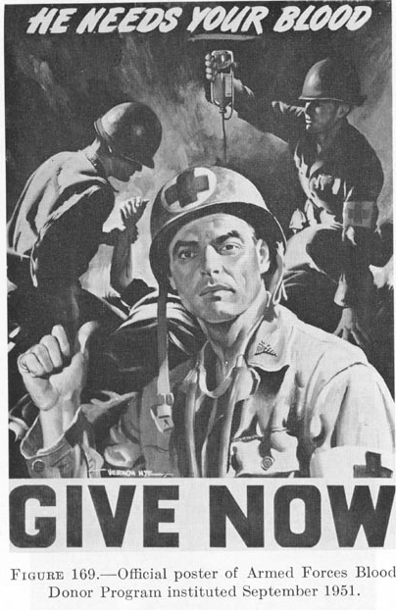
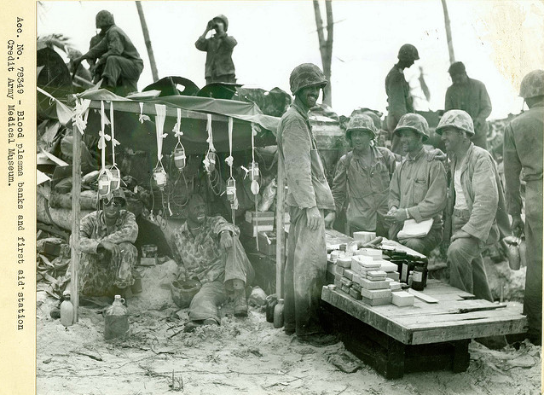
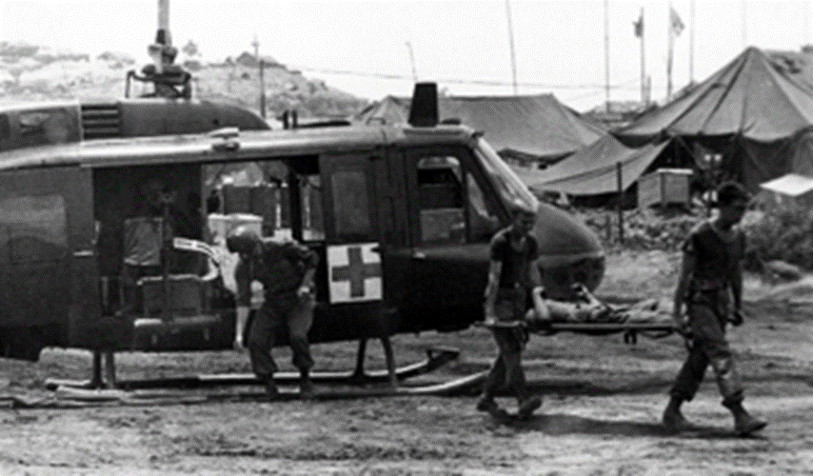
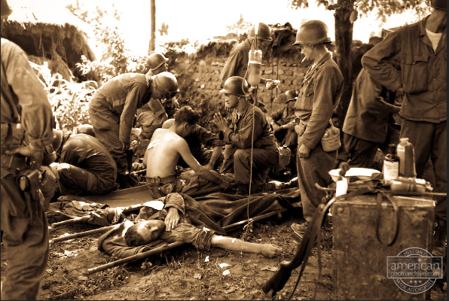
HISTORY OF BLOOD AND WAR
Korean War
Vietnam War

Slide 28
Lessons
Re-Learned…

Slide 29
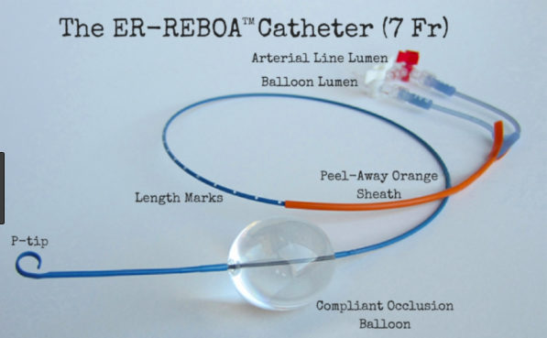
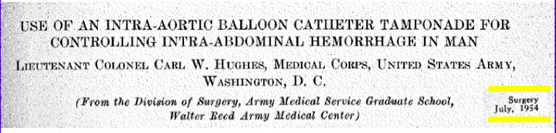
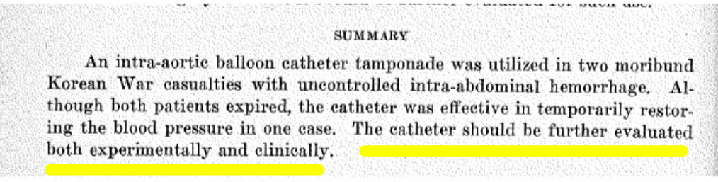
Not the only lesson re-learned
…it’s been over 60 years…
The only mistake in life is the lesson not learned.
-Albert Einstein

Slide 30
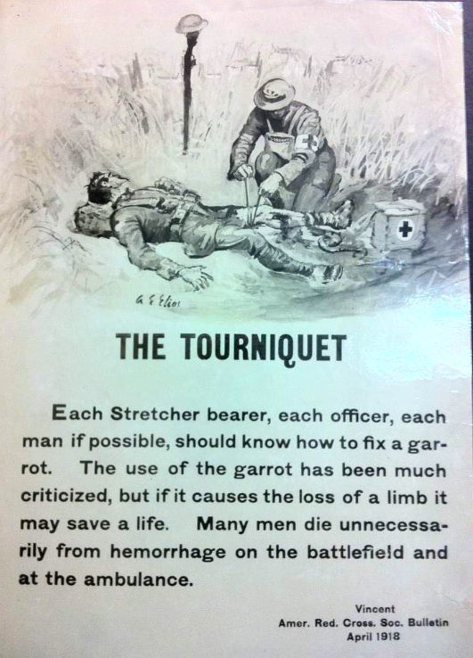
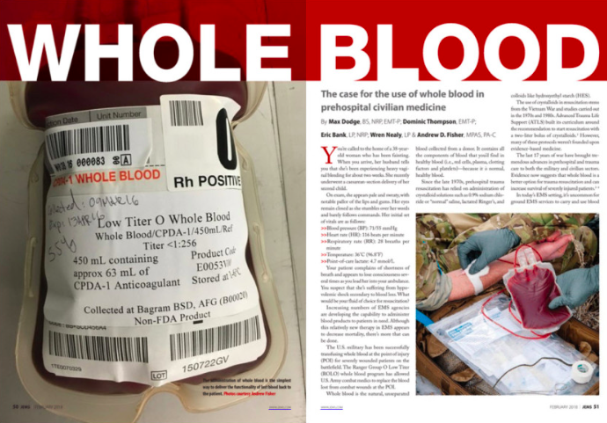
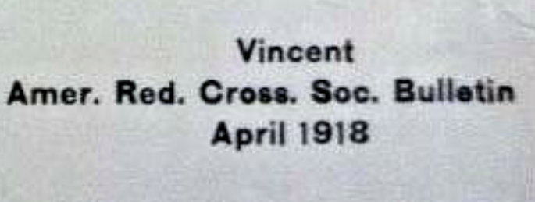
….and Re-Learned
Notes:
But….TQ are relative new….and not everyone knows how to use them, right?

Slide 31
Whole Blood in the Combat Zone

Slide 32
Advanced Resuscitative Care TCCC - 2019
Focuses on early whole blood

Slide 34
Notes:
All the HN….that’s why there is not good outcome
uS patients represent 22% of transfusions
78% of transfused patients have not been US forces

Slide 35
Notes:
Why LOTWB is logistically feasible….look at the ratios

Slide 36
L – Logistically feasible
T – Time tested
O – Organized (pre-screened donors)
W – Walking Blood Bank
B – Better Outcomes

Slide 37
L – Logistically feasible
T – Time tested
O – Organized (pre-screened donors)
W – Walking Blood Bank
B – Better Outcomes

Slide 38
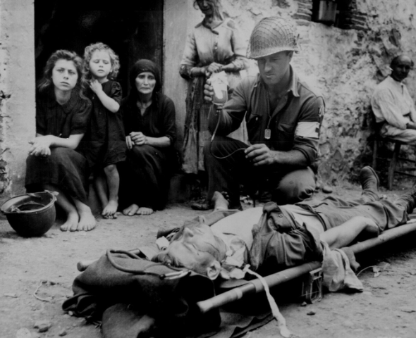

Slide 39
L – Logistically feasible
T – Time tested
O – Organized (pre-screened donors)
W – Walking Blood Bank
B – Better Outcomes

Slide 40
L – Logistically feasible
T – Time tested
O – Organized (pre-screened donors)
W – Walking Blood Bank
B – Better Outcomes

Slide 41
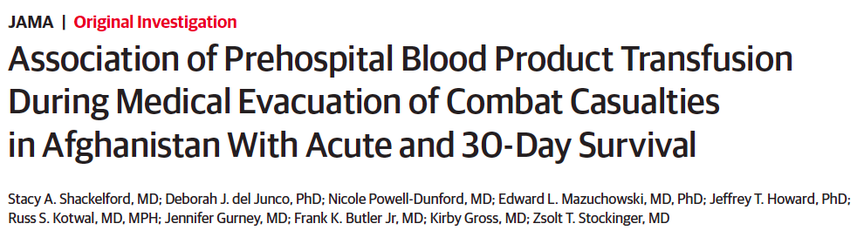
Pre-hospital blood transfusion Large reduction in risk of death

Slide 42
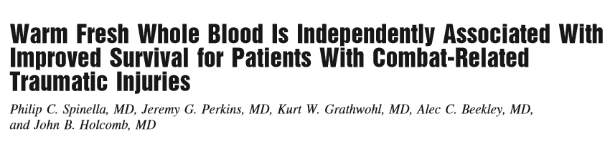


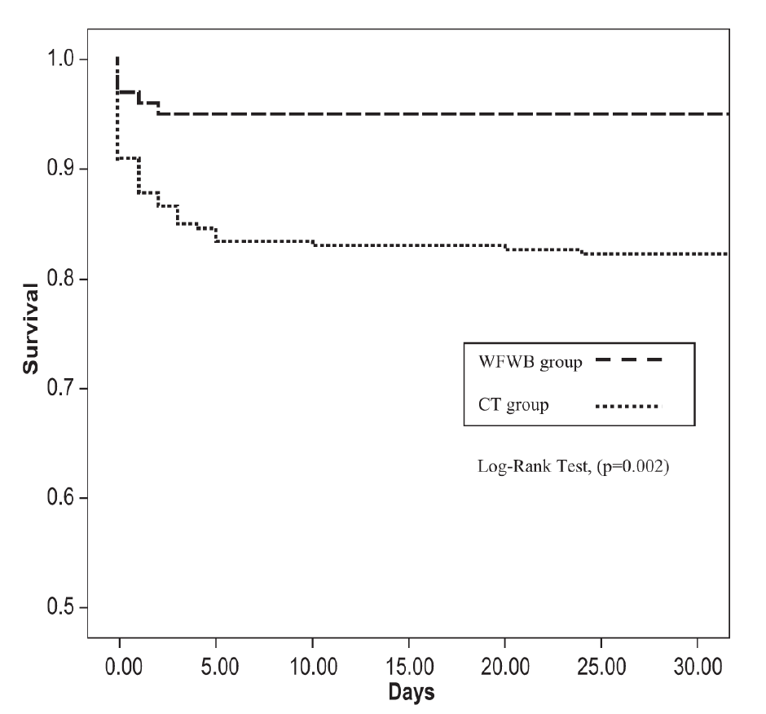
Just like Cinderella…what and when
24 hour survival
a.
HR = 0.26 (95% CI = 0.08 – 0.84, P=0.025)
  Time matters
  Product matters

Slide 43
L – Logistically feasible
T – Time tested
O – Organized (pre-screened donors)
W – Walking Blood Bank
B – Better Outcomes

Slide 44
L – Logistically feasible
T – Time tested
O – Organized (pre-screened donors)
W – Walking Blood Bank
B – Better Outcomes

Slide 45
No crossmatch required
One product as opposed to 2-3
HUGE demand in the deployed environment because of logistic feasibility
After fielding LTOWB, it has become the preferred transfusion therapy
Use increased 400%
Limited by supply

Slide 47
43% CT
35% WB
57% WB
65% CT
Notes:
When WB transfusions were graphed with all blood products used in resuscitation, we found that WB comprised a higher percentage of the total volume of resuscitation in OIR vs OFS (57% vs 35%).

Slide 48
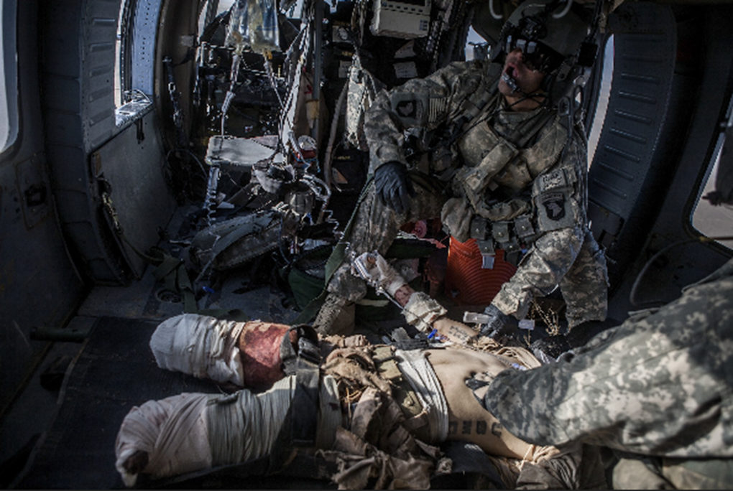
Logistical Benefits of CS-LTOWB (2017 CENTCOM)
  CS-LTOWB transfusions increased 400%
  Total number of products transfused rose 133%
Notes:
The benefits of CS-LTOWB are the likely reason for the large demand signal and the relatively high utilization ratio. CS-LTOWB provides the full spectrum of component therapy in one space efficient product. It also simplifies the resuscitative effort by not requiring special equipment or cross-matching, and it shortens time to transfusion, which may contribute to improved survival.

Slide 49
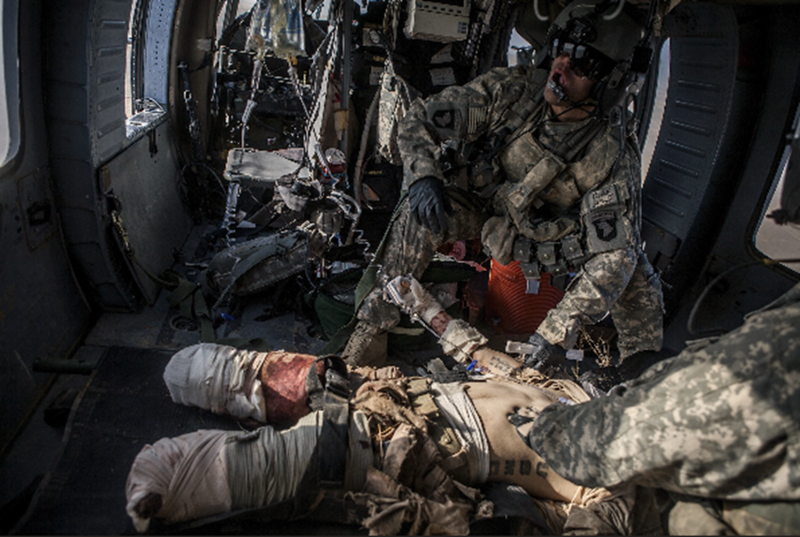
Low Titer Group O Whole Blood
Logistical Benefits in deployed setting
  CS-LTOWB simplifies the resuscitative effort and shortens time to transfusion
Notes:
The benefits of CS-LTOWB are the likely reason for the large demand signal and the relatively high utilization ratio. CS-LTOWB provides the full spectrum of component therapy in one space efficient product. It also simplifies the resuscitative effort by not requiring special equipment or cross-matching, and it shortens time to transfusion, which may contribute to improved survival.

Slide 50
Low Titer Group O Whole Blood
Logistical Benefits in deployed setting
  CS-LTOWB simplifies the resuscitative effort and shortens time to transfusion
  Further investigation is needed regarding:
  clinical outcomes of LTOWB
  Comparative effectiveness compared to CT and WFWB transfusions
  Complications of LTOWB
Notes:
The benefits of CS-LTOWB are the likely reason for the large demand signal and the relatively high utilization ratio. CS-LTOWB provides the full spectrum of component therapy in one space efficient product. It also simplifies the resuscitative effort by not requiring special equipment or cross-matching, and it shortens time to transfusion, which may contribute to improved survival.

Slide 51

Hi Five Time: Is LTOWB the Answer?

Slide 52
Warm Fresh Whole Blood
Used in combat zone for >17 years
  Limited supply of components
  No platelets at most Forward Surgical Teams
  Focused Empiricism → better outcomes
2002-2019 >10,700 WFWB transfused to 1836 patients

Slide 53
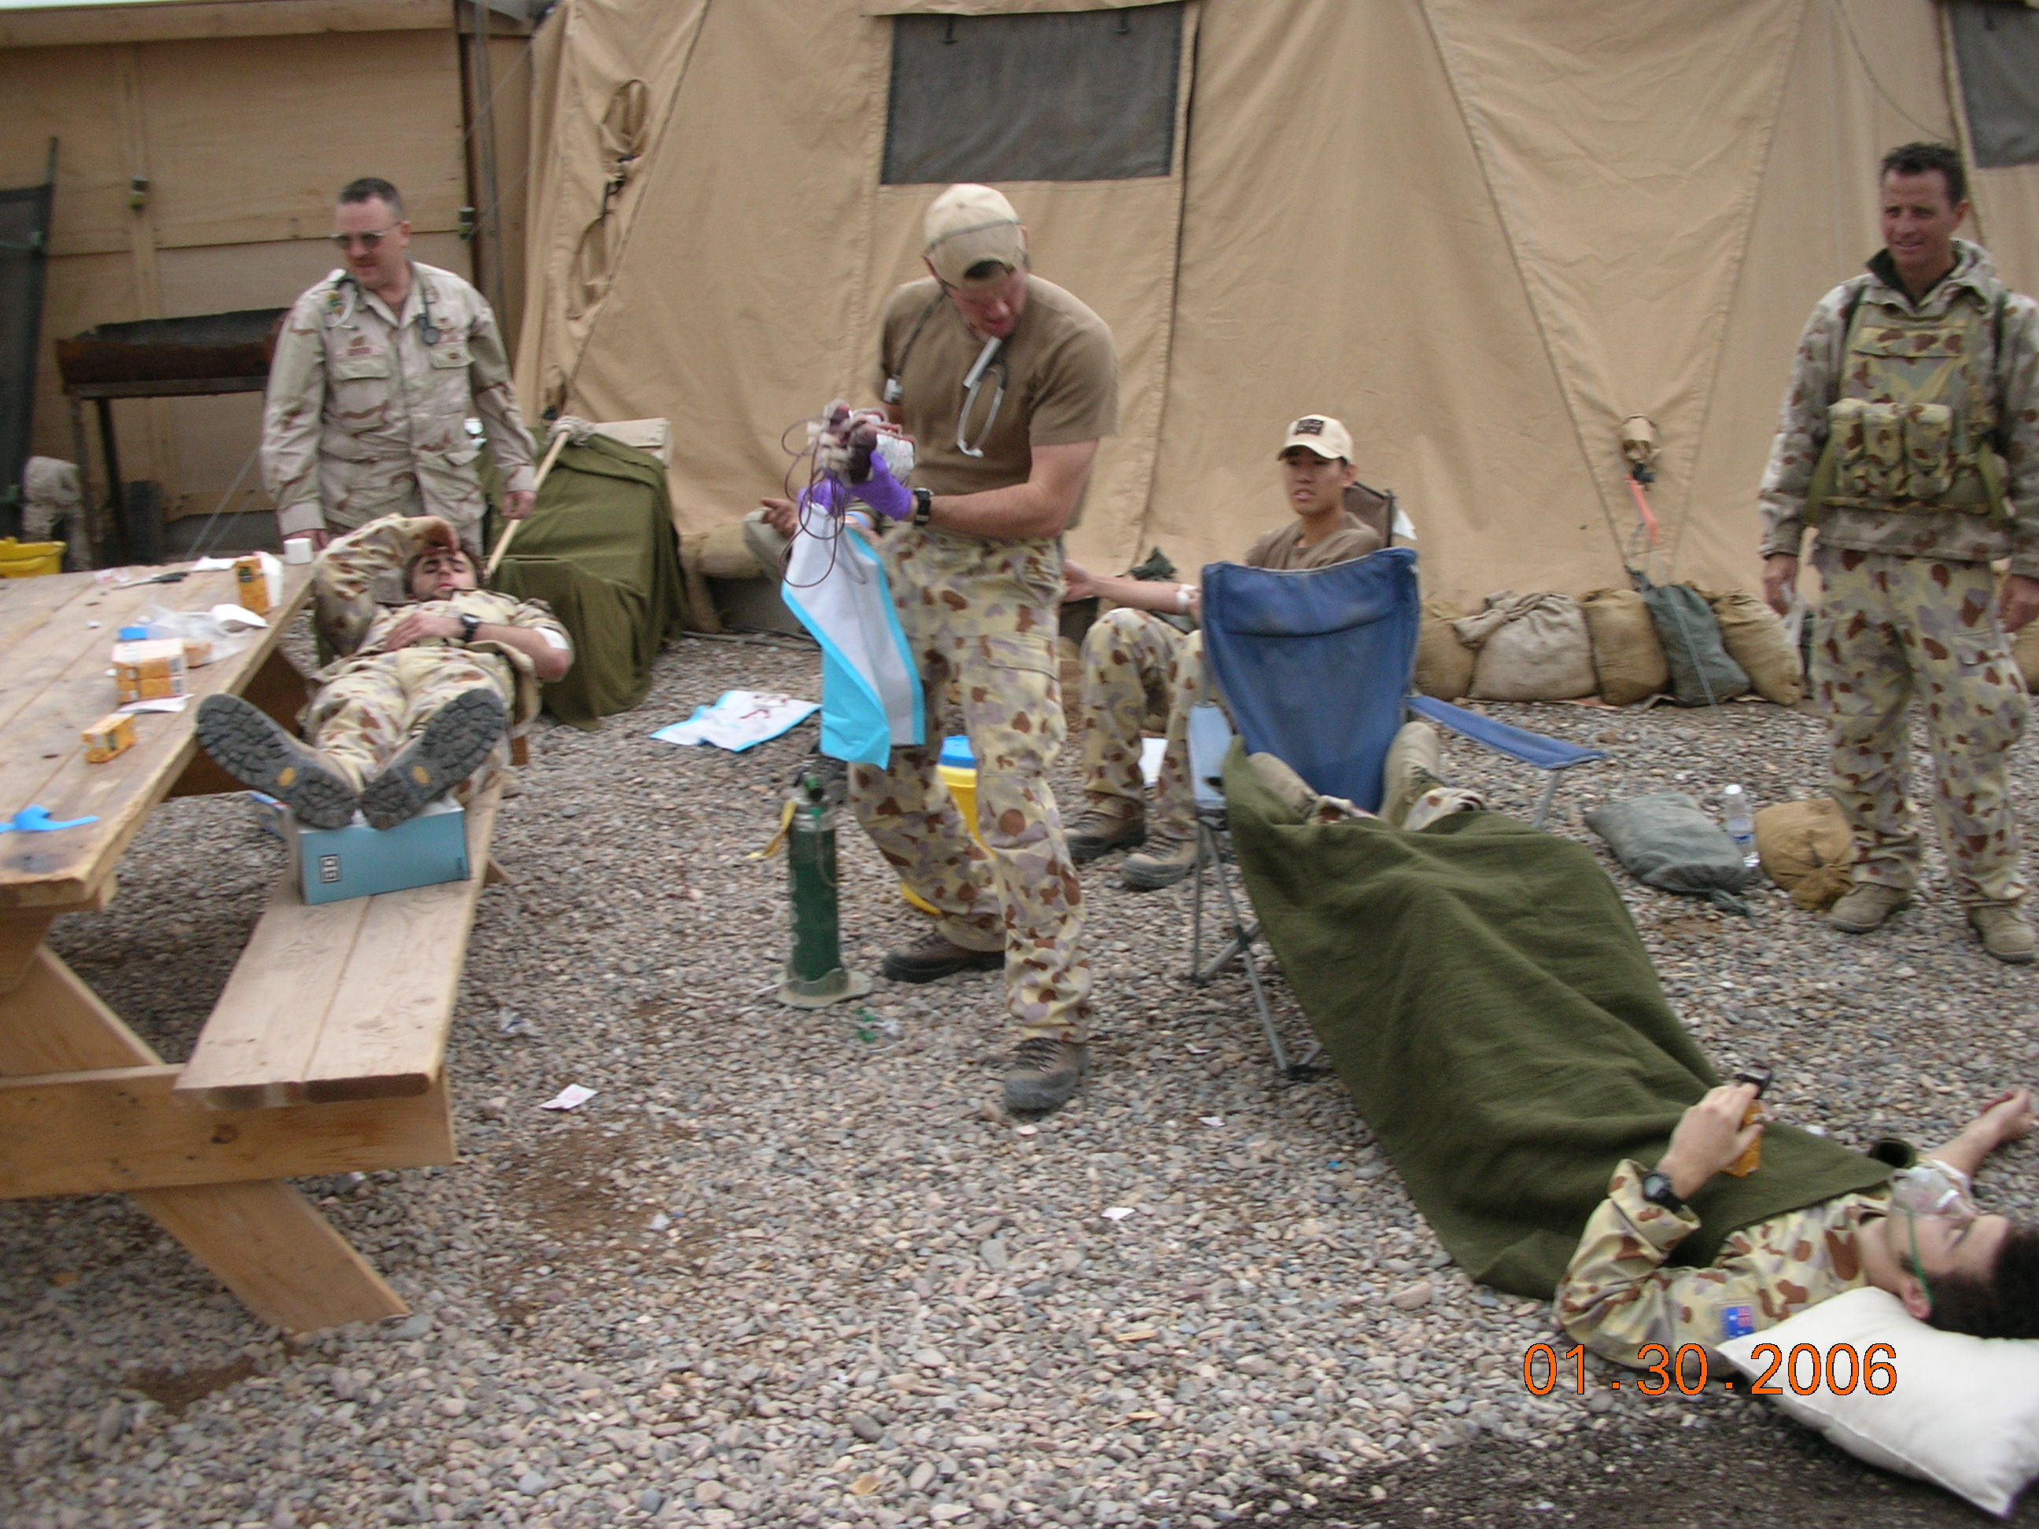

Slide 54
What’s New In Hemostatic Resuscitation
DCR CPG
Blood use in Combat Zone
Fresh Whole Blood Outcomes
It’s (all) about time
Notes:
AND DEATH OCCURS EARLY

Slide 55
Study Objective
To compare early survival after injury in combat casualties resuscitated with fresh whole blood (FWB) vs. no-FWB (red cells, plasma, platelets) after appropriate adjustment for immortal time bias and severity of injury and bleeding

Slide 56
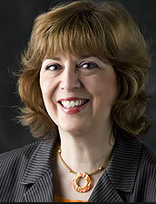

Methods
5 matching factors classified 221 FWB patients into 29 unique profiles / strata
884 no-FWB patients selected by identical matching to the profiles specified by the 29 strata
Analysis strategies:
  For mortality outcome: multi-level mixed model logistic regression with stratum as the random intercept to appropriately adjust for both matching and other co-variates
  For sum of blood products: Survivor-average casual effect (SACE) modeling with adjustment for matching factors and the severe head injury covariate using multiple logistic regressions
Notes:
In a similar analysis involving matching that we did in the PHT analysis – 5 matching factors profiled(or characterized) the 221 FWB patients into 29 unique strata
The 884 no-FWB patients were identically matched to the profiles specified by the 29 strata

Slide 57
Methods
Adult patients, battle or non-battle injured in Afghanistan from February 2008 to September 2014
>2 units of RBC-containing products
non-missing data
Excluded patients with >20% total body surface area burn
1,105 patients
221 FWB; 884 no-FWB frequency-matched to FWB
Retrospective study
Role 2 Database
Exposure: FWB vs component transfusion without FWB (no-FWB)
Notes:
Given this was at the Role 2 – or forward surgical team setting – platelets were rarely available about only about 11% of patients received platelets – in terms of plasma – the majority of patients that receive RBC received plasma….but the cohort was defined as FWB compared to no FWB in patients who received >2 units of RBC

Slide 58
Outcome Measures
Primary Outcome:
  Mortality within 6 hours of Role 2 admission
Secondary Outcomes:
  The total sum of RBC-containing transfusions
  Total sum of all blood product transfusions
Adjusted to be independent of any effect of
FWB on the competing risk of early (6 hr)
injury mortality due to hemorrhage
Notes:
SURVIVOR AVERAGE CAUSAL EFFECT MODELING – determines the effect of FWB on blood product consumption independent of FWB’s protective effet on early mortality.
Helps eliminate ‘confounding by indication’

Slide 59
FWB Patient Characteristics
 | n | %
Age, median (IQR) | 26 | (22, 30)
Gender
No. of patients without missing data | 220 | 99.5
Male | 217 | 98.2
Injury Typeª
Penetrating | 205 | 92.8
Other | 16 | 7.2
Head injuryª
Severe | 13 | 5.9
Moderate | 6 | 2.7
None | 202 | 91.4
Patient affiliationª
US military | 84 | 38.0
Other | 137 | 62.0
Tourniquet use | 103 | 46.6
Prehospital bloodª | 7 | 3.2
Notes:
ªMultilevel mixed-effects logistic regression adjusted simultaneously for the matching factors of injury type, patient affiliation, tourniquet use, prehospital blood, and hourly rate of unit RBC/FWB transfusion and for the covariate head injury assessed by maximum head abbreviated injury scale score or Glasgow coma scale when MAIS missing
^{b}Hourly rate of unit RBC/FWB transfusion was calculated as units of FWB or RBCs divided by patient Role 2 length of stay with a maximum length of stay of 6 hours. Hourly rate of unit RBC/FWB transfusion were examined in quartiles (Low, 0.33333 to <1.71429; Low-Medium, 1.71429 to <2.88462; High-Medium, 2.88462 to 4.90909; High, ≥4.90909)
^{c}Shock was defined as admission systolic blood pressure ≤90, admission pulse ≥120 or shock index ≥0.9
^{d}Dose was calculated as units of FWB divided by the total units of FWB and RBCs. Patients categorized as low dose received a dose <0.33, while high dose patients received a dose ≥0.33

Slide 60
FWB Patient Characteristics
 | n | %
Hourly rate of RBC-containing unit transfusions^{a, b}
Low (0.33 to <1.71 units per hr) | 59 | 26.7
Medium-Low (1.71 to <2.88 units per hr) | 62 | 28.1
Medium-High (2.88 to 4.91 units per hr) | 55 | 24.9
High (>4.91 units per hr) | 45 | 20.4
Shock^{c}
Yes | 143 | 64.7
No | 78 | 35.3
Dose of FWB
Low | 66 | 29.9
High | 155 | 70.1
Admission base deficit, median (IQR) | -7 | (-13, -4)
Median (IQR) MAIS score, median (IQR), n=132 | 3 | (2, 3)
Median (IQR) Injury severity score^{f}, median (IQR), n=132 | 9 | (5, 14)
Time from point of injury to Role 2 facility, median (IQR), n=113 | 60 | (35, 117)
Notes:
ªMultilevel mixed-effects logistic regression adjusted simultaneously for the matching factors of injury type, patient affiliation, tourniquet use, prehospital blood, and hourly rate of unit RBC/FWB transfusion and for the covariate head injury assessed by maximum head abbreviated injury scale score or Glasgow coma scale when MAIS missing
^{b}Hourly rate of unit RBC/FWB transfusion was calculated as units of FWB or RBCs divided by patient Role 2 length of stay with a maximum length of stay of 6 hours. Hourly rate of unit RBC/FWB transfusion were examined in quartiles (Low, 0.33333 to <1.71429; Low-Medium, 1.71429 to <2.88462; High-Medium, 2.88462 to 4.90909; High, ≥4.90909)
^{c}Shock was defined as admission systolic blood pressure ≤90, admission pulse ≥120 or shock index ≥0.9
^{d}Dose was calculated as units of FWB divided by the total units of FWB and RBCs. Patients categorized as low dose received a dose <0.33, while high dose patients received a dose ≥0.33

Slide 61
How is FWB vs. no-FWB Associated with Outcomes? adjusted for matching and severity of head injury
Outcome | Odds Ratio | 95% Cl |  | P value
6 hour mortality (7% vs 21%) | 0.27 | 0.13 | 0.58 | 0.001
Subgroup with severe head injury | 0.07 | 0.004 | 1.26 | 0.072
Subgroup w/o severe head injury | 0.35 | 0.15 | 0.79 | 0.011
Low Dose of FWB (<33% of all RBCs) | 0.73 | 0.28 | 1.89 | 0.515
High Dose FWB (>33% of all RBCs) | 0.14 | 0.04 | 0.51 | 0.003
Subgroup adjusted for 13 covariates | 0.15 | 0.03 | 0.78 | 0.024
Sum total of RBC-containing units in those predicted to survive >6 hrs regardless of Rx | Did not differ, FWB group median=12 |  |  | 0.426
Sum total of all blood product units in those predicted to survive >6 hrs regardless of Rx | Did not differ, FWB group median=17 |  |  | 0.685
Notes:
These results from the adjusted analyses estimate the effect of FWB vs. RBC transfusion on the study outcomes of interest.
The 6 hour overall mortality was 7% or 15/221 in the group transfused FWB vs. an estimated 21% or 186/884 in the group transfused RBCs. The odds ratio suggests a highly significant protective effect.
FWB had a stronger protective effect against 6 hour mortality in the subgroup with severe head injury compared with the subgroup without severe head injury, although the difference between the two subgroups was not significant (p=0.129, not shown in the table). WFWB group was significantly associated with reduced mortality for trauma patients without severe head injury (adjusted OR=0.35)
A resuscitation regimen including WFWB may also have the potential to benefit trauma patients with severe head injury (adjusted OR=0.07, 95% CI 0.004-1.26).
This strong association, albeit not statistically significant, requires additional investigation
Relative to RBC transfusion, FWB showed a significant dose-response effect. Patients who received FWB for >33% of their RBC-containing transfusions had a significantly greater reduction in mortality (OR=0.14) than patients who received FWB for <= 33% of their RBC-containing units (OR=0.73).
In the adjusted analysis of the subset of 68 FWB patients and 354 RBC patients who had nonmissing values on 13 instead of just 6 covariates, the OR was even more protective against 6 hour mortality (0.15 vs. 0.27).
In red are the results for the secondary outcomes, the sum totals of unit transfusions, adjusted by survivor-average causal effect modeling. There were no between-group differences for either RBC-containing units or all blood products combined in the patients predicted to survive >6 hours regardless of FWB or RBC transfusion.

Slide 62
Conclusions
FWB is associated with significantly reduced 6-hour mortality in combat casualties.
FWB was not significantly associated with the sum of total blood product transfusions in analyses appropriately adjusted for FWB’s strong protective effect on the competing effect of early mortality.
Notes:
**OR 0.27 / or 0.15 when adjusted for 13 co-variates; both has statistical significant. Given this was a retrospective observational study…not an RCT it is challenged to support causality. We attempted to strengthen the association by systematically testing the ‘alternative hypotheses’ (other explanations) for the observed association which were impressive favoring WB for survival.
**We used SURVIVOR AVERAGE CAUSAL EFFECT MODELING to determined the effect of FWB on blood product consumption independent of FWB’s protective effect on early mortality…..sooooooo If we had not used SACE (survivor average causal effect) modeling our results would have looked like FWB substantially increased blood product consumption because FWB saved the lives of the highest risk bleeding patiwns who needed a lot of blood transfusions whereas their matched high-risk counterparts who did not receive FWB died before they could get enough transfusions.
Mark Yazer described it as “confounding by indication”….the SACE modeling accounts (and controls) for this.

Slide 63
Military Use of WB in
Deployed Environment
CS-LTOWB
WFWB
WFWB improves 6 hour outcomes
Outcomes needed for CS-LTOWB
Demand signal for CS-LTOWB is high
ASBP continues to support and increase supply

Slide 64
What’s New In Hemostatic Resuscitation
DCR CPG
Blood use in Combat Zone
Fresh Whole Blood outcomes
It’s (all) about time
Notes:
AND DEATH OCCURS EARLY

Slide 65
Why 6-hour mortality endpoint?

Slide 66
Why 6-hour mortality endpoint?
Clinically important time point for hemorrhage-related deaths
Accounted for 83% of deaths among Role 2 patients
Improved transfusion rate approximation as follow-up time ended at 6 hours instead of 24 hours.
Is 4 hours more clinically relevant??

Slide 67

Death from Hemorrhage Occurs Early
Early transfusion saves lives
  MINUTES MATTER

Slide 68
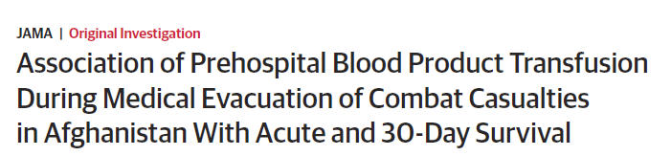
“Among medically evacuated US military combat causalities in Afghanistan, blood product transfusion prehospital or within minutes of injury was associated with greater 24-hour and 30-day survival than delayed transfusion or no transfusion.”
Shackelford et al JAMA 2017
Notes:
This is a study that was published in JAMA in 2017 that shows the importance of EARLY blood transfusion.

Slide 69
Death from Hemorrhage -- EARLY
Must start resuscitation early!!!
MINUTES MATTER
Notes:
Combat casualties

Slide 70
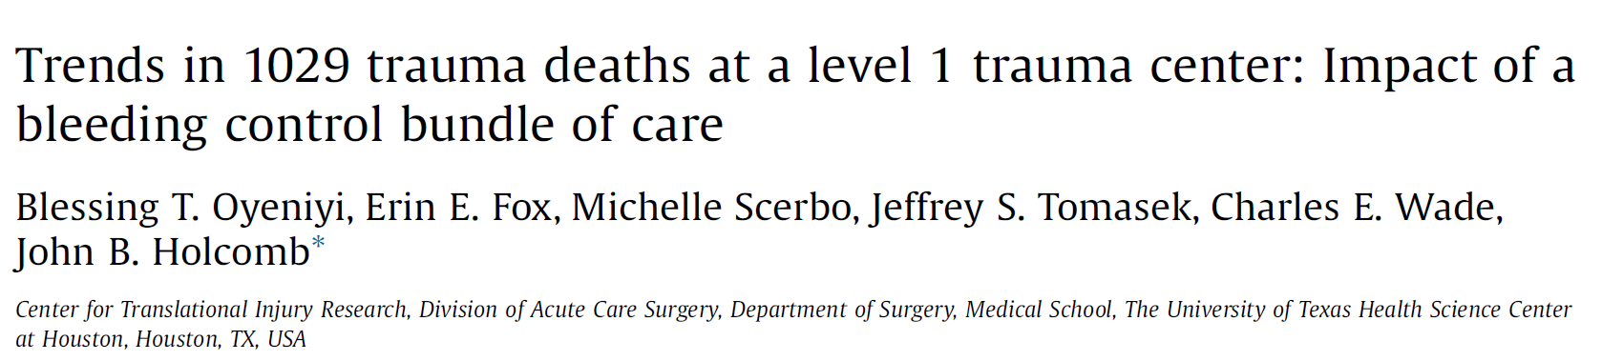
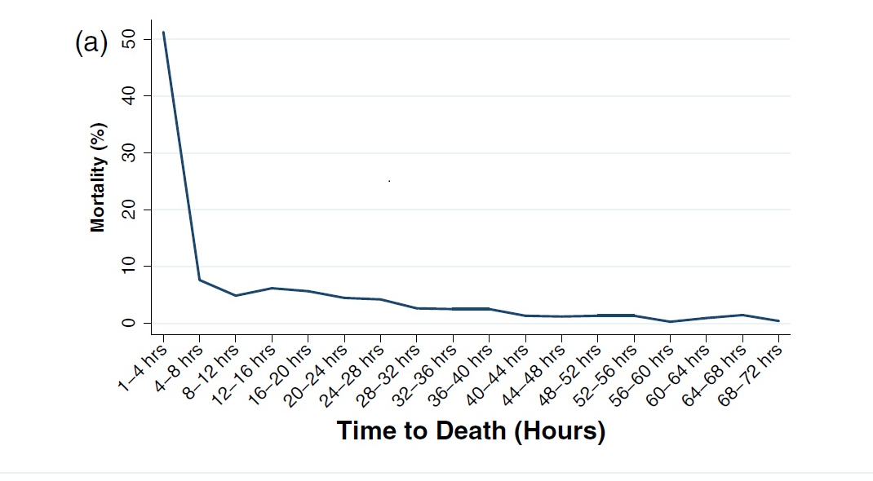
Injury 2016
Median time to Hem death = 1.65 hours

Slide 71
JTS Data on PFC - Unpublished
How long can evacuation time be safely delayed
in US Military casualties?

Slide 72
24 hour survival from time of injury:
72% of the deaths occurred within the first hour after injury
95% occurred within 4 hours after injury
US military survival cohort
n=5,269
Notes:
This Kaplan Meier survival curve followed all 5,269 US military casualties for the 1st 24 hours from the time of injury. 72% of the total deaths within 24 hours occurred within the 1st hour, and 95% occurred within 4 hours after injury.

Slide 73
30 day survival from time of injury:
764 deaths occurred within 30 days of injury (14% of 5269)
94% occurred within 24 hours after injury
US military survival cohort
n=5,269
Notes:
Of the total 734 deaths that occurred within 30 days of injury (14% of 5,269), 94% occurred within the 1st 24 hours after injury. Thereafter, survival declined very gradually with only a few deaths until the curve virtually flattened by day 7.

Slide 74
< 1 hour delay associated with 24 hour survival
Survival analysis: evacuation delays associated with 24h survival
When hospital care began within one hour of injury → 60% reduction in mortality
Adjusted for age and ISS (assigned by AFMES for decedents)
US military survival cohort
n=5,269
Notes:
We next ran Cox survival analyses to evaluate how evacuation delays were associated with 24 hour survival. Evacuation (prehospital) times were divided into quintiles, and we tested successive quintile contrasts. Shown here is the comparison of quintile #1, evacuation delays <= 1 hour after injury, with all 4 subsequent quintiles (2-5). This is the only quintile contrast that resulted in a significant between-group difference. Patients whose hospital care began within 1 hour of injury had a 60% reduction in mortality relative to patients with longer evacuation delays.

Slide 75
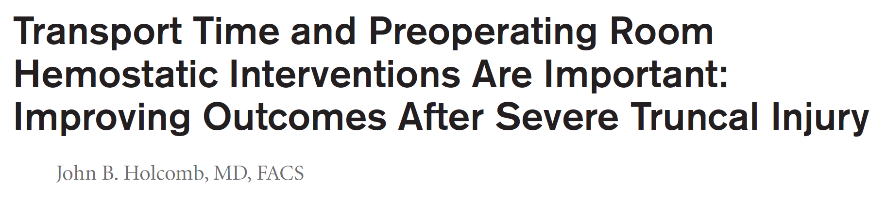
At minute
128
55
28
900
800
Adjusted for age and ISS (assigned by AFMES for decedents)
The Consistent Curve
of Death and Potential for Improved Survival
700
600
500
Rate of Deaths (number/min)
400
300
200
Minutes Matter!
100
0
0
50
100
150
200
250
300
Time (min)
Notes:
Minutes matter….time is the enemy

Slide 76
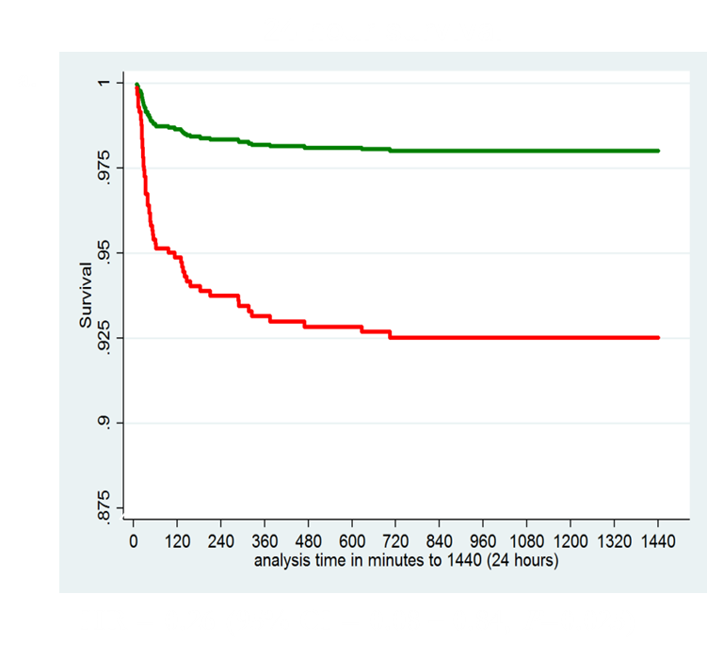
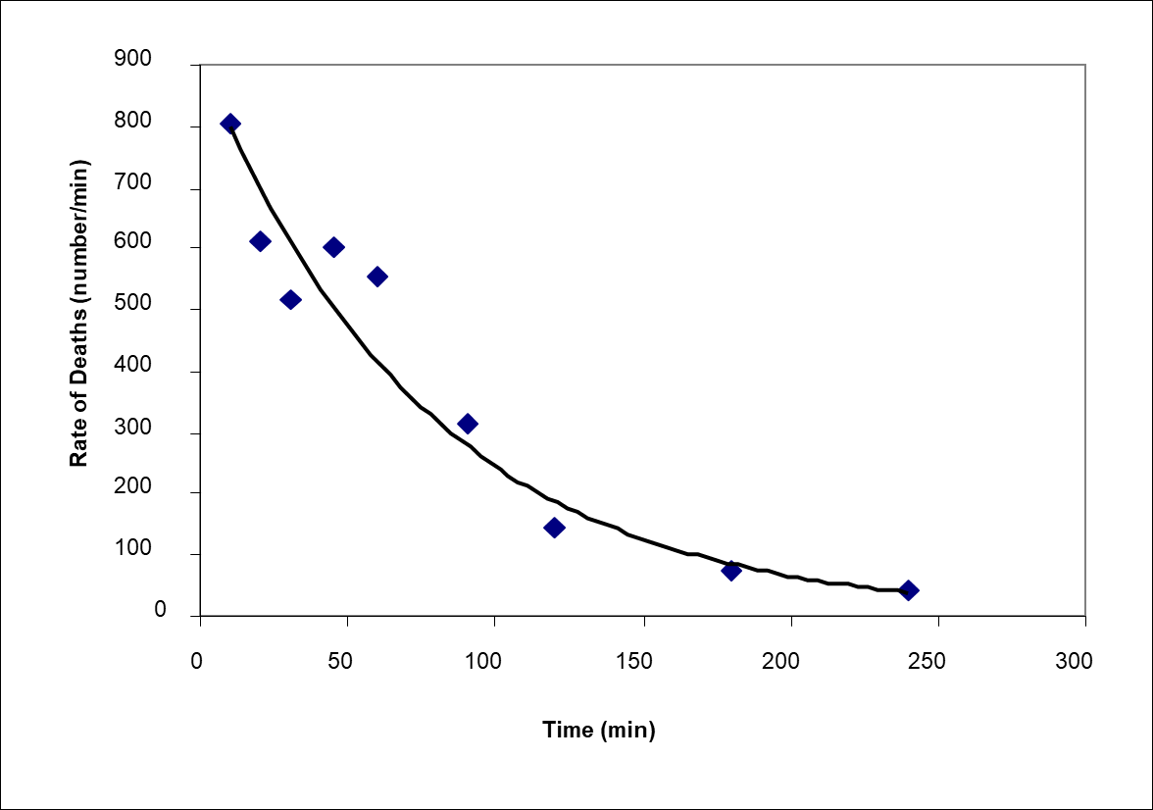
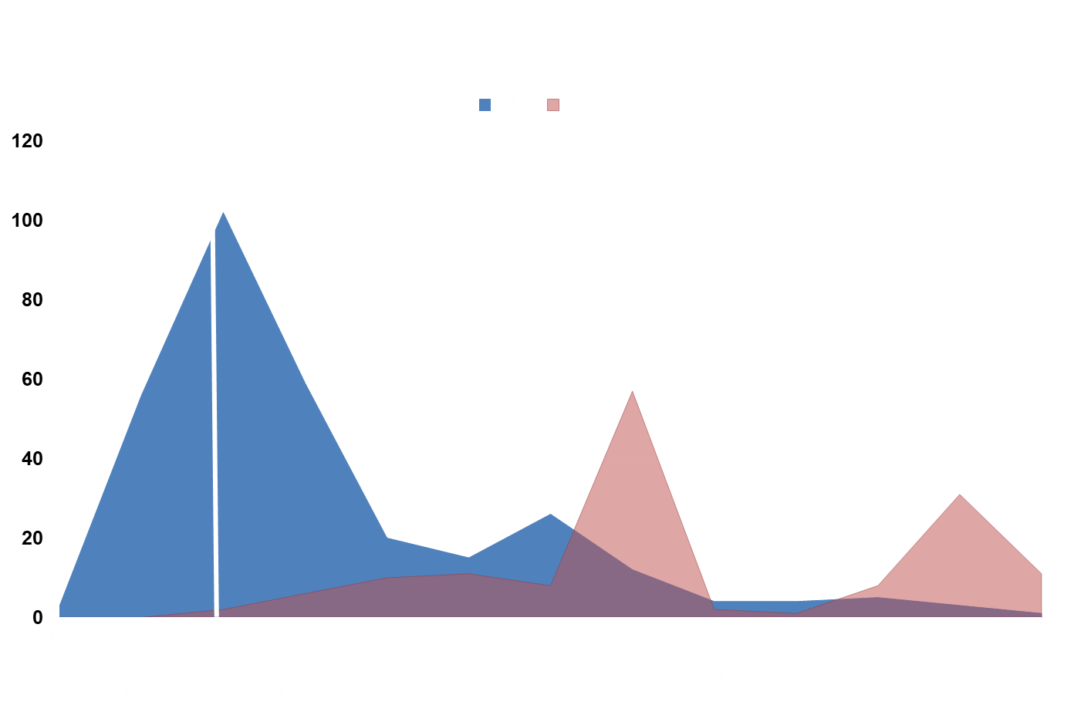
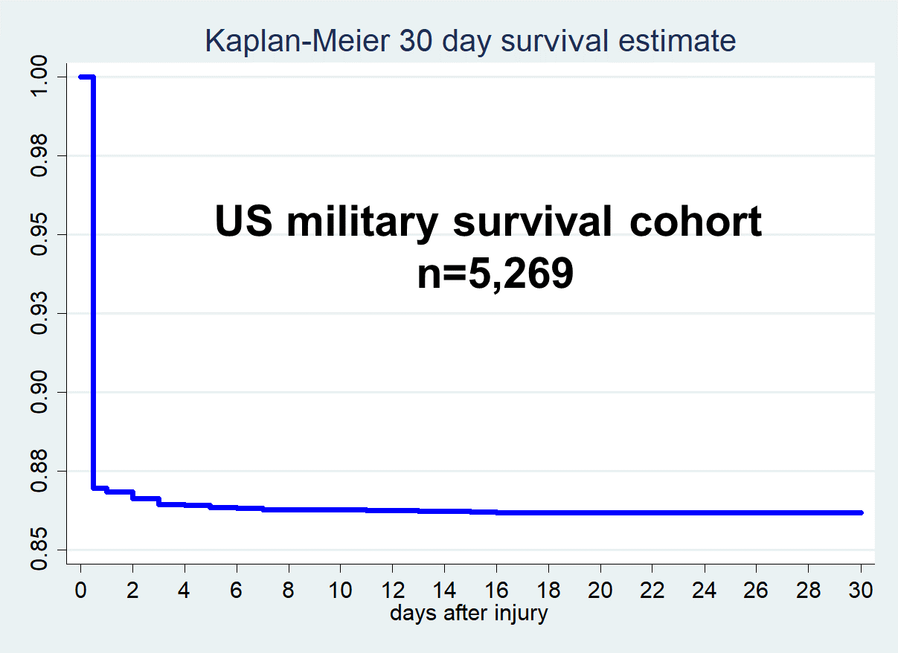
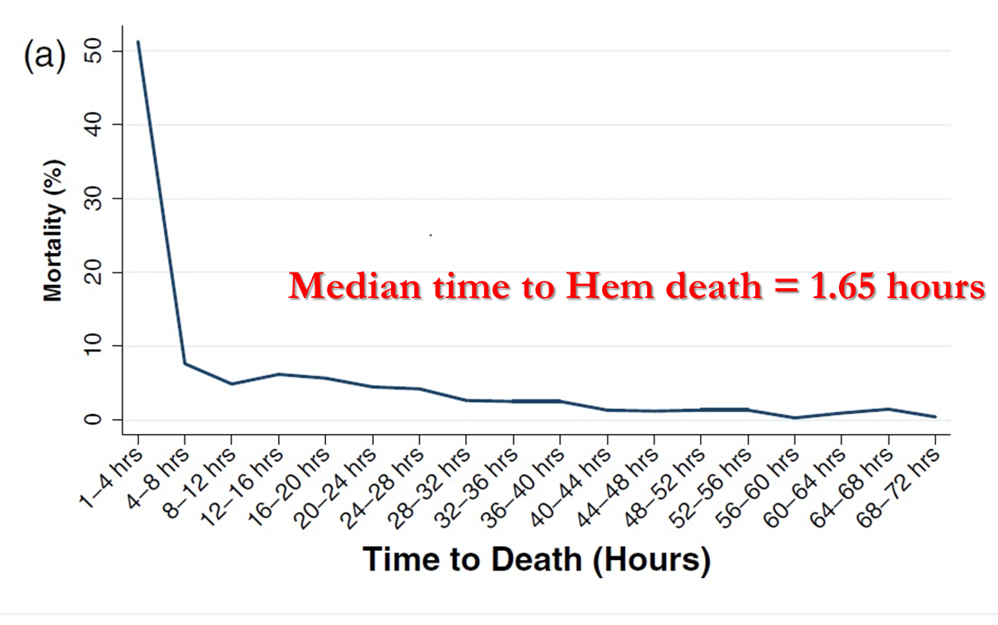
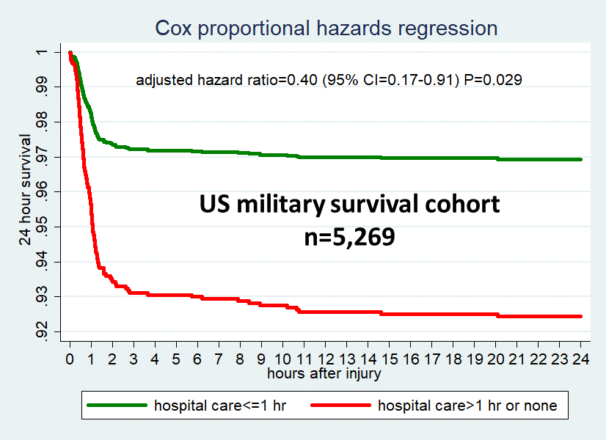
MINUTES MATTER…DEATH OCCURS EARLY!
Notes:
So….no matter which curve you are looking at -- INTERVENTIONS NEED TO OCCUR EARLY
Time Matters
AND DEATH OCCURS EARLY – within 4-6 hours….

Slide 77
CONCLUSIONS
DCR paradigm should continue to evolve
LTOWB is logistically preferable to CT
NEED OUTCOMES for blood products!
TIME is important and research should focus on ‘time extenders’
Notes:
AND DEATH OCCURS EARLY

Slide 78

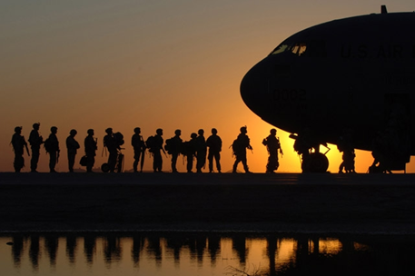
Thank you

Slide 79
Limitations
A retrospective cohort design cannot overcome unmeasured, potentially important confounding variables (e.g., more specific indications and contraindications for pre-hospital or FWB transfusion).
Missing data values, especially for pre-hospital patient characteristics, diagnostic assessments, injury occurrence and intervention time stamps, and longer-term outcomes (including complications) remain a challenge.
Notes:
FOR BOTH ANALYSIS

Slide 80
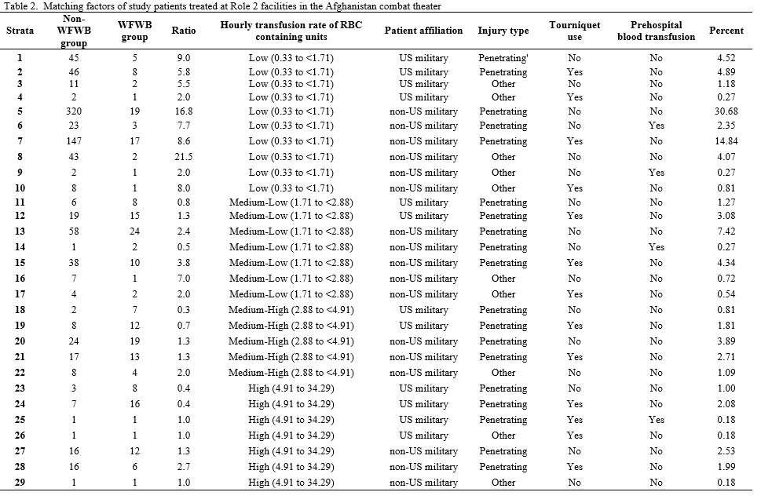
Frequency matching
Notes:
Numbers aren’t important here. Just talk about how we used frequency matching which is better better because patients are identically matched instead of approximately matched. The table can give them an idea of what the risk profiles look like.

Slide 81
Methods- Cox regression
Assumed whole blood start time (time-dependent covariate)
  Not available in dataset or after record review
  Assumed start time= 25% of the way through their Role 2 length of stay
  Then increased the assumed start-time in 1% increments
Stratified: matched groups
Adjustments: severity of head injury, average hourly transfusion rate of RBC-containing units
Separate sensitivity analysis: restricted to matching Non-WFWB group patients who received platelets
Proportional-hazards assumption tested using Schoenfeld residuals and log-log plots

Slide 82
Cox regression
When assuming the start of WFWB was delayed until WFWB group patients had completed 25% of Role 2 stay, the association remained significant (HR=0.21, 95% CI=0.10-0.46, P<0.01)
Findings remained consistent until the assumed WFWB delay was increased to 41%
221 WFWB group patients versus 119 matched Non-WFWB group counterparts who received platelets
  6 hour mortality was still decreased in the WFWB group, though not statistically significant given the smaller sample size
  HR=0.42, 95% CI=0.14-1.25, P=0.118

Slide 83
….and Lessons Re-Learned
Notes:
But….TQ are relative new….and not everyone knows how to use them, right?

Slide 84
Exposure
Table 1. Definitions of exposure and non-exposure study groups
Name | Receipt of warm fresh whole blood? | Receipt of plasma, cryoprecipitate, or apheresis-collected platelets? | Receipt of red blood cells?
WFWB group | Yes | Possiblyª | Possiblyª
Non-WFWB group | No | Possibly | Yes
ªThirteen of 221 WFWB group recipients received only WFWB and no plasma, cryoprecipitate, apheresis-collected platelets, or red blood cells

Slide 85
How is WFWB vs. non-WFWB Associated with Outcomes? adjusted for matching and severity of head injury
Outcome | Odds Ratio | 95% Cl |  | P value
6 hour mortality (7% vs 21%) | 0.27 | 0.13 | 0.58 | 0.001
Subgroup with severe head injury | 0.07 | 0.004 | 1.26 | 0.072
Subgroup w/o severe head injury | 0.35 | 0.15 | 0.79 | 0.011
Low Dose of FWB (<33% of all RBCs) | 0.54 | 0.22 | 1.34 | 0.18
High Dose FWB (>33% of all RBCs) | 0.12 | 0.04 | 0.38 | <0.01
Subgroup adjusted for 13 covariates | 0.15 | 0.03 | 0.78 | 0.024
Sum total of RBC-containing units in those predicted to survive >6 hrs regardless of Rx | Did not differ, FWB group median=13 |  |  | 0.43
Sum total of all blood product units in those predicted to survive >6 hrs regardless of Rx | Did not differ, FWB group median=21 |  |  | 0.69
Notes:
These results from the adjusted analyses estimate the effect of FWB vs. RBC transfusion on the study outcomes of interest.
The 6 hour overall mortality was 7% or 15/221 in the group transfused FWB vs. an estimated 21% or 186/884 in the group transfused RBCs. The odds ratio suggests a highly significant protective effect.
FWB had a stronger protective effect against 6 hour mortality in the subgroup with severe head injury compared with the subgroup without severe head injury, although the difference between the two subgroups was not significant (p=0.129, not shown in the table)
Relative to RBC transfusion, FWB showed a significant dose-response effect. Patients who received FWB for >33% of their RBC-containing transfusions had a significantly greater reduction in mortality (OR=0.14) than patients who received FWB for <= 33% of their RBC-containing units (OR=0.73).
In the adjusted analysis of the subset of 68 FWB patients and 354 RBC patients who had nonmissing values on 13 instead of just 6 covariates, the OR was even more protective against 6 hour mortality (0.15 vs. 0.27).
In red are the results for the secondary outcomes, the sum totals of unit transfusions, adjusted by survivor-average causal effect modeling. There were no between-group differences for either RBC-containing units or all blood products combined in the patients predicted to survive >6 hours regardless of FWB or RBC transfusion.

Slide 86
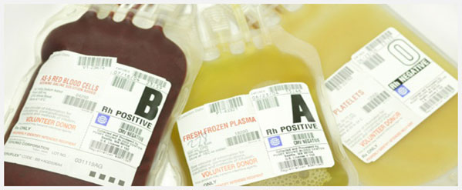
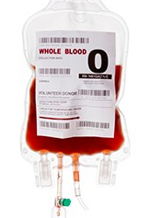

Component Therapy vs. Whole Blood
Component Therapy:
680 mL RBC unit + PLT
unit + FFP unit + Cryo unit
  RBC concentration: 29%
  Platelets: 80,000
  Coagulation factors: 65%
Whole Blood:
500 mL, single WB unit
  RBC concentration: 38-50%
  Platelets: 150,000-400,000
  Coagulation factors: 100%
Notes:
Volume and Concentrations Between Component Therapy vs. Warm Whole Blood
Also…there is 3 times the volume of anticoagulant and additives with reconstituted whole blood from components compared to whole blood

Slide 87
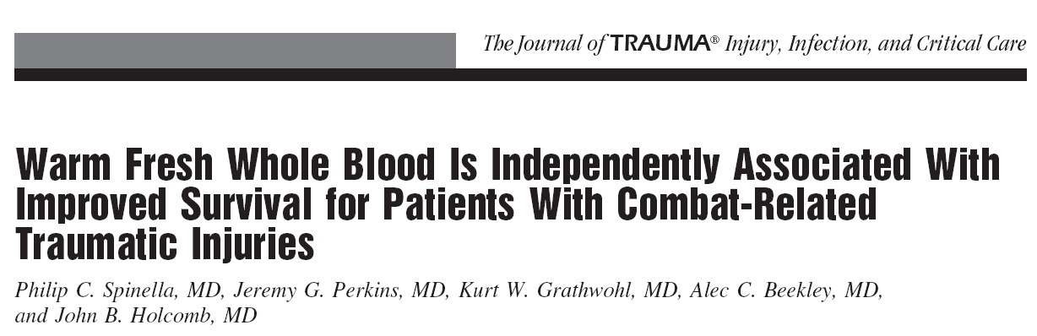
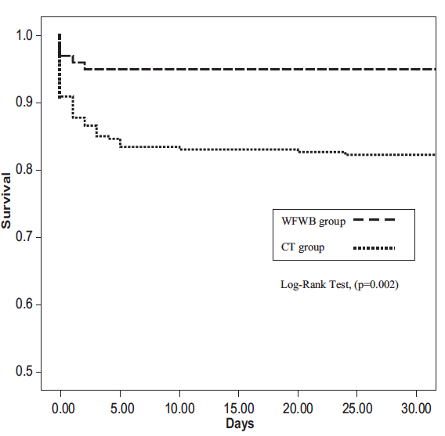
WHOLE BLOOD
100 WB patients (Fresh,Type-Specific) vs 254 CT controls
7.4 vs 9.3 L Blood Product
1.7 vs 2.5 L citrate/additive Survival 95% vs 82%
OR WB 12.4 (p=0.001)

Slide 88
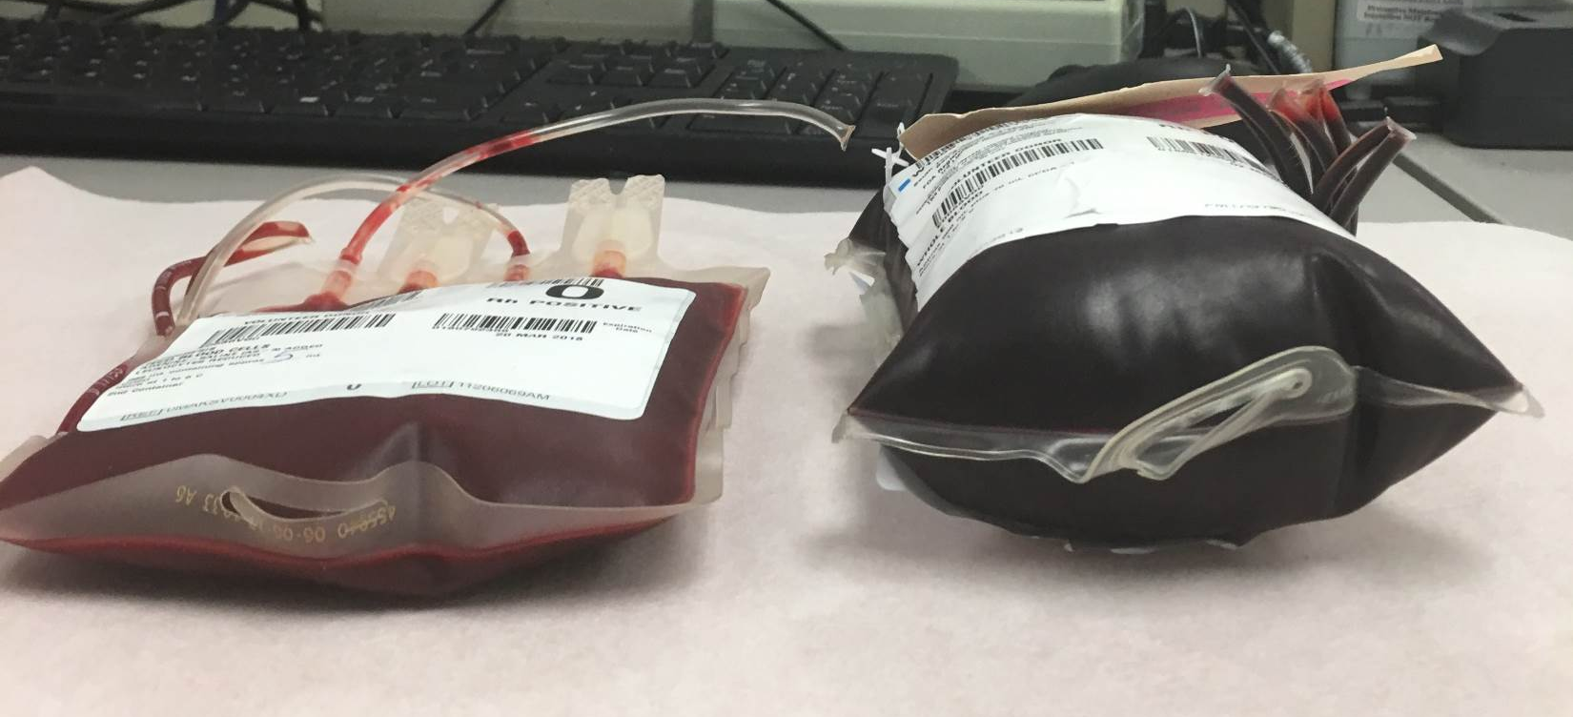
RBC’s vs. Whole Blood

Slide 89

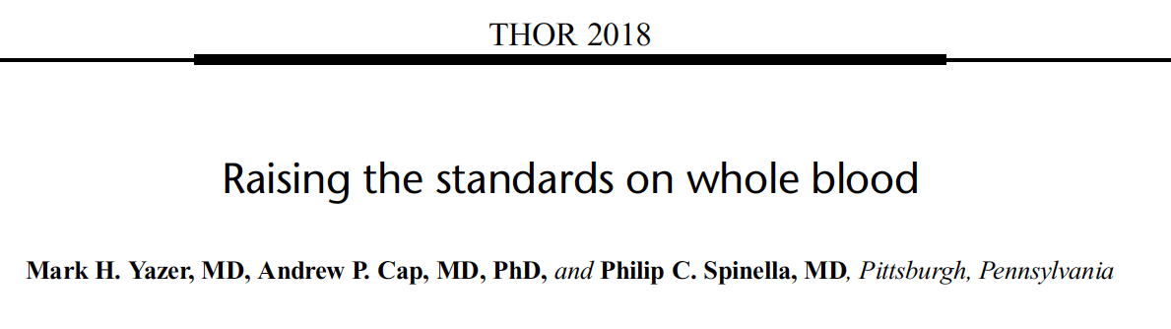

Why really transfuse Whole Blood…..
you only have to see the results once
Notes:
Selection of Compatible Blood and Blood Components for Transfusion
Recipients shall receive
ABO group-compatible Red Blood Cell components
ABO group-specific Whole Blood
Low titer group O Whole Blood (for non group O or for recipients whose ABO group is unknown)

Slide 90
>1-1.5hr delay associated with survival between >1 - 24 hrs
US military survival cohort
n=5,269
Notes:
For evacuation delays only 1-30 minutes longer, mortality was not significantly reduced. As you can see in this graph that uses the exact same scales on the X and Y axes as the previous graph, there were far fewer deaths after the 1st hour post-injury, which dramatically decreased the statistical power to detect a significant between-group difference. Similarly, there were no significant between-group differences for any of the other quintiles (i.e., >1-4, >4- 6, >6-9, >9-23 hours post-injury) relative to longer delays.

Slide 91
>1-1.5hr delay associated with survival between >1 - 24 hrs
US military survival cohort
n=5,269
Notes:
For evacuation delays only 1-30 minutes longer, mortality was not significantly reduced. As you can see in this graph that uses the exact same scales on the X and Y axes as the previous graph, there were far fewer deaths after the 1st hour post-injury, which dramatically decreased the statistical power to detect a significant between-group difference. Similarly, there were no significant between-group differences for any of the other quintiles (i.e., >1-4, >4- 6, >6-9, >9-23 hours post-injury) relative to longer delays.

Slide 92
Notes:
Why LOTWB is logistically feasible….look at the ratios

