Slide 1
DEBATE
Does the benefit of PRT for outweigh the effects on platelet count and function for severely bleeding patients?
Heather Pidcoke, MD, MSCI, PhD
Chief Medical Research Officer, OVPR
Associate Director, Research, TMI
Colorado State University
H.Pidcoke@Colostate.edu

Slide 2
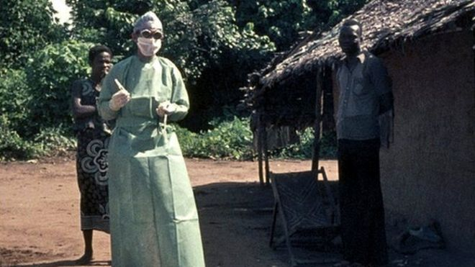
What are the risks?
 | YEAR | LOCATION | FATALITIES | CASE FATALITY RATE (%)
 | 1976 | Democratic Republic of Congo | 280 | 88
 | 1976 | Sudan | 151 | 53
 | 1977 | Democratic Republic of Congo | 1 | 100
 | 1979 | Sudan | 22 | 65
 | 1994 | Gabon | 31 | 60
 | 1994 | Cote d'Ivoire | 0 | 0
 | 1995 | Democratic Republic of Congo | 254 | 81
 | 1996 | Gabon | 21 | 68
 | 1996 | Gabon | 45 | 75
 | 1996 | South Africa | 1 | 100
 | 2000 | Uganda | 224 | 53
 | 2001 | Gabon | 53 | 82
 | 2001 | Congo | 44 | 75
 | 2003 | Congo | 128 | 90
 | 2003 | Congo | 29 | 83
 | 2004 | Sudan | 7 | 41
 | 2005 | Congo | 10 | 83
 | 2007 | Democratic Republic of Congo | 187 | 71
 | 2007 | Uganda | 37 | 25
 | 2008 | Democratic Republic of Congo | 14 | 44
 | 2011 | Uganda | 1 | 100
 | 2012 | Uganda | 17 | 71
 | 2012 | Uganda | 4 | 57
 | 2012 | Democratic Republic of Congo | 29 | 51
 | 2014 | Democratic Republic of Congo | 49 | 74
 | 2014 | Guinea | 1607 | 62
 | 2014 | Sierra Leone | 2582 | 29
 | 2014 | Liberia | 3384 | 43
 | 2014 | Nigeria | 8 | 40
 | 2014 | Senegal | 0 | 0
 | 2014 | United States | 4 cases, 1 death
 | 2014 | Spain | 1 case, 0 deaths
 | 2014 | Mali | 8 cases, 6 deaths

Slide 3
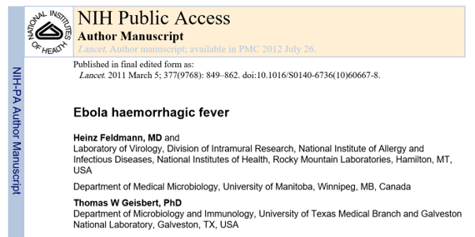
What are the risks?
 | YEAR | LOCATION | FATALITIES | CASE FATALITY RATE (%)
 | 1976 | Democratic Republic of Congo | 280 | 88
 | 1976 | Sudan | 151 | 53
 | 1977 | Democratic Republic of Congo | 1 | 100
 | 1979 | Sudan | 22 | 65
 | 1994 | Gabon | 31 | 60
 | 1994 | Cote d'Ivoire | 0 | 0
 | 1995 | Democratic Republic of Congo | 254 | 81
 | 1996 | Gabon | 21 | 68
 | 1996 | Gabon | 45 | 75
 | 1996 | South Africa | 1 | 100
 | 2000 | Uganda | 224 | 53
 | 2001 | Gabon | 53 | 82
 | 2001 | Congo | 44 | 75
 | 2003 | Congo | 128 | 90
 | 2003 | Congo | 29 | 83
 | 2004 | Sudan | 7 | 41
 | 2005 | Congo | 10 | 83
 | 2007 | Democratic Republic of Congo | 187 | 71
 | 2007 | Uganda | 37 | 25
 | 2008 | Democratic Republic of Congo | 14 | 44
 | 2011 | Uganda | 1 | 100
 | 2012 | Uganda | 17 | 71
 | 2012 | Uganda | 4 | 57
 | 2012 | Democratic Republic of Congo | 29 | 51
 | 2014 | Democratic Republic of Congo | 49 | 74
 | 2014 | Guinea | 1607 | 62
 | 2014 | Sierra Leone | 2582 | 29
 | 2014 | Liberia | 3384 | 43
 | 2014 | Nigeria | 8 | 40
 | 2014 | Senegal | 0 | 0
 | 2014 | United States | 4 cases, 1 death
 | 2014 | Spain | 1 case, 0 deaths
 | 2014 | Mali | 8 cases, 6 deaths
Conclusions
“Substantial progress has been made during past decades in the understanding of the biology and pathogenesis of Ebola virus infections in vitro and in vivo.”
“Substantial progress has also been achieved in the development of countermeasures, with rapid diagnostics being implemented in developed settings and with some promising therapeutics and vaccine candidates having entered or being close to entering clinical trials.”
“Promising therapeutics and vaccines need to be moved forward into clinical trials, and provision needs to be made for emergencies... …we urgently need strategies, financial support, and political will to bring these developments to the populations of endemic areas in equatorial Africa…”

Slide 4
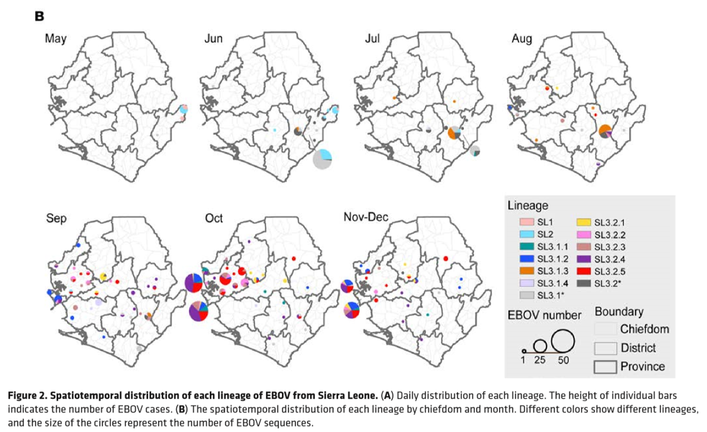
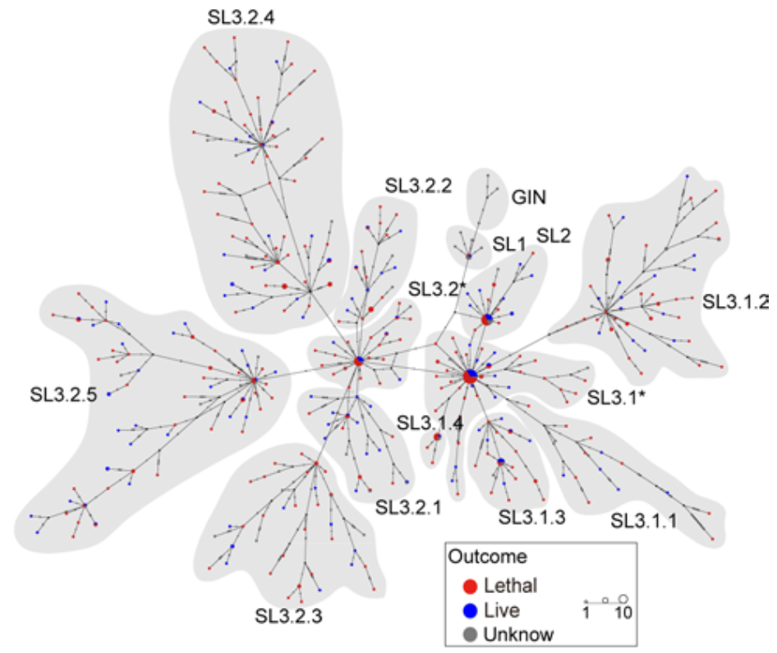
What are the risks?
Ebola – evidence for mutation
Median-joining haplotype network for the EBOV sequences

Slide 5
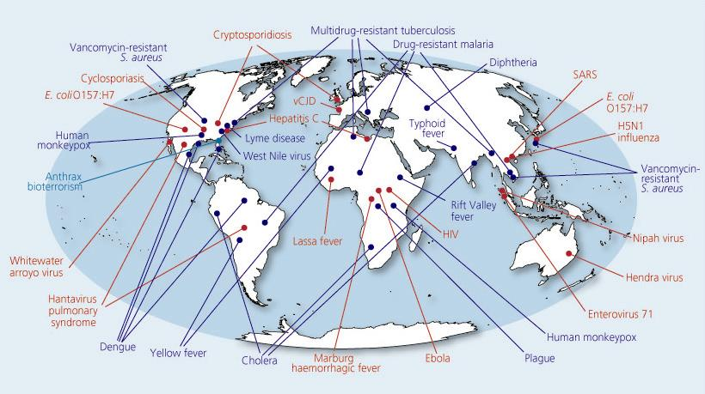
Safety of Blood Transfusion is a Global Problem ~ 5 New Viruses Discovered Each Year
Kindly shared by Dr. Larry Corash
BABESIA
MERS
SFTS
Yellow Fever
ZIKA
PLASMODIA
DENV
CHIKV
TRYPANOSOMES
Adapted from Morens DM. Nature. 2004;430:242–9.

Slide 6
Emerging Pathogens: Rate of emergence and spread
Kindly shared by Dr. Larry Corash
$300
Babesia
Zika
$250
HIV-HCV NAT
WNV NAT
T.Cruzi
Future:
Widespread Leukoreduction
$200
Yellow Fever
Chikungunya
Dengue
Plasmodium
SFTS virus
Others…
Cost per unit
HIV-1 p24
$150
HCV 1
HIV-1/2,
HCV
HIV-1 Ab
HBcALT
Bacterial Detection
AABB Rule 5.1.5.1
HTLV
$100
Diversion pouch
1985
1990
1995
2000
2005
2016
2018
New pathogen detection requires time for development and increases costs
Custer B, et al. Cost-Effectiveness Analysis: What It Really Means for Transfusion Medicine Decision Making. Transfusion Medicine Reviews . 2009;23(1):1-12.

Slide 7
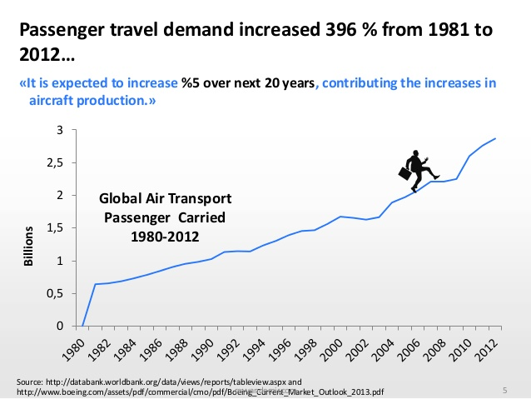
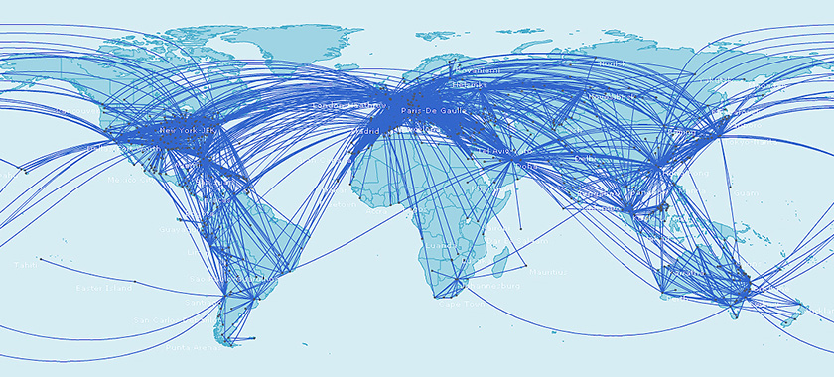
Increased travel increases the risk of emerging pathogens coming to developed countries
“Over the last 40 years global air travel has almost increased eight fold”
“RPKs (revenue passenger kilometers) are projected to increase by a factor of 6 by 2029 from their 1990 values”
http://www.bitsofscience.org/graph-global-air-travel-increase-6848/
Notes:
http://en.wikipedia.org/wiki/List_of_the_busiest_airports_in_Europe
There are 4 times more travellers transiting by Olso Airport than there are inhabitants in Norway (22M vs 5M)
In Switzerland (8M inhabitants) there are 44M people transiting by Swiss Airports (5.5 times more than nbr of inhabitants)

Slide 8
Infectious disease vectors? Fuggettaboutit… We don’t have time

Slide 9
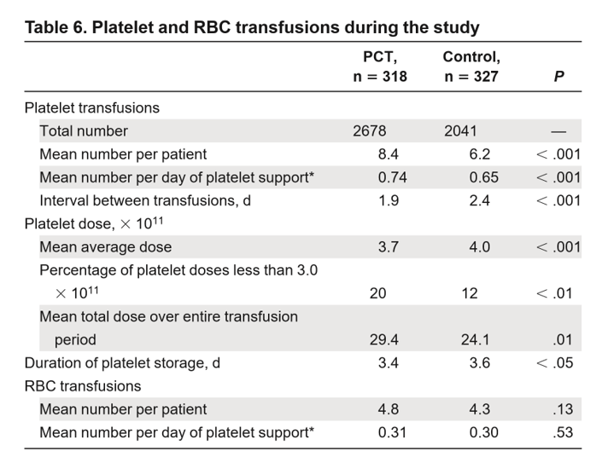
PRT reduces platelet count & efficacy – effect?
Mirasol
Intercept
469 patients, 567 transfusions
51% (control) v 54% (PRT)
non-inferiority p= 0.012 (3% diff ≥ Gr2)
645 patients, 4719 transfusions
58.5% (control) v 57.5% (PRT)
non-inferiority p=0.01 (1% diff ≥ Gr2)
Transfusion requirement |  | Control | Intervention | p
No. of transfusion episodes |  | 279 | 277
No. of red cell transfusions | median (IQR) | 4 (2-7) | 4 (2-6) | 0.135
No. of plasma transfusions | median (IQR) | 0 (0-0) | 0 (0-0) | 0.842
No. of PLT transfusions per transfusion episode | median (IQR) | 4 (2-7) | 5 (2.5-7.5) | 0.328
PLT transfusion interval | mean h (95% CI) | 83 (77-91) | 71 (67-77) | 0.002
van der Meer PF,et al. Blood. 2018 Jul 12;132(2):223-231
McCullough J, et al. Blood. 2004 Sep 1;104(5):1534-41

Slide 10
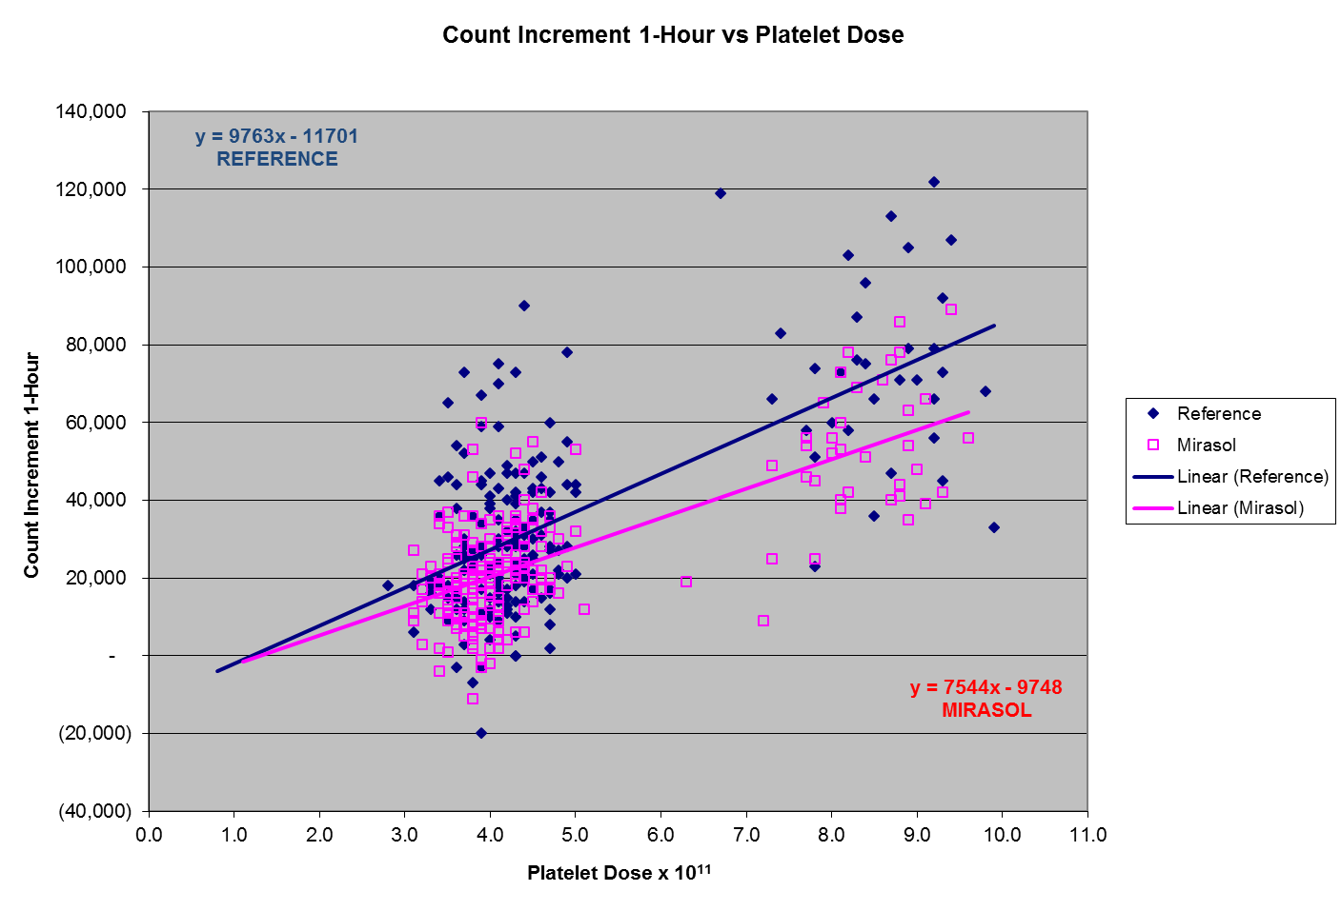
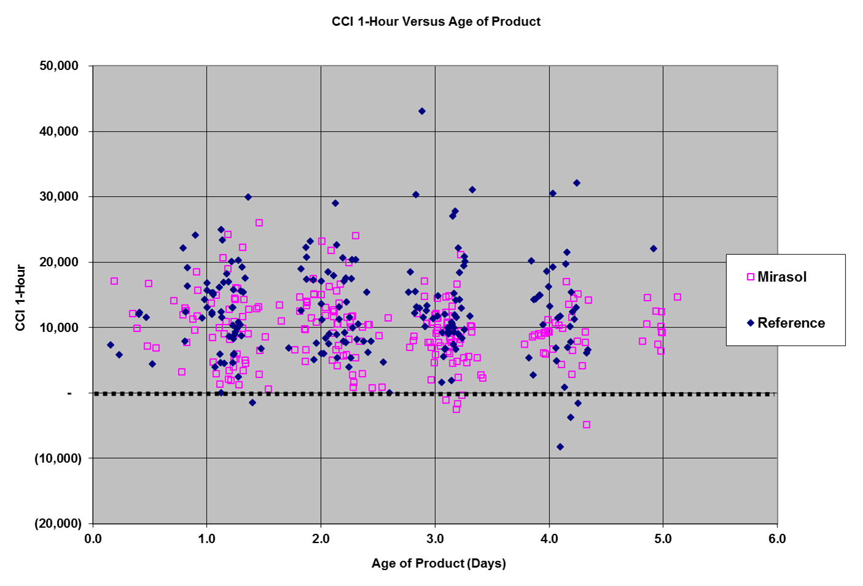
How does it compare to donor variability? 1 Hour
Kindly shared by Dr. Ray Goodrich

Slide 11
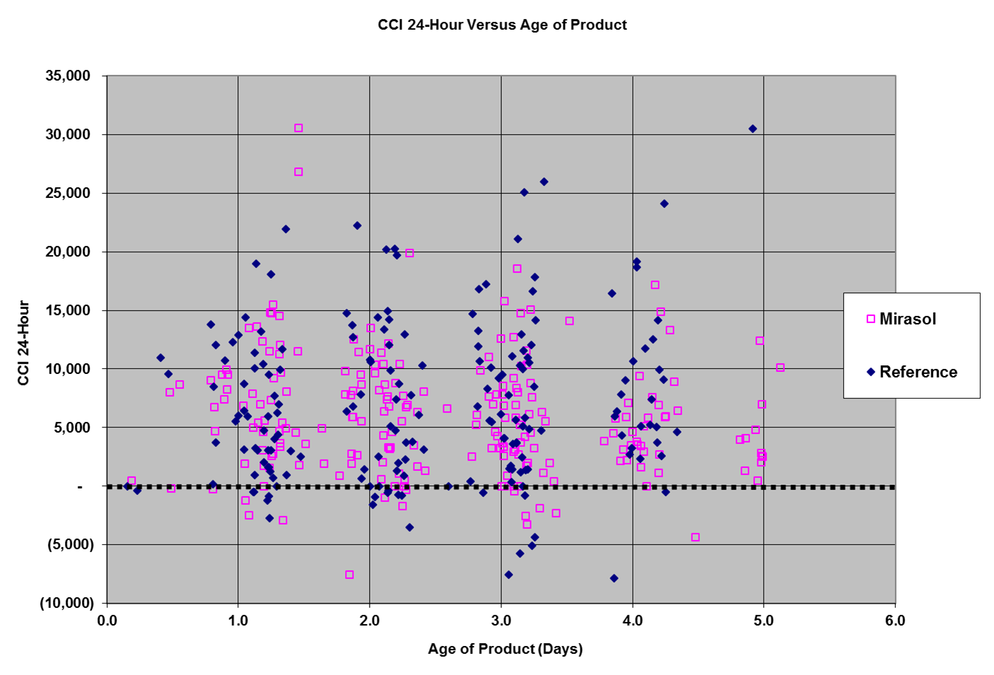
How does it compare to donor variability? 24 hours
Kindly shared by Dr. Ray Goodrich

Slide 12
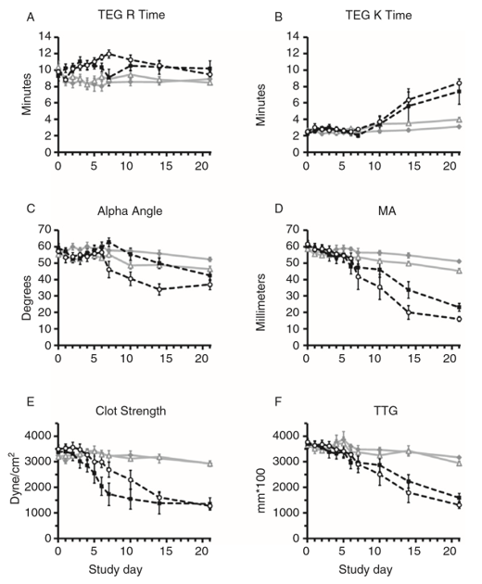
Is it necessary to mitigate the deficit?
Pidcoke HF, et al. Transfusion. 2013 Jan;53 Suppl 1:137S-149S

Slide 13
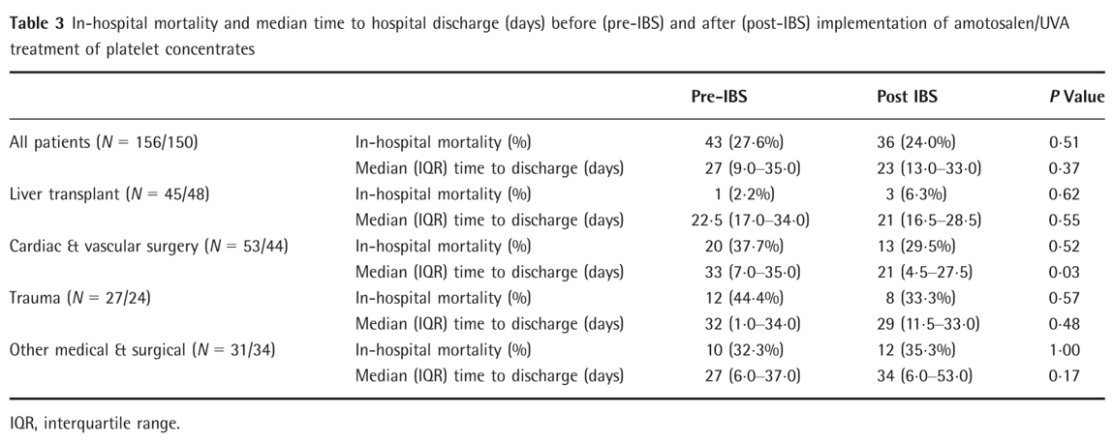
Is it necessary to mitigate the deficit?
Nussbaumer W, et al. Vox Sang. 2017 Apr;112(3):249-256

Slide 14
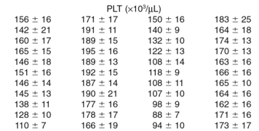
Is it possible to mitigate the deficit? Storage in PAS
Pidcoke HF, et al. Transfusion. 2013 Jan;53 Suppl 1:137S-149S
Getz TM, et al. Transfusion. 2016 Jun;56(6):1320-8

Slide 15
Is it possible to mitigate the deficit?
Kindly shared by Dr. Dana Devine
30%
50%
70%
± RiaSTAP
Blood replacement&
± RiaSTAP suppl.
PI-treatment
Arbaeen AF, et al.
Transfusion. 2017 May;57(5):1208-1217.
PI-treatment
* n= 8 replicates ±SD, (p < 0.01)

Slide 16
Things I learned in trauma kindergarden
When you are filling an empty tank, something is better than nothing
If the injury is life-threatening, saving the patient’s life is more important than avoiding hepatitis or HIV, but….
Ebola is a whole other story – some things will kill your patient in the short term

Slide 17
