Slide 1
Tissue Engineering, Regenerative Medicine and Blood What’s the art of the possible?
Dr. Abi Spear
Senior Principal Scientist
Notes:
My name is Abi Spear, I’m a Senior Principal Scientist at the Defence Science and Technology Laboratory and I lead the UK Defence Project in Regenerative Medicine

Slide 2
Executive agency of the UK Ministry of Defence
Any S&T of relevance to UK Defence and Security
Strategic capabilities
Combination of internal research programmes, collaboration, partnership and funding
Notes:
Dstl is an executive agency of the UK Ministry of Defence. We’re based at a number of sites around the UK but our Headquaters is at Porton Down near Salisbury. We deliver science and technology solutions to our Customers and Stakeholders across the whole spectrum of science and technology and steward a range of strategic capabilities for the UK. We partner extensively in order to deliver this. We have our own internal research capability and carry out research internally at Dstl where this is required due to the fact that we have unique or critical capability but otherwise we collaborate with and fund experts in academic and industry.

Slide 3
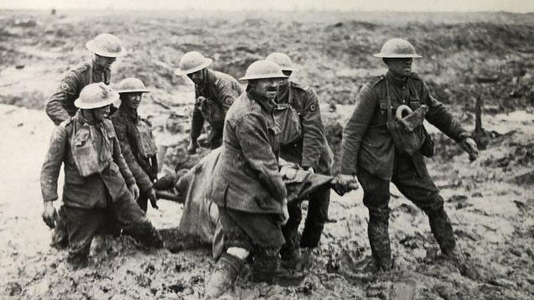
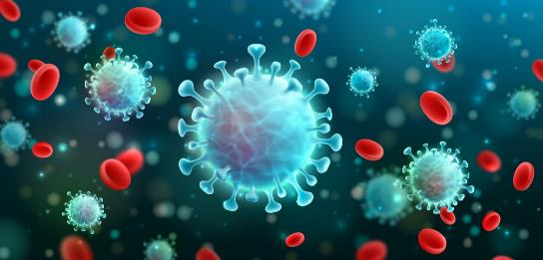
Next generation and generation-after-next
Notes:
We’ve heard through this conference about the past, the present and a bit of back to the future. But this session is now firmly about the future – next generation and generation after next capabilities in blood component science. Although some of it not as far away as you might think.

Slide 4
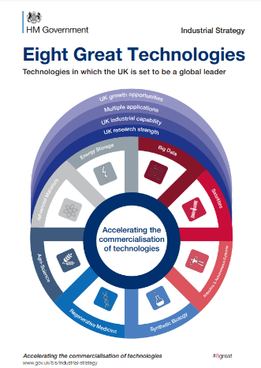
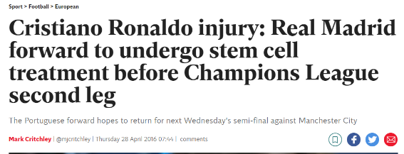
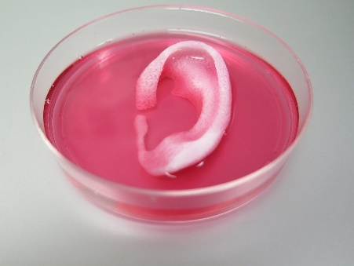
Regenerative Medicine at the Front Line
Tissue Engineering and Regenerative Medicine aim to replace tissue lost as a result of disease or injury
Notes:
As I said I lead the Tissue Engineering and Regenerative Medicine project at Dstl. At its most basic definition tissue engineering and regenerative medicine aim to replace tissue lost as a result of disease or injury. And I think as you guys will all know it’s been one of those ‘hot topics’ right around the world for the last 10 years. In 2013 the then-UK Government designated it as one of it’s ‘Eight Great Technologies’ – technologies that were singled out for particular investment. Regenerative medicine is most typically associated with particular techniques and news stories, not all of them positive, mainly centred around stem cell therapy and growing replacement organs in the lab.

Slide 5
Holds promise for the treatment of personnel injured in combat. How should UK MOD engage?
Gaps of relevance to Defence Medical research requirements
Different to traditional Regenerative Medicine research projects
Outcome rather than tools and techniques
Early after injury
Focussed
Tissue Engineering and Regenerative Medicine aim to replace tissue lost as a result of disease or injury
Blood and Extremity Soft Tissue
Notes:
It was clear from these definitions and from the sustained interest and investment in the area that it held great promise for the treatment of personnel injured in combat. But it wasn’t necessarily clear how UK MOD should engage. It’s a vast area where our involvement could easily have become piecemeal and unfocussed. There was already a good deal of activity in academia and industry which it was important to harness and either build on as necessary, or close gaps of relevance to Defence medical research requirements. So we carried out an evidence-based scoping study which considered how and where we should focus our effort, which we published open access. The resultant project, which has now been running for about four years

Slide 6
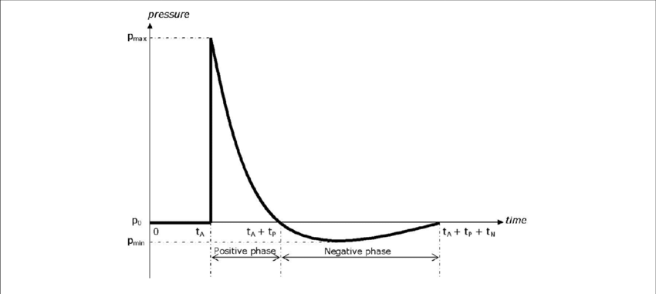
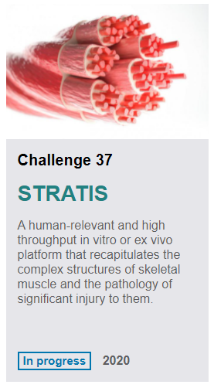
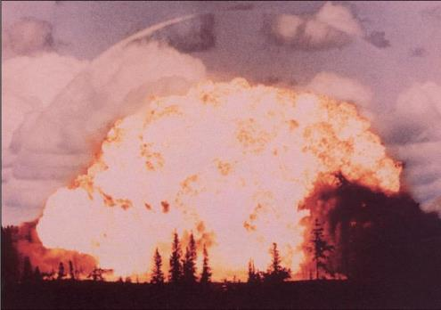
Strategy
Mixed approach:
External funding and co-funding (DASA, R-Cloud, EPSRC, NC3Rs).
Collaboration and communication of research requirements
Includes a requirement to ensure the availability of the most appropriate models to understand relevant injury and test new therapeutic approaches based on these research themes.
Internal research and capability development (e.g. prototype shock tube)

Slide 7
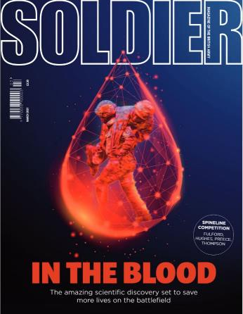
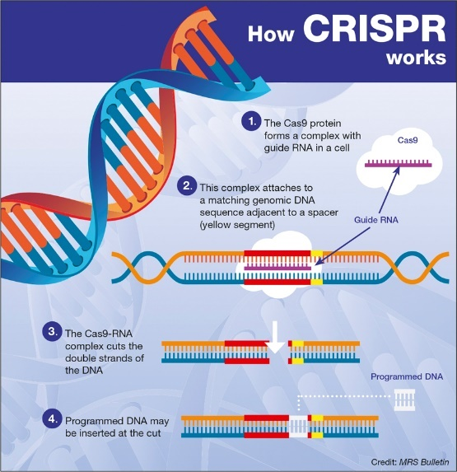
Bioengineered Blood components
Applying the principles of tissue engineering to blood components to improve their performance (e.g. stability) and/or add new capabilities.
Lab-grown blood components – obviating the need for traditional donation
Bio-engineering

Slide 8
Bioengineered blood components
A variety of small studies funded
Engineered red blood cells – Bristol University
Platelets – University of Cambridge
Value proposition study for the redistributed manufacture of blood components delivered by Redistributed Manufacturing in Healthcare Network+ (RiHN)
Bioengineered / synthetic blood components
How would you design blood?

Slide 9
Bench science to reality
‘Valley of death’
Specific Defence requirements
There are challenges!
Route for exploitation in our context – including relevant models
Collaboration – including across disciplines, agencies etc.

Slide 10
amspear@dstl.gov.uk

