Slide 1
Treatment of hemorrhagic shock in children
Christine M. Leeper, MD MS
Assistant Professor of Surgery and Critical Care
University of Pittsburgh

Slide 2
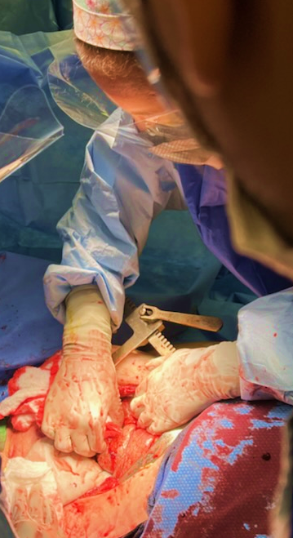
No financial disclosures
Trauma surgeon and intensivist at adult level 1 academic center
Clinical/translational research lab focusing on pediatric trauma and transfusion medicine and TIC
Notes:
Thank you for the great honor of presenting today. I’m Christine Leeper, trauma surgeon and intensivist at the University of Pittsburgh. While my clinical practice includes mainly adults, my research lab focuses on pediatric trauma, transfusion medicine, and trauma-induced coagulopathy. I’ll be speaking today about the management of hemorrhagic shock in pediatric trauma,

Slide 3
Alternate title
might save their lives when they are acutely bleeding after injury
Notes:
And usually my role at these meetings is to remind folks that children are people too, and I took some inspiration from this parenting book in order to rename my talk, which will from now on be called “Children are People Too: How we Fail Our Children and How We might…save their lives when they are acutely bleeding after injury.

Slide 4
Pediatric trauma: epidemiology
Notes:
I'm going to start by briefly addressing the epidemiology of pediatric trauma

Slide 5
Us civilian pediatric trauma
35,000,000
Pediatric Trauma ED Visits
$24.9 Billion
ED/Inpatient Trauma Costs
Notes:
Because the magnitude of this problem can’t be overstated. From the most recent data, there are 81 million children in the US, representing 22% of our nation’s population. Emergency department visits for trauma account for 25 billion dollars in spending annually, and there are over 15,000 pediatric trauma deaths resulting in 802,000 years of life lost each year.

Slide 6
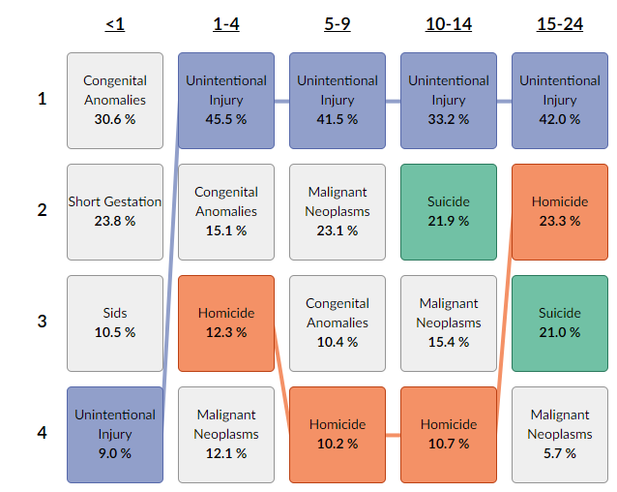
Causes of death by age group: Trauma kills children in the US
ALL TRAUMA
58%
52%
66%
86%
Notes:
Trauma is what kills children in this country. Depending on the age group, injury accounts for a minimum of 50% up to 86% of the total annual mortality.

Slide 7
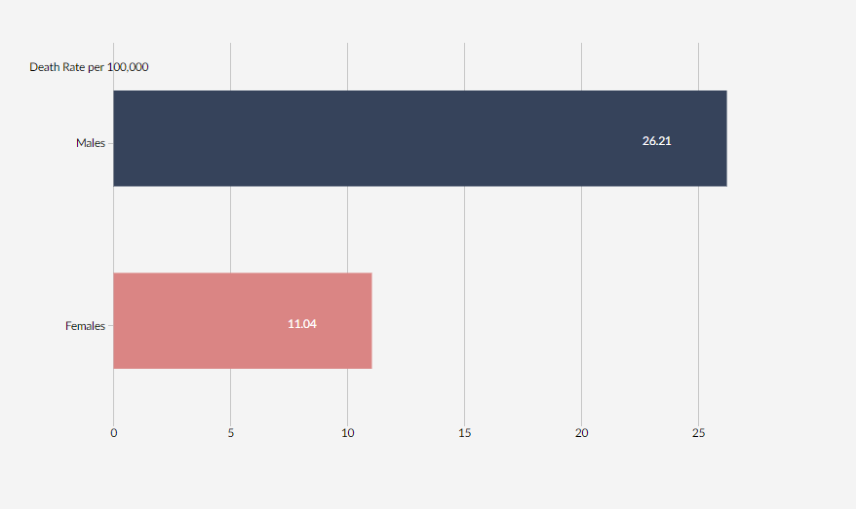
Adjusted death rate by race/sex
BLACK
NATIVE
AMERICAN
MALE
WHITE
FEMALE
ASIAN/PI
Notes:
Black children and native American children have disproportionately higher rates of death compared to their white and Asian/pacific islander counterparts. And male children in the US die at a rate twice that of female children

Slide 8
Death per 100,000 by age group
Age 15-18
Age 0-4
Age 10-14
Age 5-9
Notes:
Looking at age, the middle childhood groups are at a distinct ADvantage compared to the youngest children, who are at higher risk of child abuse, and the adolescent age groups who have the highest death rate. These data span the last two decades, and you can see that the fluctuation in death rates is nearly entirely attributable to changes in the adolescent group, where initial gains in survival due to enhanced motor vehicle safety and injury prevention have been wiped out by distracted driving and a steep rise in penetrating trauma.

Slide 9
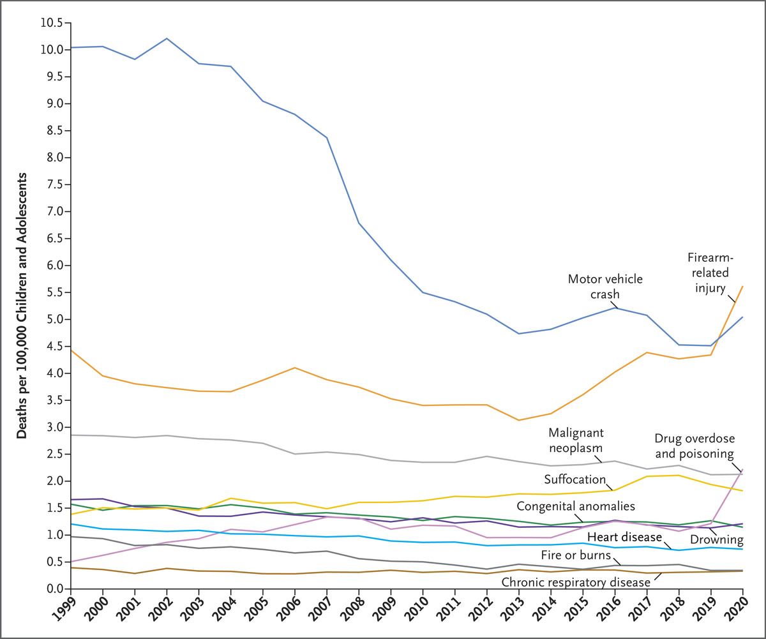
Understanding pediatric trauma is an urgent priority
Leading Causes of Death among Children and Adolescents in the United States, 1999 through 2020.
JE Goldstick et al. N Engl J Med 2022;386:1955-1956
Notes:
Speaking of penetrating trauma, this is a now widely circulated figure that shows one way in which we have failed our children, this depicts the 30% increase in firearm related deaths in children between 2019 and 2020, overtaking motor vehicle collisions as the leading cause of trauma mortality with no signs of slowing down. Now more than ever, understanding pediatric trauma is an urgent priority.

Slide 10
Outcomes
Bleeding is the leading cause of preventable death in children ¹⁻³
2000 preventable pediatric deaths per year in the US due to traumatic bleeding
28-day mortality rates in injured children with life threatening hemorrhage range from 36-50% ⁴
Approximately twice that of injured adults (21-24%) ⁵⁻⁶
1. Kwon AM. Eur J Trauma Emerg Surg. 2014;40(3):279-85.
2. Davis JS. J Trauma Acute Care Surg. 2014;77(2):213-8.
3. Fox N. Journal of Emergency Medicine & Critical Care. 2018;4(1):4.
4. Leonard JC. 2021;49(11):1943-54.
5. Holcomb JB. JAMA Surg. 2013;148(2):127-36.
6. Holcomb JB. Jama. 2015;313(5):471-82.
Notes:
And we need to understand this better not only due to the increasing frequency of major hemorrhage in children but also because at preset, children in hemorrhagic shock after injury fare quite poorly. Bleeding is the leading cause of preventable death in pediatric trauma. The 28-day mortality rate for injured children with life threatening hemorrhage is staggering, 36-50%, much higher in comparison to mortality rates in bleeding adult trauma patients.

Slide 11
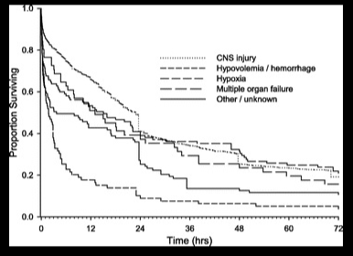
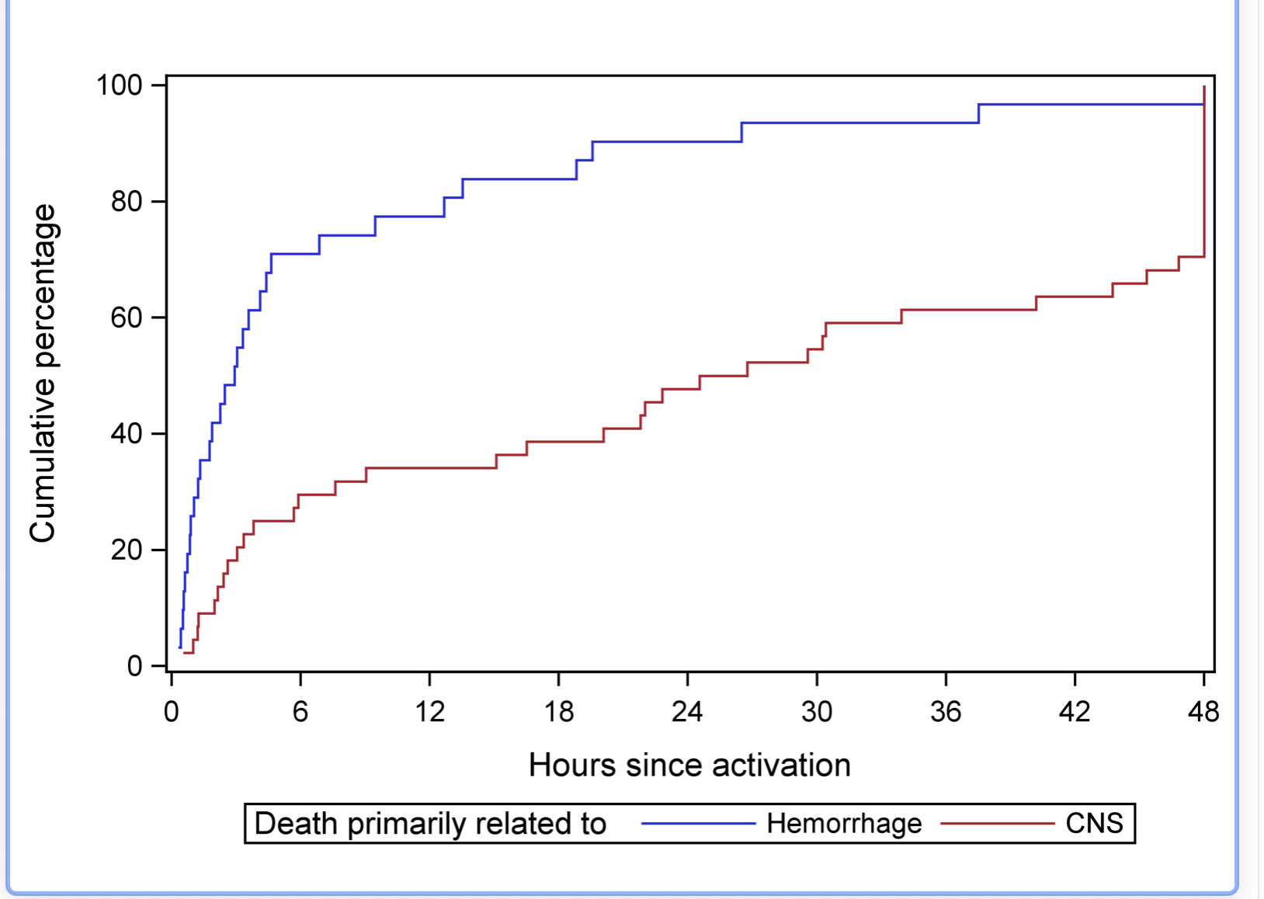
Timing of death
Median time to death:
Hemorrhage = 17 hours
Brain injury = 52 hours
Burd et al JTACS
Leonard et al CCM
Leonard et al CCM
Notes:
Death due to bleeding occurs quickly. This is time to death in two quality pediatric studies, the first a large national database study by Randy Burd and the second a multicenter prospective observational study by Julie Leonard and colleagues. Death due to hemorrhage is in blue and death due to brain injury is in red. These curves are the inverse of one another but show the same trend, which is that the median time to death for bleeding was around 17 hours and about 90% of the hemorrhagic death has occurred by 24 hours.

Slide 12
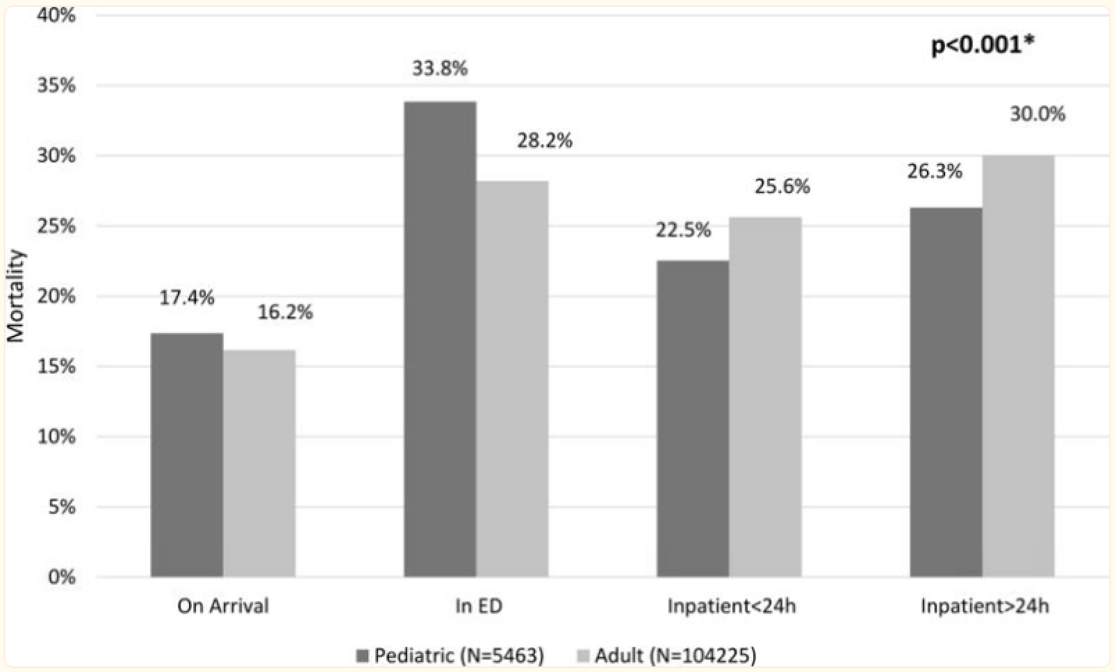
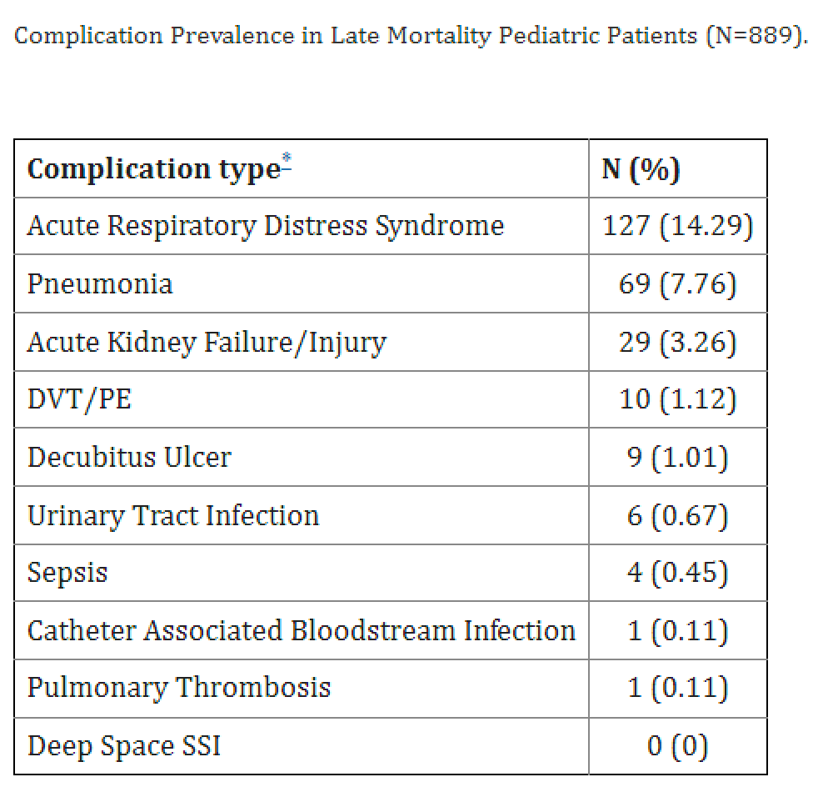
TIMING OF DEATH: PEDS VS ADULT
Compared to adults, children have a higher proportion of early death versus late death ​
McLaughlin et al. Timing of Mortality in Pediatric Trauma Patients: A National Trauma Databank Analysis
J Pediatr Surg. 2018 Feb; 53(2): 344–351.
Notes:
In contrast to adults, late death is less common in children. In this 2018 study using the national trauma database, children had greater frequency of death in the ED compared to inpatient or beyond 24 hours; pediatric trauma largely lacks the third mode of late death due to the fact that multisystem organ failure and late complications after trauma are much less prevalent than in adults, so importantly, interventions to reduce death have to target the resuscitative phase.

Slide 13
Gaps in knowledge
Notes:
Taken together, it’s clear that injury impacts many children and is associated with poor outcomes. And despite that, the gaps in knowledge regarding the optimal care of the bleeding pediatric patient are vast.

Slide 14
“Although traumatic injury is the leading cause of death in pediatric patients and hemorrhagic shock may be involved in a significant proportion of these deaths, the quality of literature to establish best clinical practices…[and] to develop recommendations… for the care of these patients was lacking.”
National Institute of Child Health & Human Development; R13HD102128
Notes:
This was highlighted recently when a consensus conference was held to discuss the quality of existing research and determine what pediatric specific recommendations could be made. In short, the strength of the recommendations was universally low, as the quality of literature to establish best clinical practices and to develop recommendations for the care of these patients is lacking.

Slide 15
Data are limited
Why?
Low volume at any single center
Challenging logistics – consent, limited blood volume for research
Additional "protections" in place for pediatric studies
Lack of funding (especially compared to less common childhood diseases)
Notes:
Why is this the case. It's multifactorial but some contributors are that severe bleeding after injury in children is a relatively low frequency event at any one center, which makes it harder to study and to standardize care across many team members who may see one severe trauma annually. Next, the logistics of pediatric research including parental consent and volume of blood draws among others, can be challenging... there are stringent regulations at a local and national level due to children being a vulnerable research population... and there is a lack of funding for pediatric trauma research as compared to other less common childhood diseases.....So.... in the absence of compelling pediatric-specific data, many centers and clinicians across the country are forced to extrapolate from adult data.

Slide 16
Why might children be different?
Anatomically unique - body proportions, airways, bony composition
Low levels of underlying co-morbidity
Vital signs and labs have different normal ranges
Development is ongoing – physiologic changes across childhood
5 month old ≠ 5 year old ≠ 15 year old
Notes:
And this is problematic as children differ in important ways from adults, ways that are highly relevant in trauma. Children are anatomically unique, they typically have low levels of underlying comorbidity, their vital signs and labs have different normal ranges, and development is ongoing with major physiologic changes happening throughout childhood.

Slide 17
Why are pediatric-specific data needed?
Children have quantitative and qualitative differences in the hemostatic system
Lower levels of protein C, protein S, coagulation proteins and prothrombin
Lower concentrations of plasminogen, tissue plasminogen activator, and α-antiplasmin
Increased plasminogen activator inhibitor-1
Hemostatic factor levels and activity vary throughout childhood
Unique response to injury and response to interventions in children
Leeper CM, Strotmeyer SJ, Neal MD, Gaines BA. Ann Surg. 2019 Lucisano, Leeper, Gaines. Semin Thromb Hemost. 2020 Hrebinko et al, JTACS 2021 Leeper et al JTACS 2018 Moore et al 2016 Morgan et al, AAST 2023
Picture: Zachary Scott
Notes:
Children have quantitative and qualitative differences in the hemostatic system as compared to adults at baseline. They have Lower levels of protein C, protein S, coagulation proteins and prothrombin; Lower plasma concentrations of plasminogen, t-PA and α2-antiplasmin; and Increased concentration of PAI-1. And not only do these factors differ at baseline, but the level and activity are fluctuating throughout childhood as the hemostatic system matures. It stands to reason then that these differences may produce a unique response to injury and interventions in children compared to adults. This has been born out in several studies showing a unique pediatric TIC response, including sex dimorphisms in TEG that appear after puberty, different distribution of fibrinolysis phenotypes in adults versus children, and differences in post-injury endothelial biomarkers. These differences suggest that a pediatric-specific approach to resuscitation may be warranted.

Slide 18
Optimal resuscitation of the pediatric trauma patient
Empiric Resuscitation Strategies​
Crystalloid
Component Therapy​
Low Titer Group O Whole Blood
Timing of Resuscitation
Prehospital vs in-hospital
Hemostatic Adjuncts
Tranexamic Acid
Cryoprecipitate
Notes:
So here are some of the data we do have regarding hemostatic resuscitation strategies for pediatric trauma patients. I’ll address empiric Resuscitation Strategies, timing of resuscitation, and hemostatic adjuncts

Slide 19
crystalloid
The most recent Advanced Trauma Life Saving (ATLS) Manual has changed its recommendations from two 20 mL/kg crystalloid boluses in children to one 20 mL/kg crystalloid bolus prior to consideration of blood products for children in presumed hemorrhagic shock
Polites et al, JTACS 2018, 2020
Notes:
Lest you think this issue has been put to bed, it is far from certainty that a bleeding child will receive blood. Phil, you need to print more t-shirts. The major victory recently was that the ATLS guideline reduced their recommended crystalloid bolus for children in suspected hemorrhagic shock from two down to one before giving blood. These are some multicenter observational data showing that crystalloid use does not decrease mortality or the need for transfusion, but does delay the time to transfusion and had detrimental consequences including volume overload and coagulopathy. One frequent confounding factor in deciding to transfuse is recognition of life threatening hemorrhage in children, which is made challenging by children's superior compensatory mechanisms to preserve blood pressure and look pretty decent right up until they don't.

Slide 20
Hemostatic resuscitation options
BALANCED COMPONENT THERAPY: RBCS, PLASMA, PLATELETS
24-hour mortality​ | ​ | ​ | ​
​ | Odds Ratio​ | 95% CI​ | P value​
High plasma:RBC ratio​ | 0.36​ | 0.13-0.99​ | 0.05​
Plasma deficit (10mL/kg)​ | 1.2​ | 1.05-1.30​ | 0.01​
High platelet:RBC ratio​ | 1.36​ | 0.28-6.66​ | 0.70​
Platelet deficit (10mL/kg)​ | 1.1​ | 1.05-1.20​ | 0.04​
Spinella et al 2022
Butler et al 2019
Notes:
Balanced resuscitation is one of the more frequently studied topics. Here are two studies that showed a benefit with high ratio plasma resuscitation. On the left is a prospective multicenter study of 450 children and on the right is an almost 600 patient TQIP study both showing a 24-hour survival benefit to more balanced resuscitation. That's a fine strategy except as Mark stated yesterday, we are not good at balanced resuscitation in pediatric trauma. Children usually have limited IV access; component products, especially plasma and platelets, need to travel from different areas of the hospital, and many pediatric clinicians are not massively transfusing with any regularity so it's unfamiliar and often uncoordinated. In several studies, ratios for pediatric trauma resuscitation were not even close to 1:1, most were somewhere between 1:5 – 1:9.

Slide 21
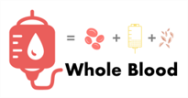
Hemostatic resuscitation options
Low Titer Group O Whole Blood
Notes:
Which brings me to the second option for hemostatic resuscitation, low titer group O whole blood, which I blessedly don’t have to describe at all today.

Slide 22
LTOWB in the US
Adult centers
Pediatric centers
12
2023
Notes:
While an increasing number of adult centers are using whole blood, the number of pediatric centers with a whole blood program is currently somewhere around 12. The most commonly cited reasons for this lag in implementation are a lack of data regarding efficacy, and concerns about safety, supply and wastage.

Slide 23
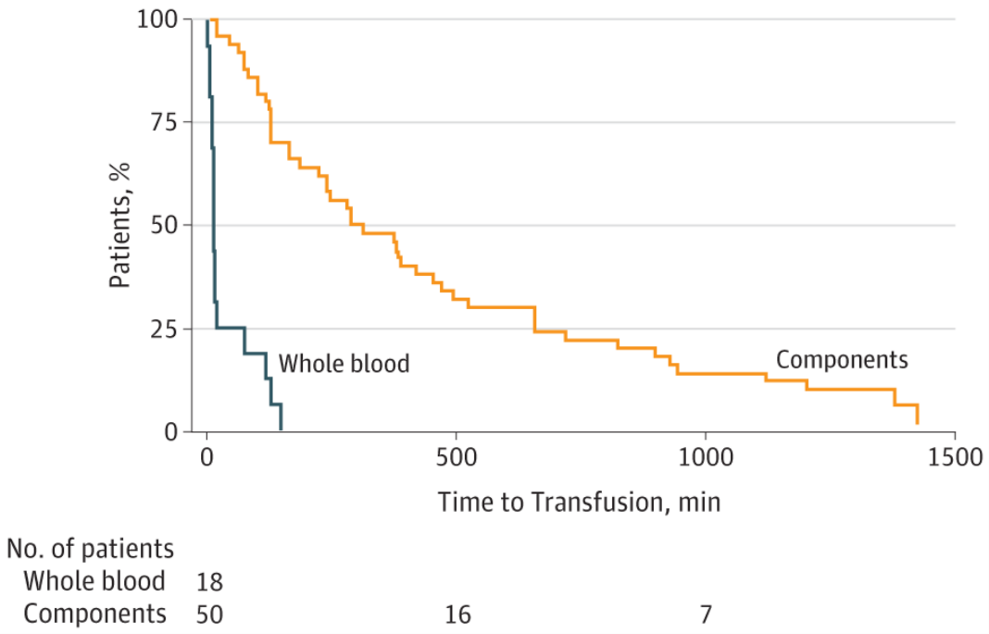
ltowb: Feasibility and efficiency
First pediatric civilian cohort
Compared to historical CT group
Feasible
Efficient = Faster time to product administration compared to components
Leeper CM, Gaines BA. JAMA Peds. 2018.
Notes:
Our practice at Children's Hospital of Pittsburgh changed from components to whole blood in 2016. These data are from the first pediatric civilian cohort who received whole blood at our hospital. The actual mechanics of transfusing whole blood are not different from packed cells, so it was feasible and acceptable to all providers. Not surprisingly, it was also logistically simpler and more efficient than trying to acquire multiple products from different locations. This graph shows that the time from patient arrival to balanced resuscitation went from a median of 303 minutes to 15 minutes.

Slide 24
Ltowb: Safety
No major transfusion reactions
No increase in organ failure
No increase in hospital complications
AKI
Sepsis
ARDS
Thromboembolism
No increase in hemolysis for those at risk = Non Group O patients
Transfusion. 2020 Jun;60 Suppl 3:S24-S30
Transfusion. 2018 Oct;58(10):2280-2288
Transfusion. 2021 Jul;61 Suppl 1:S8-S14
Notes:
Regarding safety, there have been several pediatric studies showing no major transfusion reactions, no increase in organ failure, or in-hospital complications including kidney injury, sepsis, ARDS or thromboembolic events, and importantly no increased risk of hemolysis amongst non-group O versus group O recipients of whole blood.

Slide 25
Ltowb: Cold platelets
LTOWB vs room temp platelet recipients
Pre- and post- transfusion platelet count and thromboelastography maximum amplitude
No significant difference
Leeper et al, JTACS 2019
Notes:
You can see I modeled my platelet graphic after Drs Neal and Kornblith. There’s the HMGB-1! No. So these are data are from a small pediatric study looking at surrogate markers of platelet function in the whole blood recipients compared to room temperature platelet recipients. Here we showed no difference in the pre- and post transfusion platelet count and TEG maximum amplitude, suggesting that cold platelets are working at least as well as room temperature platelets.

Slide 26
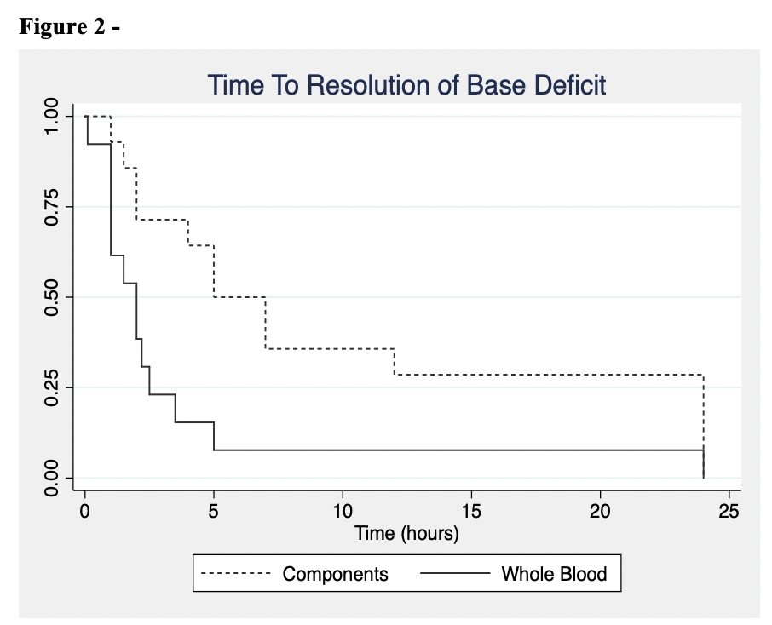
Notes:
These figures show a comparison of LTOWB recipients to component recipients with outcome measures of shock and trauma-induced coagulopathy. In the panel on the left, serial base deficit were measured pre and post transfusion, showing faster biochemical resolution of shock in the LTOWB group. Similarly on the right, there was lower post-transfusion INR values in the LTOWB group, INR being an assay that I consider to be a generally poor marker of clinical coagulopathy but a reasonably good indicator of global hemostatic dysregulation after injury and a valuable prognostic indicator.

Slide 27
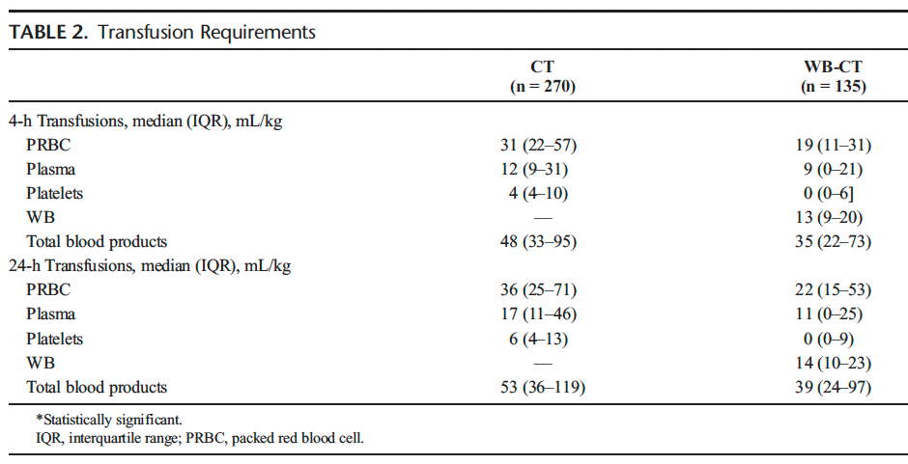
transfusion volume
In LTOWB group vs CT group:
Less plasma and platelet
Less volume overall
Fewer donor exposures
Whole blood hemostatic resuscitation in pediatric trauma: A nationwide propensity-matched analysis. Anand et al J Trauma Acute Care Surg . 2021 Oct 1;91(4):573-578
Notes:
It's also been shown in a few pediatric studies now, including this one by Bellal's group using the TQIP database, that whole blood recipients receive less of individual products as well as less total volume overall, therefore are exposed to fewer donors which theoretically could reduce transfusion-associated risks like infection or transfusion reactions.

Slide 28
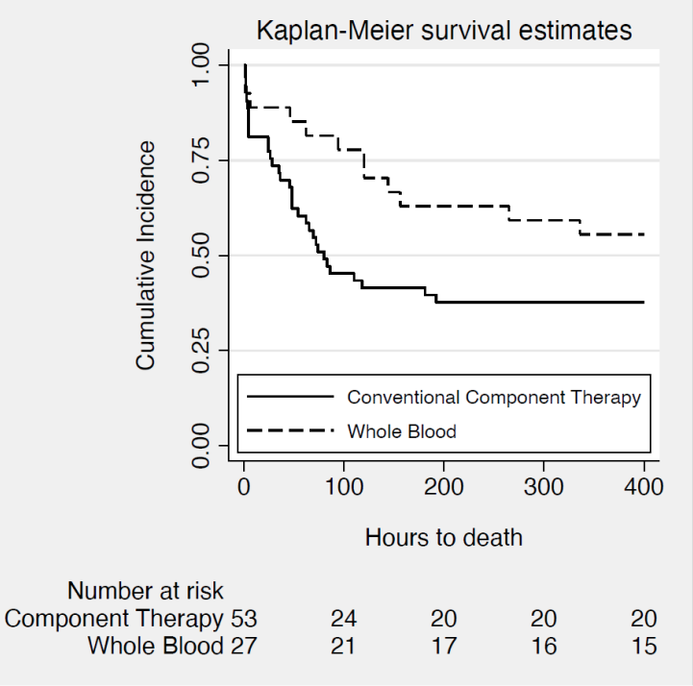
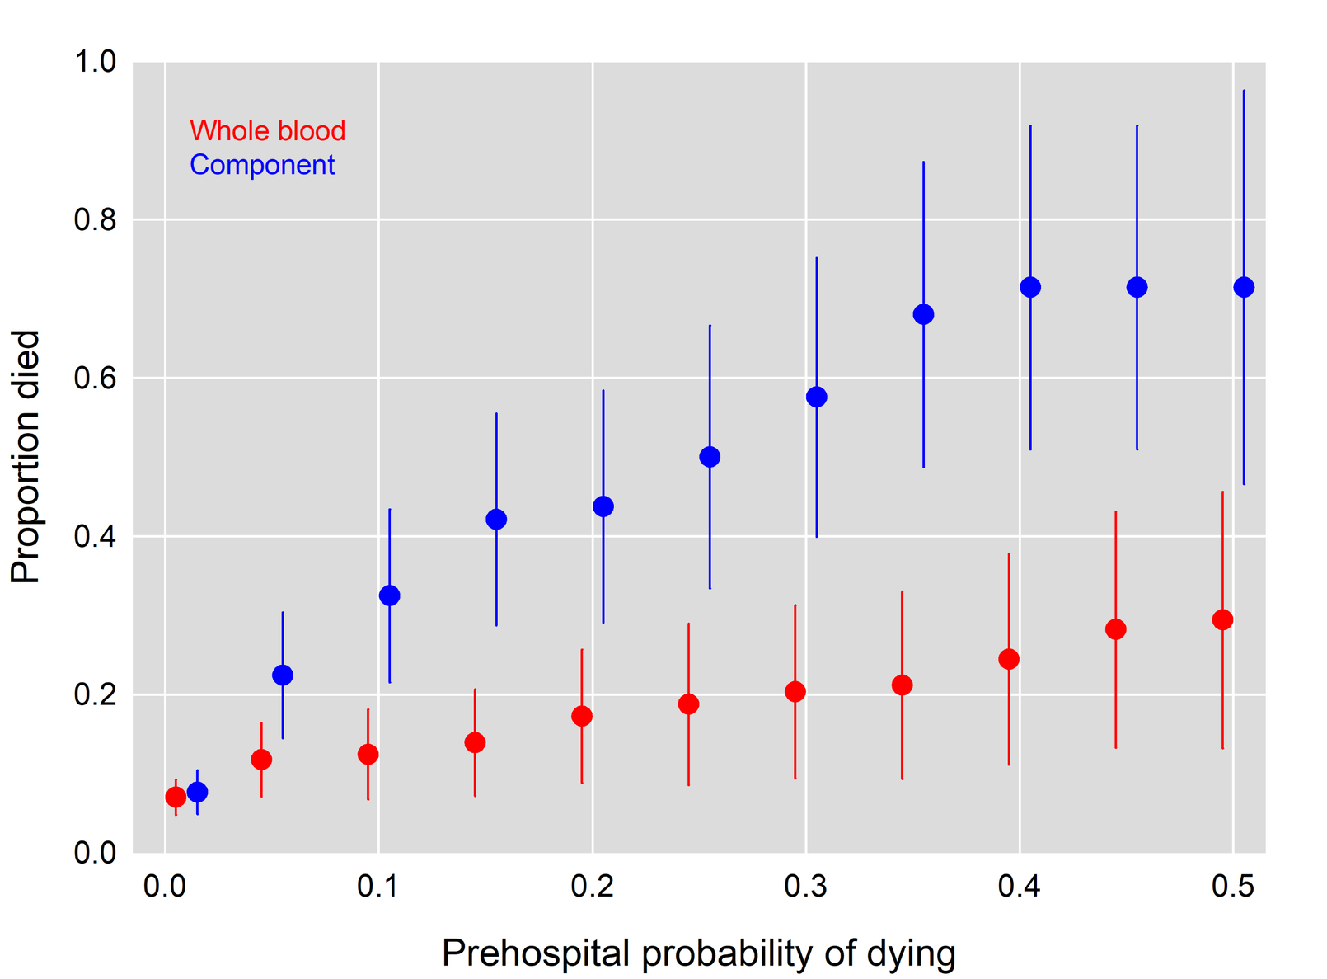
Mortality: who benefits?
Children:
Adults:
72 hrs: AOR=0.23, p=0.009)
28 days: AOR=0.41, p= 0.02)
Sperry, Cotton et al, SWAT study group. JACS 2023
Gaines et al, Ann Surg 2020
Notes:
Finally, mortality. In adults, several studies have documented a mortality benefit to LTOWB. In all comers in pediatric trauma, there has been no difference shown to date in mortality between whole blood and component groups. However, there do seem to be select populations in which use of whole blood confers a survival advantage, namely children receiving massive transfusion as seen here on the left who had increased survival at both early and late mortality time point. This interestingly is concordant with a recent adult publication on the right, showing a survival advantage in adults at highest risk of mortality.

Slide 29
Optimal resuscitation of the pediatric trauma patient
Empiric Resuscitation Strategies​
Crystalloid
Component Therapy​
Low Titer Group O Whole Blood
Timing of Resuscitation
Prehospital vs in-hospital
Hemostatic Adjuncts
Tranexamic Acid
Cryoprecipitate
Notes:
So to summarize the transfusion data, these studies suggest the use of whole blood in pediatric trauma is feasible, safe, efficient and has some advantages over component therapy. But I have to emphasize that this is supported largely by single center data, from a single center, plus one TQIP study, plus anecdotal data from other early adopters. And many clinicians site these weaknesses in the data as reason to continue using component therapy as the standard of care…. Next is the timing of resuscitation, meaning is prehospital transfusion in children a safe and worthwhile endeavor.

Slide 30
Barriers
Robust blood supply
Mature system with the means to recycle/offload products near expiration
Skilled pediatric providers
Weight-based dosing guidelines
Intravenous/Intraosseous access: challenge in children
Notes:
And while it may seem intuitive to all of us to start resuscitation as near to the time of injury as possible, there are barriers to a pediatric prehospital blood program. This requires a Robust blood supply, a Mature system with the means to recycle/offload products near expiration, Skilled pediatric providers and Weight-based dosing guidelines, and rapid Intravenous/Intraosseous access which can be a challenge in children

Slide 31
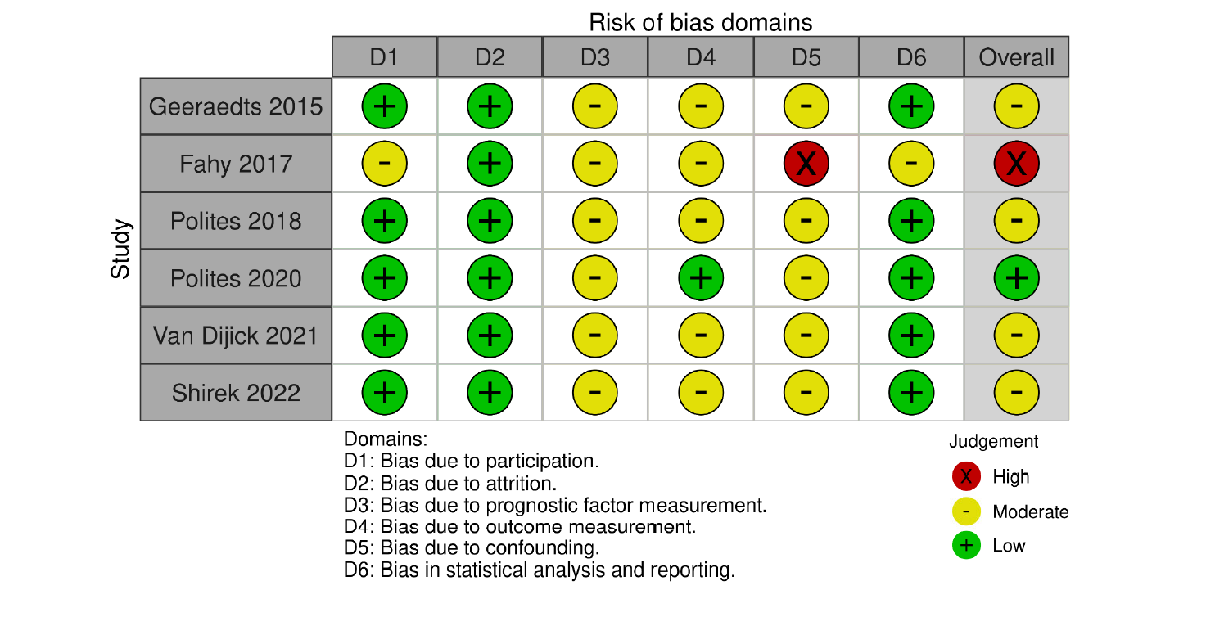
Feasible, safe
Safety and feasibility
Small cohorts (2-30 subjects)
Insufficient for mortality outcome and moderate to high degree of bias
Notes:
There have been a handful of small studies that contributed to suggesting prehospital transfusion of blood products was feasible and safe, but none was of sufficient size to detect a difference in mortality and had moderate to high degree of bias

Slide 32
Where should resus start?
Pennsylvania trauma system database
Age < 18 years // Scene runs // Blood transfusion Prehospital vs Emergency Department
Propensity matched 3:1, balanced with regard to age, sex, race, mechanism of injury, shock index, GCS, Injury Severity Score (ISS), insurance type
After matching, both 24-hour (16% vs. 27%) and in-hospital mortality (20% vs. 32%) were lower in the prehospital transfusion group
The number needed to transfuse in the prehospital setting to save one child's life was 5
Notes:
So we looked at the State of Pennsylvania trauma system database, and propensity matched children who received blood in the ED to those who received blood prehospital in order to balance some important covariates. After matching, both 24-hour and in-hospital mortality were lower in the prehospital transfusion group. The number needed to transfuse to save one childs life was 5. So while there are barriers to establishing pediatric prehospital programs, I would say this is indeed a worthwhile endeavor.

Slide 33
Optimal resuscitation of the pediatric trauma patient
Empiric Resuscitation Strategies​
Crystalloid
Component Therapy​
Low Titer Group O Whole Blood
Timing of Resuscitation
Prehospital vs in-hospital
Hemostatic Adjuncts
Tranexamic Acid
Cryoprecipitate
Notes:
On to hemostatic adjuncts.

Slide 34
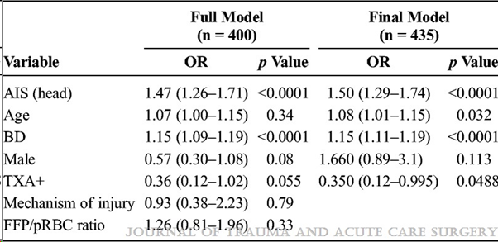
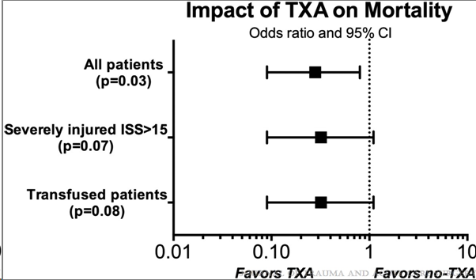
tranexamic acid
n=66
Hamele et al 2020
Small cohorts
Military cohorts not comparable to peds civilian trauma
Data are hypothesis-generating but not compelling
n=59
Eckert et al 2014
Adult data:
CRASH-2 Investigators, Lancet. 2010
Guyette FX, Sperry JL. JAMA Surg. 2020
Rowell SE, Schreiber MA. JAMA. 2020
Drew B, Butler FK. J Spec Oper Med. 2020
Notes:
In adult trauma TXA is Standard of care as supported by data from multiple large RCTs. The use of TXA in injured children is supported entirely by these two studies from military cohorts during the conflicts in Iraq and Afghanistan. The first, in which 66 children received TXA, and the second, in which 59 children received TXA, both showed a mortality benefit after controlling for a variety of important covariates. But as was shown yesterday, these are children with blast injury and high velocity penetrating trauma, which does not reflect the average pediatric civilian trauma cohort.

Slide 35
TxA: UNANSWERED QUESTIONS
Wide variety in dosing/regimens
Not studied in large cohorts
Not studied in civilian cohorts
Not studied in combination with other treatments → LTOWB
DO CHILDREN BENEFIT??
Notes:
Moreover, there is tremendous variation across centers in terms of dosing, regimens, and eligible children. It’s not been studied in large cohorts, nor in combination with other interventions, specifically whole blood. So it’s hard to take these limited data and make a compelling argument for the use of empiric TXA for children.

Slide 36
Txa in other pediatric populations
Experience in pediatric populations where TXA is used more frequently and in higher doses: craniofacial, cardiac, spine surgery
Substantially higher doses (50-100mg/kg bolus)
No increased adverse events
Notes:
In the absence of more robust trauma data, we can draw from the experience of the pediatric craniofacial, cardiac and spine surgeons who use TXA with increased frequency at much higher doses, and reassuringly there is no safety signal in those cohorts.

Slide 37
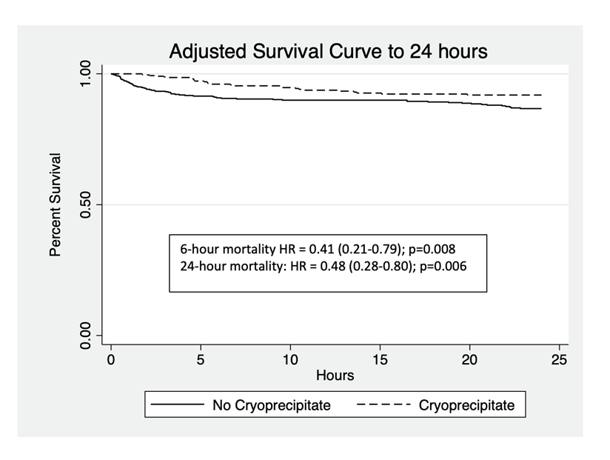
cryoprecipitate
Propensity-weighted cohort study of the Pediatric Trauma Quality Improvement Program data
Giving cryoprecipitate within the first 4 hours of arrival in addition to component products was associated with lower 24-hour mortality in children receiving massive transfusion
The survival benefit associated with cryoprecipitate usage was lost overall by seven days, except for those with penetrating injuries and ultra-massive transfusion (≥ 100 ml/kg)
Notes:
Regarding the use of empiric cryoprecipitate in children, Dr Meltzer used the peds TQIP database to propensity match massively transfused recipients of cryo versus no cryo. This analysis showed that Giving cryoprecipitate within the first 4 hours of arrival in addition to component products was associated with lower 24-hour mortality. There were a number of limitations to this study, namely that there were relatively Small numbers, this was conducted Prior to the implementation of LTOWB, there was potential for Survival bias, and the analysis failed to account for other hemostatic adjuncts. This single study is not practice changing, but is hypothesis generating.

Slide 38
Optimal resuscitation of the pediatric trauma patient
Notes:
So while I can tell you that these are probably good strategies to treat children after injury, we don't have the kind of high quality, practice changing data to support it like we have in adult trauma. Yet.

Slide 39
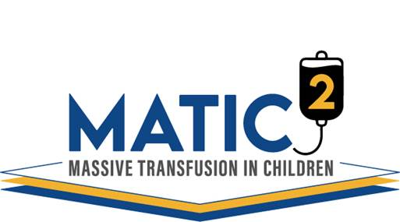
A pragmatic, Bayesian, combined non-inferiority/superiority, randomized, controlled, multicenter, adaptive, platform pediatric trauma resuscitation trial
Notes:
That is the goal of our upcoming MATIC-2 trial, which is a pragmatic, Bayesian, combined non-inferiority/superiority, randomized controlled, multicenter, adaptive platform pediatric trauma resuscitation trial.

Slide 40
Platform = Integrated clinical trial infrastructure
Maximum value is obtained from the investment of time and resources necessary to conduct the trial
If any of the study interventions is stopped early
For efficacy → becomes standard care
For futility/harm → removed from the trial
…then a new therapy/domain can be added
Notes:
So first the general structure of the trial is a platform design. The benefit of a platform design is that you maximize all the time, money and other resources that go into setting up the infrastructure needed to conduct the trial. There can be multiple domains testing different interventions simultaneously. What that means practically is that at any of the analysis checkpoints, one or more of the interventions could be stopped either for efficacy, in which case it becomes the standard of care, or for futility or harm, in which case it is removed from the trial. At that time, the trial doesn't shut down, rather a new therapy or domain can be added and tested.

Slide 41
MATIC-2: General Methods
Domains
Blood product domain = Low Titer Group O Whole Blood vs Component Therapy
Hemostatic adjunct domain = Tranexamic Acid vs Placebo
20 high volume academic pediatric trauma centers in the United States
1000 children
Notes:
Initially in MATIC2 there will be two domains, a blood product domain randomizing to whole blood or component therapy, and a hemostatic adjunct domain, randomizing to TXA or placebo. We'll be enrolling 1,000 subjects at 20 pediatric trauma centers in the US.

Slide 42
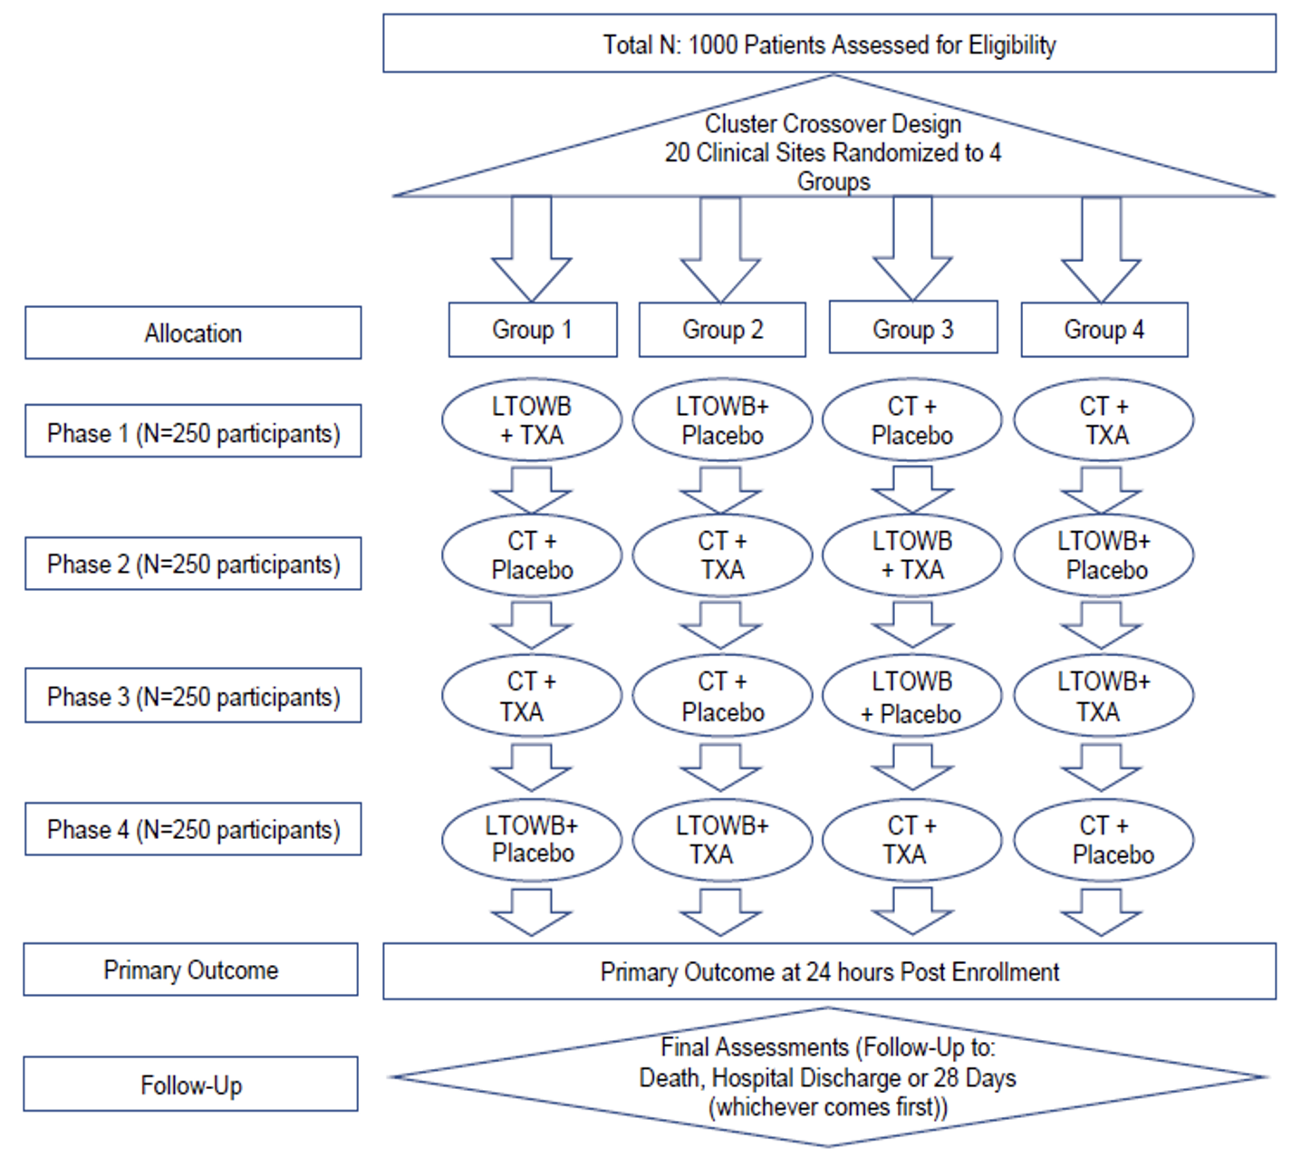
Eligibility Criteria
Notes:
Inclusion criteria are age less than 18 and MTP activation after traumatic injury, and at the behest of the FDA some additional objective criteria, which are hypotension, tachycardia or findings consistent with bleeding.

Slide 43
design
Cross over cluster design
Sites randomized to LTOWB or CT and TXA or placebo
4 clusters, stratified by patient volume at each site (#MTP/year)
Cross over after every 250 patients
Rationale for design
Minimizes waste of LTOWB
Does not require 24/7 research coordinator coverage (no individual randomization)
Notes:
MATIC2 will have a crossover cluster design, meaning randomization occurs at the center level, not the patient level. This will result in 4 clusters containing 5 sites each stratified by center volume that will change assignment after every 250 subjects enrolled. The purpose of this is to minimize waste of blood products and minimize burden on research staff. This is depicted visually here, you can see that the 4 groups will start with a study assignment, then this will change after 250 subjects are enrolled such that every site will see each combination of study interventions over the course of the trial: whole blood + TXA, whole blood +placebo, components + TXA and components + placebo.

Slide 44
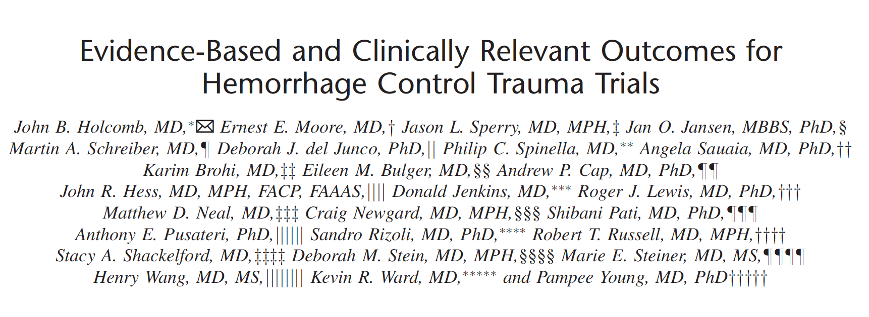
Primary Outcome – 24 Hour Mortality
Cumulative Percentage of Mortality
Figure 12: Mortality due to hemorrhage in children with traumatic injury and life-threatening hemorrhage
Notes:
The primary outcome is 24-hour mortality, which has been identified as a clinically relevant outcome for trials looking at hemostatic resuscitation interventions. This is consistant with the data I showed earlier where most death due to hemorrhage in children occurs early.

Slide 45
outcomes
Secondary:
Cumulative survival up to 28-days
24-hour total product transfusion volumes
Exploratory
Interaction between LTOWB and TXA on all cause 24-hour mortality
Number of donor exposures
Hospital-, ventilator- and ICU-free days
Adjudicated primary cause of death
Safety
Acute kidney injury
Acute respiratory distress syndrome
Sepsis
Seizure
Thromboembolism
Markers of hemolysis
Alloimmunization in Rh negative female recipients of Rh+ LTOWB
Transfusion-related adverse events
SAEs
Notes:
We will have other secondary, exploratory and safety outcomes, which are all listed here. Some I'll point out include cumulative survival, the interaction between whole blood and TXA, cause of death, and Alloimmunization rates for Rh negative recipients of Rh positive product.

Slide 46
Subgroup Analyses
Personalized trauma therapy → which subgroups benefit from which therapies?
Age
Sex
Interaction between Age, Sex and puberty (age> 11)
Traumatic Brain Injury
Injury mechanism (blunt, penetrating, both)
Shock (lactate, base deficit)
Coagulopathy
Notes:
In addition to the primary and secondary outcomes, we are planning multiple subgroups analyses to leverage the power of the platform design to detect subsets of patients who may benefit form a given intervention. These will include age, sex, the intersection of those two to assess for hormonal influence, traumatic brain injury, injury mechanism, in shock and/or coagulopathic on admission amongst others.

Slide 47
Mechanistic aim
multiomics
teg
Angelo D’Alessandro and Kirk Hansen, Univ Colorado
Untargeted metabolomics, lipidomics, proteomics and circulating plasma immune mediator analysis
100 ul of plasma
Frozen at -80 C for batch testing
TEG 5000 analyzer
Rapid TEG
Functional coagulopathy
Fibrinolysis phenotypes
Notes:
We are also including a mechanistic aim will include an untargeted multiomics analysis, led by Angelo D’Alessandro and Kirk Hansen, at the University of Colorado, which requires 100 microliters of plasma only and provides comprehensive panels of metabolomics, proteomics and lipidomics. Rapid thromboelastography will also be run in order to get a functional assessment of coagulation as well as fibrinolysis phenotypes which may or may not be relevant to TXA efficacy.

Slide 48
Mechanistic aim
TXA pharmacokinetics
BIOREPOSITORY
Gideon Stitt, Univ Utah
No PK of TXA in children with traumatic life-threatening bleeding
Associations between peak and AUC with outcomes and toxicity
May assist with dosing in future
Sample size = 750 total samples collected from 500 subjects randomized to TXA
Susan Shea, Univ Pittsburgh
Bank excess plasma
EDTA and citrate tubes
Future analyses: circulating vesicles, cell-free DNA, the peptidome
Notes:
We will also conduct a TXA pharmacokinetics analysis, led by Gideon Stitt at the University of Utah, in order to identify optimal dosing in the future. This will require approximately 750 samples from some of the 500 subjects randomized to TXA. And lastly we will be banking excess plasma in a study biorepository led by Dr. Susan Shea for future analyses based on these findings.

Slide 49
Human Protections
Exception for Informed Consent (EFIC)
Enrolling a cohort with life-threatening hemorrhage who require immediate intervention
Current equipoise regarding optimal hemostatic resuscitation
Potential for direct survival benefit
Inadequate time to obtain informed consent
Absolute inability to perform this study without consent waiver
Community Consultation and Public Disclosure
Single IRB
Notes:
MATIC2 will be conducted under Exception for Informed Consent or EFIC, with a single central IRB.

Slide 50
Funding
BARDA = Biomedical Advanced Research and Development Authority
Division of Radiological/Nuclear Threat Medical Countermeasures
Trauma is within scope
Prioritize research in vulnerable populations (children)
Notes:
We are in the final round of contract negotiation with BARDA, specifically the Rad/Nuc division who are interested in trauma resuscitation as well as research in vulnerable populations.

Slide 51
Funding & Timeline
Proposal under review at BARDA
Study timeline = 5 years total
1 year for site contracting, single IRB, EFIC
3.5 years subject enrollment
0.5 years for data cleaning, analysis, final report
Notes:
Our proposal is currently under review at BARDA. We anticipate the contract will be for a 5 year duration. The first year will be for site contracts, EFIC activities and IRB approval, then 3.5 years for subject enrollment, then the last 6 months for data cleaning and analysis.

Slide 52
MATIC-2 leadership
CO-PRINCIPAL INVESTIGATORS
CCC – University of Pittsburgh
Christine M. Leeper, MD MS
Philip C. Spinella, MD
DCC – University of Pittsburgh
Stephen Wisniewski, PhD
Abdus Wahed, PhD
Multi-OMICS – UC Anshutz
Angelo D’Alessandro, PhD
Notes:
We have a team of PIs leading different components of the trial. Myself and Phil Spinella are leading the CCC, Steve Wisniewski and Abdus Wahed are leading the DCC, and Angelo D'Alessandro is leading the mechanistic effort.

Slide 53
MATIC-2 Leadership
Executive Committee
Barbara Gaines, Kirk Hansen, Cassandra Josephson, Julie Leonard
Steering Committee
Trauma Surgery: Jason Sperry, Jeffrey Upperman, Matthew Neal, Jan Jansen
Transfusion Medicine: Mark Yazer, Meghan Delaney, Pampee Young
Emergency Medicine: Roger Lewis, Michael Sayre
Pediatric Critical Care Medicine: Marie Steiner MD, Jennifer Muszynski
Ethics: Sara Goldkind
Patient Advocates: AlloHope Foundation; Bethany Weathersby, Chief Executive Officer, and Molly Sherwood, Director of Research)
Notes:
In addition to the PIs, we have an executive committee that includes Barb Gaines, Kirk Hansen, Cassandra Josephson and Julie Leonard. Our steering committee is a multidisciplinary group that includes representatives from Trauma Surgery, Transfusion medicine, emergency medicine, critical care, a bioethicist, and patient advocates. We're tremendously grateful also for all the site PIs, clinicians and research teams, and we're really looking forward to getting this done and learning more about optimal resuscitation in pediatric trauma.

Slide 54
Thank you
Trauma & Transfusion Medicine Research Center
Barb Gaines
Macky Neal
Phil Spinella
Susan Shea
Tim Billiar
Jason Sperry
Josh Brown
Brian Zuckerbraun
Matthew Rosengart
Melanie Scott
Mark Yazer
Darrell Triulzi
Ward Richardson
Christine Perlick
Chris McKenna
Shannon Shoemaker
Jayne Zona
Jayne Rasmussen
Dennis Simon
Notes:
With that, I’d like to acknowledge the tremendous clinical and research teams in Pittsburgh. And I thank you all again for the opportunity to be here today..

