Slide 1
What’s New in Hemostatic Resucitation: Civilians
25 June 2019
Donald Jenkins MD FACS
Professor/Clinical, Division of Trauma and Emergency Surgery Vice Chair for Quality, Department of Surgery Betty and Bob Kelso Distinguished Chair in Burn and Trauma Surgery Associate Deputy Director, Military Health Institute UT Health San Antonio

Slide 2
Disclosures
None

Slide 3
Acknowledgements
Elizabeth Scherer, MD, Leslie Greebon, MD, Elly Xenakis MD, Max Braverman, MD, Kayla Ireland, MD Rachelle Jonas, Susannah Nicholson, MD, Ashley McGinity, MD, Doug Pokorny, MD and Mark DeRosa UT Health San Antonio
Elizabeth Waltman and South Texas Blood and Tissue Center
USAISR
THOR
Alan Murdock, MD and Tammy Murdock, MD Pittsburgh PA
COL John Holcomb, ISR (Retired, Houston TX)

Slide 4
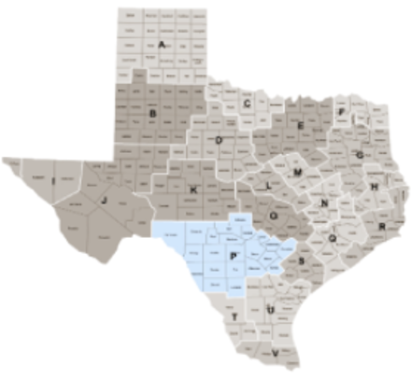
South Texas Trauma Area
22 counties
26,000 sq mi
5 rotary wing HEMS organizations, 18 helicopter bases
3 Level I trauma centers
Military
UTHSCSA/UHS
Adult
Pediatric

Slide 5
Objective: Identify potential triggers for massive transfusion protocol (MTP) activation
Methods:
Retrospective
Trauma registry, chart review
January 2015 to January 2018
Compared MTP to non-MTP adult trauma patients
Variables evaluated by t-test, chi-square test, and logistic regression
MTP = >10u blood products 24 hours or 5u/60 minutes

Slide 6
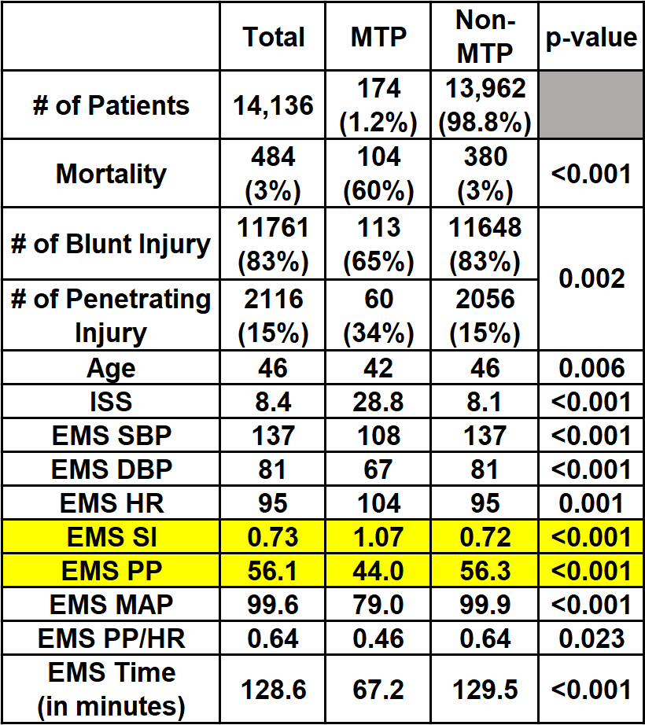
o
o
*
SI = HR/SBP
PP = SBP – DBP
o Variable for evaluation was chi-square test
* Variable for evaluation of all other p-values was the independent samples t-test

Slide 7
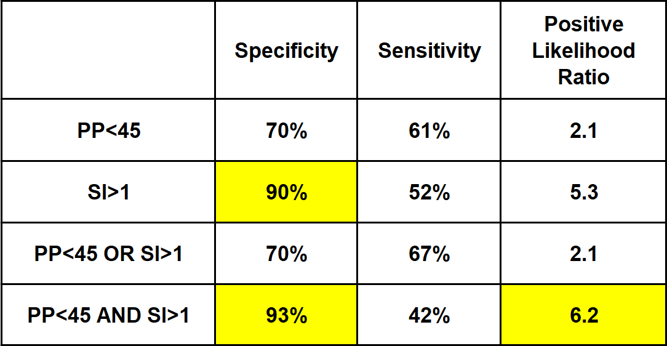
Potential Triggers for MTP

Slide 8
Outcome Data
* Variable for evaluation was the independent samples t-test

Slide 9
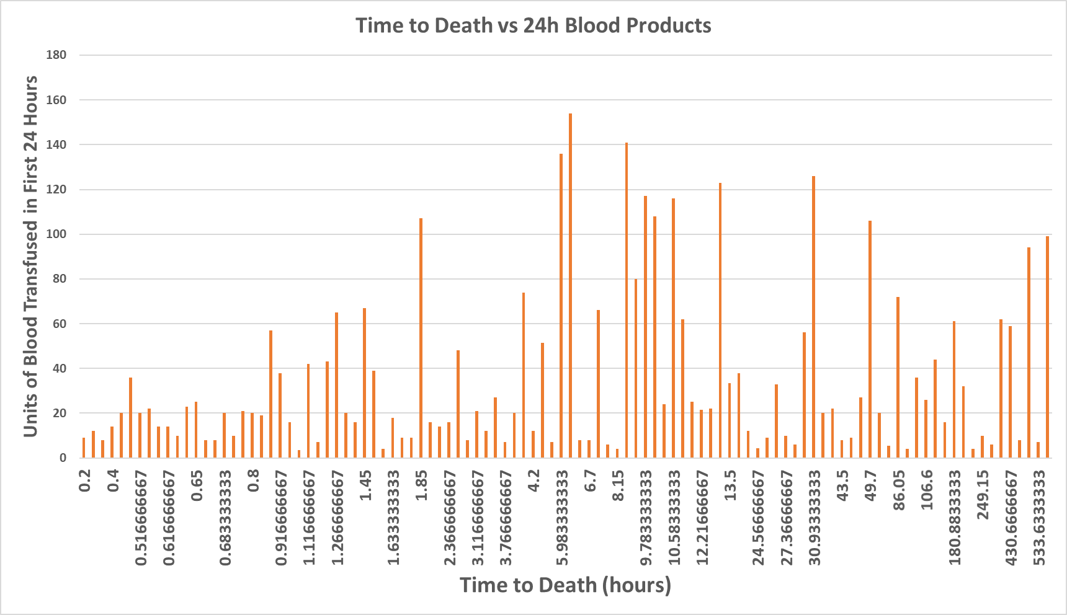

Slide 10
Odds Ratios
The adjusted odds of MTP were higher in:
Men
Penetrating injury
Patients in shock
Shock was defined as scene SBP ≤90, pulse ≥120, SI ≥0.9.
The adjusted odds of MTP increased [1.02 (95% CI 1.01-1.03)] with each year increase in patient age

Slide 11
Conclusion
Renewed focus on all aspects of hemorrhage control and early hemostatic resuscitation
New transfusion triggers validated
SI and PP correlate highly with MTP
Growth of program in South Texas and initiation of programs at other trauma centers
Notes:
Need to update

Slide 12
Pre-hospital Cold Stored O+ Whole Blood in San Antonio
Kicked off January 29, 2018
3000 new male LTO+WB donors (1:256)
18 helicopters, 2 units each
7 ground ambulances, 1 unit each
Pre-determined criteria for transfusion
Pediatric patients ≥5 yo included
Women of childbearing age included
Rh isoimmunization risk versus bleeding to death

Slide 13
Whole Blood Transfusion Criteria
Penetrating Trauma (requires 1 physiologic parameter)
Blunt Trauma (requires 2 physiologic parameters)
Physiologic Parameters
Patient age ≥ 5
Single reading of systolic blood pressure (SBP) < 90 mm Hg
Single reading of heart rate (HR) > 120
Shock index > 1
Pulse Pressure < 45
Positive focused assessment with sonography in trauma (FAST)
Point of care lactate greater than 5.0 mg/dl
Known or presumed anticoagulant use; or dual anti-platelet therapy
Signs of hemorrhage: (high index of suspicion of active internal bleeding or visual evidence of external bleeding)

Slide 14
Hot off the Presses: 1 u LTO+WB saves 2 lives
1st week of January
SAEMS responds to woman down in bathtub
38 weeks pregnant (G3P2)
Hemorrhaging
SBP = 60
SAEMS MOF transfuses 1u LTO+WB
On hospital arrival SBP = 85, 2 more units PRBC
Stat C-section for placenta previa, A+ blood type
The next day
Mom and baby doing well

Slide 15
Other Directions
September 2018
San Antonio Fire and EMS roll out
Medic Officers – 35 patients have received LTOWB
Geography: density/need
October-November 2018
Roll out to Level IV centers in south Texas
Comprehensive coverage of entire trauma region with LTO+WB

Slide 16
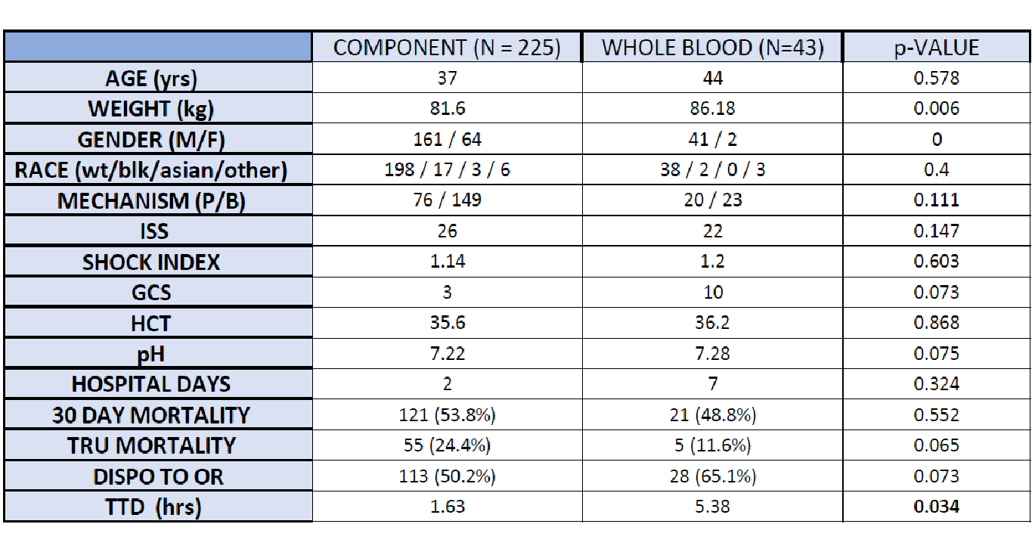
Contemporary work by Pokorny including first year in Whole Blood era
25 % < 90 min

Slide 17
MTP Patients Receiving Whole Blood Only (Classic MTP Definition) at UHS
Zero of Three Patients In This Category Died
Current STRAC Pre-hospital LTOWB Use

Slide 18
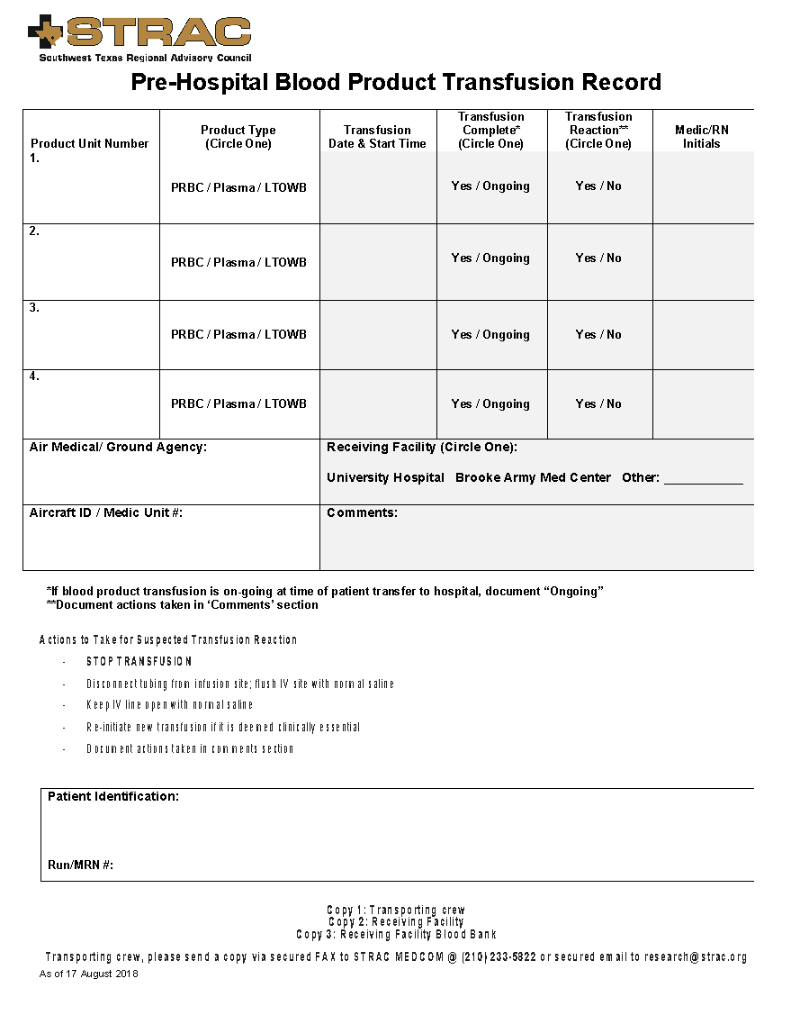
Clinical References/Resources
www.strac.org/blood
This card can be given to receiving facilities

Slide 19
Contemporary work by Pokorny First Year in Whole Blood Era
Component therapy emergency transfusion
Death rate in trauma room = 24%
Time to death = 1 ½ hours
Whole blood as emergency transfusion
Death rate in trauma room = 11%
Time to death = 5 ½ hours

Slide 20
Current Numbers
225 pre-hospital patients transfused
Over 300 patients transfused at University Hospital
1000+ units
Does not include BAMC patients (200+)

Slide 21
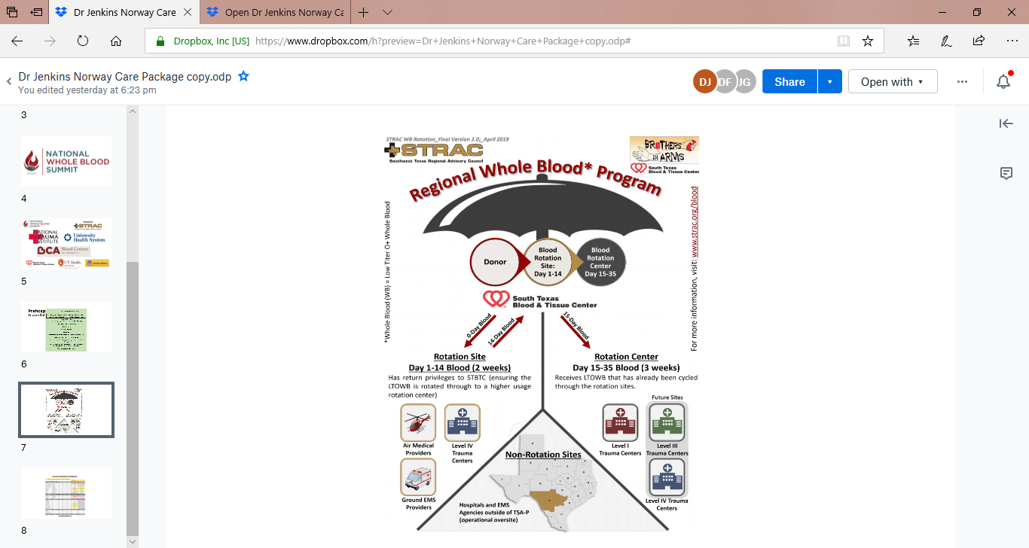

Slide 22
Obstetric Hemorrhage and Massive Transfusion

Slide 23
Postpartum Hemorrhage
Definition >500 mL vaginal delivery or >1000 mL cesarean section
ACOG reVITALize ≥ 1000 mL in 24 hrs or hypovolemia
PPH has been widely recognized as a major cause of maternal mortality worldwide
Early mortality (within 24 hours)
1 woman dies of PPH every 4 minutes worldwide and PPH is increasingly frequent
PPH rate over past 20 years from 1.5 to 4%

Slide 24
WOMAN Trial World Maternal Antifibrinolytic
200 hospitals, 21 countries > 20,000 women
TXA for PPH
10,000 women got TXA, 10,000 placebo
No difference in hysterectomy
Significant decrease in hemorrhage deaths with TXA, especially if within 3 hours of delivery

Slide 25
WHO Recommendations
Uterotonics in 3rd stage of labor
Tranexamic acid for refractory bleeding
Aortic occlusion
Angioembolization
Surgical intervention
Isotonic crystalloids, not colloids
NOTHING about transfusion

Slide 26
Finding #2 — The leading causes of pregnancy-related death in 2012 included cardiovascular and coronary conditions, obstetric hemorrhage, infection/sepsis, and cardiomyopathy.
76 percent of all pregnancy-related deaths.
Finding #5 — Most pregnancy-related deaths were potentially preventable.
Case review found that the majority of pregnancy-related deaths caused by cardiovascular disease, obstetric hemorrhage, and infection/sepsis were preventable
Finding #8 —Hemorrhage and Cardiac Event were the two most common causes of death while pregnant or within 7 days postpartum.
Of the 80 deaths that occurred while a woman was pregnant or within 7 days postpartum, hemorrhage & cardiac event accounted for 36 % of these deaths
https://docs.house.gov/meetings/IF/IF14/20180927/108724/HHRG-115-IF14-20180927-SD022.pdf
Notes:
Task Force & DSHS submit a report to the governor, lieutenant governor, speaker of the house & legislative committees by September 1 on even-numbered years
Review of cases of maternal deaths started in 2015
A death is considered preventable if the Task Force finds that there was at least some chance of the death being avoided by one or more reasonable changes to the circumstances of the patient, provider, facility, systems or community factors.Appendix B, Figure B2.
, as shown in Appendix B, Figure B3. 12 The Task Force determined that there was at least some chance for preventability in almost 80 percent of pregnancy-related deaths as shown in
, followed by Hypertension/Preeclampsia, Amniotic Embolism, and Other Causes.

Slide 27
Recommendations
Recommendation #4 — Promote a culture of safety and high reliability through implementation of best practices in birthing facilities.
The Task Force found a number of provider and facility factors associated with maternal death including failure to recognize risk status, delays in diagnosis, and delays in implementation of appropriate treatment.
DSHS and its partners have begun implementation of the maternal safety initiatives of TexasAIM, which address both hemorrhage and severe hypertension. The TexasAIM initiative also includes education and implementation of the Maternal Early Warning Systems (MEWS) which prompts early diagnosis and intervention.
Recommendation #5 — Identify or develop and implement programs to reduce maternal mortality from cardiovascular and coronary conditions, cardiomyopathy and infection/sepsis.
The Task Force recommends identification and implementation of best-practice programs to reduce risks of maternal death from these conditions.
https://docs.house.gov/meetings/IF/IF14/20180927/108724/HHRG-115-IF14-20180927-SD022.pdf
Notes:
Provider level factors contributing to death included inadequate response to or management of triggers leading to delayed and poorly coordinated response to diagnosis and treatment in the pregnancy, delivery, and the postpartum period; ineffective treatment; and complications from current C-section or labor induction or augmentation. Failure to recognize maternal early warning signs and high risk maternal health status were identified. Delays in treatment and inadequate or ineffective treatment of hypertension, hemorrhage, and infection were identified. Lack of leadership and communication contributed to missed diagnoses and ineffective treatment. Failure to recognize high-risk patients contributed to failure to refer high risk patients to appropriate care specialties and a delay in or lack of bedside clinician presence. Prioritization of the pregnancy outcome over the maternal condition in some cases of pregnancy-related death led to emergent delivery despite declining maternal health status.
At the facility level, inadequate knowledge, judgement, or performance by facility personnel; lack of recognition of high risk status; and lack of continuity of care were top contributing factors to death. Lack of recognition of high-risk status by facility staff, poor documentation in the patient’s chart, and delayed response to warning signs of declining health status by nursing staff was observed. Lack of recognition of risk factors for hemorrhage and delayed or no response to warning signs were observed. Finally, continuity of care was impacted by the inability to secure appropriate outpatient care and lack of appropriate hand-off of patients between hospital staff and outpatient providers.

Slide 28
University Hospital Experience
2 years, over 7000 deliveries
600+ women transfused in first 24 hours following delivery
Over 10% required MTP
MTP patients
Greater length of stay/ICU
Greater rate of fetal death
Greater rate of hysterectomy

Slide 29
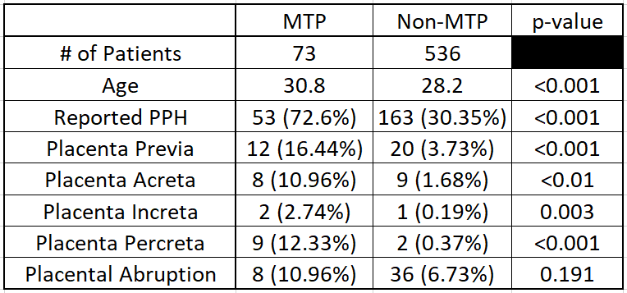
Distribution of patient characteristics between MTP and Non-MTP groups.

Slide 30
Hypothesis
Lack of adequate blood resuscitation in OB PPH resuscitation
Many MTP’s, no agreed upon ratios
No agreed upon transfusion triggers
No standard hemostatic resuscitation
No early hemostatic resuscitation
No use of aortic occlusion
No use of TXA

Slide 31
Answers
Develop and implement transfusion protocols
Cold stored whole blood as initial emergency transfusion
TXA if transfusion initiated
Access femoral artery in high risk cases
Easy/rapid deployment of aortic occluding balloon

Slide 32
LTO+WB
93% of our patients are Rh+
Plan to use same LTO+WB as is used for trauma patient
If high risk patient admitted ahead of scheduled delivery
Direct crossmatch and set units aside
If Rh-, draw 4 units O-WB, crossmatch and set units aside

Slide 33
Follow Up
Close performance improvement
Study each patient proactively
Safety review at 30 days and at 25 patients
Modify program as needed based upon incidents or trends
Is 4 units of whole blood enough? Too much?
Waste of blood?
Antibody development?
ICU and overall length of stay
Complications

Slide 34
Benefits
Decrease recipient exposure to multiple donors
Most physiologic and hemostatic agent
May (should) decrease rate of need for MTP
Shorter ICU and overall LOS

Slide 35
Mass Casualty Incident Plan

Slide 36
Day to Day Latest Plans
Resupply HEMS in real-time at trauma center
HEMS notifies MEDCOM of LTOWB use
MEDCOM notifies STBTC
STBTC rendezvous at trauma center with HEMS

Slide 37
Latest Plans
Ground EMS w/o LTOWB (not supplied or used entire supply) but patient in need
GEMS notifies MEDCOM
MEDCOM contacts trauma center with LTOWB between GEMS location and destination trauma center to arrange rendezvous

Slide 38
MCI plans
MEDCOM notifies STBTC of need
MEDCOM arranges for SAFD/EMS to get cooler with 20 LTOWB from STBTC
GEMS drives to regional hospital or scene of event OR
MEDCOM arranges GEMS/HEMS rendezvous to fly LTOWB to regional hospital or scene

Slide 39
MCI
True MCI which will rapidly diminish blood supply
First to be consumed: platelets
Platelets longest to donate/recover

Slide 40
MCI Plan Walking Blood Bank
Number of casualties x 4 = # LTOWB
When current stock inadequate, active WBB
Utilize BIA donors via ‘Crimson Alert’
Coordinate with STBTC donor buses to 16 HEB parking lots
Sites chosen by matching donor zip code clusters to nearest 24/7 HEB
Robo-call initiated by MEDCOM to appropriate number of donors, geographically distributed

Slide 41
WBB Plan
Preference given to BIA donors
Other STRAC hospitals in San Antonio donate man power to assist STBTC at HEB’s
Utilize VIA/Lyft to get donors and volunteers to HEB locations
Utilize HEB Favor delivery system, coordinated by MEDCOM, to distribute LTOWB to trauma centers (not necessarily geographic; need based distribution)

Slide 42
WBB Plan
Usual donor screening questionnaire
Specimen for standard testing
LTOWB from BIA donor into container
Timed at donation, will not be cooled
Tamper-proof tape on container
Rendezvous with Favor on site, MEDCOM coordinates
Post-transfusion testing of donor blood

Slide 43
WBB Plan
Likely attract many more donors beyond BIA donors
Draw blood as needed
Likely need standard testing: blood unavailable for several days but would resupply the STBTC
Need to coordinate with DoD MCI plan
DoD goes on lock down
Favor takes blood to SAMMC
Who shuttles it from the gate to the hospital?

Slide 44
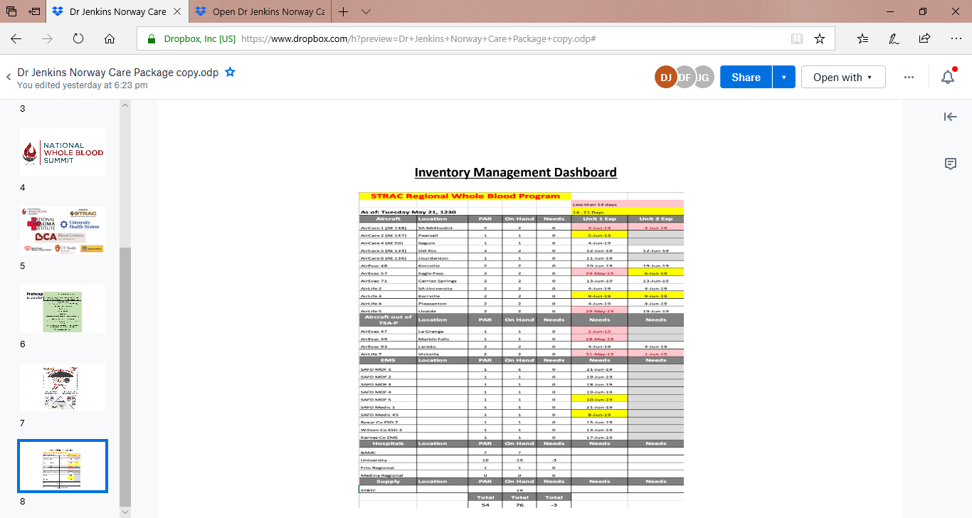

Slide 45
Future Directions
Cold Stored Platelets
14 vs 21 days
Retrospective testing of pre-hospital transfusion
Not currently done anywhere in US
Best practice as an AABB standard
Logistics of testing and patient followup

Slide 47
Whole Blood Summit
196 attendees
Networking opportunities
Look for 2020 dates
2/3 of whole blood not rotated from pre- to in-hospital goes to red cells
BIA program rotation results in 3% waste

Slide 48
References
https://apps.who.int/iris/bitstream/handle/10665/75411/9789241548502_eng.pdf;jsessionid=056E99DEE2B321D808D5E4CC456B0F7B?sequence=1
https://www.who.int/reproductivehealth/topics/maternal_perinatal/pph-woman-trial/en/
https://emedicine.medscape.com/article/275038-overview
https://www.ncbi.nlm.nih.gov/pmc/articles/PMC2680565/

Slide 49
References
Duffy, Jennifer, and Afshan B. Hameed.. "Cardiac Disorders in Pregnancy." CURRENT Diagnosis & Treatment: Obstetrics & Gynecology, 12e DeCherney AH, Nathan L, Laufer N, Roman AS. DeCherney A.H., Nathan L, Laufer N, Roman A.S. Eds. Alan H. DeCherney, et al. New York, NY: McGraw-Hill, , http://accessmedicine.mhmedical.com.libproxy.uthscsa.edu/content.aspx?bookid=2559&sectionid=206961814.
Candice K. Silversides, Jasmine Grewal, Jennifer Mason, Mathew Sermer, Marla Kiess, Valerie Rychel, Rachel M. Wald, Jack M. Colman, Samuel C. Siu. Pregnancy Outcomes in Women With Heart Disease. Journal of the American College of Cardiology May 2018, 71 (21) 2419-2430; DOI: 10.1016/j.jacc.2018.02.076
Lin, Lin MD; Chen, Yan-Hong MD; Sun, Wen MD; Gong, Jing-Jin MM; Li, Pu MM; Chen, Juan-Juan MD; Yan, Hao MD; Ren, Lu-Wen MM; Chen, Dun-Jin MDRisk factors of obstetric admissions to the intensive care unit: An 8-year retrospective study. Medicine. 98(11):e14835, March 2019.
https://hhs.texas.gov/sites/default/files/documents/about-hhs/communications-events/meetings-events/maternal-mortality-morbidity/m3tf-agenda7-170929.pdf
Patterson, Karen C., et al.. "Critical Illness in Pregnancy." Principles of Critical Care, 4e Eds. Jesse B. Hall, et al. New York, NY: McGraw-Hill, 2014, http://accesssurgery.mhmedical.com.libproxy.uthscsa.edu/content.aspx?bookid=1340&sectionid=80028447.
Halpern, Dan G., et al.. "HEART DISEASE IN PREGNANCY." Hurst's The Heart, 14e Eds. Valentin Fuster, et al. New York, NY: McGraw-Hill, , http://accessmedicine.mhmedical.com.libproxy.uthscsa.edu/content.aspx?bookid=2046&sectionid=176567047.
Lee, S, Kim, H, et al. Use of the shock index to predict maternal outcomes in women referred for postpartum hemorrhage. Int J Gynecol Obstet 2019 144: 221-224.
Committee on Practice Bulletins-Obstetrics. Practice Bulletin No. 183: Postpartum Hemorrhage. Obstet Gynecol 2017; 130:e168.

Slide 50
Contact
Donald H. Jenkins, MD, FACS Professor/Clinical, Division of Trauma and Emergency Surgery, Vice Chair for Quality, Department of Surgery, Betty and Bob Kelso Distinguished Chair in Burn and Trauma Surgery, Associate Deputy Director, Military Health Institute
UT Health San Antonio
7703 Floyd Curl Drive
San Antonio, TX 78229-3900
Phone: (210) 743-4130
Jenkinsd4@uthscsa.edu

Slide 51
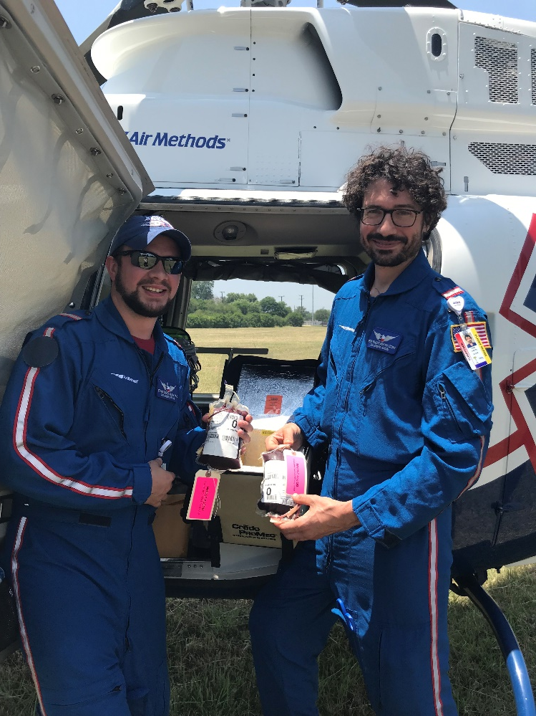
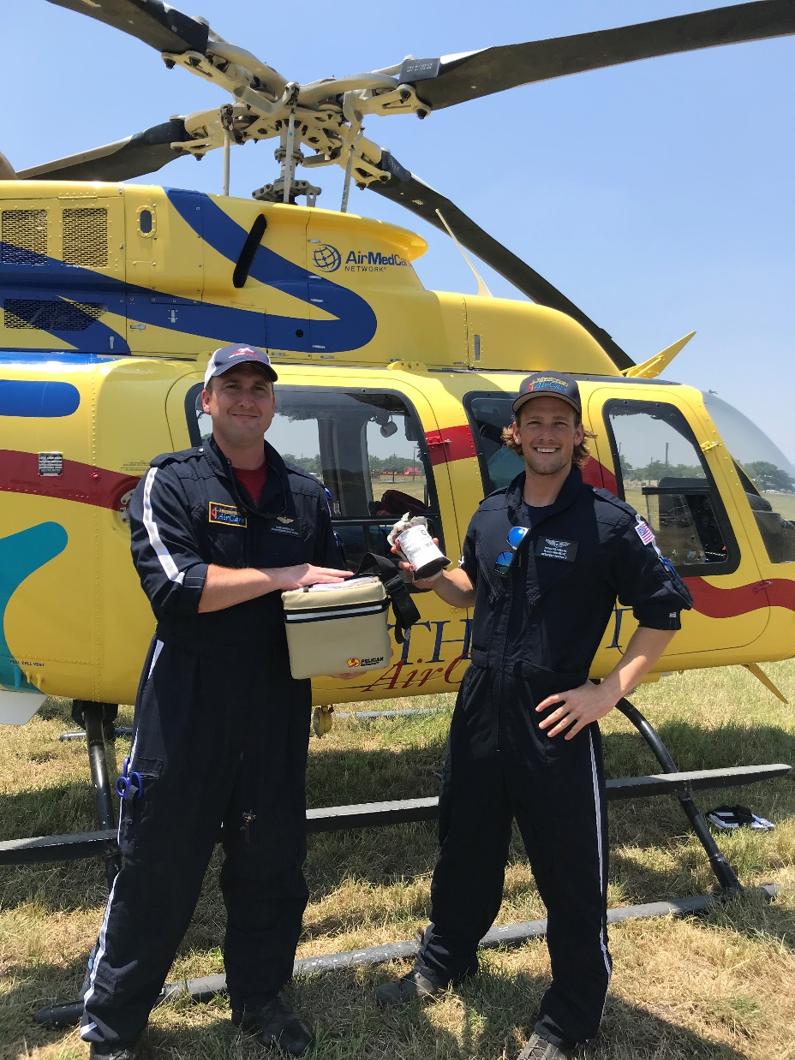
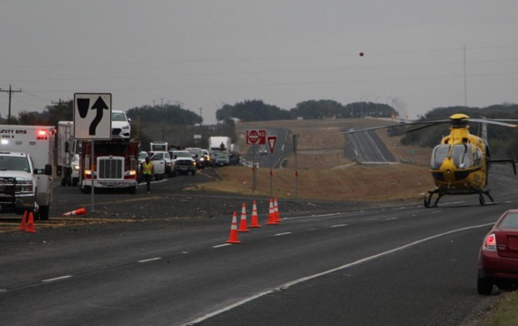
Thank You! Questions?

