Slide 1
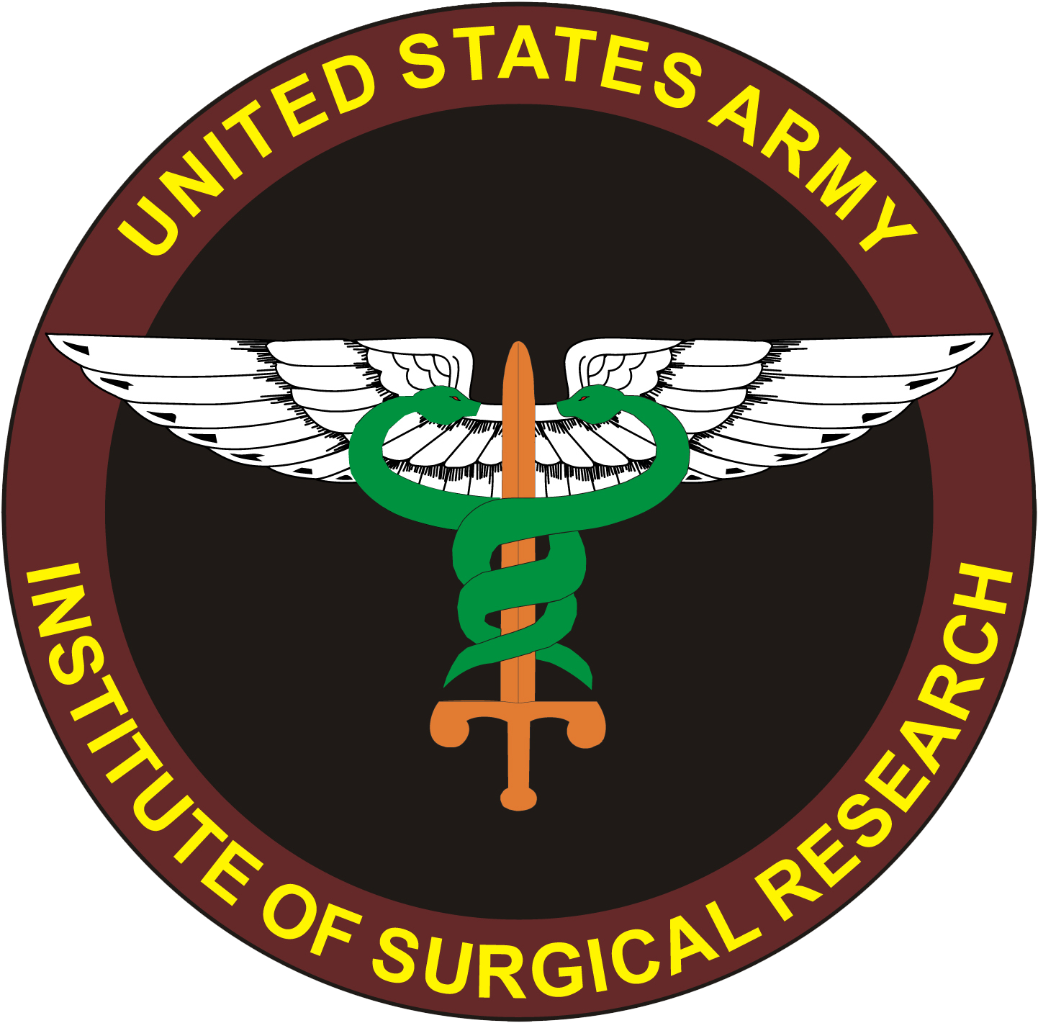
THOR RDCR 10th Symposium
27 June 2022
Beyond Transfusion: Transformational Change in Trauma Care
COL Andrew P. Cap, MD, PhD
Director of Research
US Army Institute of Surgical Research

Slide 2
Disclaimer:
The opinions or assertions contained herein are the private views of the authors and are not to be construed as official or as reflecting the views of the Department of the Army or the Department of Defense.
Disclosures:
I have no relevant conflicts of interest.
I am an active duty officer in the U.S. Army.

Slide 3
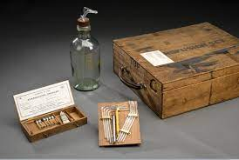
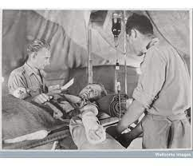
WWI: First Blood 1915
Whole Blood saves; cross-matching, citrate
“Administration of saline worsens acidosis and is harmful to the critical wounded.”
          --Dr. Cannon, WWI 1918
Blood Transfusion at the Frontlines: WWI, 1918

Slide 4
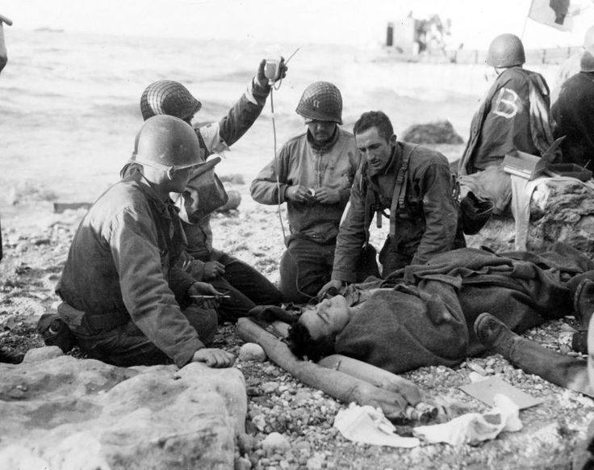
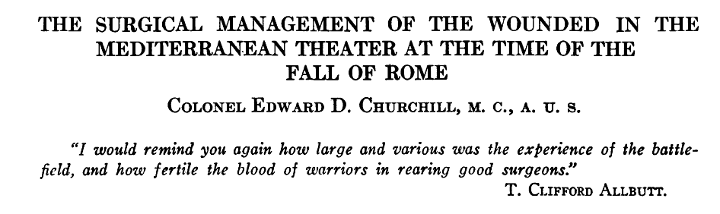
WWII: plasma as a bridge to Whole Blood
Soldier receiving freeze-dried plasma on Omaha Beach, 1944.
NB: plasma is only a bridge! (poor outcomes with plasma-only resuscitation in 1942)
WB from US (cold stored LTOWB) not available until 1944!
-- Walking blood bank through mid-1944
-- WB program (Aug ‘44) driven by unacceptable mortality in Normandy (inadequate collection from WBB for massive transfusion needs)
WB: cornerstone of military blood planning through Vietnam.

Slide 5
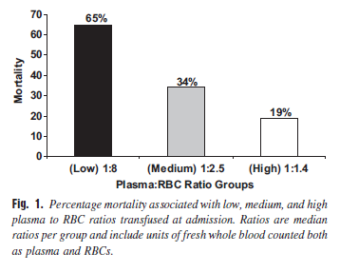
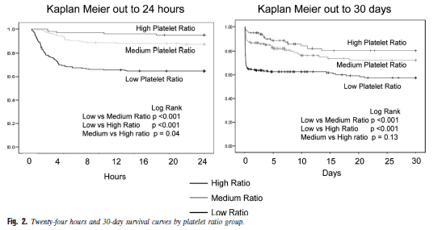
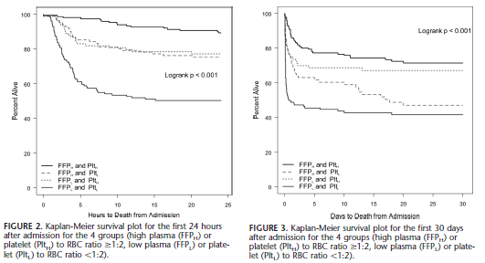
Post-Vietnam: The Birth of Damage Control Resuscitation
Perkins JG, et al. J Trauma. 2009 Apr;66(4 Suppl):S77-84.
  Borgman MA, et al. J Trauma. 2007 Oct;63(4):805-13.
No more crystalloids, give balanced components!
  Holcomb JB, et al. Ann Surg. 2008 Sep;248(3):447-58.

Slide 6
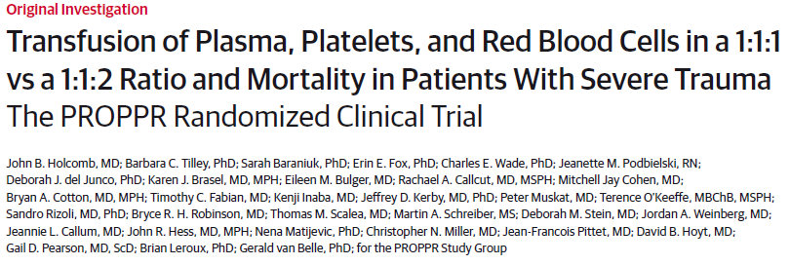
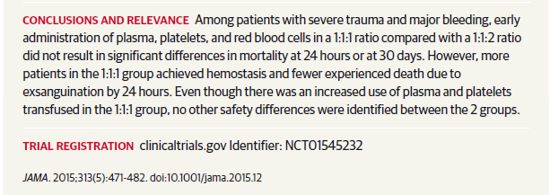
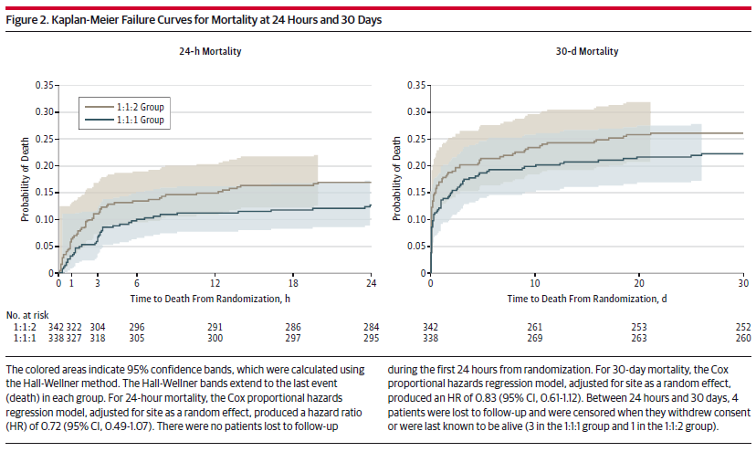
DCR (balanced resuscitation) Validation:
PROPPR

Slide 7
Rediscovery of FWB
FWB looks pretty good…
Whole blood at the tip of the spear: A retrospective cohort analysis of warm fresh whole blood resuscitation versus component therapy in severely injured combat casualties.Gurney JM, Staudt AM, Del Junco DJ, Shackelford SA, Mann-Salinas EA, Cap AP, Spinella PC, Martin MJ.Surgery. 2022 Feb;171(2):518-525. doi: 10.1016/j.surg.2021.05.051. Epub 2021 Jul 10.PMID: 34253322
Warm fresh whole blood is independently associated with improved survival for patients with combat-related traumatic injuries.Spinella PC, Perkins JG, Grathwohl KW, Beekley AC, Holcomb JB.J Trauma. 2009 Apr;66(4 Suppl):S69-76. doi: 10.1097/TA.0b013e31819d85fb.PMID: 19359973

Slide 8
What about CSWB?
Can we use that as we did in WWII, Korea, Vietnam…
PREHOSPTIAL LOW TITER GROUP O WHOLE BLOOD IS FEASIBLE AND SAFE: RESULTS OF A PROSPECTIVE RANDOMIZED PILOT TRIAL.Guyette FX, Zenati M, Triulzi DJ, Yazer MH, Skroczky H, Early BJ, Adams PW, Brown JB, Alarcon L, Neal MD, Forsythe RM, Zuckerbraun BS, Peitzman AB, Billiar TR, Sperry JL.J Trauma Acute Care Surg. 2022 Jan 25. doi: 10.1097/TA.0000000000003551. Online ahead of print.PMID: 35081595
Low Titer Group O Whole Blood In Injured Children Requiring Massive Transfusion.Gaines BA, Yazer MH, Triulzi DJ, Sperry JL, Neal MD, Billiar TR, Leeper CM.Ann Surg. 2021 Oct 8. doi: 10.1097/SLA.0000000000005251. Online ahead of print.PMID: 35129530

Slide 9
Overall: estimation of outcomes for MOD-SEV patients → WB probably has an advantage

Slide 10
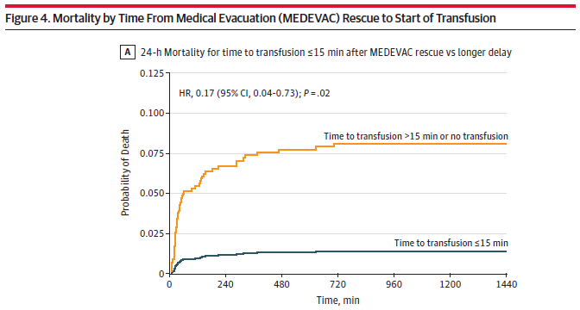
Other things learned in the desert…
Time is life. Transfuse early.
Must start transfusion within 30-40 min of severe injury.
Increasing duration of shock is not helpful.
Think BLS. How many minutes before myocardium and brain die?
Shackelford JAMA 2017.

Slide 11
Yes, we can do what we did in WWII: plasma then DCR (1:1:1 or WB)
Plasma given pre-hospital as a bridge to full DCR reduces mortality by 1/3 (23% vs. 33%)!
Proof of concept for FDP as a bridge to WB in DCR...
Note: outcomes even better with plasma+RBC

Slide 12
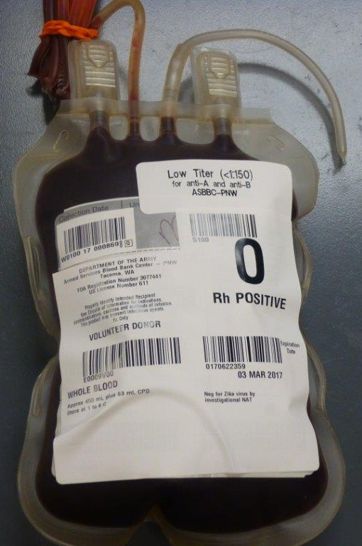
WB vs. Components:
More concentrated, simpler
 | WB 4°C | Components (1:1:1)
Hgb HCT | 12-13 35-37 | 9 28
PLT | 138-165 | 90-120
Fibrinogen, Factors | Normal @ baseline, FVIII ≥ 50% d7 | All 62% dilution @ baseline, plus loss FVIII
TEG | Nearly normal d21 | Reduced vs. WB
PLT aggregation | ≥ 50% baseline d7-10 | Nearly complete loss d5 in RT-PLT
Practical aspects (4L) | 8 bags, one storage mode (8 U, 4000 ml) | 13 bags, three storage modes (6:6:1, 4150 ml)

Slide 13
LTOWB re-introduced as primary transfusion product for DCR
6

Slide 14
PRBC use down as LTOWB up; liquid plasma replaces FFP
6

Slide 15
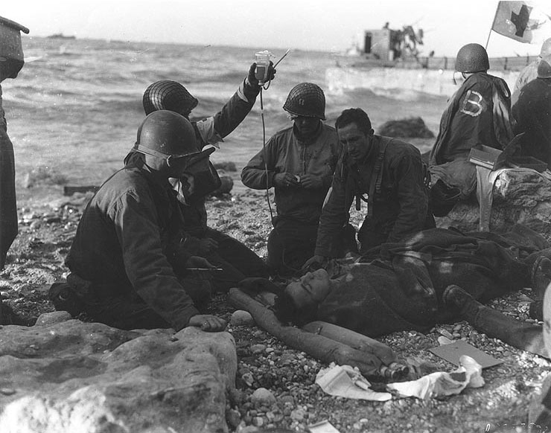
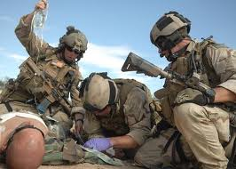
Past, Present and Future of Resuscitation?
Whole Blood is King!
Components are cool!
WW I
WW II
Korea
Vietnam
OIF/OEF
Back to the future!
60 years of Blood
30 years of Clear Fluids
WB + plasma
Prehospital transfusion

Slide 16
“Houston, we have a problem…”
No benefit to prehospital RBC+LyoPlas!
6

Slide 17
Benefit of early blood transfusion: is it all just a matter of timing?
COMBAT (no benefit): 20 min prehospital – too short to see benefit of prehospital blood?
RePHILL (no benefit): 90 min prehospital & 50 min until intervention – too late?
PAMPer (benefit): just right? (40 min transport time)

Slide 18
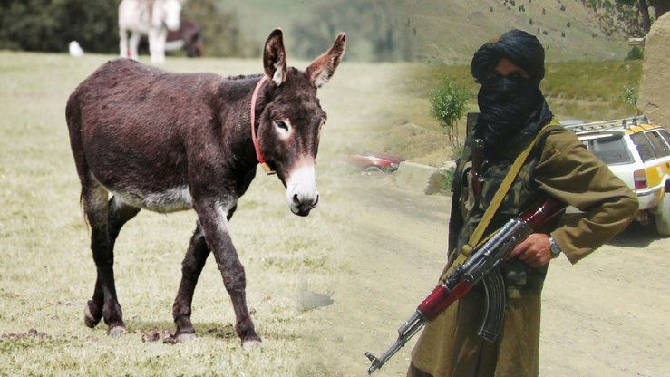
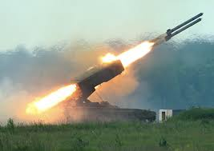
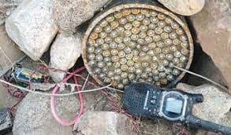
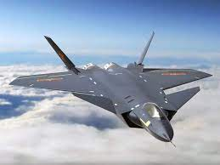
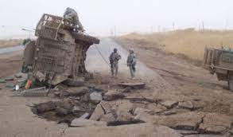
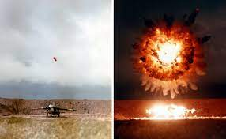
If timing is everything, we have a problem…
Afghanistan / Iraq:
Improvised explosive devices
Small arms, mortars, RPGs →
Low casualty density, rapid transfusion & evacuation to surgery
Russia / China:
Sophisticated / lethal weapons, contested air →
High casualty density, delayed transfusion & evacuation to surgery

Slide 19
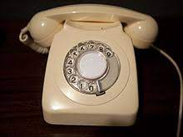
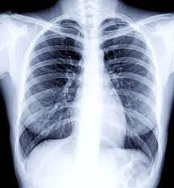
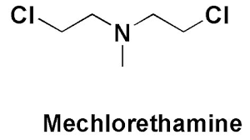
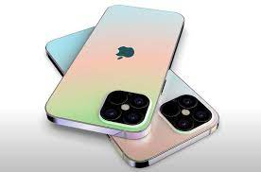
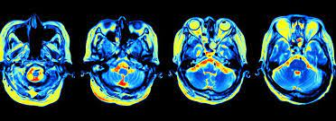
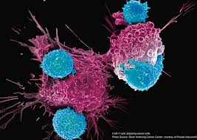
Is there really nothing more we can do?
Back to WWII (plasma as bridge to WB)?
But… have we not made a few advances in biology & engineering since 1915?
fMRI
CAR-T cells

Slide 20
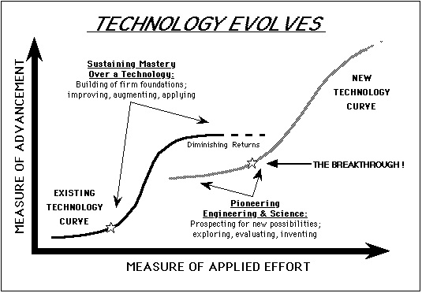
If we want better outcomes, we need new tools (innovation)!
Where we need to be for MDO/LSCO
Combat Casualty Care 2021
What we need to do NOW!
Combat Casualty Care 2001

Slide 21
Fundamental Challenges of
Prolonged Field Care: the 5+1 Pillars – RDCR Capability
New Trauma Treatments
Clinical Translational Research
Organ function support & engineering solutions
Blood & Shock Resuscitation
Hemorrhage & vascular dysfunction
Combat wound care
Pain, sensory trauma
Acute (0-1 hours)
Blood / Airway Loss
→ ↓ DO2 →↓ ATP → ↓ pH → ↑ K+
→ Cell death
→ Endothelial dysfunction
→ Coagulopathy
Delayed (6-24 hours)
Inflammatory second hit
Progression of organ failure
Wound progression, thrombosis & infection
Vascular dysfunction / edema / thrombosis
→ Organ failure: brain, heart, kidney, lung
Wound contamination &
colonization
Intermediate (2-6 hours)
Pillar 1
Pillar 2
Pillar 3
Pillar 4
Pillar 5

Slide 22
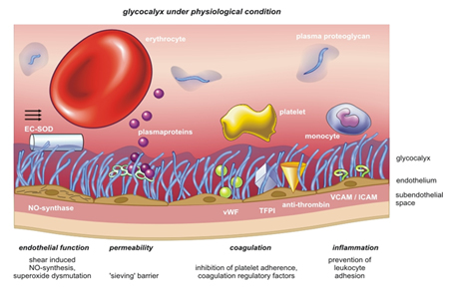
Blood + Endothelium =
Blood is an Organ
Embryonic mesoderm → hemogenic endothelium → HSC → blood: 3d week embryo
Blood = RBCs, WBCs, Platelets, Plasma, and… Endothelium (10¹³ cells)
Microcirculation estimated to cover an area of up to 7000 m²
Largest organ system, highest turnover rate.
COL Andrew P. Cap, andrew.p.cap.mil@mail.mil

Slide 23
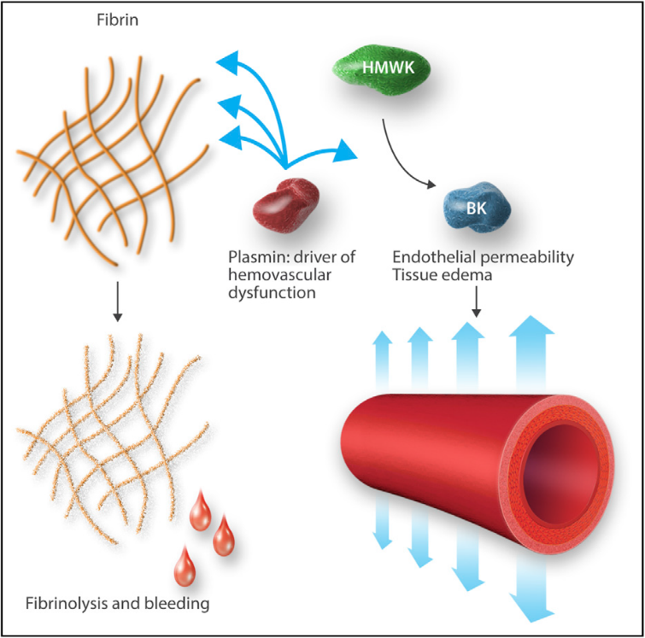
TRAUMA BLOOD & ENDOTHELIAL PATHOPHYSIOLOGY
Coagulopathy not as simple as low thrombin
  -- time X factor consumption: hyper → hypothrombin; fibrinogen depleted first
  -- in vitro vs. in vivo reality: long PT vs. ↑ thrombin in vivo
  -- cell-based coagulation: 1000X on surfaces (PLT, EC, WBC)
  -- fibrinolysis: depth/duration of shock
  -- platelet consumption & dysfunction over time
  -- plasmin nexus: immune activation, vascular dysfunction
Darlington et al. Shock 2019.
Cap Blood 2017.

Slide 24
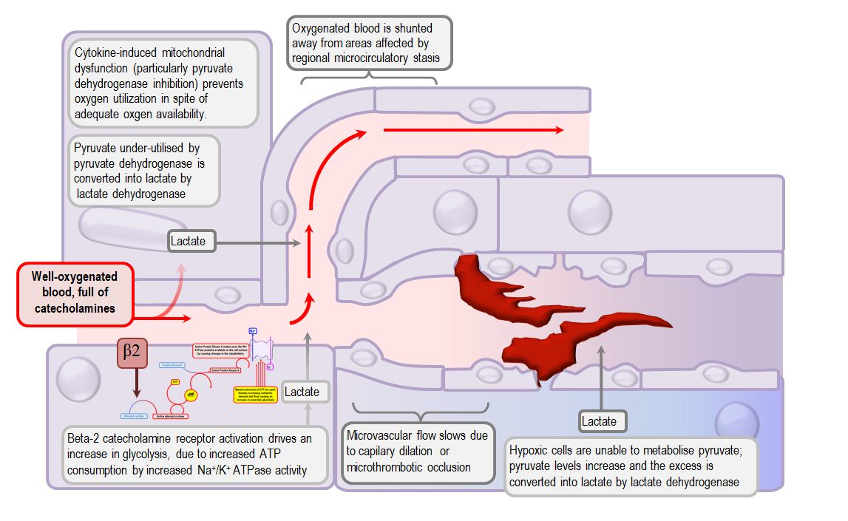
Shock: starts with inadequate oxygen delivery… then it gets complicated
Shock metabolic points of intervention?
-- shutdown of pyruvate entry into TCA
-- catabolism of NAD+
-- catecholamine driven ATP depletion
Inhibition of pyruvate dehydrogenase complex by PDK a druggable target…
COL Andrew P. Cap, andrew.p.cap.mil@mail.mil

Slide 25
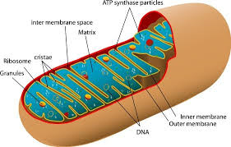
Loss of Blood + Damaged Endothelium → Blood Failure
Mitochondrial
Dysfunction
Final common pathway is metabolic failure. Need blood ASAP + “shock drug.”
COL Andrew P. Cap, andrew.p.cap.mil@mail.mil
25

Slide 26
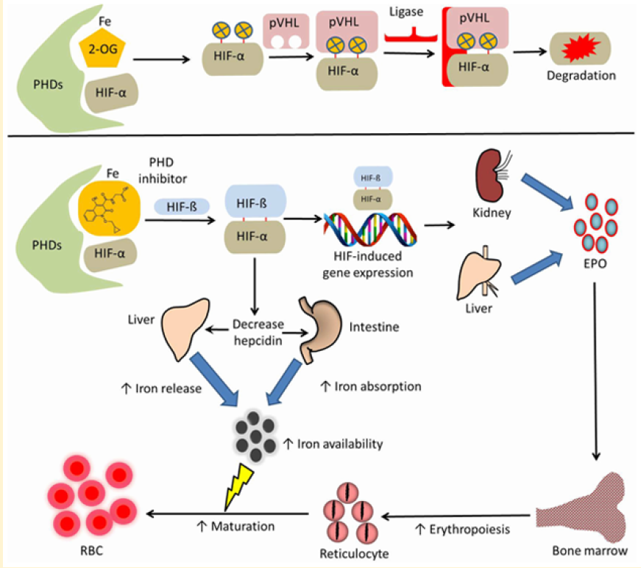
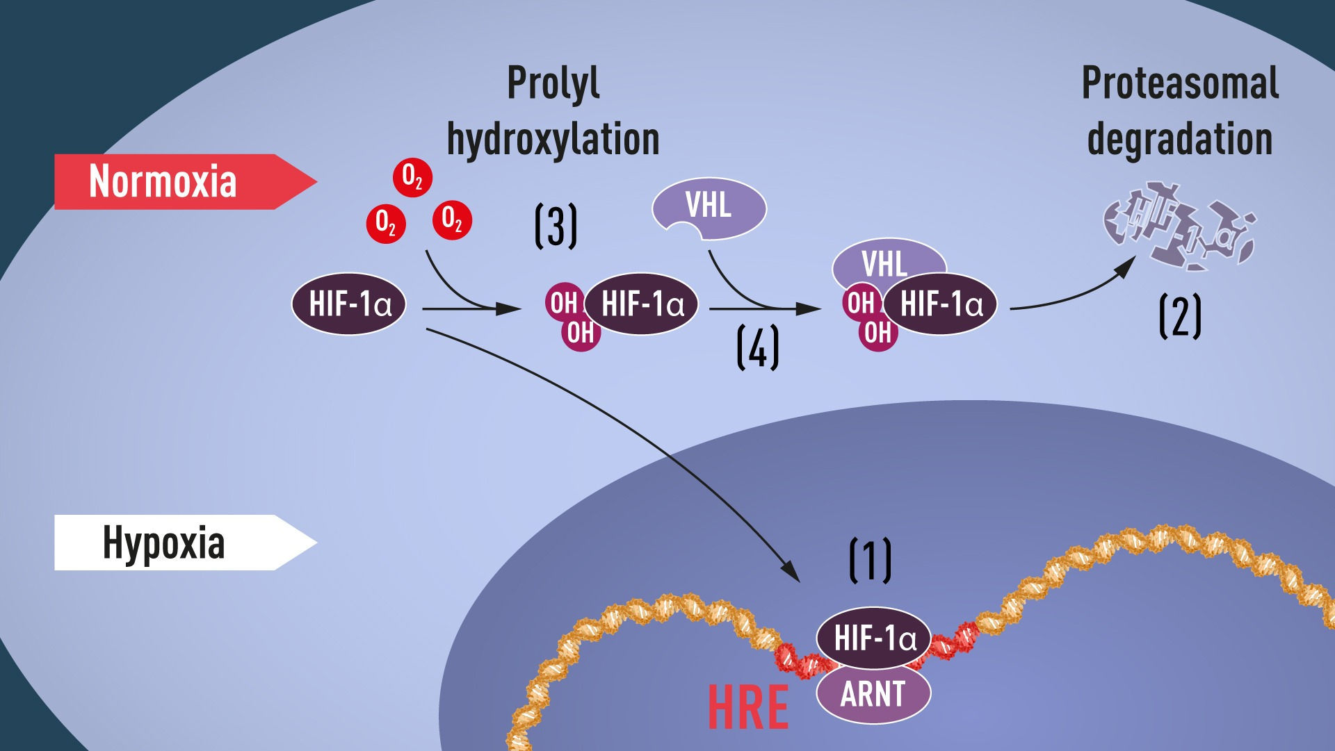
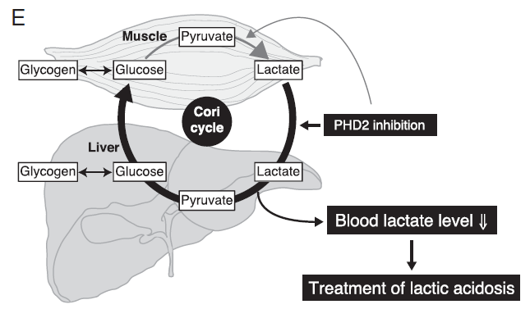
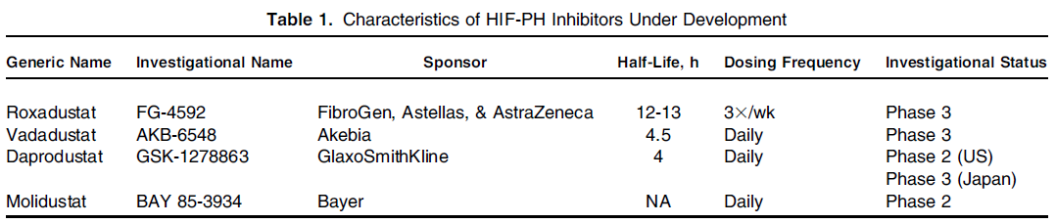
Prolyl Hydroxylase Domain Inhibitors (PHDi)
Improve Adaptation to Hypoxia
Erythropoietic Effects
Metabolic Reprogramming
nobelproze.org
Joharapurkar AA, et al, J Med Chem 2018
Suhara T, et al, PNAS, 2015
2019 Nobel Prize in Physiology/Medicine to William G. Kaelin Jr.
Sir Peter J. Ratcliffe
Gregg L. Semenza
for their discoveries of how cells sense and adapt to oxygen availability
Gupta N, AJKD 2017
COL Andrew P. Cap, andrew.p.cap.mil@mail.mil

Slide 27
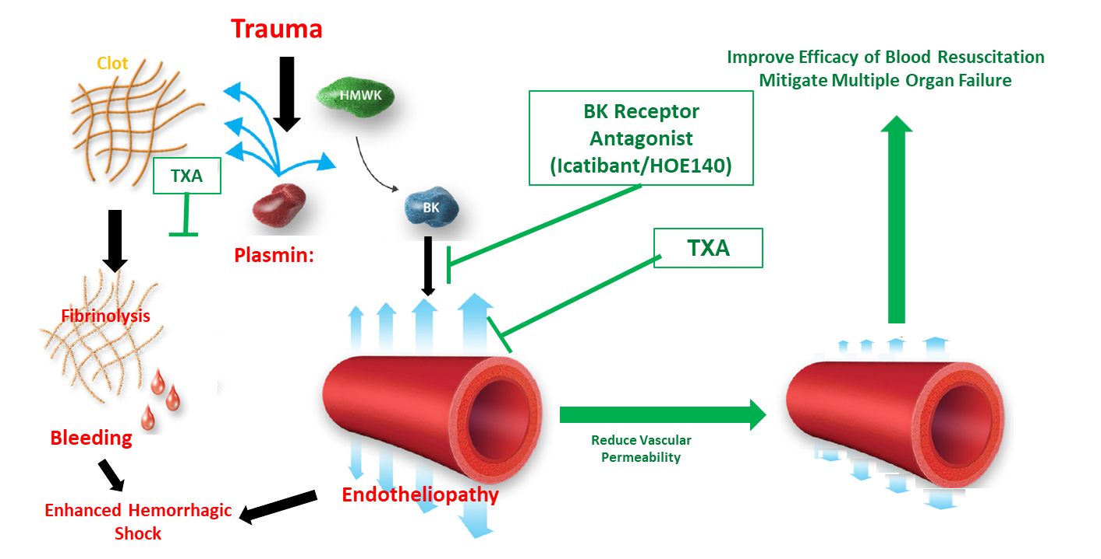
Icatibant and Tranexamic Acid: Targeting Plasmin (Hemovascular Dysfunction in Shock)

Slide 28
New target for evaluation in hemorrhagic shock: Angpt1/2 – Tie2
Angpt2 release from W-P bodies during inflammation → antagonizes Tie2 signaling
VE-PTP = Tie2 “off switch”

Slide 29
Rescue of Tie2 signaling & prevention of vascular leak by Angpt1 mimetic
HHHRHSF
Sepsis: Angpt2 highly elevated, Angpt1 depressed
-- Angpt2 level and/or Angpt2/Angpt1 ratio predicts vascular leak & mortality
-- Angpt2 polymorphisms predict poor outcomes
Vasculotide (VT): Angpt1 mimetic (no homology)
HHHRHSF → rescues Tie2 signaling and prevents leak/mortality
-- siRNA knockdown of Angpt2 also works

Slide 30
COVID-19 (& trauma, sepsis, radiation, heat stroke) = EC injury pattern

Slide 31
COVID-19 (& trauma, sepsis, radiation, heat stroke) = loss of EC anticoagulant phenotype

Slide 32
Turning off the “off switch” for Tie2: inhibition of VE-PTP preserves EC function
AKB-9778 restores EC anticoagulant phenotype
Promising proof-of-concept for trauma/
hemorrhage:
-- less consumptive coagulopathy?
-- less microvascular thrombosis & organ failure?
This may not be THE answer, but it’s an example of where we need to explore to develop new solutions.

Slide 33
The future of trauma and shock resuscitation?
Transfusion is the foundation, but it is not enough.
Need to leverage improving understanding of blood + endothelium as a system to develop solutions.
Need to combine blood, endothelial signaling targets, metabolic pathways to increase survival.
Need multi-disciplinary approaches.
Significant pre-clinical work still required to support translation to clinical trials.

Slide 34
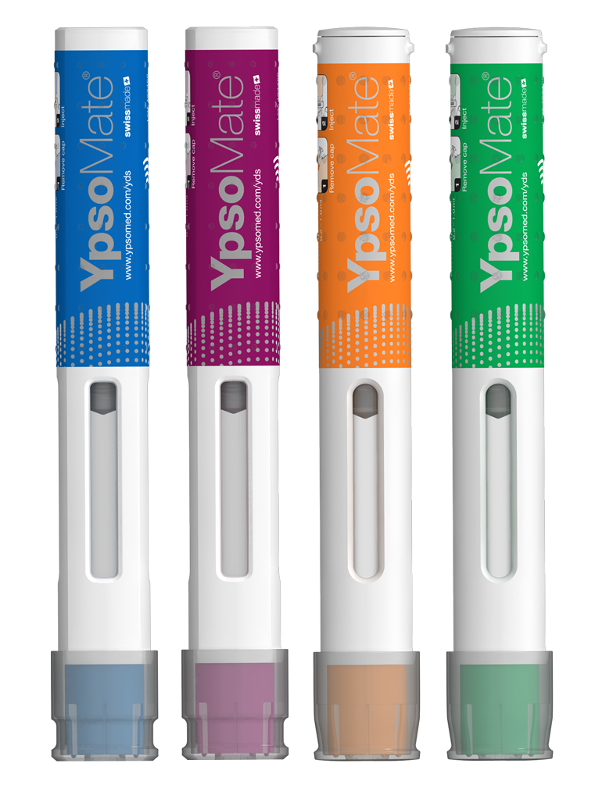
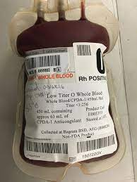
The future: self/buddy aid with shelf stable drugs, blood ASAP?
Autoinjectors: metabolic & endothelial drugs, TXA, Ketamine…

Slide 35
Questions?

