Slide 1
Reducing Metabolic Needs In Hemorrhagic Shock
Samuel A. Tisherman, MD, FACS, FCCM
Professor
Department of Surgery, Program in Trauma
University of Maryland School of Medicine

Slide 2
Disclosures
Co-author of patent
  “Emergency Preservation and Resuscitation Method”
Grant support
  US Department of Defense

Slide 3
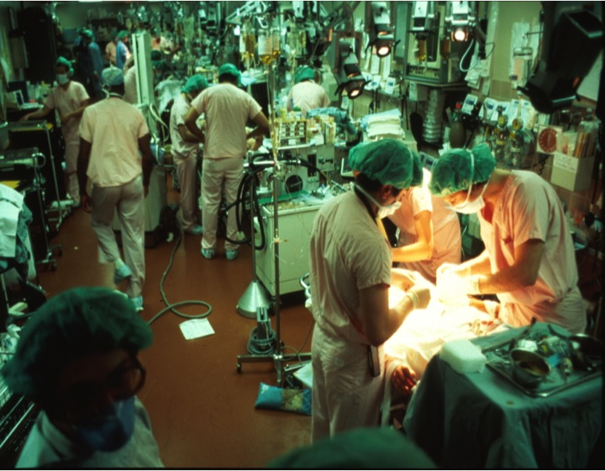
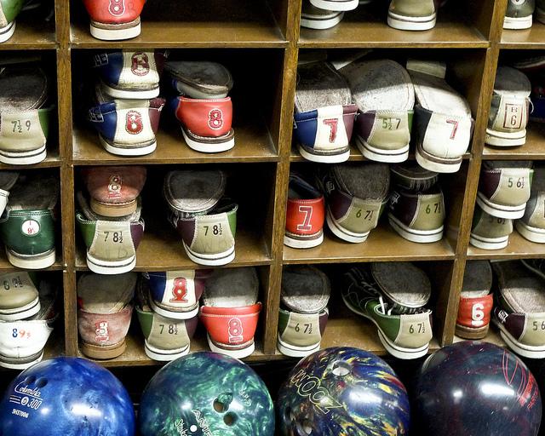
Trauma case at Shock Trauma
23 yo male
Stab wound to the heart
Arrest in Trauma Resuscitation Unit

Slide 4
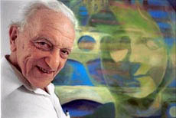
Peter Safar
Father of CPR
Ad
  Looking for medical students for cardiac arrest research

Slide 5
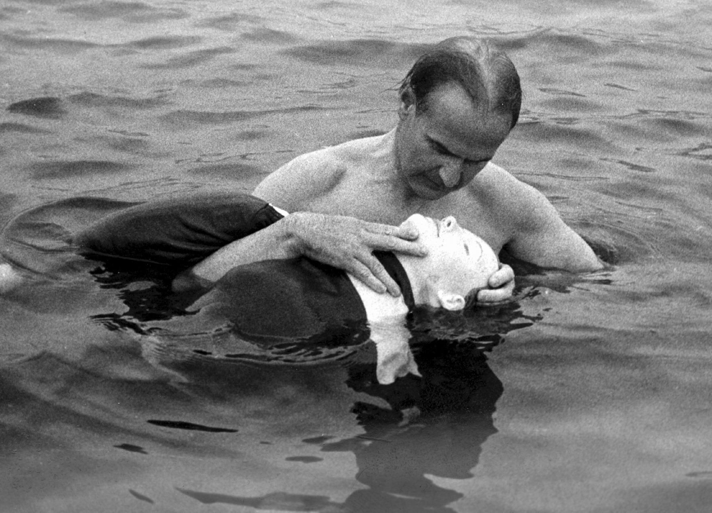
Asmund Laerdal and Resusci-Anne

Slide 6
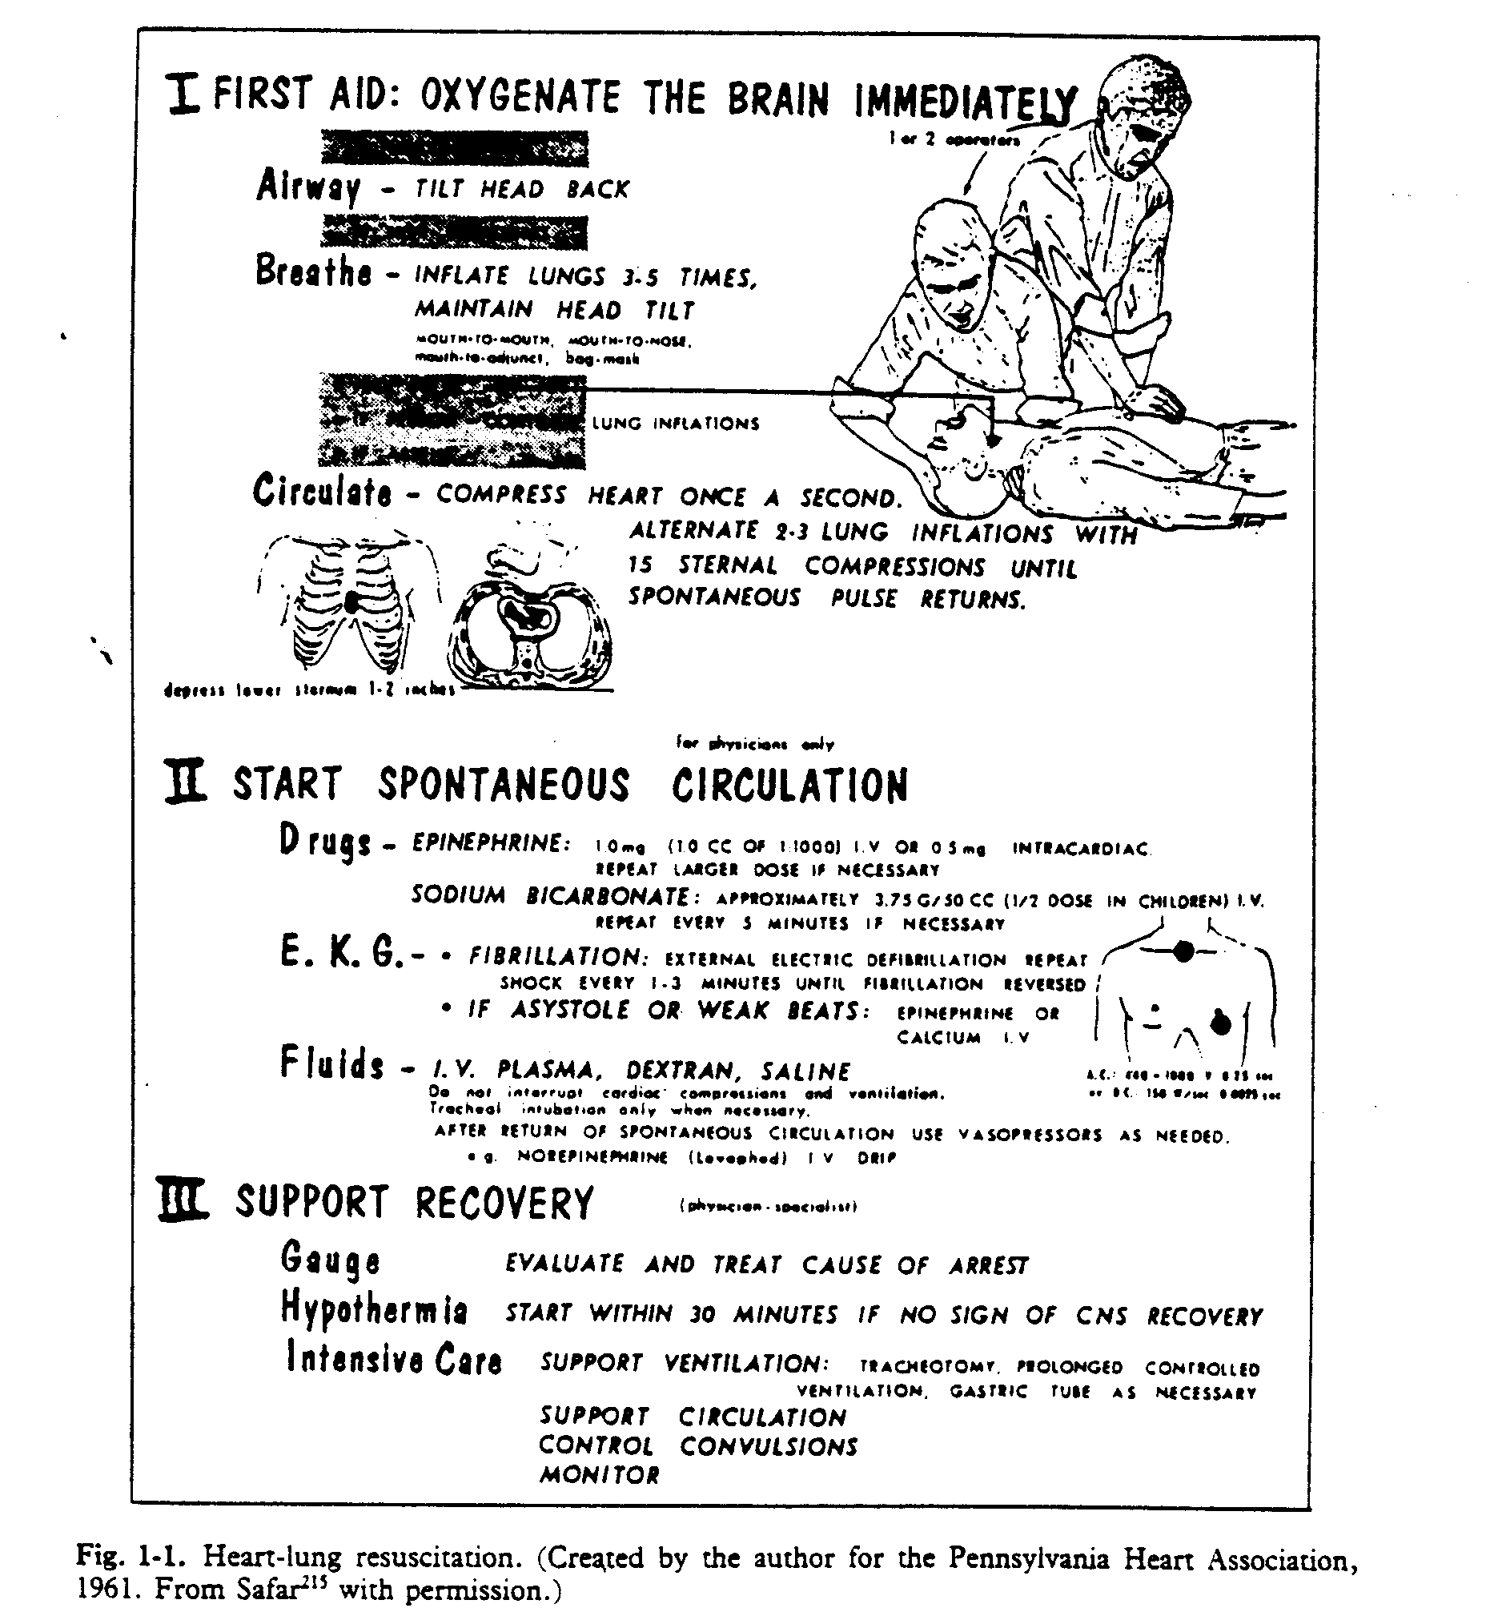
ABCs of CPR
Hypothermia: Start within 30 minutes if no signs of CNS recovery

Slide 7
2015 ERC/AHA Guidelines
Post-cardiac Arrest Care
Comatose (ie, lack of meaningful response to verbal commands) adults
Targeted temperature management
  32°C to 36°C
  At least 24 hours after achieving goal
Prevent fever for >72 hrs

Slide 8
Traumatic Cardiac Arrest and TTM
Shock Trauma Center, 2008-2010
6 pt with coma after arrest during initial assessment
32-34ºC for 24 h
No complications of hypothermia
Outcome
  1 died (had prehospital arrest)
  2 chronic care
  3 active rehab
Tuma, et al. J Trauma, 2011.

Slide 9
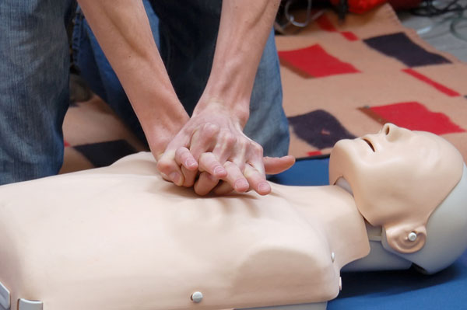
CPR doesn’t work in trauma

Slide 10
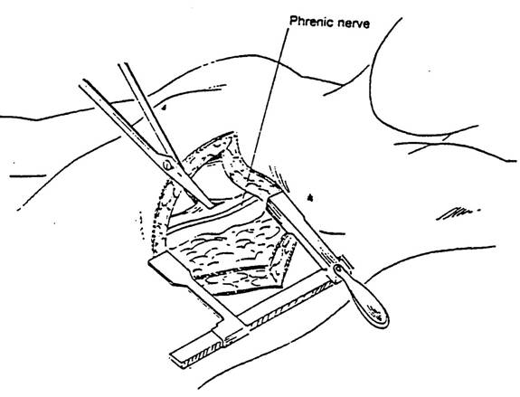
Cardiac arrest from trauma
Survival (%)
Rhee, JACS, 2000

Slide 11
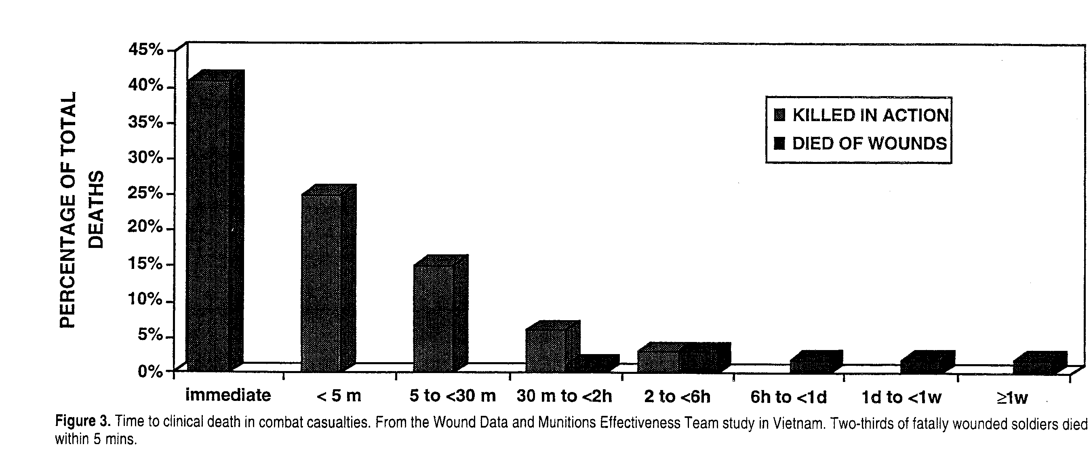
Time to Death in Combat Casualties
Dr. Peter Safar
Col. Ron Bellamy
Notes:
Soliders killed in action often died with wounds that were technically repairable.

Slide 12

Emergency Preservation and Resuscitation
“Protection and preservation of the organism during circulatory arrest of 2 h or longer for transportation and control of bleeding during pulselessness followed by delayed resuscitation.”
Could allow survival from otherwise lethal insults
How do we do it?

Slide 13

Hibernation and hemorrhagic shock
Hibernators show resistance to shock and ischemia-reperfusion injury
Can this be translated to non-hibernators?
Wolf, et al. Shock, 2018.

Slide 14
Hibernation and hemorrhagic shock
Potential agents
  Delta opioid receptor activation
    Hibernation induction trigger
    D-Ala2-Leu5-enkephalin (DADLE)
  Adenosine, lidocaine, and magnesium
    Decrease O2 demand via anti-adrenergic effects
  D-ß hydroxybutyrate
    Alternative energy source
Wolf, et al. Shock, 2018.

Slide 15
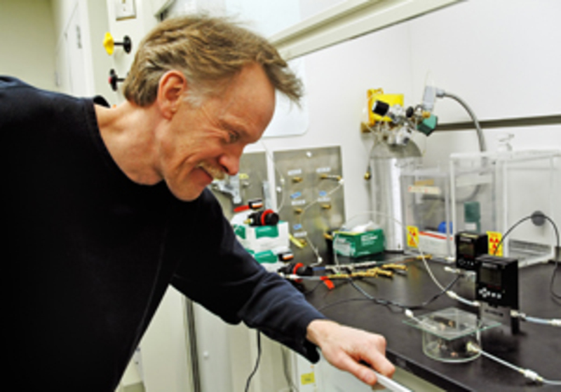
Hydrogen sulfide
Hydrogen sulfide (H₂S) is a specific, potent, and reversible inhibitor of complex IV (cytochrome c oxidase)
Mark Roth
  UW Hutchinson Center
  Zombie mouse master
    Wired Magazine
Blackstone, et al. Science, 2005.

Slide 16
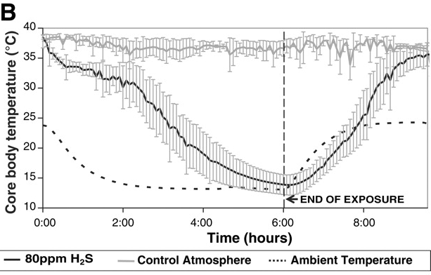
Hydrogen sulfide
Blackstone, et al. Science, 2005.

Slide 17
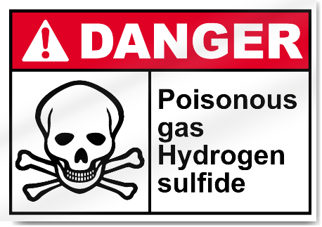
Hydrogen sulfide
Intravenous formulations available
Variable results with shock or cardiac arrest

Slide 18
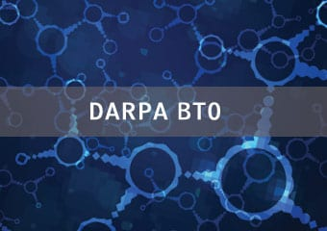
Biochronicity project
Biological Technologies Office (BTO)
Defense Advanced Research Projects Agency (DARPA)

Slide 19
Biochronicity project
Goal is metabolic suppression and reducing oxygen demand
  Selectively and reversibly
LY294002
  Phosphoinositol-3-kinase (PI3-K) family of intracellular signal-transducer enzymes
Black, et al. JTACS, 2016.

Slide 20
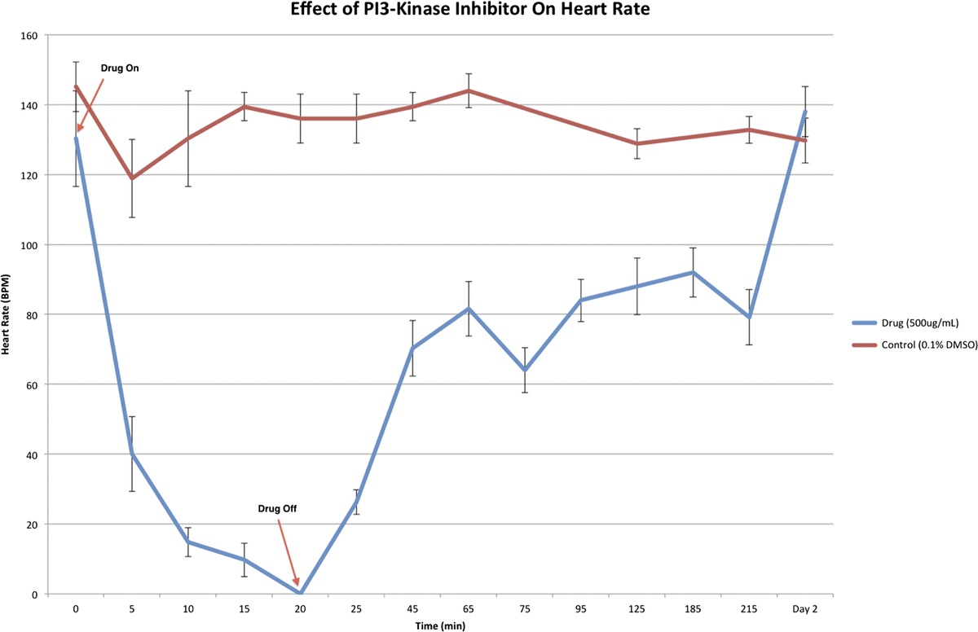
LY294002 works in zebrafish
Drug on
Heart rate
Drug off
Black, et al. JTACS, 2016.

Slide 21
Biochronicity project: LY294002
What about pigs?
Groups
  Trauma and ischemia/reperfusion only
    35% blood volume bleed, aortic clamp x45 min
  DMSO only
  LY only
  LY and trauma
Black, et al. JTACS, 2016.

Slide 22
Biochronicity project: LY294002
Decreased O₂ consumption and CO₂ production
No short term detrimental organ injury
“Inhibition of this pathway may have some protective effect against the detrimental effects of DMSO”
Long term outcome???
Black, et al. JTACS, 2016.

Slide 23
Decreasing metabolism with drugs
Large animal outcome studies needed
Clinical trials?

Slide 24

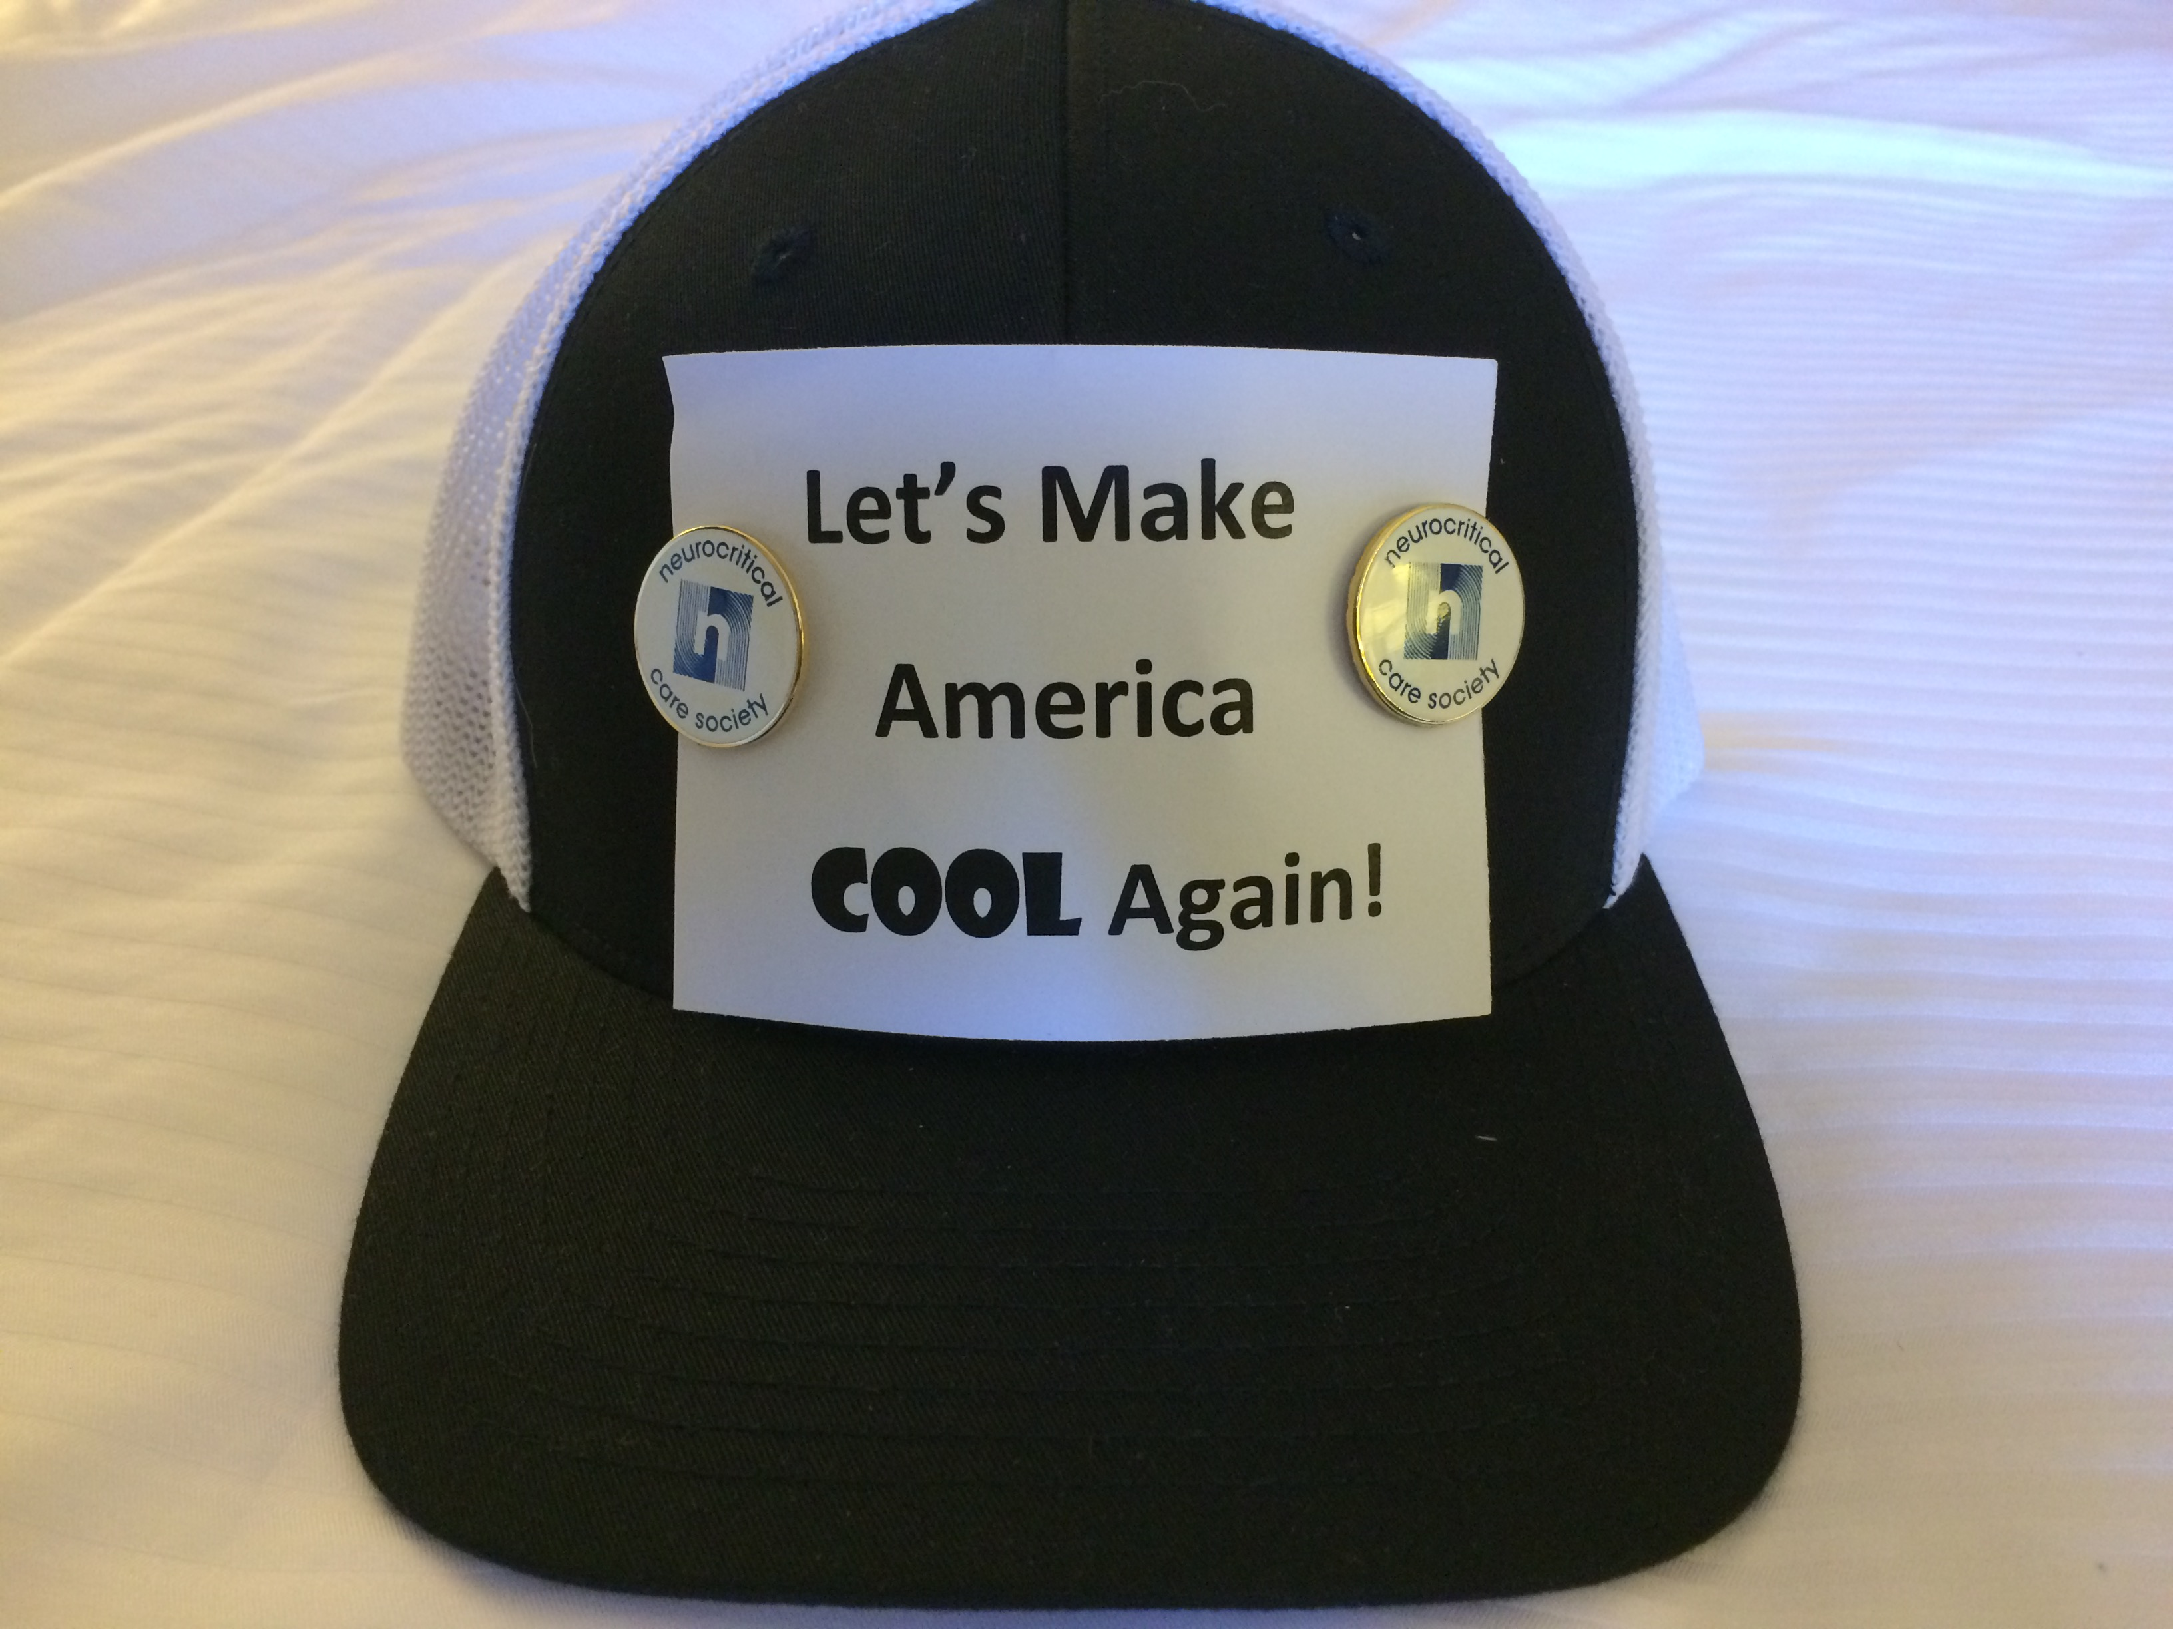
Is hypothermia the answer?

Slide 25
Hypothermia influences
Hth after CA
Drowning
Circ arrest

Slide 26
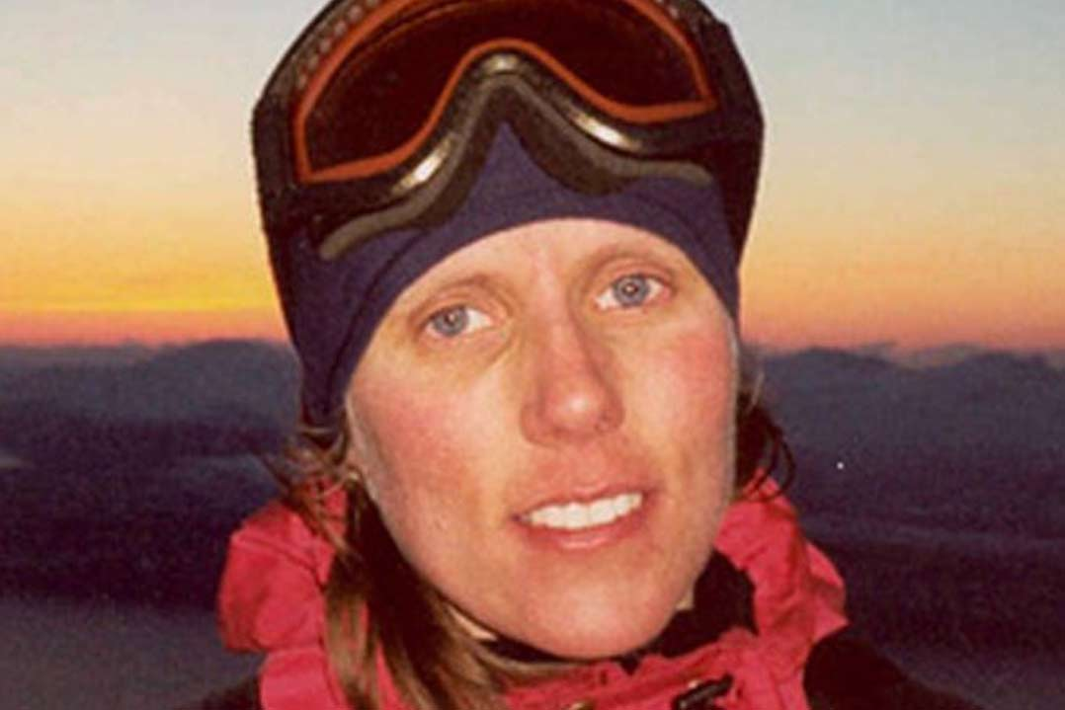
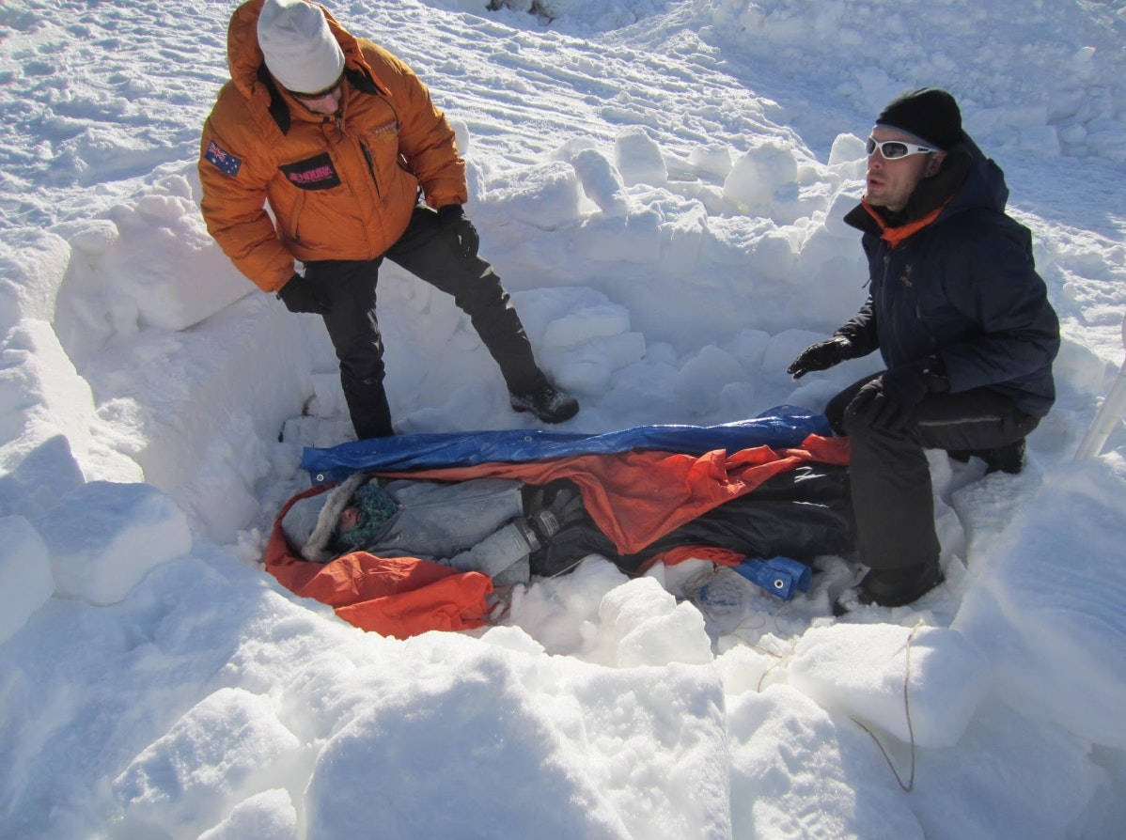
Exposure hypothermia
Narvik
Anna Bagenholm - Lowest Body Temperature (13.7ºC)
Ever and Lived to Tell the Tale

Slide 27
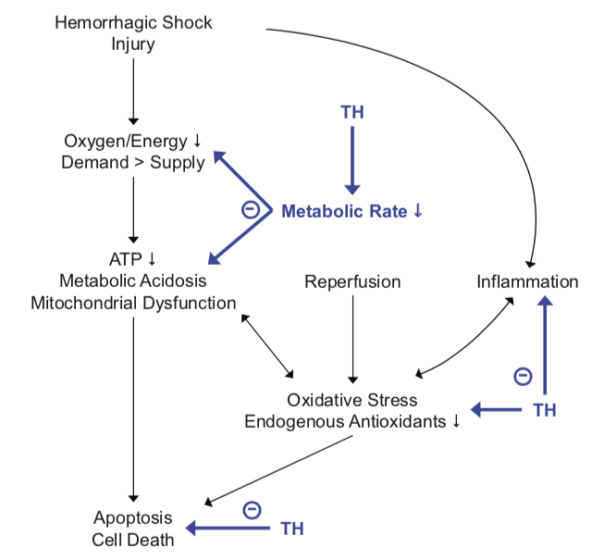

Potential mechanisms of action
Coagulopathy
Stress
Shivering
Wolf, et al. Shock, 2018.

Slide 28
Triad of death in trauma

Slide 29
Retrospective studies
Increased injury severity
Decreased temperature
Increased mortality

Slide 30
PA Trauma Outcome Study
Statewide trauma registry
38,520 trauma patients (2000-2002)
  1,921 (5%) hypothermic on admission (<35ºC)
Adjusted for everything possible
  Age, Injury severity, Mechanism of injury
  Route of temp measurement
Odds ratio for death 3.03 (2.62-3.5)
Crit Care Med, 2005.

Slide 31
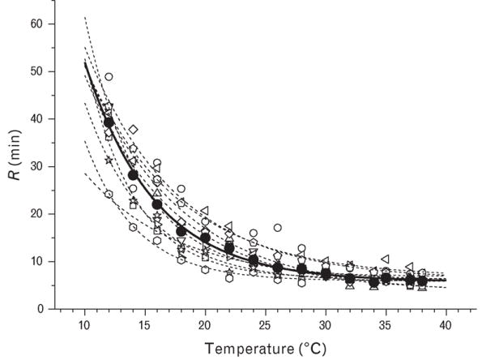
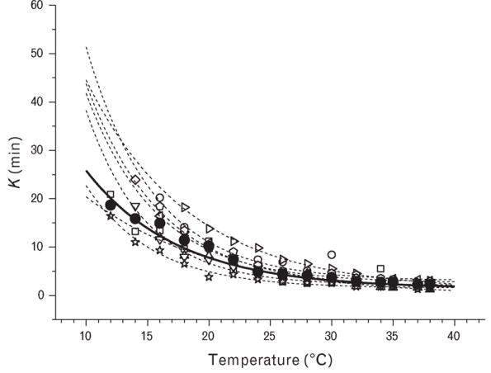
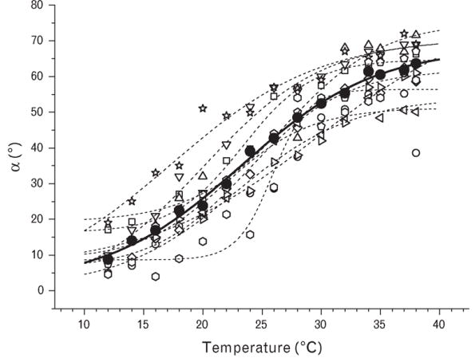
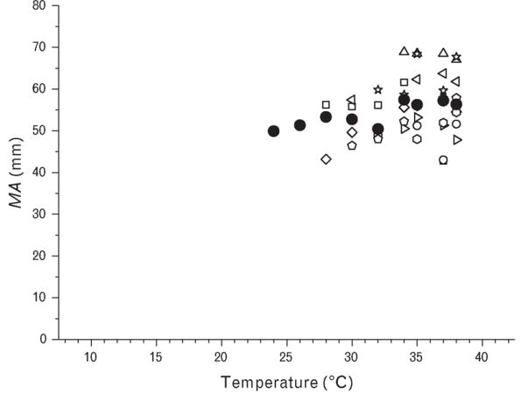
Hypothermia and Thromboelastography
R time
K time
30ºC
α angle
MA
Ruzicka, et al. Blood Coagulation & Fibrinolysis, 2012.

Slide 32
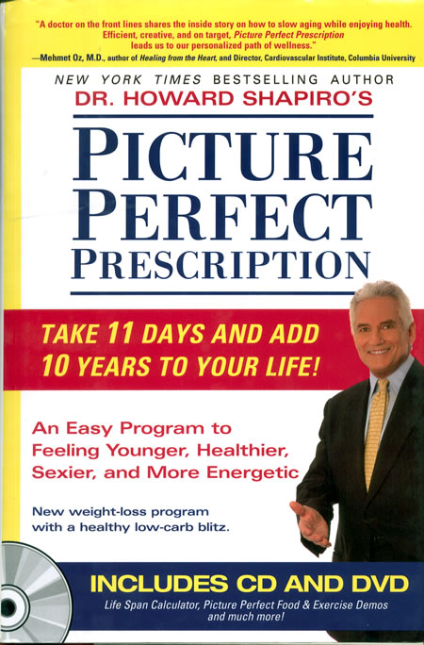

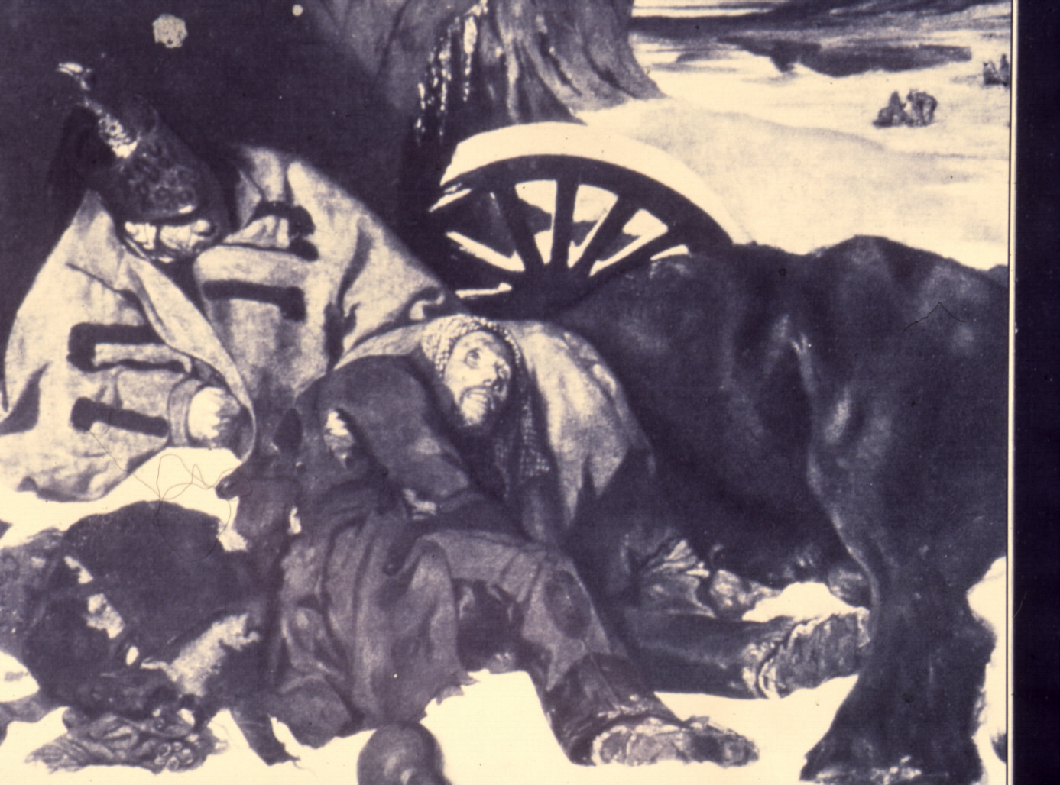
Hypothermia will add
10 years to your life
Notes:
There is an important difference between exposure hypothermia (like Napoleon’s men) and therapeutic hypothermia.

Slide 33

Notes:
In the trauma world, what I am about to talk about is considered blasphemy

Slide 34
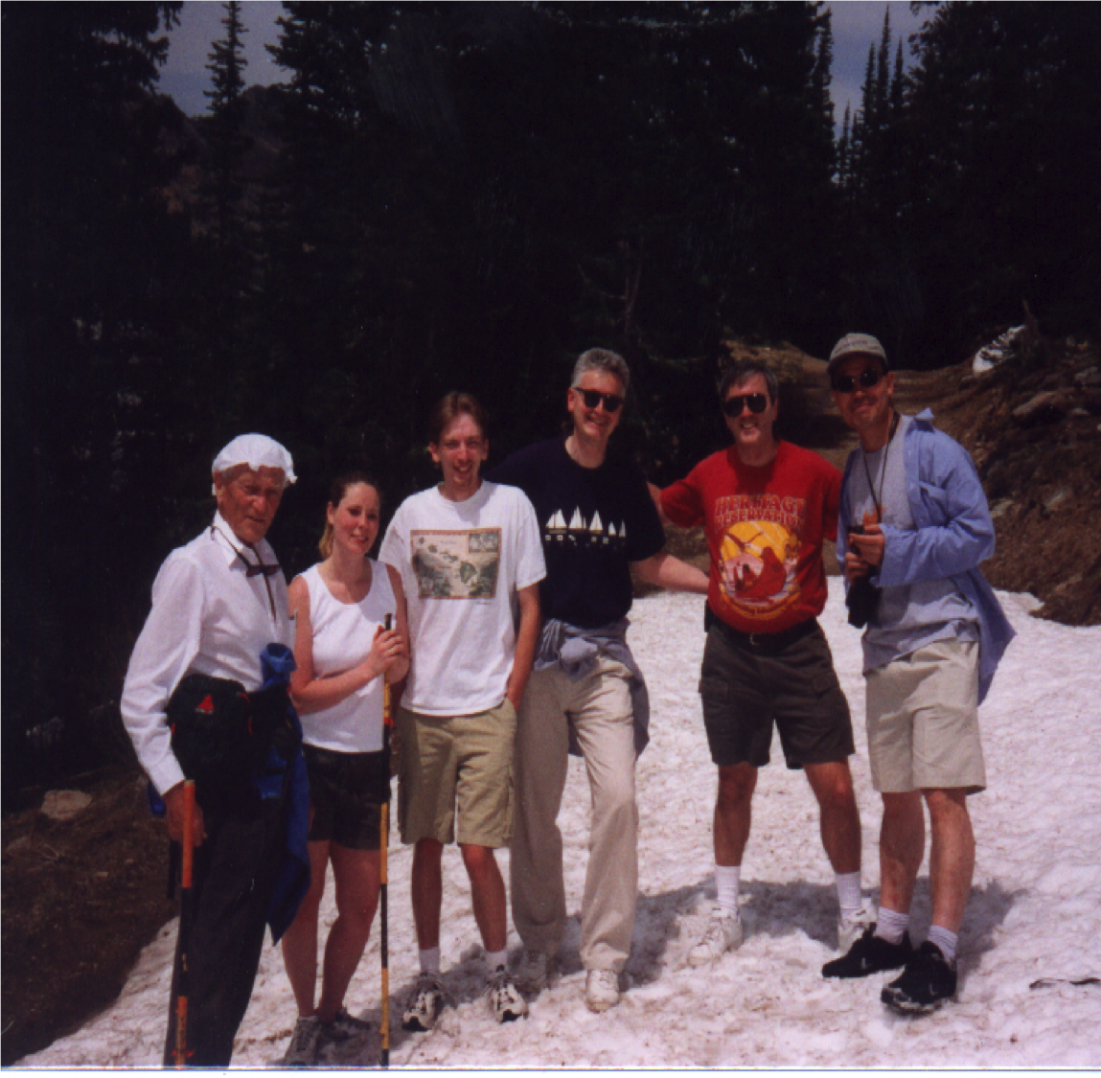
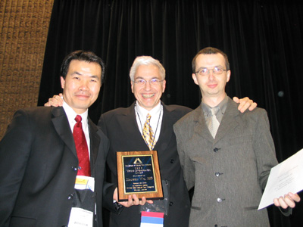
Safar Center for Resuscitation Research

Slide 35
Pig HS Outcome Model ICU to 24 h
2.0%
Isoflurane
Isoflurane=0.5%
Stop isoflurane
after splenectomy
Normothermia Group (Norm) (38°C)
Temperature
Hypothermia Groups (Hypo-Ice & -Rm) (34°C)
Blood
withdrawal
68.6 ml/kg/h
20 ml/kg/h
10 ml/kg/h
Splenectomy
Spleen Cut
MAP
Induction of Hypothermia + Limited Fluid Resuscitation
FR+intensive care
Hemorrhagic Shock
0
35’
40’
95’
HS 3 h
RT12 h
RT 24h
Wu, et al. J Trauma, 2005.
Time

Slide 36
Pig Survival
8
Hypo-Rm, n=8
*
7
p<0.05 (Hypo-Rm vs Norm)
6
5
Hypo-Ice, n=8
# Survivors
4
3
Norm, n=8
2
1
HS
3 h
0
0
4
8
12
16
20
24
Wu, et al. J Trauma, 2005.
Time (h)

Slide 37
Hemorrhagic shock and hypothermia
George, et al. J Trauma, 2010.

Slide 38
Hemorrhagic shock and hypothermia
George, et al. J Trauma, 2010.

Slide 39
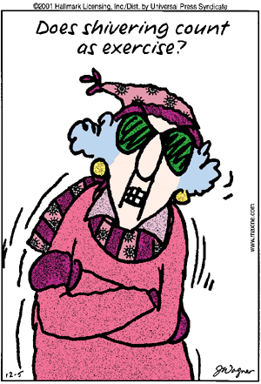
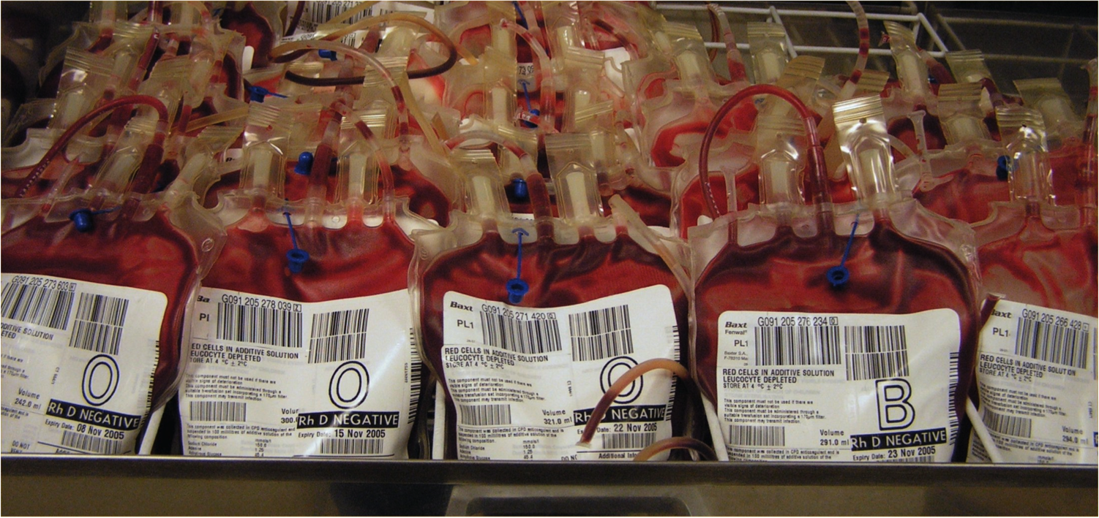
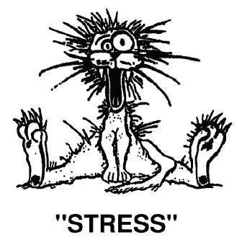
Why the dichotomy?

Slide 40
Trauma case at Shock Trauma
23 yo male
Stab wound to the heart
Arrest in Trauma Resuscitation Unit

Slide 41
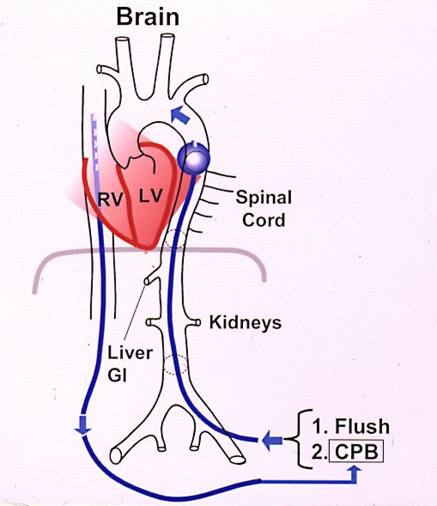
Emergency preservation and resuscitation (EPR)
Intra-aortic cold flush with saline

Slide 42
Exsanguination Cardiac Arrest Model
MAP
Exsanguination
Cardiac Arrest
15-180 min
Tty
VF
Bleed
Flush
CPB

Slide 43
Hypothermia Dose Response
15-20 min
34ºC
30 min
28ºC
60 min
15ºC
90 min
10ºC

Slide 44
Exsanguination Cardiac Arrest (Tty 10ºC)
90 min
120 min
Final OPC
5 Brain Death
4 Coma
Volume
>500 ml/kg
Whole body
3 Severe Disability
2 Moderate Disability
1 Normal
Behringer, CCM, 2003.

Slide 45
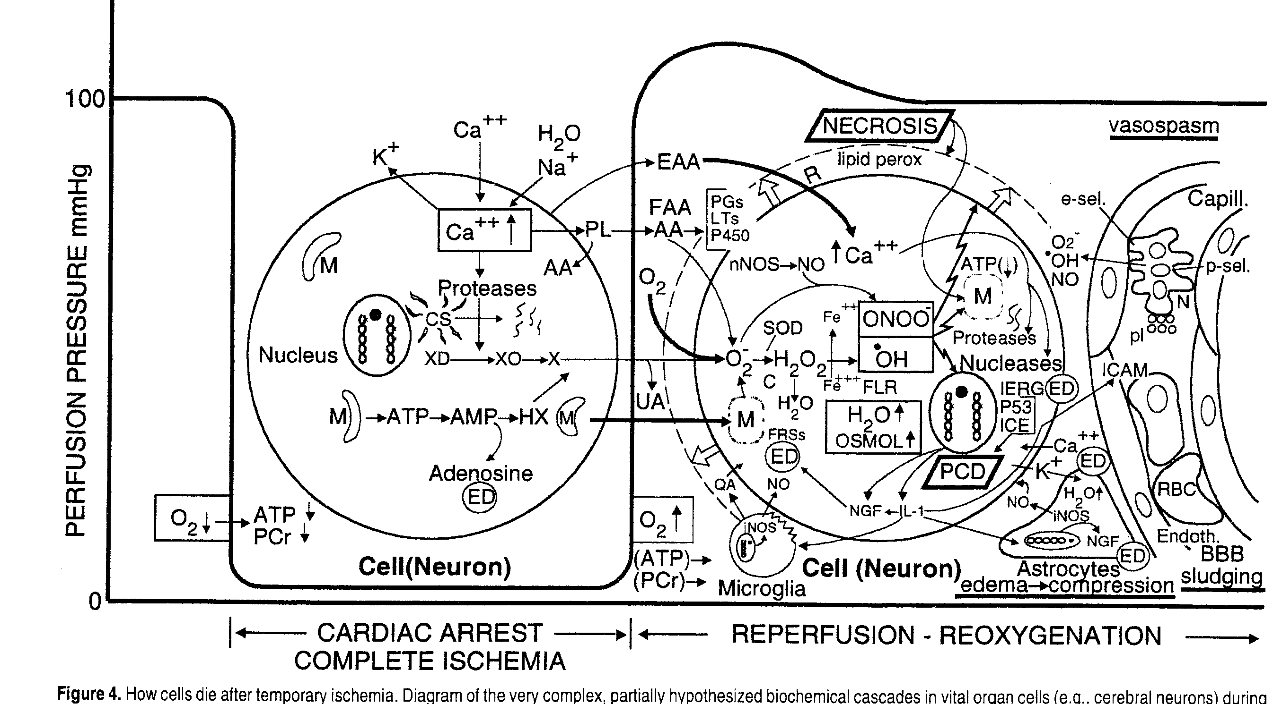
Mechanisms
Notes:
Based on recognized mechanisms of what occurs in neurons during ischemia and reperfusion, we came up with a list of potential drugs that might improve brain outcome.

Slide 46
Drug list
Adenosine
Thiopental
Thio/Phenytoin
MK801
YM872
Nimodipine
Diltiazem
Lidocaine
Insulin/glucose
W7
Cyclohexamide
Tempol
Cyclosporine A

Slide 47
Drug list
Adenosine
Thiopental
Thio/Phenytoin
MK801
YM872
Nimodipine
Diltiazem
Lidocaine
Insulin/glucose
W7
Cyclohexamide
Tempol
Cyclosporine A

Slide 49
Prolonged HS->arrest, EPR
Splenectomy
Spleen transection
MAP
HS time
CPR:124±11 min
SA: 128±17 min
CPR group
EPR group
Continuous bleeding
Cardiac arrest
CPB
Wu et al. Circulation, 2006.

Slide 50
Prolonged HS->arrest, EPR
Overall Performance Category | CPR | EPR-I (hypo-12h) | EPR-II (hypo-36)
5 Dead | ••• •••• | • | •
4 Coma |  | • | •
3 Severe disability |  | •••
2 Moderate disability |  | •
1 Normal |  | • | •••••
*
*Seizures
Wu et al. Circulation, 2006.

Slide 51
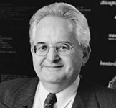
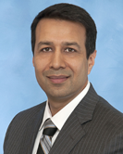
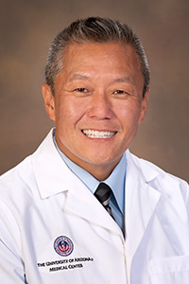
We’re not the only ones
Hasan Alam
Peter Rhee
Lyn Yaffe

Slide 52
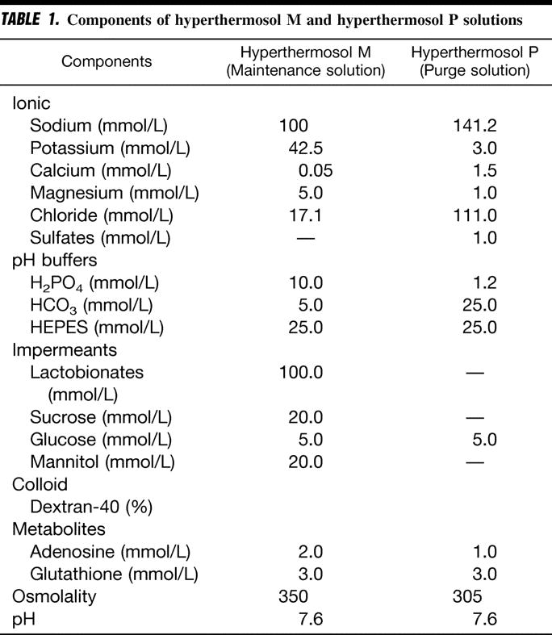
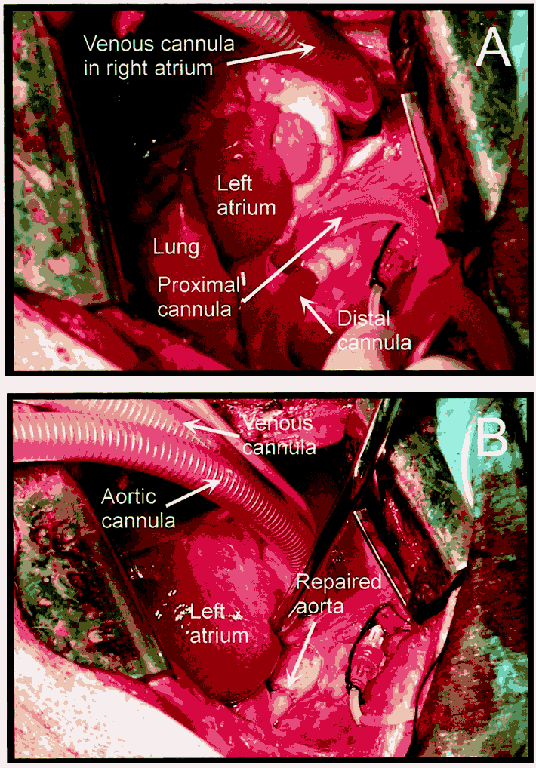
USUHS Model
HypoThermosol®

Slide 53
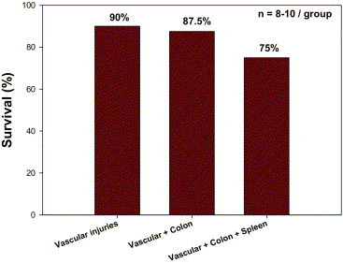
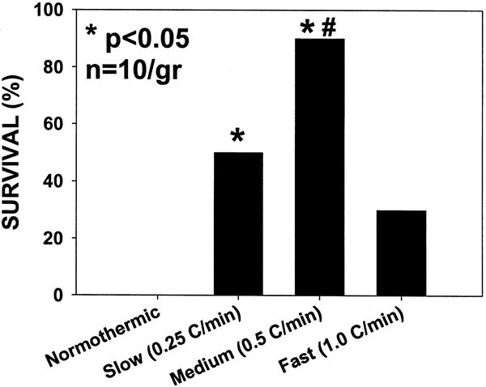
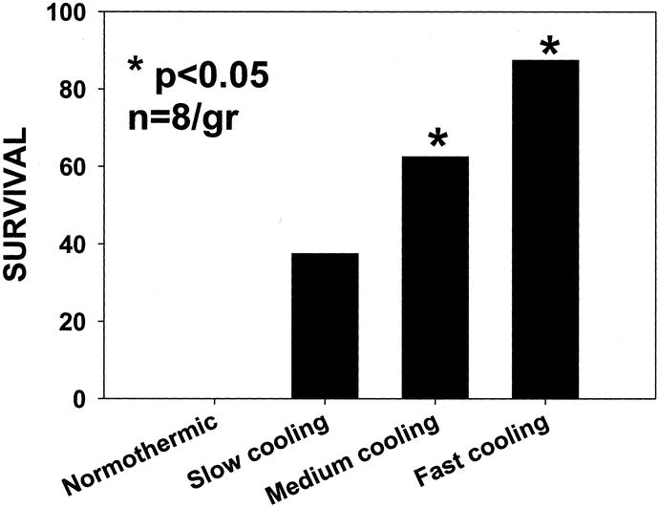
Rhee and Alam
Rewarming
Cooling
Notes:
Peter Rhee and Hasan Alam have also worked in this area and found that rapid cooling and moderately rapid rewarming were beneficial. They also showed that this was possible with multiple simulated injuries.

Slide 54
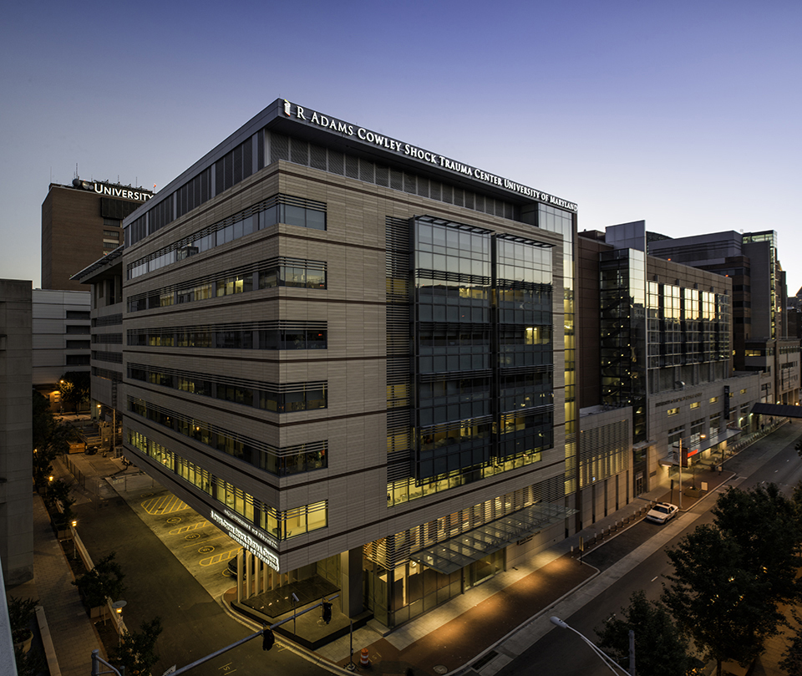
Shock Trauma Center
University of Maryland Medical Center
Emergency Preservation and Resuscitation
for Cardiac Arrest from Trauma

Slide 55
Specific aims
Rapidly identify potential candidates for EPR within 5 min of pulselessness.
Rapidly induce EPR by infusing ice-cold saline to attain a tympanic membrane/nasopharyngeal temperature of 10ºC.
Following hemostasis, delayed resuscitation will be via cardiopulmonary bypass (CPB) with heparin.
Survival without significant neurologic deficits.

Slide 56
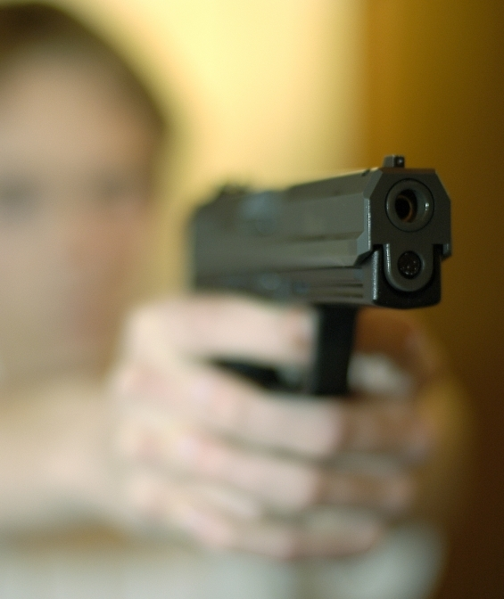
Subject Inclusion Criteria
18 - 65 yo
Signs of life (pulse, respirations, reactive pupils, or spontaneous movement) present within 5 min of ED/TRU arrival or in the ED/TRU or OR
Remains pulseless after OCCPR

Slide 57
Subject Exclusion Criteria
No signs of life for > 5 min
Traumatic brain injury
Electrical asystole
Obvious non-survivable injury
Massive tissue trauma involving multiple sites
Pregnancy
Prisoner

Slide 58
Emergency
Preservation
Final gasp
Lose pulse
Open chest
Transport to OR
Hemostasis
<60 min
Tty
Mean Arterial Pressure (MAP, mmHg)
Tympanic Temperature (Tty,ºC)
MAP
Time
Trauma
Aortic
flush
Delayed
Resuscitation on CPB

Slide 59
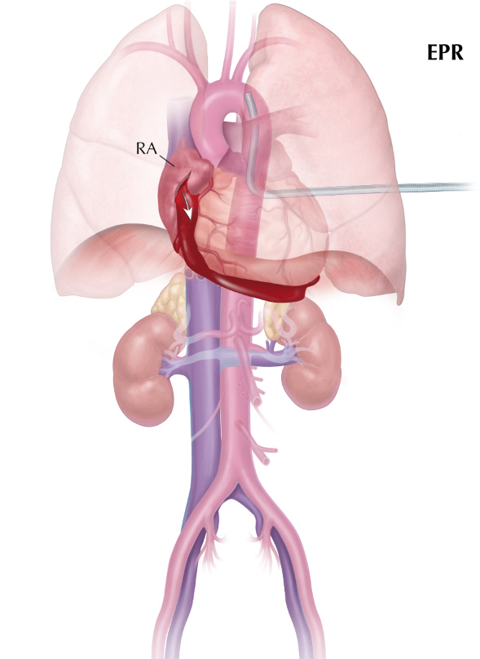
Drain blood via right atrial appendage
Aortic
cannula
Courtesy Jim Manning

Slide 60
Outcome
Survival to D/C without major neuro sequelae
Direct complications of the technique
Coagulopathy
Organ system failures
Survival (28 d)
Neurologic function (12 months)

Slide 61
Team
Trauma
surgeons
Cardiac
surgeons
Perfusionists
Trauma anesthesiologists
Cardiac anesthesiologists
Blood bank
Trauma
Resusc Unit
OR staff

Slide 62
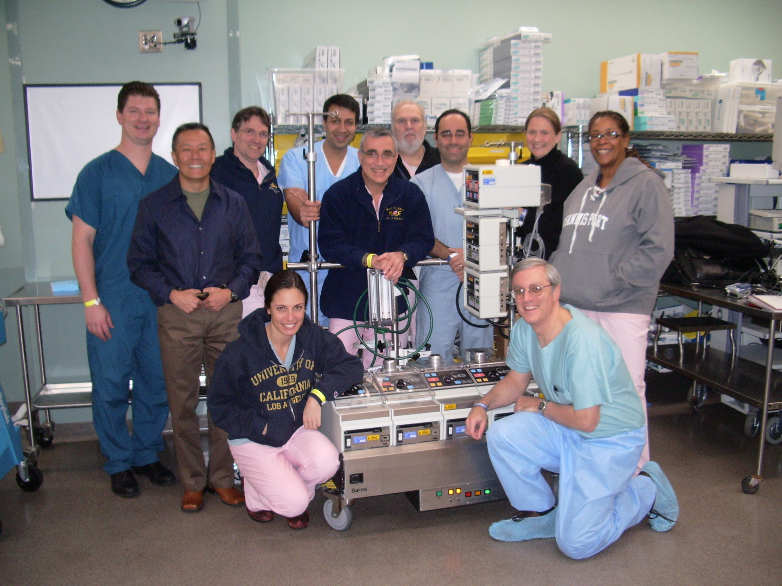
Training

Slide 63
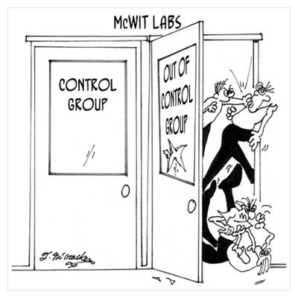
Control groups
Concurrent patients
  Meet criteria, but team not available
Historical controls
10 and 10

Slide 64
Expected effect on coagulation with EPR
John Hess

Slide 65
I hate the clotting system
Clotting
  Protamine reaction
  Anti-thrombin III deficiency
  Platelet activation with rewarming
  Calcium administration with citrate on board
  Activation by bypass cannulas
  Endotheliopathy
  Unable to test ACT or heparin levels because of citrate
    Inadequate heparin dosing
    Use TEG

Slide 66
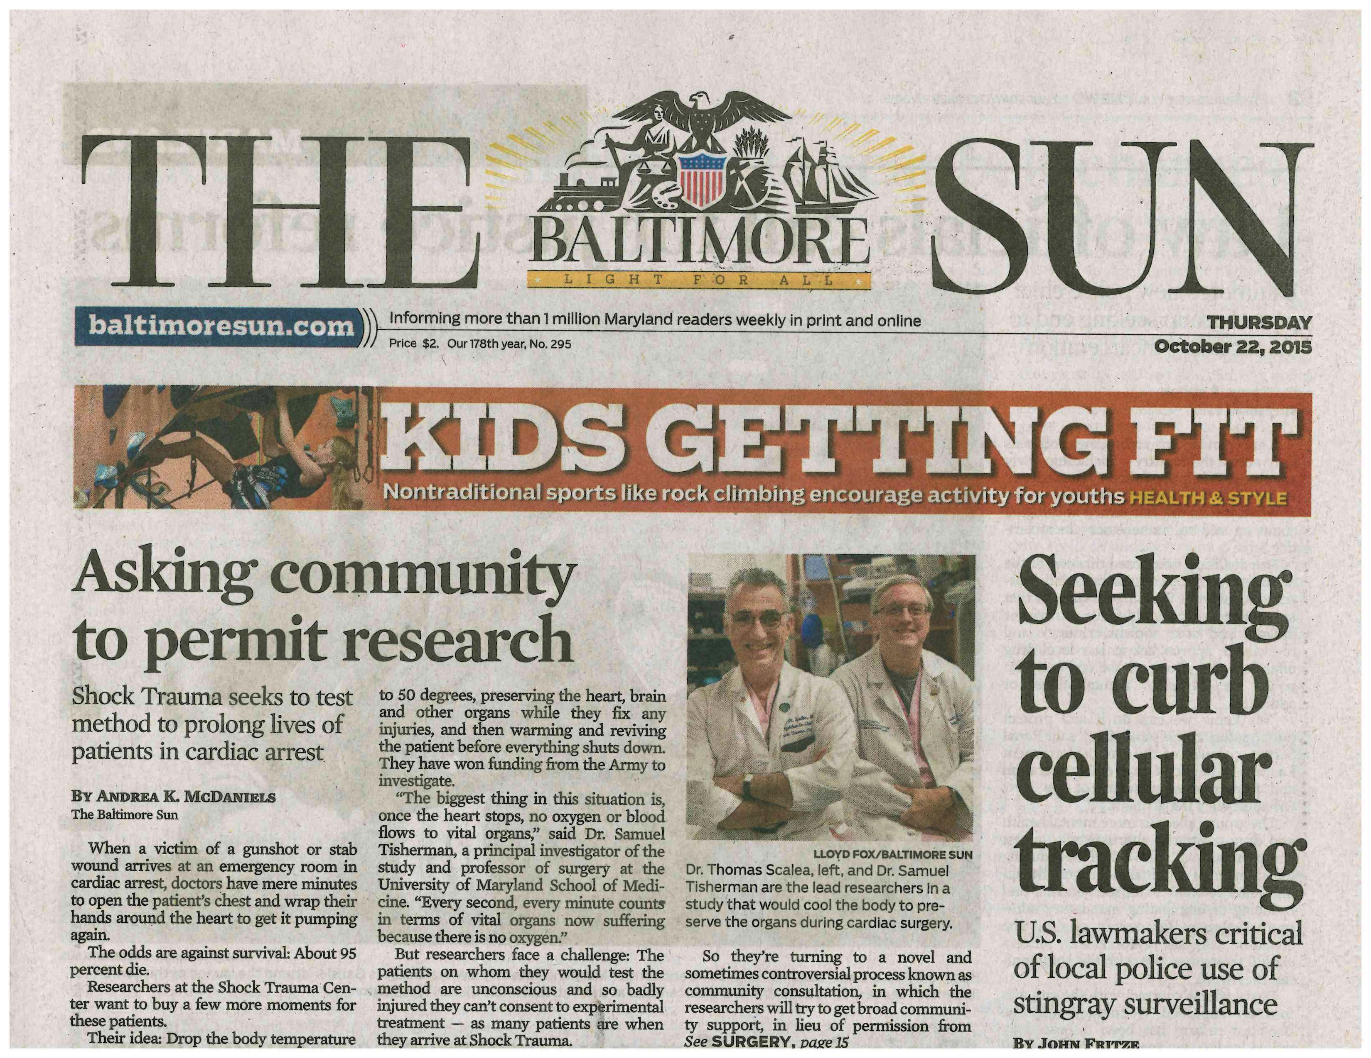
Community consultation/Public disclosure

Slide 67
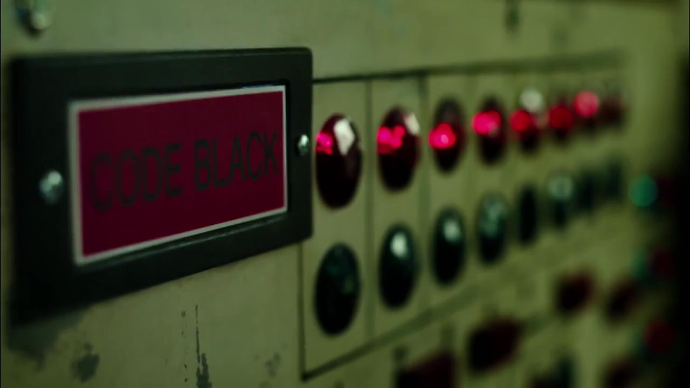
Code Black

Slide 68
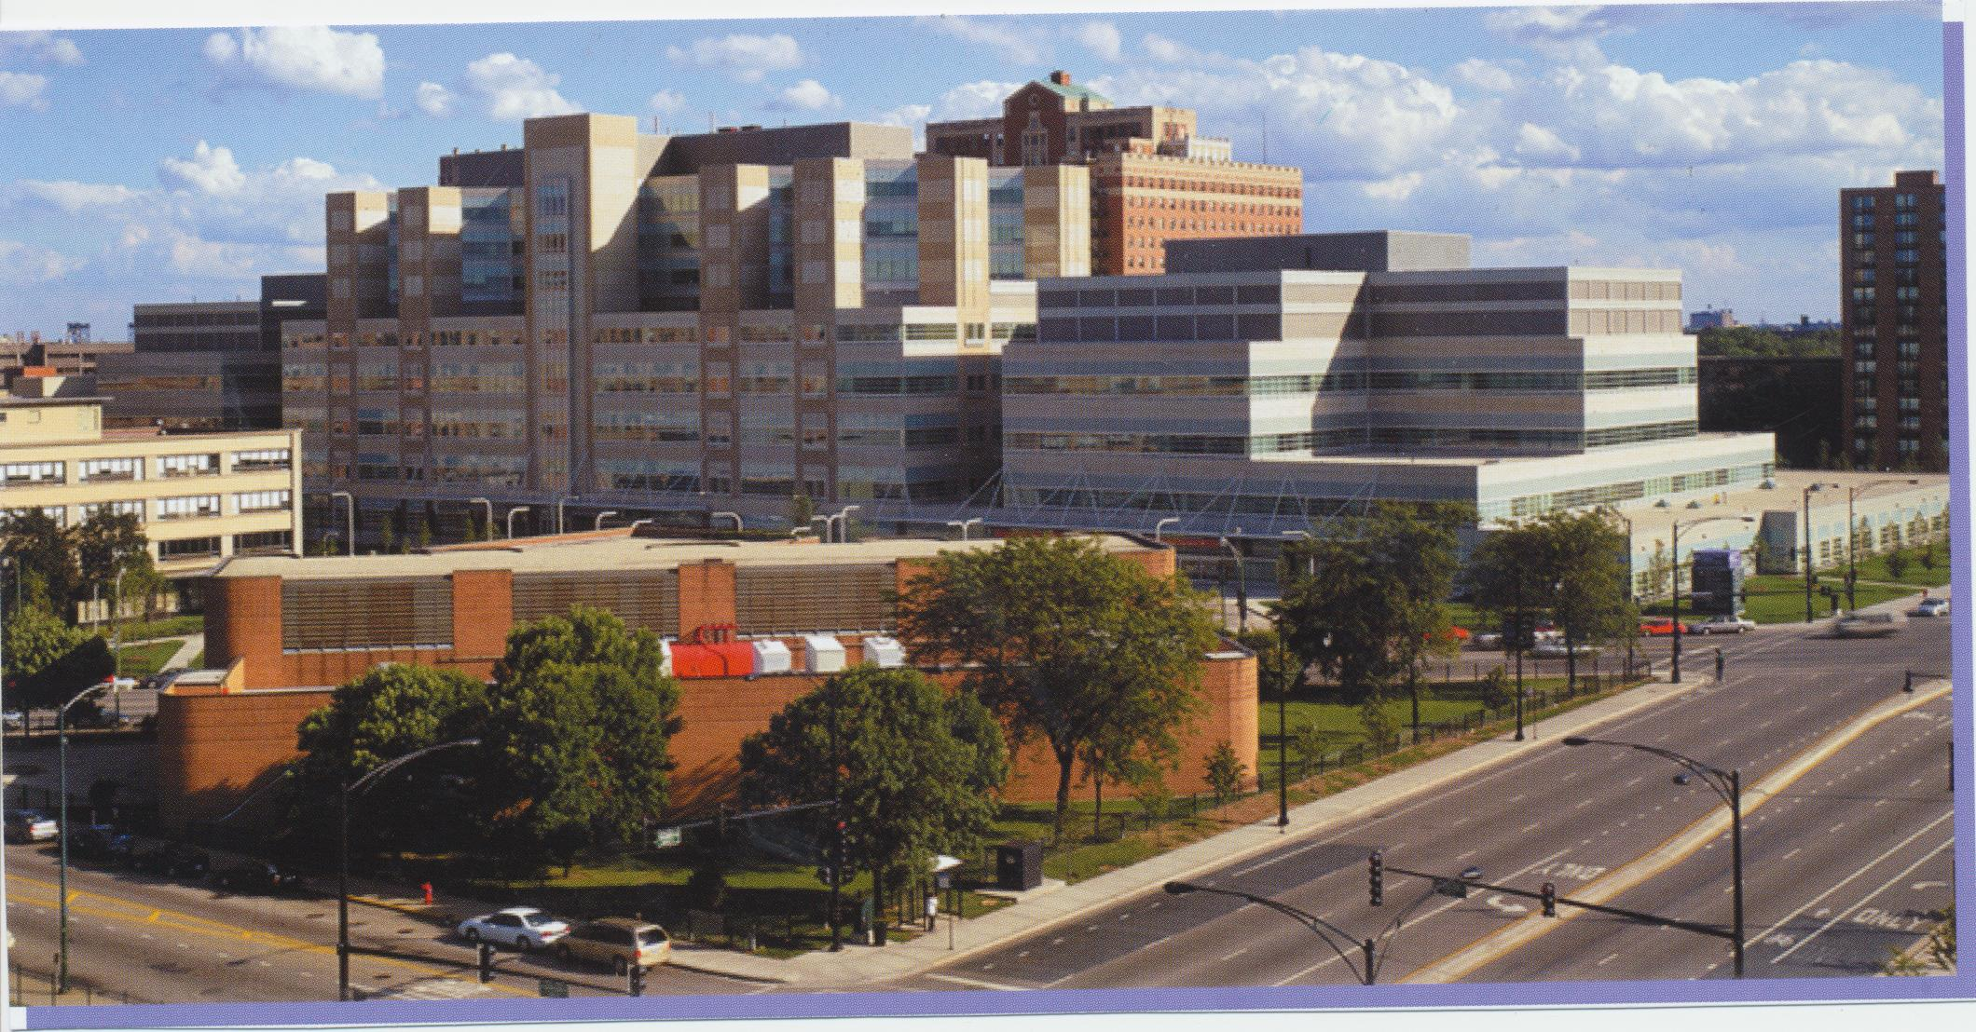
Future plans
John H. Stroger, Jr. Hospital of Cook County

Slide 69

Future plans

Slide 70

Summary
Hemorrhagic shock
  Multiple drugs look promising
    Need large animal outcome studies
  Mild hypothermia works in the lab
    No prospective human studies
Exsanguination cardiac arrest
  Emergency preservation and resuscitation

Slide 71
The Medic of the Future
Fluids
Smart catheter
Cooling device
Miniature pump
Drugs

Slide 72
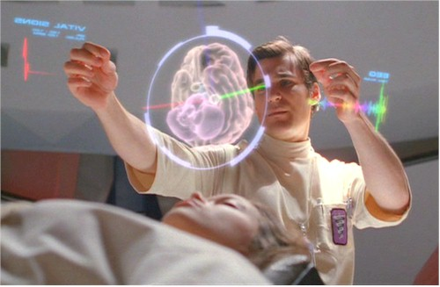
Trauma in 2412

Slide 73
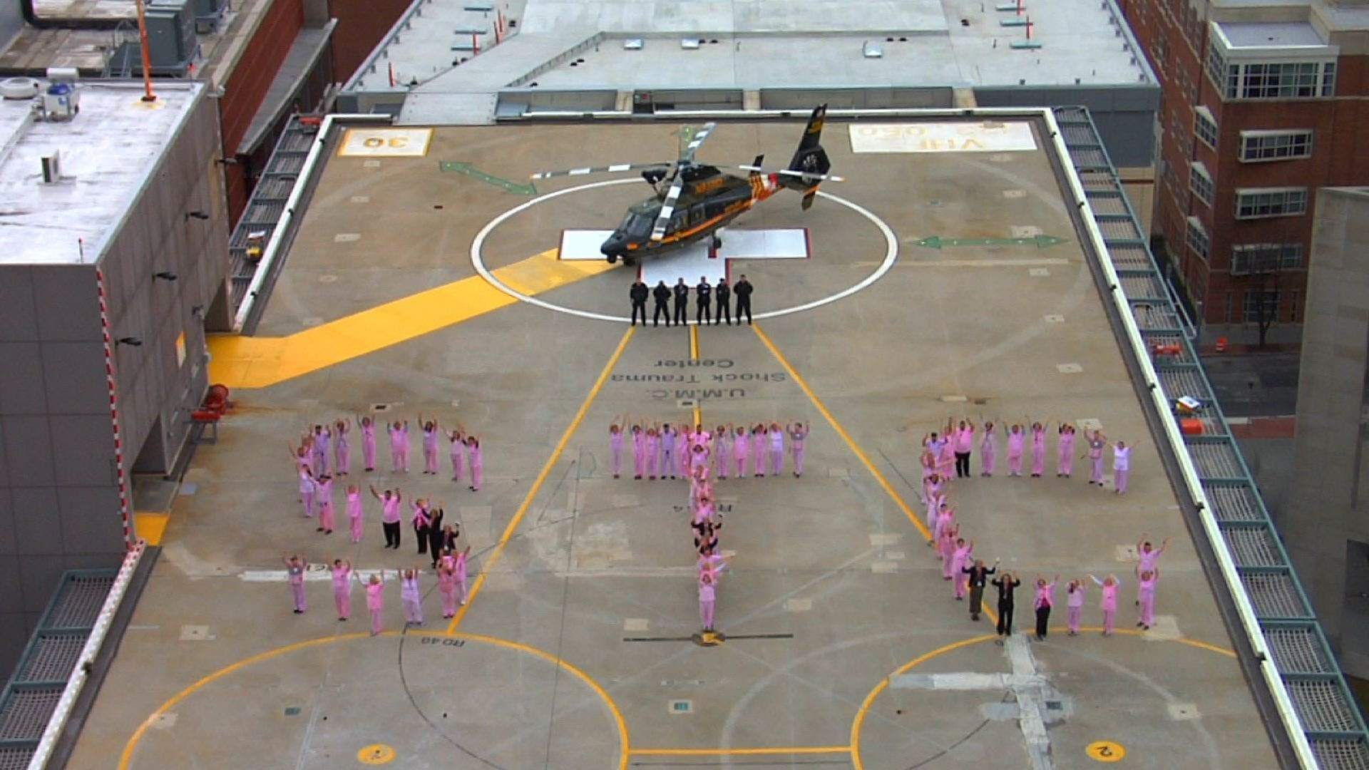
Thanks

