Slide 1

Prehospital Plasma during Air Medical Transport in Trauma
Patients at Risk for Hemorrhagic Shock
Secondary Analyses; The PAMPer Trial
J.L. Sperry, F.X. Guyette, J.B. Brown, M.H. Yazer, D.J. Triulzi, B.J. Early‑Young, P.W. Adams, B.J. Daley, R.S. Miller, B.G. Harbrecht, J.A. Claridge, H.A. Phelan, W.R. Witham, A.T. Putnam, T.M. Duane, L.H. Alarcon, C.W. Callaway, B.S. Zuckerbraun, M.D. Neal, M.R. Rosengart, R.M. Forsythe, T.R. Billiar, D.M. Yealy, A.B. Peitzman and M.S. Zenati, for the PAMPer Study Group
2019 THOR Meeting
RDRC symposium
BERGEN, NORWAY
Jun 23rd-26th

Slide 2
Disclosures
No conflicts to report.
FUNDING
Supported by a grant (W81XWH-12-2-0023) from the U.S. Army Medical Research and Materiel Command

Slide 3
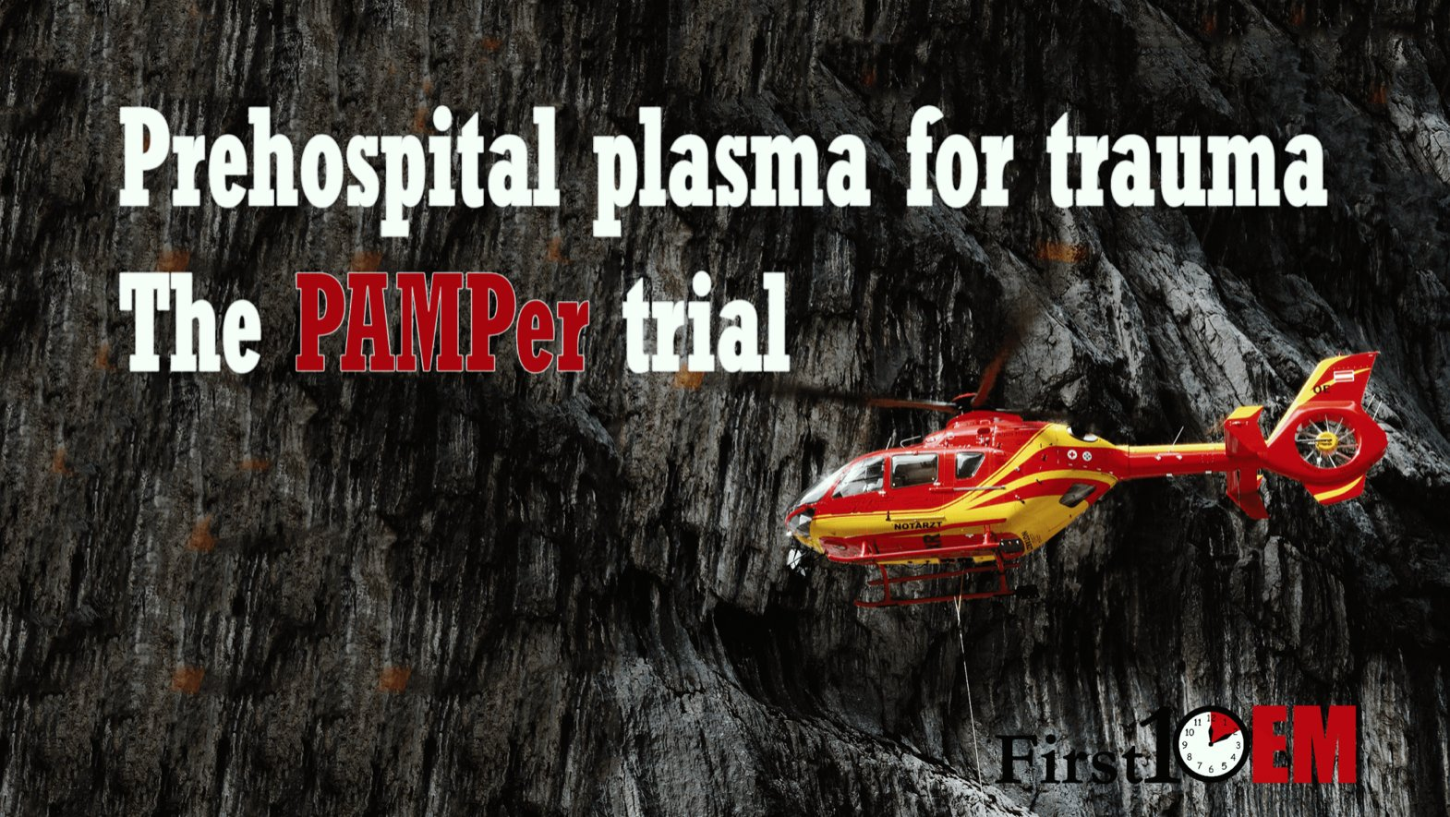

PAMPer Trial
P: Prehospital
A: Air
M: Medical
P: Plasma

Slide 4
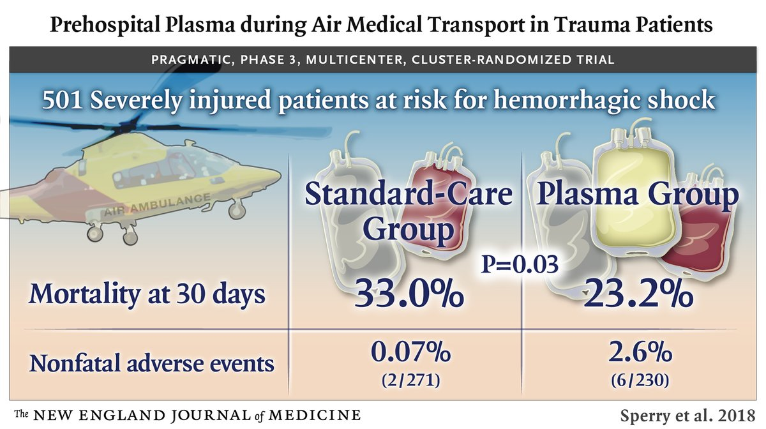
Results
23.2% vs. 33.0%; difference -9.8%, 95%CI -18.6, -1.0; p=0.03
Notes:
Soon after are large retrospective study, important prospective evidence was published from a prospective cohort analysis where sex hormones were drawn, including testosterone and estradiol, 48hrs following icu admission in critically ill patients some of whom were injured. This prospective evidenve further added to the confusion as they found the estrogen was significantly associated with mortality in both males and females, and no difference in mortality across the sexes.
Estradiol levels correlated with injury severity, TRISS probability of survival estimates, and apache II scores and elevated estradiol level were significantly associated with mortality.
This figure demonstrates as estradiol levels increase there is a proportional elevation in apache II scores and associated mortality
However due to the delayed measurements at 48 hrs these results are significantly confounded as it is know that peripheral conversion of androgens to estrogen occurs in adipose tissue and that this is stimulated by innate catecholamines and inflammatory cytokines.

Slide 5
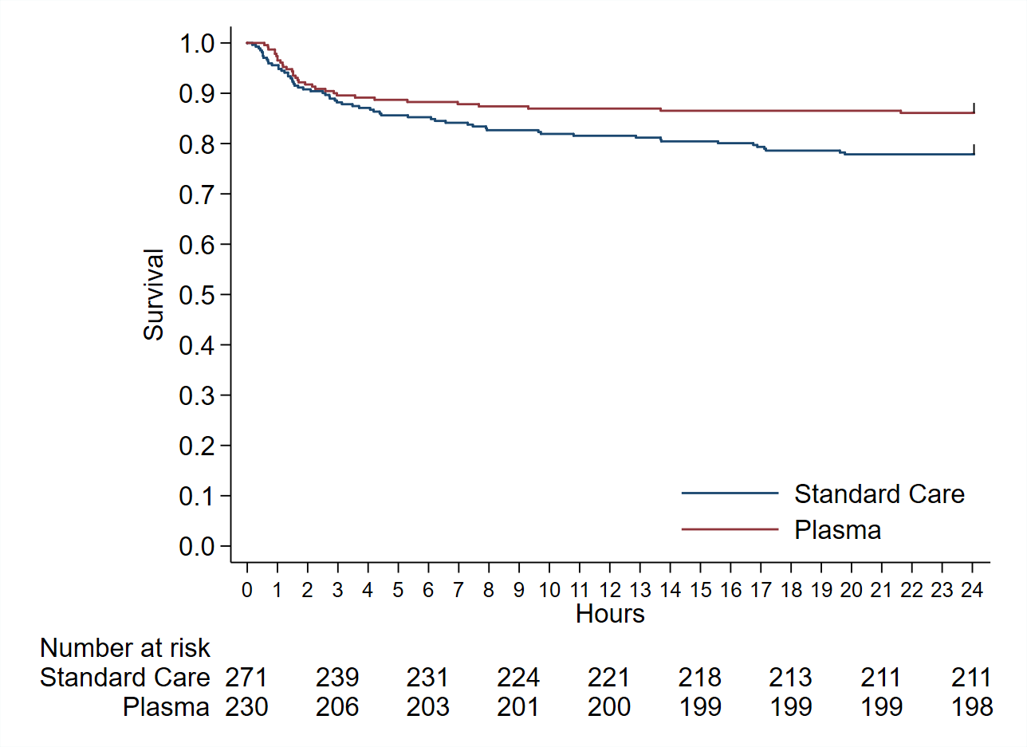
24 Hour Mortality
Log-rank chi-square 5.14, p=0.02
Notes:
Soon after are large retrospective study, important prospective evidence was published from a prospective cohort analysis where sex hormones were drawn, including testosterone and estradiol, 48hrs following icu admission in critically ill patients some of whom were injured. This prospective evidenve further added to the confusion as they found the estrogen was significantly associated with mortality in both males and females, and no difference in mortality across the sexes.
Estradiol levels correlated with injury severity, TRISS probability of survival estimates, and apache II scores and elevated estradiol level were significantly associated with mortality.
This figure demonstrates as estradiol levels increase there is a proportional elevation in apache II scores and associated mortality
However due to the delayed measurements at 48 hrs these results are significantly confounded as it is know that peripheral conversion of androgens to estrogen occurs in adipose tissue and that this is stimulated by innate catecholamines and inflammatory cytokines.

Slide 6
30-Day Mortality
Log-rank chi-square 5.70, p=0.02
Notes:
Soon after are large retrospective study, important prospective evidence was published from a prospective cohort analysis where sex hormones were drawn, including testosterone and estradiol, 48hrs following icu admission in critically ill patients some of whom were injured. This prospective evidenve further added to the confusion as they found the estrogen was significantly associated with mortality in both males and females, and no difference in mortality across the sexes.
Estradiol levels correlated with injury severity, TRISS probability of survival estimates, and apache II scores and elevated estradiol level were significantly associated with mortality.
This figure demonstrates as estradiol levels increase there is a proportional elevation in apache II scores and associated mortality
However due to the delayed measurements at 48 hrs these results are significantly confounded as it is know that peripheral conversion of androgens to estrogen occurs in adipose tissue and that this is stimulated by innate catecholamines and inflammatory cytokines.

Slide 7
Sub-Group
Heterogeneity chi squared = 12.21, p=0.79
Notes:
Soon after are large retrospective study, important prospective evidence was published from a prospective cohort analysis where sex hormones were drawn, including testosterone and estradiol, 48hrs following icu admission in critically ill patients some of whom were injured. This prospective evidenve further added to the confusion as they found the estrogen was significantly associated with mortality in both males and females, and no difference in mortality across the sexes.
Estradiol levels correlated with injury severity, TRISS probability of survival estimates, and apache II scores and elevated estradiol level were significantly associated with mortality.
This figure demonstrates as estradiol levels increase there is a proportional elevation in apache II scores and associated mortality
However due to the delayed measurements at 48 hrs these results are significantly confounded as it is know that peripheral conversion of androgens to estrogen occurs in adipose tissue and that this is stimulated by innate catecholamines and inflammatory cytokines.

Slide 8
Sub-Group-Interesting
Notes:
Soon after are large retrospective study, important prospective evidence was published from a prospective cohort analysis where sex hormones were drawn, including testosterone and estradiol, 48hrs following icu admission in critically ill patients some of whom were injured. This prospective evidenve further added to the confusion as they found the estrogen was significantly associated with mortality in both males and females, and no difference in mortality across the sexes.
Estradiol levels correlated with injury severity, TRISS probability of survival estimates, and apache II scores and elevated estradiol level were significantly associated with mortality.
This figure demonstrates as estradiol levels increase there is a proportional elevation in apache II scores and associated mortality
However due to the delayed measurements at 48 hrs these results are significantly confounded as it is know that peripheral conversion of androgens to estrogen occurs in adipose tissue and that this is stimulated by innate catecholamines and inflammatory cytokines.

Slide 9
Harmonized Data
Notes:
Soon after are large retrospective study, important prospective evidence was published from a prospective cohort analysis where sex hormones were drawn, including testosterone and estradiol, 48hrs following icu admission in critically ill patients some of whom were injured. This prospective evidenve further added to the confusion as they found the estrogen was significantly associated with mortality in both males and females, and no difference in mortality across the sexes.
Estradiol levels correlated with injury severity, TRISS probability of survival estimates, and apache II scores and elevated estradiol level were significantly associated with mortality.
This figure demonstrates as estradiol levels increase there is a proportional elevation in apache II scores and associated mortality
However due to the delayed measurements at 48 hrs these results are significantly confounded as it is know that peripheral conversion of androgens to estrogen occurs in adipose tissue and that this is stimulated by innate catecholamines and inflammatory cytokines.

Slide 10
Sub-Group-Interesting
Notes:
Soon after are large retrospective study, important prospective evidence was published from a prospective cohort analysis where sex hormones were drawn, including testosterone and estradiol, 48hrs following icu admission in critically ill patients some of whom were injured. This prospective evidenve further added to the confusion as they found the estrogen was significantly associated with mortality in both males and females, and no difference in mortality across the sexes.
Estradiol levels correlated with injury severity, TRISS probability of survival estimates, and apache II scores and elevated estradiol level were significantly associated with mortality.
This figure demonstrates as estradiol levels increase there is a proportional elevation in apache II scores and associated mortality
However due to the delayed measurements at 48 hrs these results are significantly confounded as it is know that peripheral conversion of androgens to estrogen occurs in adipose tissue and that this is stimulated by innate catecholamines and inflammatory cytokines.

Slide 11
Plasma vs Standard Care
Notes:
Soon after are large retrospective study, important prospective evidence was published from a prospective cohort analysis where sex hormones were drawn, including testosterone and estradiol, 48hrs following icu admission in critically ill patients some of whom were injured. This prospective evidenve further added to the confusion as they found the estrogen was significantly associated with mortality in both males and females, and no difference in mortality across the sexes.
Estradiol levels correlated with injury severity, TRISS probability of survival estimates, and apache II scores and elevated estradiol level were significantly associated with mortality.
This figure demonstrates as estradiol levels increase there is a proportional elevation in apache II scores and associated mortality
However due to the delayed measurements at 48 hrs these results are significantly confounded as it is know that peripheral conversion of androgens to estrogen occurs in adipose tissue and that this is stimulated by innate catecholamines and inflammatory cytokines.

Slide 12
Standard Care <20 vs > 20min
Notes:
Soon after are large retrospective study, important prospective evidence was published from a prospective cohort analysis where sex hormones were drawn, including testosterone and estradiol, 48hrs following icu admission in critically ill patients some of whom were injured. This prospective evidenve further added to the confusion as they found the estrogen was significantly associated with mortality in both males and females, and no difference in mortality across the sexes.
Estradiol levels correlated with injury severity, TRISS probability of survival estimates, and apache II scores and elevated estradiol level were significantly associated with mortality.
This figure demonstrates as estradiol levels increase there is a proportional elevation in apache II scores and associated mortality
However due to the delayed measurements at 48 hrs these results are significantly confounded as it is know that peripheral conversion of androgens to estrogen occurs in adipose tissue and that this is stimulated by innate catecholamines and inflammatory cytokines.

Slide 13
Plasma <20 vs > 20min
Notes:
Soon after are large retrospective study, important prospective evidence was published from a prospective cohort analysis where sex hormones were drawn, including testosterone and estradiol, 48hrs following icu admission in critically ill patients some of whom were injured. This prospective evidenve further added to the confusion as they found the estrogen was significantly associated with mortality in both males and females, and no difference in mortality across the sexes.
Estradiol levels correlated with injury severity, TRISS probability of survival estimates, and apache II scores and elevated estradiol level were significantly associated with mortality.
This figure demonstrates as estradiol levels increase there is a proportional elevation in apache II scores and associated mortality
However due to the delayed measurements at 48 hrs these results are significantly confounded as it is know that peripheral conversion of androgens to estrogen occurs in adipose tissue and that this is stimulated by innate catecholamines and inflammatory cytokines.

Slide 14
Sub-Group-Interesting
Notes:
Soon after are large retrospective study, important prospective evidence was published from a prospective cohort analysis where sex hormones were drawn, including testosterone and estradiol, 48hrs following icu admission in critically ill patients some of whom were injured. This prospective evidenve further added to the confusion as they found the estrogen was significantly associated with mortality in both males and females, and no difference in mortality across the sexes.
Estradiol levels correlated with injury severity, TRISS probability of survival estimates, and apache II scores and elevated estradiol level were significantly associated with mortality.
This figure demonstrates as estradiol levels increase there is a proportional elevation in apache II scores and associated mortality
However due to the delayed measurements at 48 hrs these results are significantly confounded as it is know that peripheral conversion of androgens to estrogen occurs in adipose tissue and that this is stimulated by innate catecholamines and inflammatory cytokines.

Slide 15
PAMPer 2nd Analysis

Slide 16
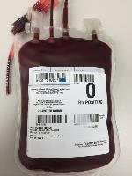

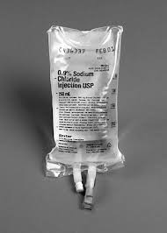
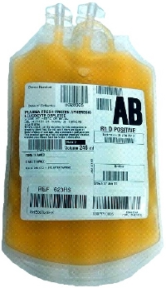
????

Slide 17
Secondary Analysis
Crystalloid Only n= 157
Blood +/- crystalloid n= 114
Plasma +/- crystalloid n= 170
Plasma and Blood +/- crystalloid n= 60

Slide 18
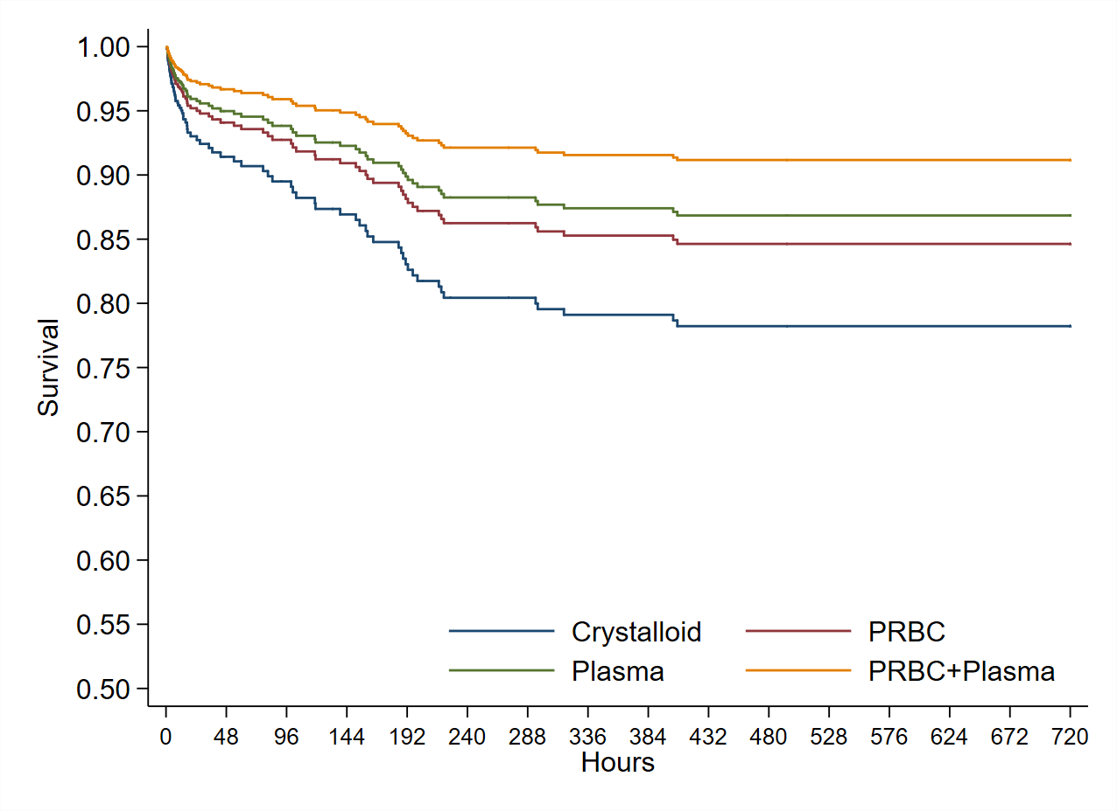

PAMPER Prehosp Resuscitation Secondary Analysis

Slide 19
Sub-Group-Interesting
Notes:
Soon after are large retrospective study, important prospective evidence was published from a prospective cohort analysis where sex hormones were drawn, including testosterone and estradiol, 48hrs following icu admission in critically ill patients some of whom were injured. This prospective evidenve further added to the confusion as they found the estrogen was significantly associated with mortality in both males and females, and no difference in mortality across the sexes.
Estradiol levels correlated with injury severity, TRISS probability of survival estimates, and apache II scores and elevated estradiol level were significantly associated with mortality.
This figure demonstrates as estradiol levels increase there is a proportional elevation in apache II scores and associated mortality
However due to the delayed measurements at 48 hrs these results are significantly confounded as it is know that peripheral conversion of androgens to estrogen occurs in adipose tissue and that this is stimulated by innate catecholamines and inflammatory cytokines.

Slide 20
Harmonized Data
Notes:
Soon after are large retrospective study, important prospective evidence was published from a prospective cohort analysis where sex hormones were drawn, including testosterone and estradiol, 48hrs following icu admission in critically ill patients some of whom were injured. This prospective evidenve further added to the confusion as they found the estrogen was significantly associated with mortality in both males and females, and no difference in mortality across the sexes.
Estradiol levels correlated with injury severity, TRISS probability of survival estimates, and apache II scores and elevated estradiol level were significantly associated with mortality.
This figure demonstrates as estradiol levels increase there is a proportional elevation in apache II scores and associated mortality
However due to the delayed measurements at 48 hrs these results are significantly confounded as it is know that peripheral conversion of androgens to estrogen occurs in adipose tissue and that this is stimulated by innate catecholamines and inflammatory cytokines.

Slide 23
Sub-Group-Interesting
Notes:
Soon after are large retrospective study, important prospective evidence was published from a prospective cohort analysis where sex hormones were drawn, including testosterone and estradiol, 48hrs following icu admission in critically ill patients some of whom were injured. This prospective evidenve further added to the confusion as they found the estrogen was significantly associated with mortality in both males and females, and no difference in mortality across the sexes.
Estradiol levels correlated with injury severity, TRISS probability of survival estimates, and apache II scores and elevated estradiol level were significantly associated with mortality.
This figure demonstrates as estradiol levels increase there is a proportional elevation in apache II scores and associated mortality
However due to the delayed measurements at 48 hrs these results are significantly confounded as it is know that peripheral conversion of androgens to estrogen occurs in adipose tissue and that this is stimulated by innate catecholamines and inflammatory cytokines.

Slide 24
MT / Blood Transfusion
Notes:
Soon after are large retrospective study, important prospective evidence was published from a prospective cohort analysis where sex hormones were drawn, including testosterone and estradiol, 48hrs following icu admission in critically ill patients some of whom were injured. This prospective evidenve further added to the confusion as they found the estrogen was significantly associated with mortality in both males and females, and no difference in mortality across the sexes.
Estradiol levels correlated with injury severity, TRISS probability of survival estimates, and apache II scores and elevated estradiol level were significantly associated with mortality.
This figure demonstrates as estradiol levels increase there is a proportional elevation in apache II scores and associated mortality
However due to the delayed measurements at 48 hrs these results are significantly confounded as it is know that peripheral conversion of androgens to estrogen occurs in adipose tissue and that this is stimulated by innate catecholamines and inflammatory cytokines.

Slide 25
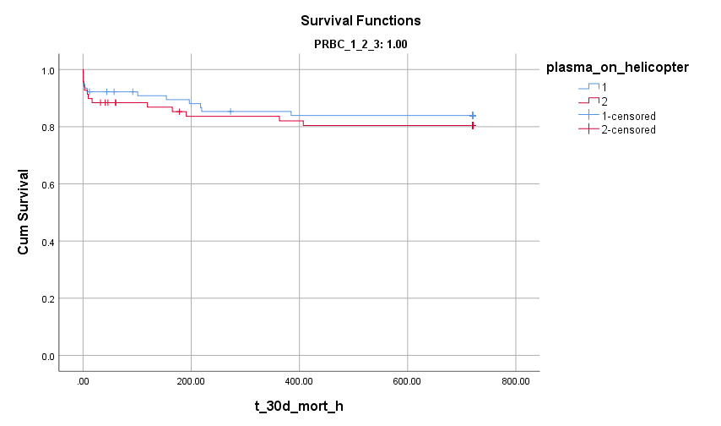
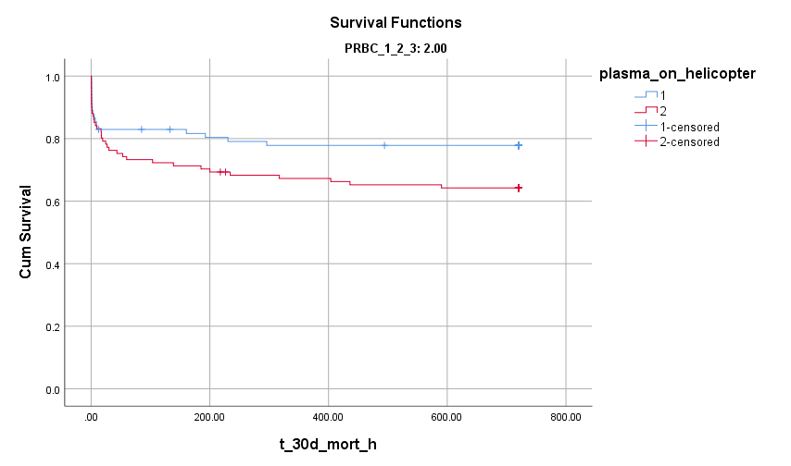
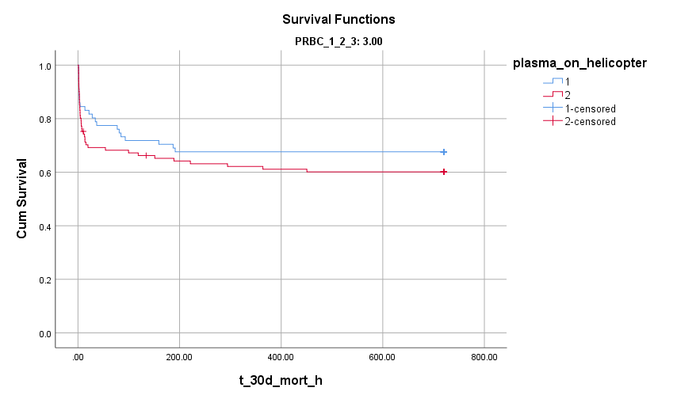
Blood Transfusion

Slide 26
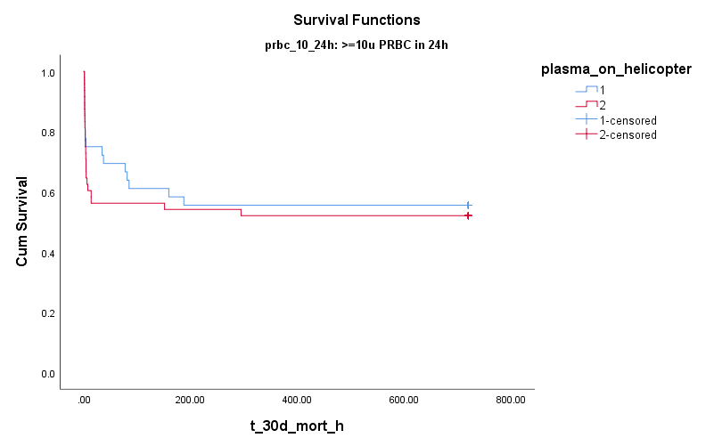
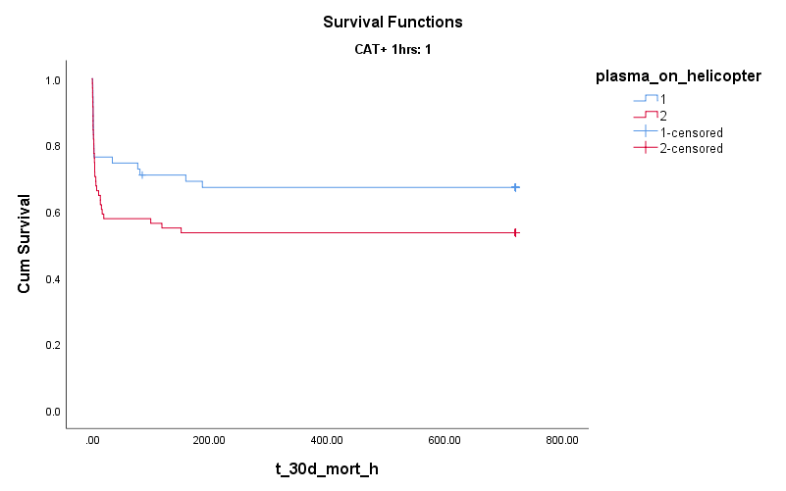
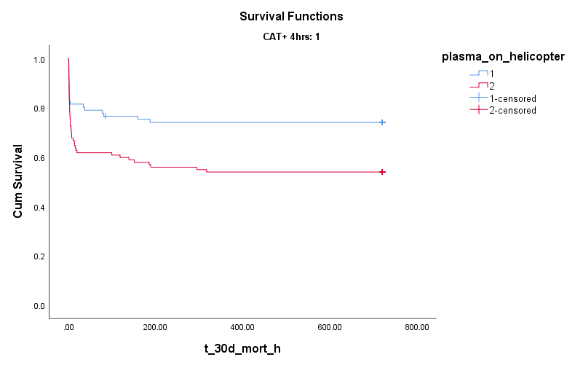
MT Definition
Log rank p=0.15
Log rank p=0.54
Log rank p=0.007
Notes:
Soon after are large retrospective study, important prospective evidence was published from a prospective cohort analysis where sex hormones were drawn, including testosterone and estradiol, 48hrs following icu admission in critically ill patients some of whom were injured. This prospective evidenve further added to the confusion as they found the estrogen was significantly associated with mortality in both males and females, and no difference in mortality across the sexes.
Estradiol levels correlated with injury severity, TRISS probability of survival estimates, and apache II scores and elevated estradiol level were significantly associated with mortality.
This figure demonstrates as estradiol levels increase there is a proportional elevation in apache II scores and associated mortality
However due to the delayed measurements at 48 hrs these results are significantly confounded as it is know that peripheral conversion of androgens to estrogen occurs in adipose tissue and that this is stimulated by innate catecholamines and inflammatory cytokines.

Slide 27
MT / Blood Transfusion
CAT in 4hrs
Minimizes survival bias
Remains predictor of high mortality
  Best for pragmatic prehospital studies that include TBI (different time of death)
Notes:
Soon after are large retrospective study, important prospective evidence was published from a prospective cohort analysis where sex hormones were drawn, including testosterone and estradiol, 48hrs following icu admission in critically ill patients some of whom were injured. This prospective evidenve further added to the confusion as they found the estrogen was significantly associated with mortality in both males and females, and no difference in mortality across the sexes.
Estradiol levels correlated with injury severity, TRISS probability of survival estimates, and apache II scores and elevated estradiol level were significantly associated with mortality.
This figure demonstrates as estradiol levels increase there is a proportional elevation in apache II scores and associated mortality
However due to the delayed measurements at 48 hrs these results are significantly confounded as it is know that peripheral conversion of androgens to estrogen occurs in adipose tissue and that this is stimulated by innate catecholamines and inflammatory cytokines.

Slide 28
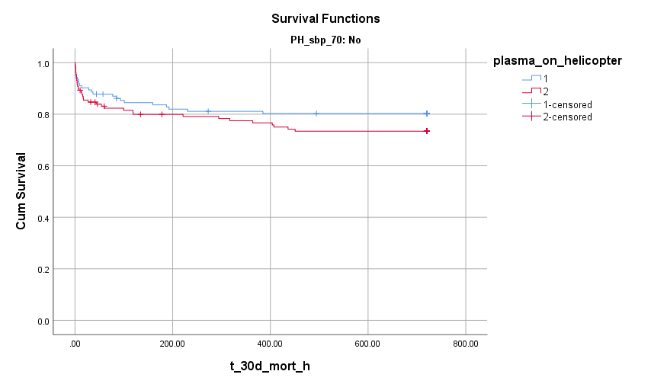
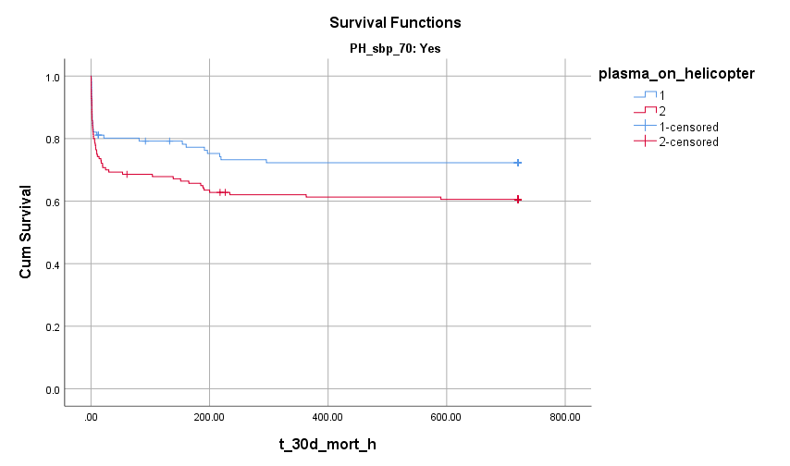
SHOCK

Slide 29
Sub-Group-Interesting
Notes:
Soon after are large retrospective study, important prospective evidence was published from a prospective cohort analysis where sex hormones were drawn, including testosterone and estradiol, 48hrs following icu admission in critically ill patients some of whom were injured. This prospective evidenve further added to the confusion as they found the estrogen was significantly associated with mortality in both males and females, and no difference in mortality across the sexes.
Estradiol levels correlated with injury severity, TRISS probability of survival estimates, and apache II scores and elevated estradiol level were significantly associated with mortality.
This figure demonstrates as estradiol levels increase there is a proportional elevation in apache II scores and associated mortality
However due to the delayed measurements at 48 hrs these results are significantly confounded as it is know that peripheral conversion of androgens to estrogen occurs in adipose tissue and that this is stimulated by innate catecholamines and inflammatory cytokines.

Slide 30
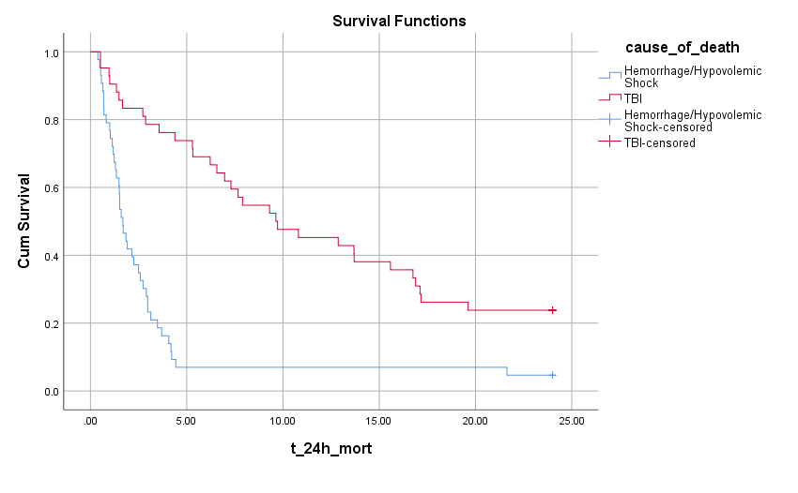
Hemorrhagic vs. TBI Death
Log rank p=0.006

Slide 31
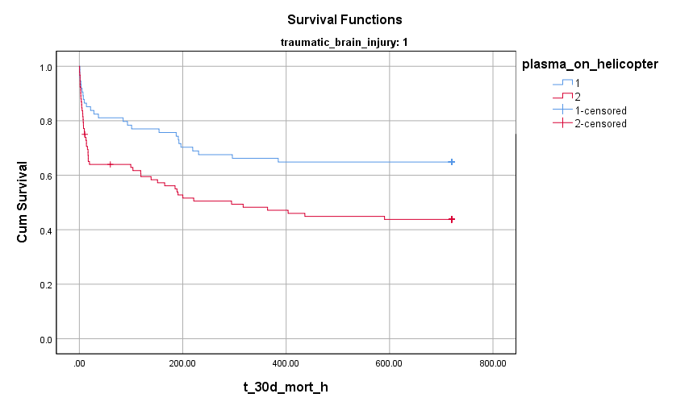
Polytrauma Including TBI
Log rank p=0.006

Slide 32

Mechanistic Analyses
Biomarkers- Cytokine, TBI, Coagulation, Endothelial/Glycocalyx
Notes:
Soon after are large retrospective study, important prospective evidence was published from a prospective cohort analysis where sex hormones were drawn, including testosterone and estradiol, 48hrs following icu admission in critically ill patients some of whom were injured. This prospective evidenve further added to the confusion as they found the estrogen was significantly associated with mortality in both males and females, and no difference in mortality across the sexes.
Estradiol levels correlated with injury severity, TRISS probability of survival estimates, and apache II scores and elevated estradiol level were significantly associated with mortality.
This figure demonstrates as estradiol levels increase there is a proportional elevation in apache II scores and associated mortality
However due to the delayed measurements at 48 hrs these results are significantly confounded as it is know that peripheral conversion of androgens to estrogen occurs in adipose tissue and that this is stimulated by innate catecholamines and inflammatory cytokines.

Slide 33
Cytokines

Slide 34
Inflammatory mediator concentrations grouped by plasma vs. standard of care:
501 Trauma patients
21 Cytokines
3 Time points
T0 n = 370
T24 n= 318
T72 n= 284
50/50 plasma vs. standard
Sick patients (mean ISS ~24) ~30% mortality

Slide 35
Plasma is not associated with statistically different mean concentrations.
Some (unadjusted) subgroups have different mean concentrations.
  Demographics (gender)
  Injury characteristics (TBI)
  prehospital interventions
*But no difference in plasma vs. standard care.
Limitations:
  Patient variability
  Variable interventions
  Circulating vs. components
  Unmatched subgroups
  Is one cytokine concentration alone meaningful?

Slide 36
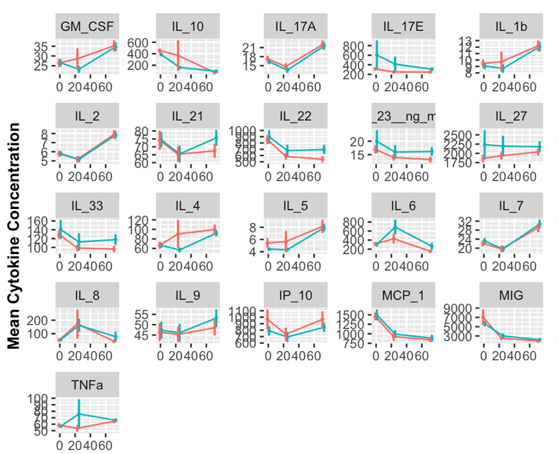
Notes:
However… main conclusion
Why is this? Well…

Slide 37
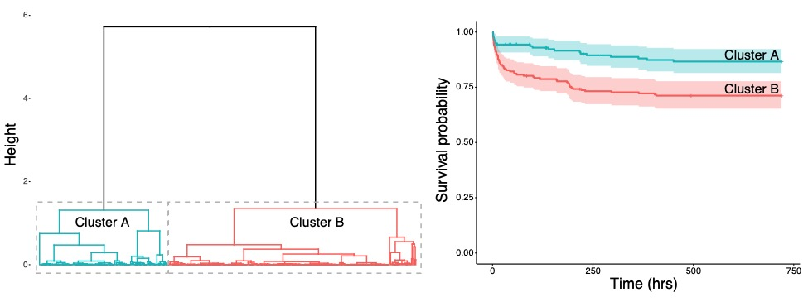
Hierarchical Clustering of Cytokines
Clusters have significantly different injury severity and patterns:
Cluster A (n=158)
Mean ISS: 18 p < 0.0001
More penetrating trauma p = 0.013
Cluster B (n=202)
Mean ISS: 27 p < 0.0001
More blunt trauma p = 0.013
More severe head p = 0.0073

Slide 38
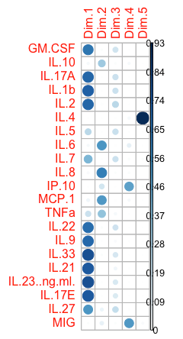
Drivers of Variance

Slide 39
Clusters Associated with Different 30-day Mortality
Cluster Dendrogram
Kaplan Meier Survival Curve with 95% CI
p = 0.00045
Mean ISS = 18
Penetrating trauma
Mean ISS = 27
Blunt trauma & TBI

Slide 40
HC of patients based on T0 cytokines leads to a clinically-relevant trauma patient taxonomy with significantly different injury severity and outcomes.
Cluster B had significantly worse outcomes:
24-hour mortality p = 0.009
30-day mortality p < 0.001
ICU LOS p = 0.016
days on mechanical ventilation p < 0.001
coagulopathy p = 0.007
acute lung injury p = 0.016
organ failure (Denver MOF) p = 0.039
severe head injury p = 0.007
No significant difference:
demographics: gender p = 0.40
demographics: age p = 0.07
prehospital plasma p = 1.0
categorical variables: Chi Square
continuous variables: Mann Whitney
survival: Log-Rank
p = 0.00045

Slide 41
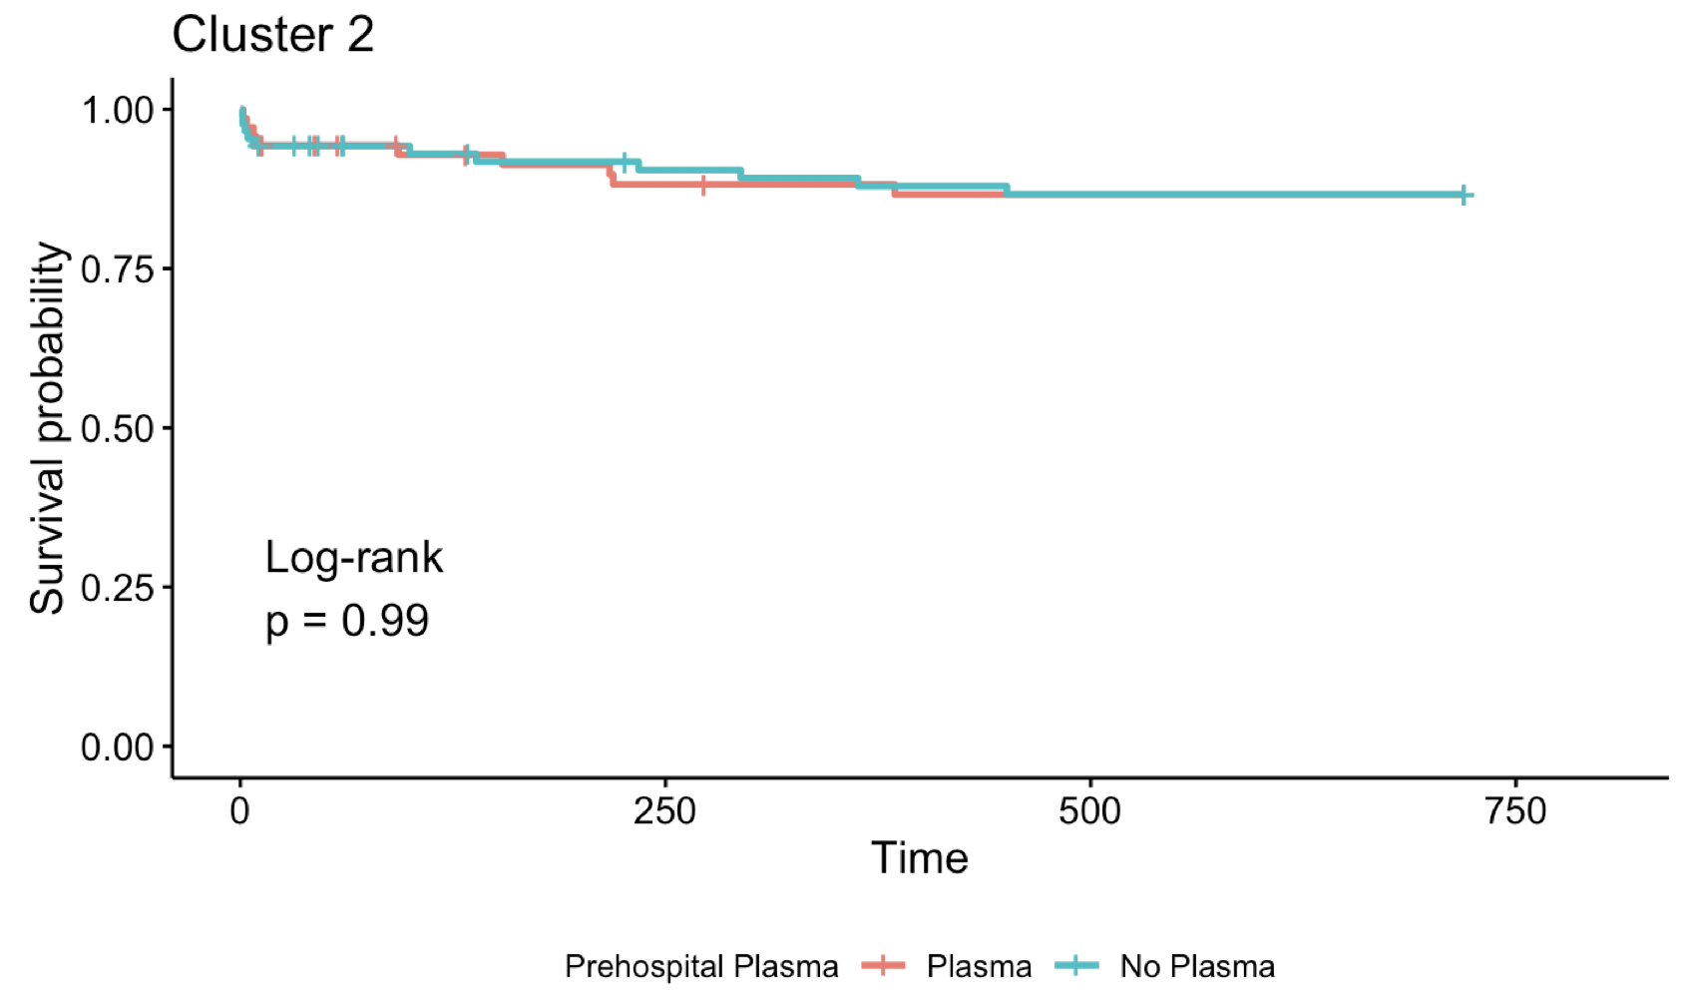
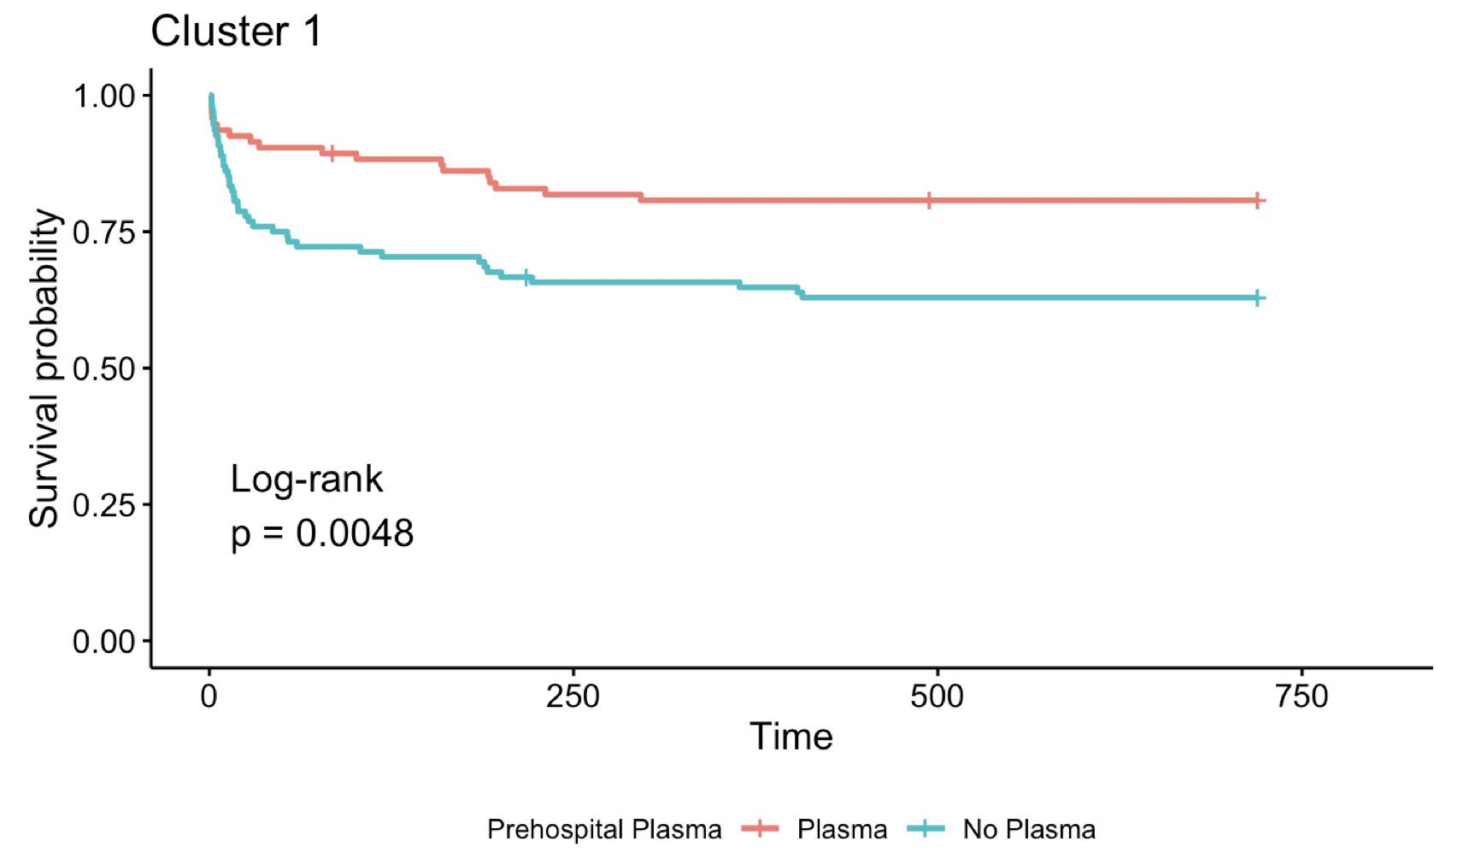
Cytokine Clusters Associated with Response to Prehospital Plasma
Cluster A
Plasma Nonresponders
Cluster B
Plasma Responders
Plasma
18%
No plasma

Slide 42
+Endothelial Cell Markers

Slide 43
Alive or Dead

Slide 44
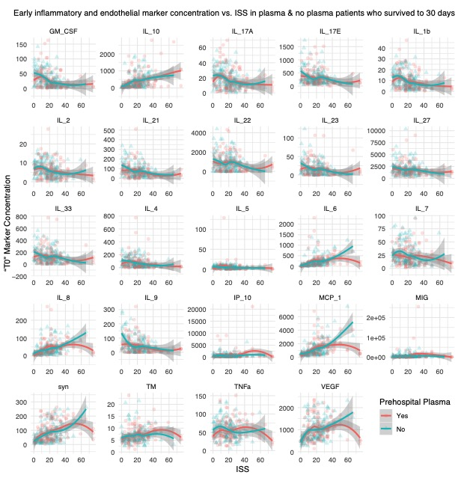
ISS Correlation

Slide 45
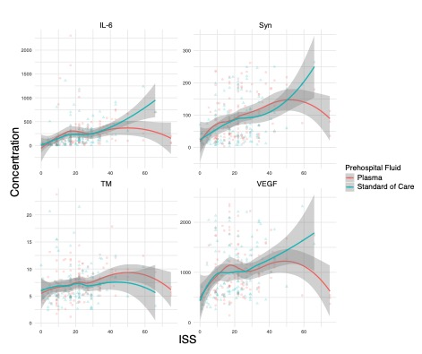
ISS Correlation

Slide 46
ISS Correlation

Slide 47
Multivariate Analysis
Endothelial cell markers alone
  ISS highest quartile > 75%ile
  Statistically lower in plasma patients in adjusted model
  At 24hrs

Slide 48
PCA Drivers of Variance

Slide 49
Dr. Danielle Gruen
Prehospital Providers
Participating Sites
MACRO- Research staff- University Pittsburgh
Dr. Frank Guyette- Department of EM at University of Pittsburgh
FUNDING -Supported by a grant (W81XWH-12-2-0023) from the U.S. Army Medical Research and Materiel Command

