Slide 1

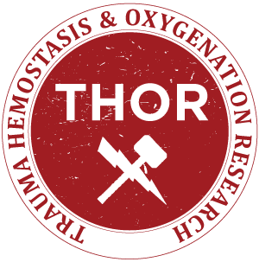

How Do We Prepare for Threat X?
Animal Model Design Considerations for Threat X and Transfusion
Isabel Lauren Jackson, PhD
Principal, True North BioPharm, LLC
June 29, 2022

Slide 2
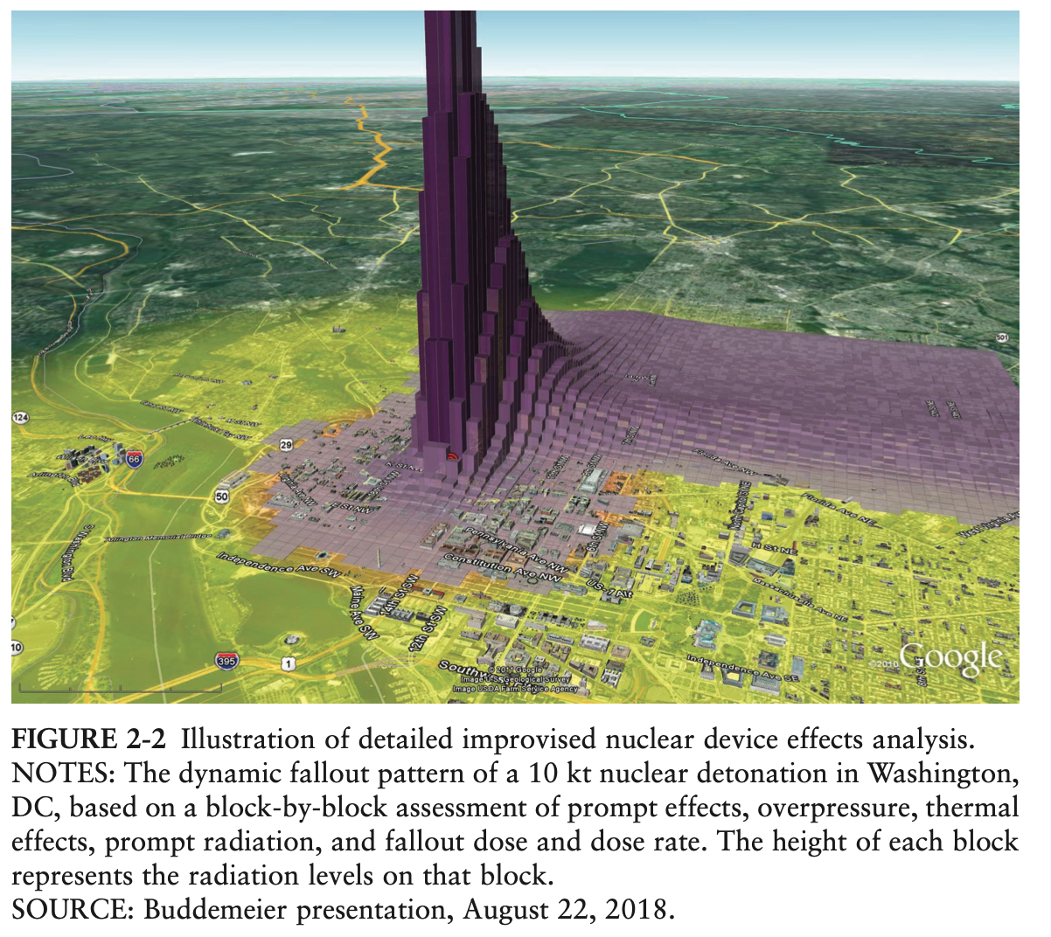
Nuclear Blasts and Fallout within Urban Environments
Detonation of a nuclear device in major U.S. city
  Hundreds of thousands to >1 million in need of medical treatment
Medical consequences
    Prompt events:
        Mechanical trauma
        Flash and flame burns
        Prompt radiation exposure
        Combined injuries
    Secondary events- radiation fallout
Triage, Transport, and Treatment
  First 24-72 hours will be primarily a local response
  Emphasis on medical countermeasures (MCM) that are effective at protracted periods of time following
  exposure- 24 h or later
Dynamic fallout pattern of a 10 kt nuclear detonation in Washington, DC

Slide 3
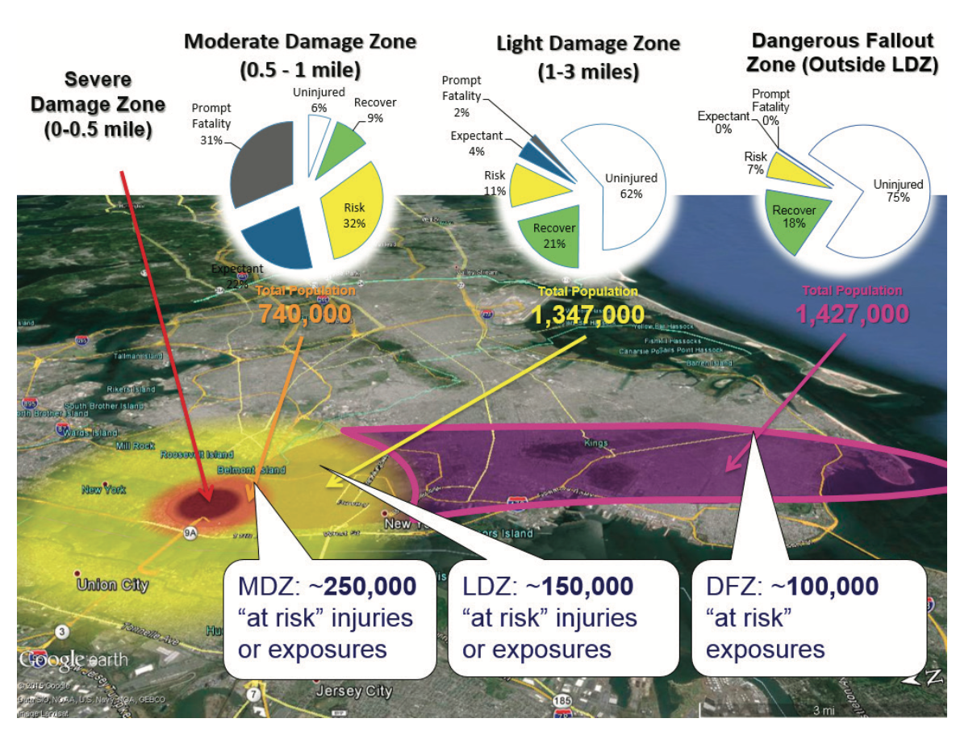
Casualties of a 10 kt nuclear detonation
Model of expected post-fallout effects after a nuclear incident in New York City
Severe Damage Zone
  Most people will not survive
Moderate Damage Zone
  Most people will survive
  Flying debris injuries common
  Estimated 250,000 ”at-risk” (in a population of 740,000)
Light Damage Zone
  Most people uninjured
  Estimated 150,000 ”at-risk” (in a population of 1.3 million)
Dangerous Fallout Zone
  Fall out decay is rapid
  There is no significant inhalation hazard
  Primary hazard is penetrating external radiation
  ~15 minutes for fallout to arrive
With medical intervention >100,000 at-risk fatalities may be avoided

Slide 4
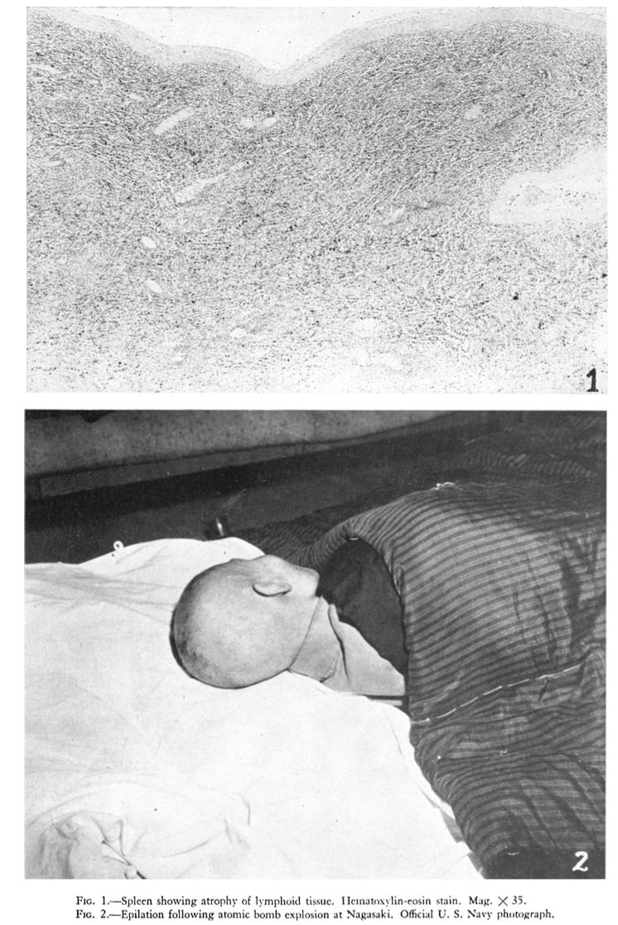
What is Acute Radiation Syndrome (ARS)?
Broadly defines a constellation of syndromes that occur hours to weeks after total or partial (>60%) body irradiation at a dose >50 cGy
Traditionally categorized as hematopoietic, gastrointestinal, or cutaneous subsyndromes of ARS
Human data generated primarily from:
  Atom Bomb survivors
  Marshallese accident victims
  Accidents at nuclear installations, e.g., Chernobyl
Warren S Cancer Res (6):9, 1946

Slide 5
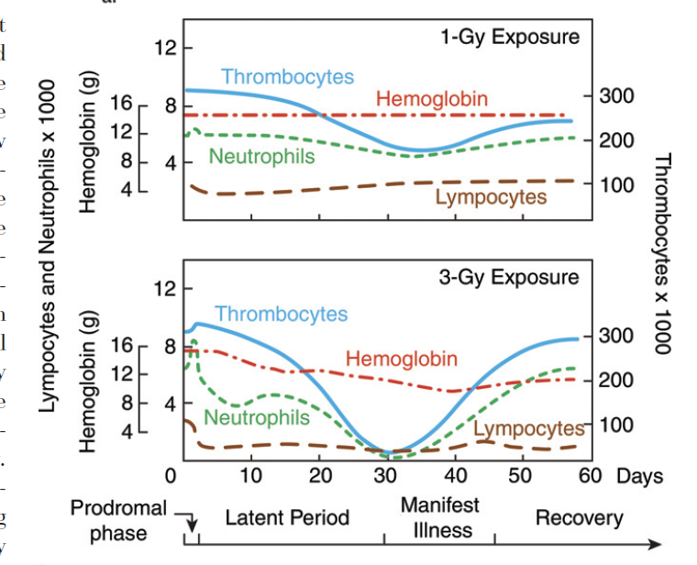
Myelosuppression associated with ARS is well-characterized
  Bone marrow is the dose-limiting organ for total body irradiation
  Exposure to >2 Gy of total body irradiation (minor signs/symptoms after 0.5 Gy)
Death within 3-4 weeks in absence of medical intervention (Lethal dose for 50% of exposed population within 60-days is 3.5 Gy; >5.5 Gy with cytokine therapy)
Clinical manifestations
    Lymphopenia
    Neutropenia
    Thrombocytopenia
    Severe acute anemia
    Hemorrhage and petechiae
AB Wolbarst et al. Radiology. 254(3):660

Slide 6
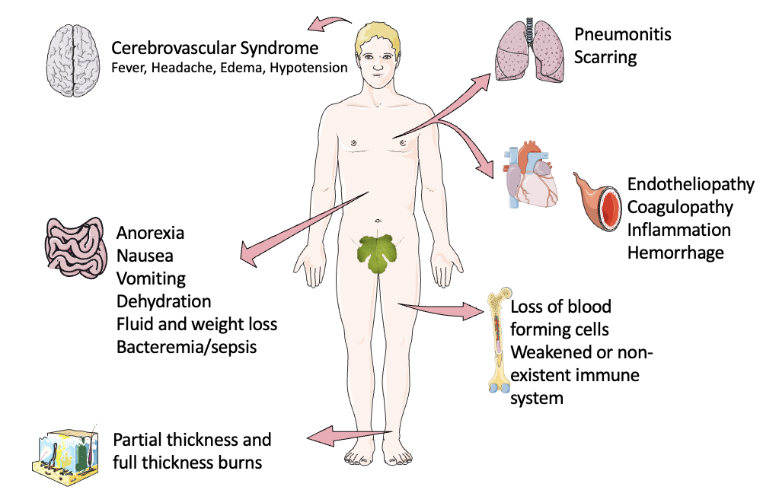
ARS is a Multi-Organ Injury/Failure Syndrome
  Pancytopenia, alone, however, cannot explain the spectrum of clinical manifestations observed among individuals with ARS
Petechiae, ecchymosis, and other hemorrhagic lesions with prolonged bleeding and coagulation times are characteristic of a “severe hemorrhagic syndrome”
Autopsy records from ARS victims describe hemorrhage inthe heart, lungs, skeletal musculature, bladder, and intestines
The pathobiology of blood failure (e.g., endotheliopathy, coagulopathy and hemorrhage ) associated with ARS has not been fully elucidated

Slide 7
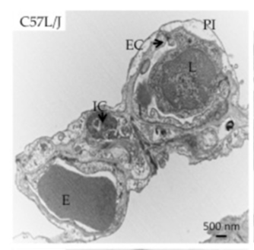
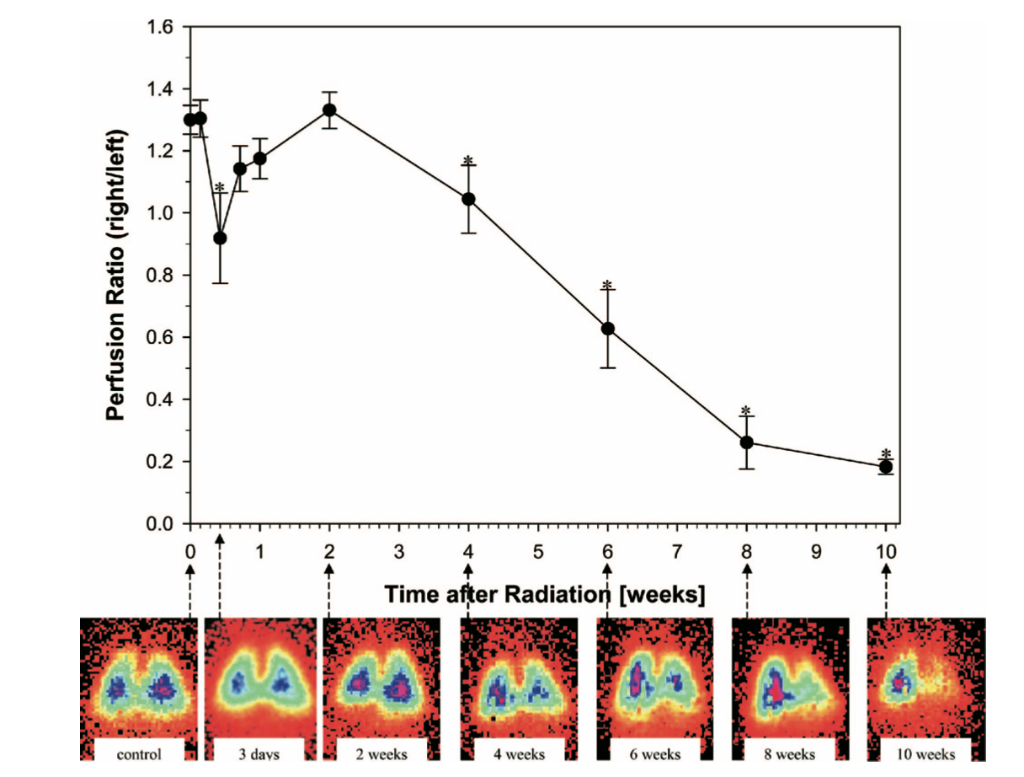
Pattern of Vascular Injury after Radiation
24 h after WTLI
C57L/J Mouse
Immediate effects (milliseconds to hours )
  Primarily caused by DNA damage and apoptosis
  Molecular injury is established
  Immediate morphologic lesions that may disappear for weeks prior to detection by light microscopy
  Vascular injury is rarely detectable
Early effects (24 hours to 60 days)
  Cytoplasmic swelling of EC leading to vascular occlusion and ischemia/reperfusion injury
  Capillary fragility, vascular permeability/loosening of tight junctions, angiogenesis
  Chronic oxidative stress (e.g., hydroxyl radical, peroxynitrite)
  Chronic hypoxia/reduced perfusion
  Increased expression of cytokines and adhesion molecules
  Increased endothelial –leukocyte interactions/inflammation
Jackson IL et al. Disease Models and Mechanisms. 10(4):425-437; 2017
Hemithoracic Irradiation, Fischer 344 Rats
Fleckenstein et al. Int. J. Radiation Oncology Biol. Phys., Vol. 68, No. 1, pp. 196–204, 2007

Slide 8
MCM Approvals under the FDA Animal Rule
FDA will rely on evidence from animal studies to provide substantial evidence of product effectiveness only when all of the following four criteria are met:
There is a reasonably well-understood pathophysiological mechanism of the toxicity of the substance and its prevention or substantial reduction by the product;
The effect is demonstrated in more than one animal species expected to react with a response predictive for humans, unless the effect is demonstrated in a single animal species that represents a sufficiently well-characterized animal model for predicting the response in humans;
The animal study endpoint is clearly related to the desired benefit in humans, generally the enhancement of survival or prevention of major morbidity; and
The data or information on the pharmacokinetics and pharmacodynamics of the product or other relevant data or information, in animals and humans, allows selection of an effective dose in humans.12

Slide 9
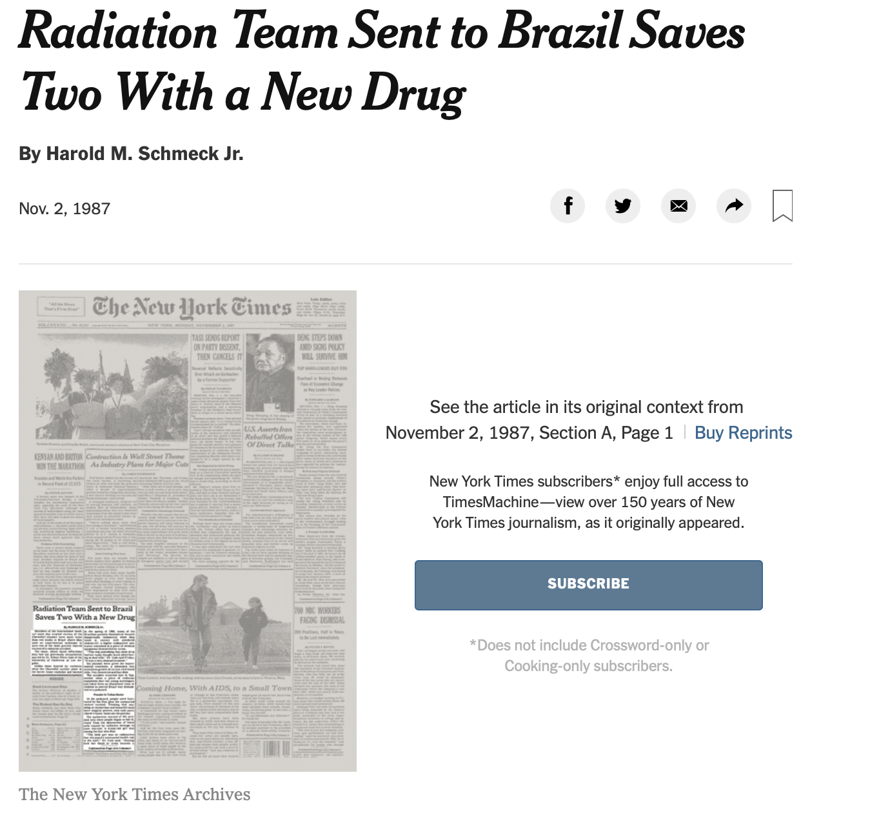
Repurposing commercially available, FDA-approved products as MCMs
  1986 - Sargramostim (GM-CSF, marketed as Leukine®) was used for the first time in humans with ARS following the Chernobyl Nuclear Power Plant accident in Ukraine.
  1987 – Sargramostim used to treat ARS in victims of the radiation accident at Goiânia, Brazil
  1991 – Sargramostim and filgrastim (G-CSF) approved for chemotherapy-induced neutropenia
  2015 – Filgrastim (Neupogen®) and peg-filgrastim (Neulasta®) approved as MCMs to treat myelosuppression associated with ARS
  2017 - Sargramostim Leukine® approved as a MCM
  2021 – Romiplostim (NPlate®, TPO receptor agonist) approved as a MCM*

Slide 10
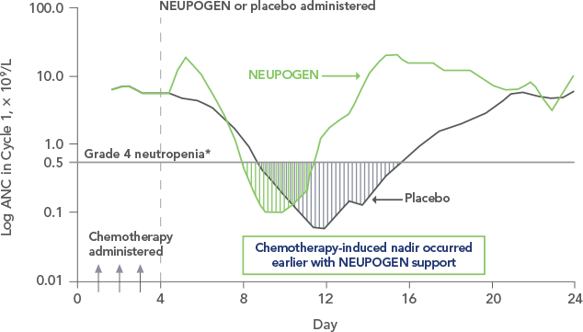
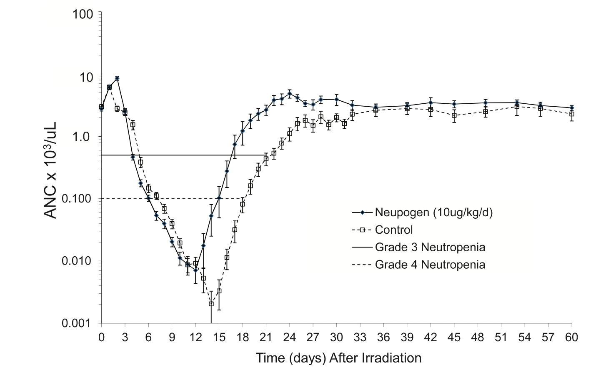
Drug Repurposing - Conserved Pathobiology
Myeloid Colony Stimulating Factors
Chemotherapy-Induced Neutropenia
Total Body Irradiation-Induced Neutropenia
Neupogenhcp.com
Farese et al. Rad Res 179, 89-100 (2013)

Slide 11
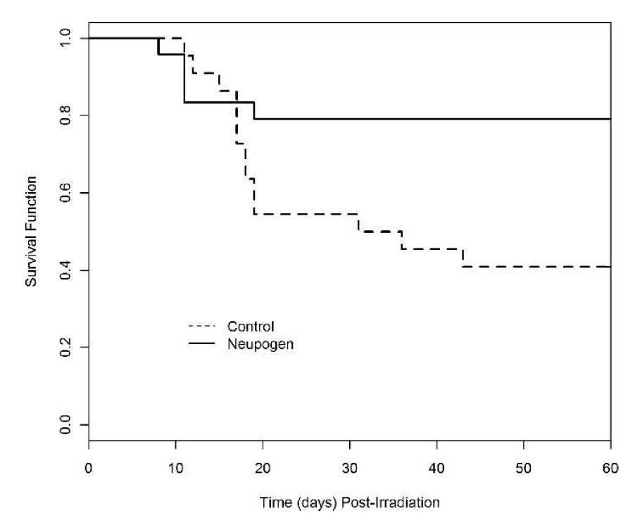
Adequate and Well-Controlled Study
Neupogen® (filgrastim) Efficacy in ARS
Randomized, Blinded, Placebo-controlled study in Chinese bred rhesus macaques
Neupogen® (10 μg/kg/d), subcutaneous Injection, starting 23-24 h post-TBI
  Administered daily until ANC >/= 1000 cells/μL for 3 consecutive days or >/= 10,000 cells/μL at any one time
Significant (p<0.004) improvement in 60-day survival
Decreased duration of Grade 4 Neutropenia from 8-15 days to 4-14 days (p = 0.009)
79.2% survival
40.9% survival
p<0.0004
Farese AM et al. Radiation Research. 2013; 179, 89-100

Slide 12
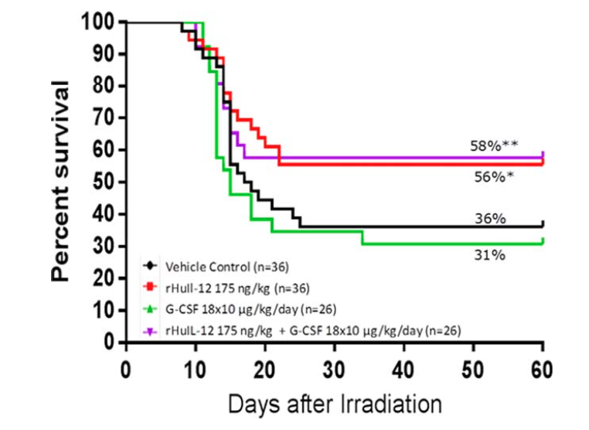
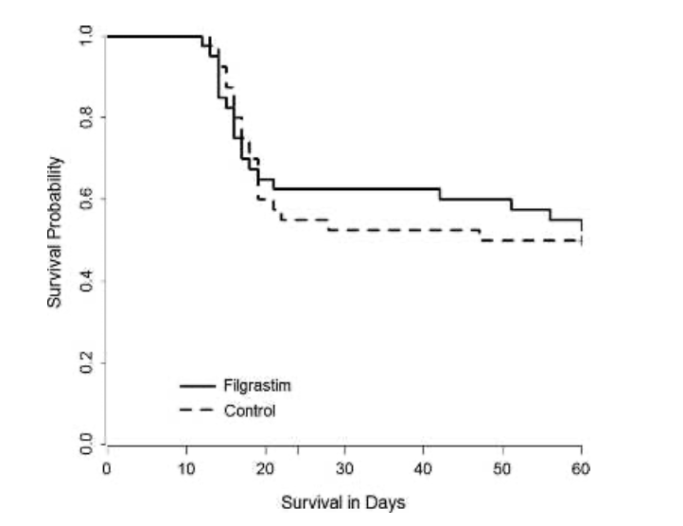
Neupogen® (filgrastim)- Loss of efficacy in the absence of blood transfusions and with delayed treatment (48h)
Filgrastim: 19/40 (47.5%)
Control: 20/40 (50%)
Gluzman Poltorak et al. Amer J Hematology, 89 ( 9):868-873, 2014
Farese AM et al. Health Physics. 106 (1): 39, 2014

Slide 13
The MacVittie Model – Whole Blood Transfusion
Whole blood product support is administered at 7-14 mL/kg by IV push for a minimum of ten minutes.
Blood product support initiated when:
Decrease of ≥ 5% in hematocrit (HCT) from the previous calendar day’s value resulting in an HCT ≤ 25%.
Hematocrit < 20% and platelet (PLT) < 100,000 cells/µL
Platelet count < 20,000 cells/μL and hemoglobin (HGB) < 6.7 g/dL
Platelet count ≤ 2, 000 cells/µL regardless of HCT and HGB.
Obvious signs of uncontrolled hemorrhage
An animal experienced a ≥ 10% decrease in HCT from the previous calendar day’s value and the PLT < 100,000 cells/µL.
Animal’s HCT was ≤ 25 % for 2 consecutive days and corresponding PLT counts were ≤ 3,000 cells/µL.
Whole blood product support may have been continued when the animal had previously received a transfusion and there was evidence of bleeding, such as bloody stool or a decrease in HCT relative to the most recent result.
Packed RBC support was administered when the PLT ≥ 100,000 cell/µL and there were no signs of bleeding but the HGB < 6.7 g/dL or HCT < 20%.

Slide 14
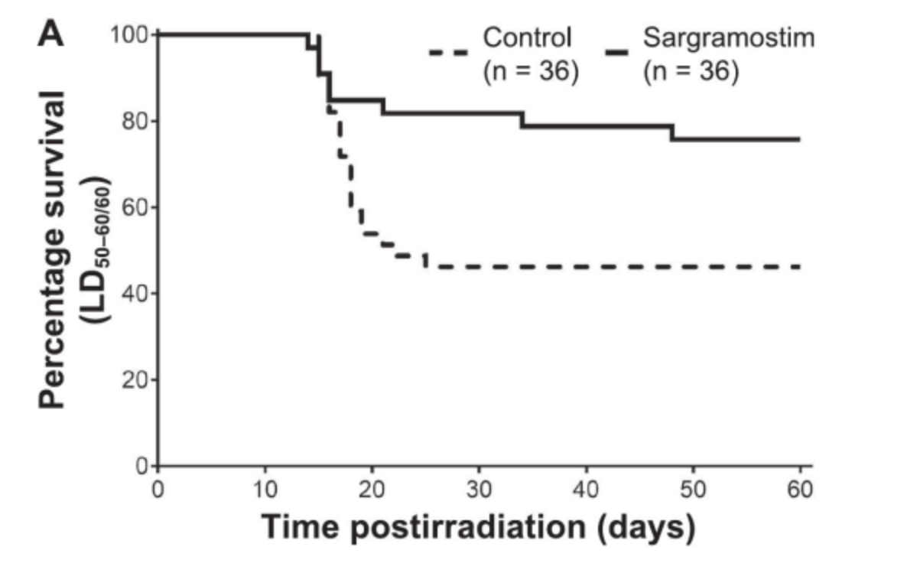
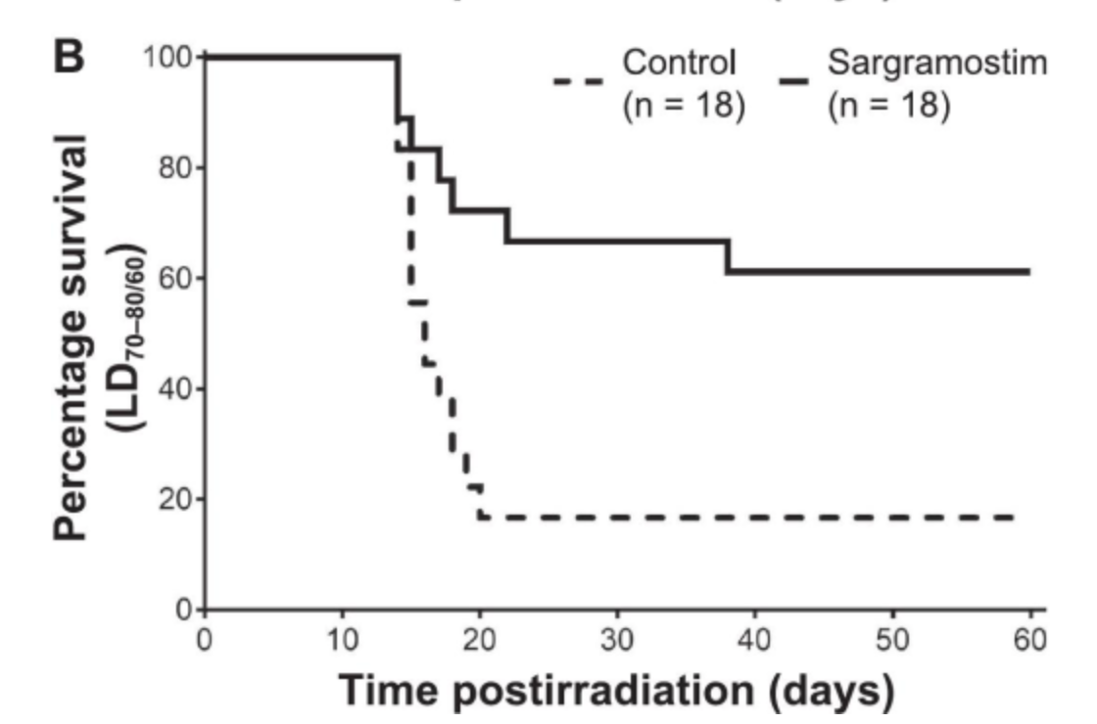
Efficacy of Leukine® when administered 48 hours after exposure to an LD_{50/60} or LD_{70/60} dose of TBI
77.8% Survival
61.1% Survival
41.7% Survival
16.7% Survival
p = 0.0018
p = 0.0076
*Animals were provided minimal supportive care (e.g., antibiotics, fluids)
Clayton NP et al. Radiation Research 195(2):191-199, 2020

Slide 15
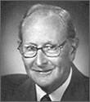
Mid-20th century transfusion studies in a canine model of TBI-induced ARS
  Major causes of death after exposure to large amounts of radiation
    Infection due to granulocytopenia
    Hemorrhage due to thrombocytopenia
Bleeding in irradiated Guinea pigs correlated with diminution in platelet count 7-8 days post-exposure (Fabricius-Moeller, 1920)
Canines exposed to 6 Gy TBI – uniformly fatal with massive hemorrhage in brain, heart, GI
Concentrated platelet transfusion product from 100 American Foxhound donors
Injected platelet concentrate at regular intervals to maintain platelet count
Prevented death due to hemorrhage – all fatalities due to infection
Eugene Cronkite, MD (1914-2001)
https://www.hematology.org/about/history/legends/eugene-cronkite-bio/eugene-cronkite-qa

Slide 16
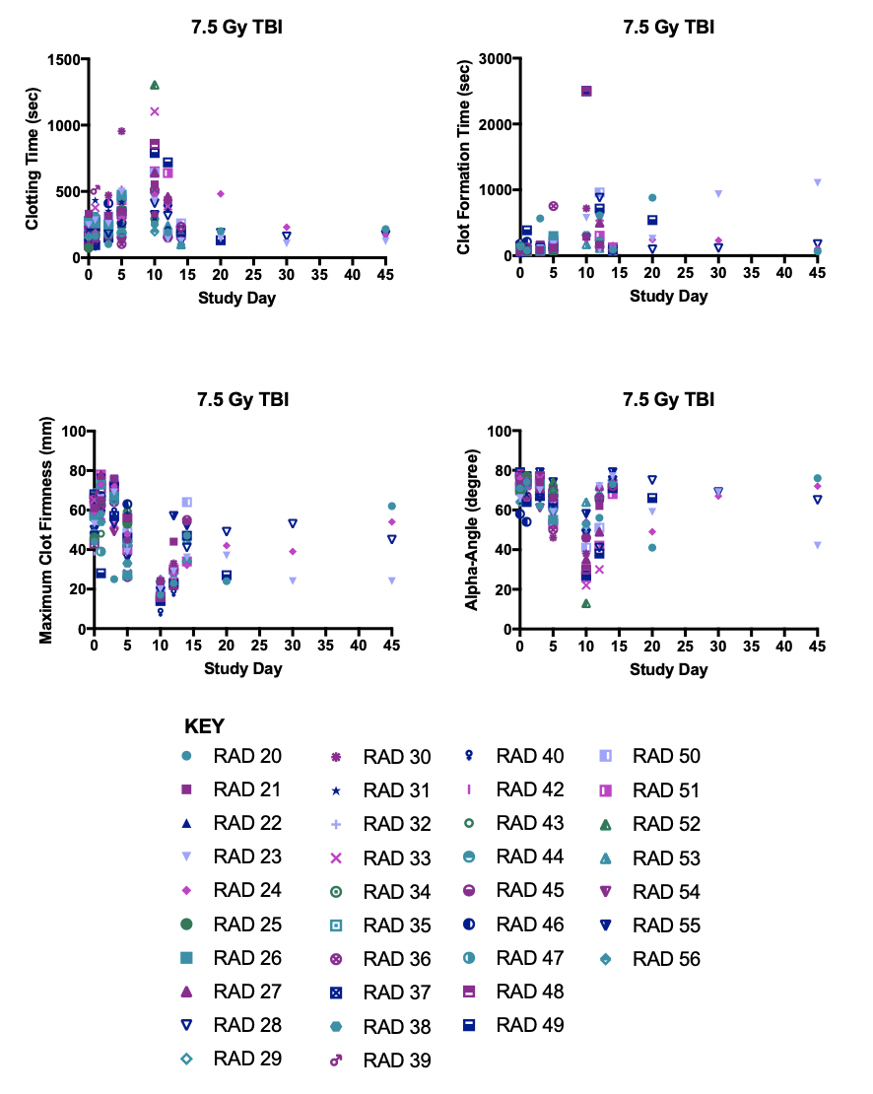
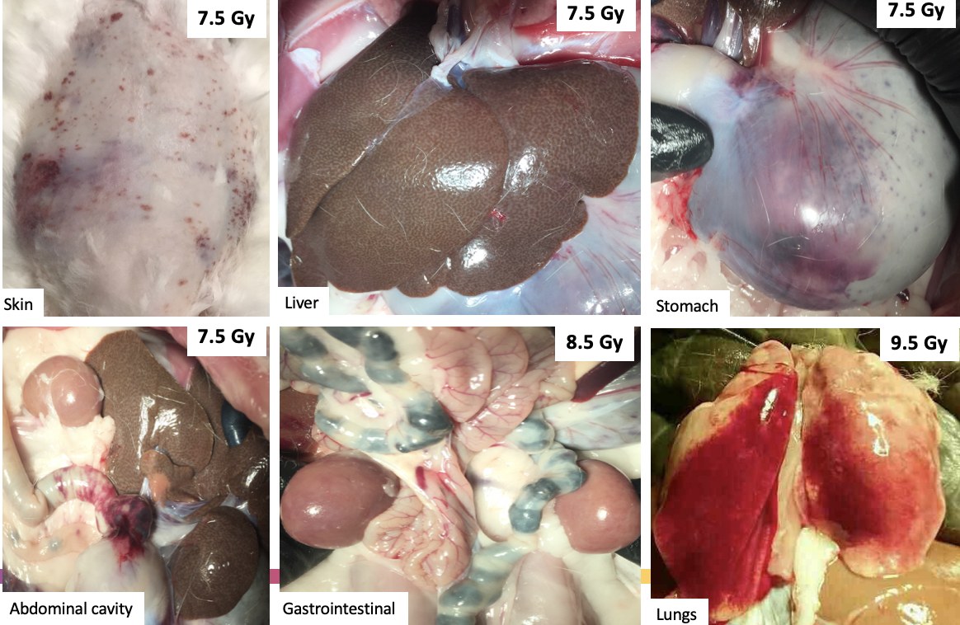
Hemorrhage associated with TBI-induced ARS
7.5 Gy
7.5 Gy

Slide 17
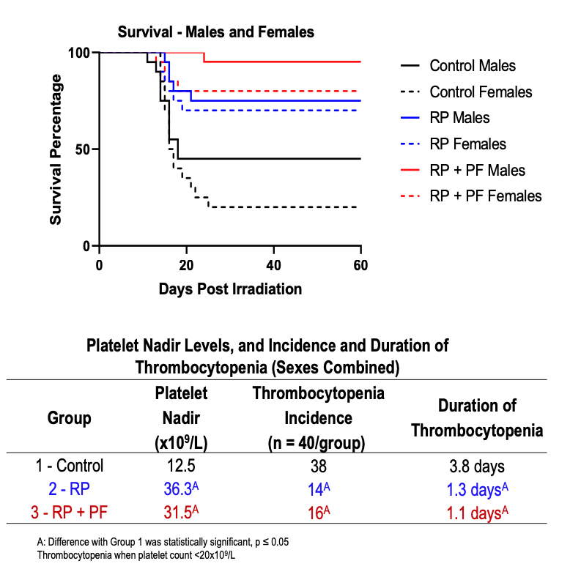
NPlate® significantly improves survival from TBI-induced ARS
Study arms (n = 40 per arm)
  Control
  Romiplostim (5mg/kg)
  Romiplostim (5mg/kg) + pegfilgrastim (0.3 mg/kg)
Primary Endpoint – Survival
  32.5% survival in control arm
  72.5% survival in romiplostim arm
  87.5% survival in romiplostim + pegfilgrastim
Platelet Counts
  Nadir was significantly less severe
  55-60% reduction in incidence of thrombocytopenia
  2.5-2.7-day reduction in duration of thrombocytopenia

Slide 18
Challenges to development of 2nd Gen Blood Products for ARS
Existing species/strains used in MCM development are insufficiently characterized (e.g., endotheliopathy, coagulopathy) to inform appropriateness of the models for blood product development under AR
Protocol is ill-defined – prophylaxis vs. treatment
Imprecise dose estimation and lack of predictive biomarkers hinders ability to stratify patients according to risk/benefit
AB Wolbarst et al. Radiology. 254(3):660

Slide 19
Animal Model Challenges and Lessons Learned
Radiation | Species/Strain Selection | Model Considerations | Supportive Care | Euthanasia Criteria
Source LINAC X-Ray γ-Ray Shielding Dose rate | Mice Minipigs Sinclair Göttingen New Zealand White Rabbits Non-Human Primate (Chinese, Indian) Rhesus macaque Cynomolgus | Inbred or Outbred Reagent Availability Import bans/animal availability Sex differences Radiation dose-response Blood volume limitations | Antibiotics (+/-, selection, tx regimen, resistance) Blood products/ transfusion | Soft Endpoint IACUC requirements Veterinary discretion Blinded vs. non-blinded
Courtesy of Mary Homer (Branch Chief, BARDA)

Slide 20
Thank you!!!
Contact Information
Isabel.lauren@truenorthbiopharm.com

