Slide 1
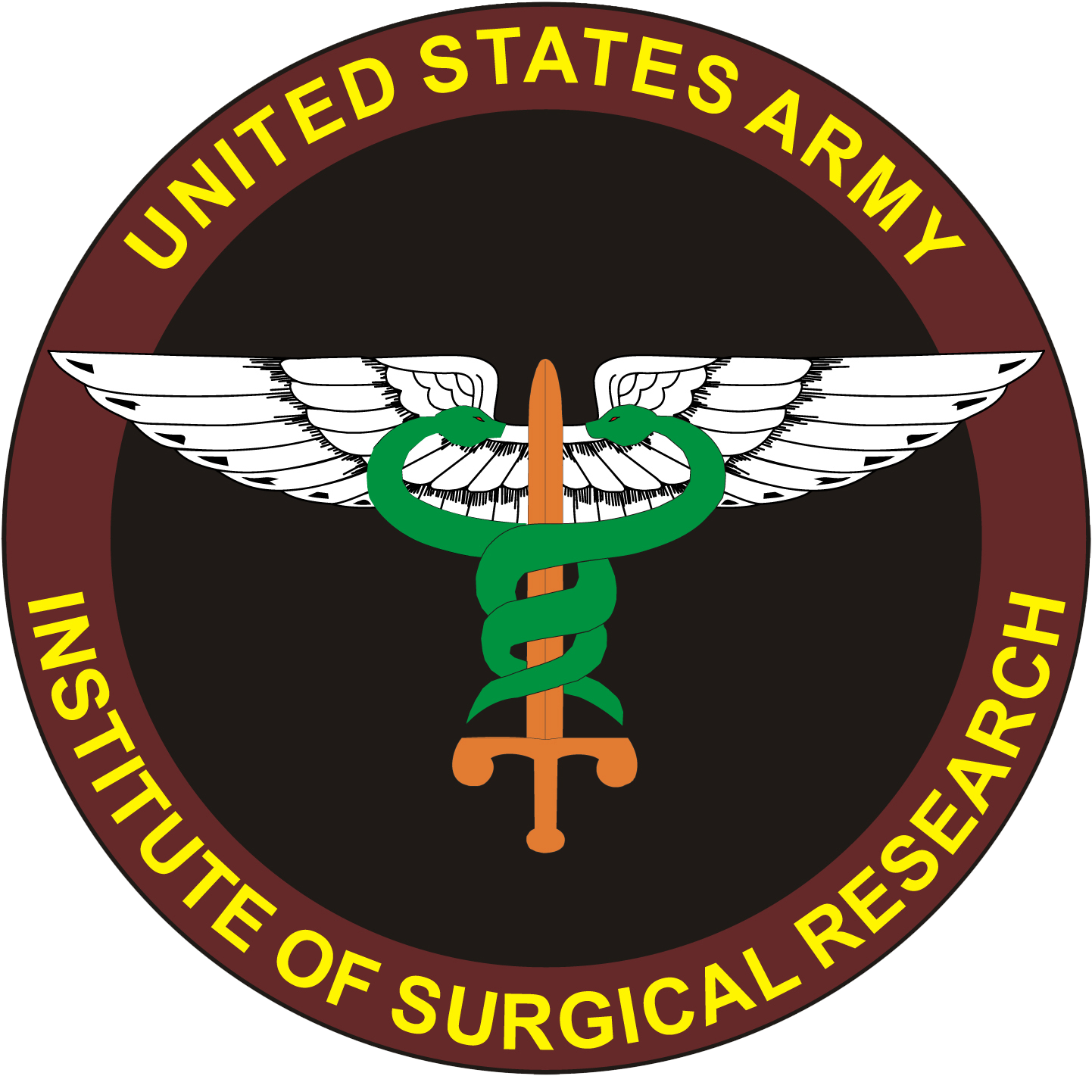
Novel Therapies for Shock and Vascular Dysfunction
COL Andrew P. Cap, MD, PhD
US Army Institute of Surgical Research

Slide 2
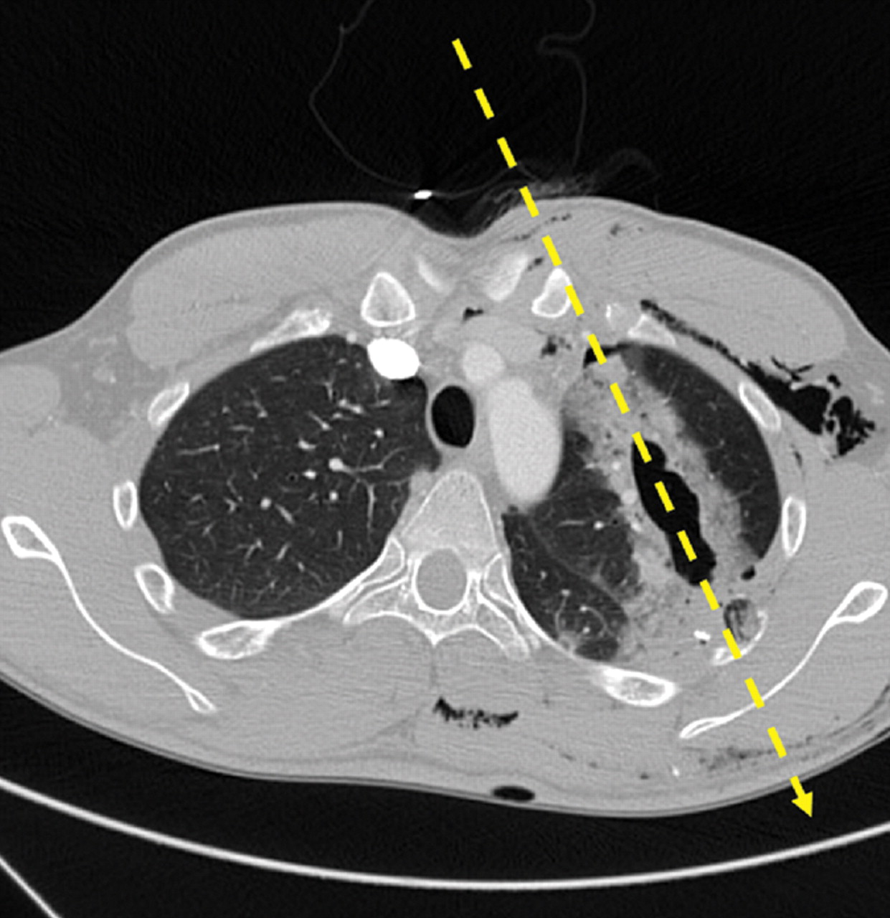
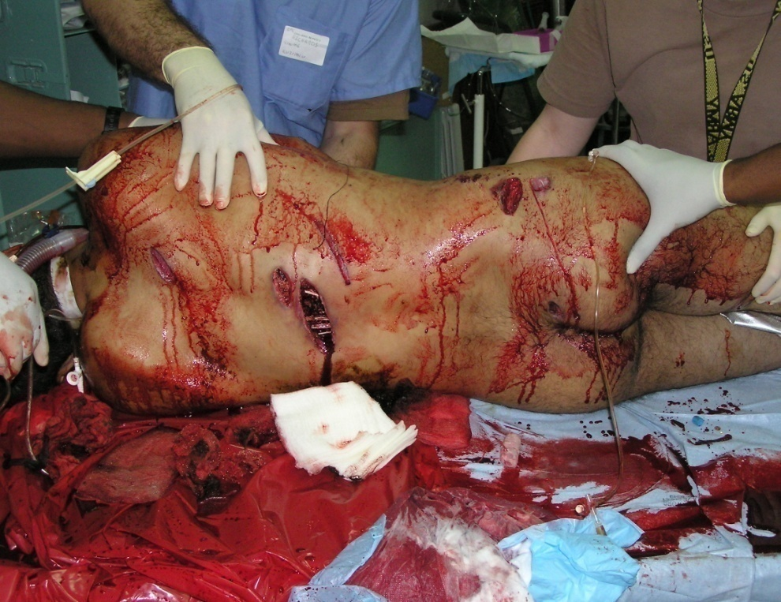
Hemorrhagic Shock
Massive injury
Blood loss
Shock
Coagulopathy/Endotheliopathy
Folio LR, Fischer T, et al. AJR Am J Roentgenol.
2011 Aug;197(2):W233-40.

Slide 3
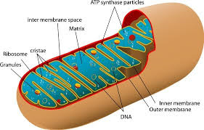
Loss of Blood → hypoxia → metabolic failure → endotheliopathy → coagulopathy → Blood Failure
Mitochondrial
Dysfunction
Bleeding → hypoxia → metabolic failure → blood failure → bleeding → hypoxia...
Need blood ASAP & “shock drug” to break the cycle!

Slide 4
Decreased time to surgery & early blood transfusion save lives
Lower mortality w/ prehospital transfusion

Slide 5
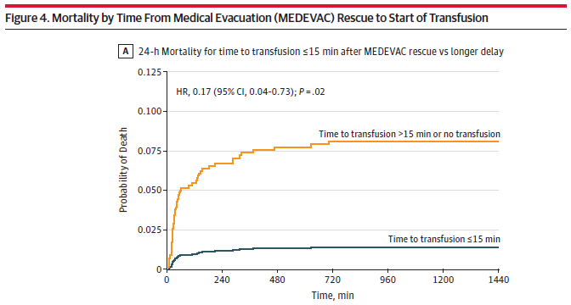
Time is life. Transfuse early.
Must start transfusion within 30-40 min of severe injury.
Increasing duration of shock is not helpful.
Think BLS. How many minutes before myocardium and brain die?
Shackelford JAMA 2017.

Slide 6
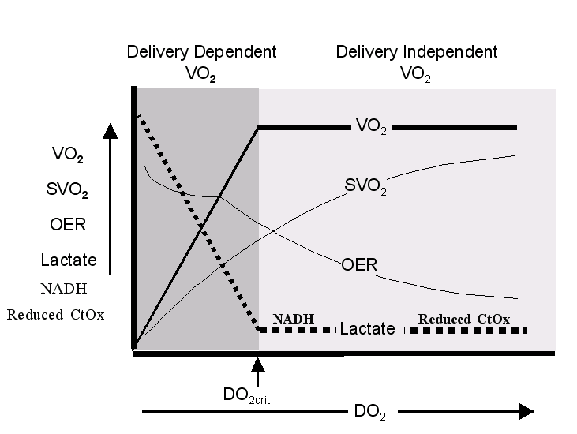
378
CO 6, Hb 4.8
551
1103
Transfusing 1:1:1
CO 3, Hb 9
413
Transfusing WB
CO 3, Hb 14
Normal
CO 6, Hb 14

Slide 7
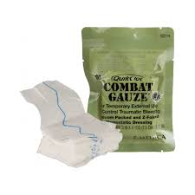
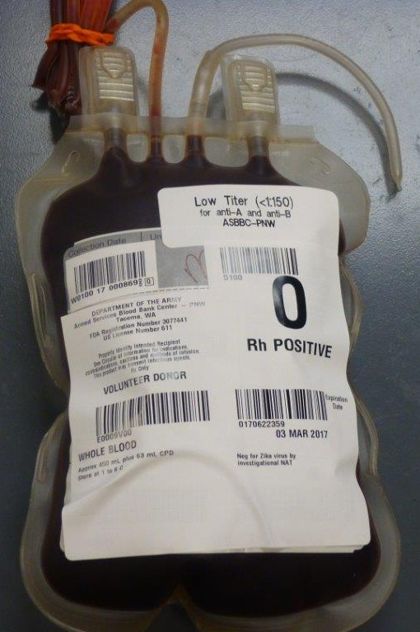
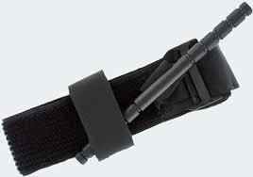
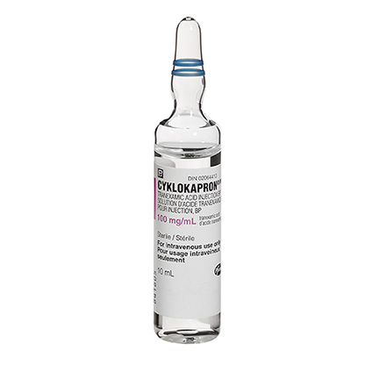
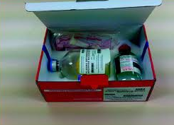
So, with TCCC… problem solved?
TXA

Slide 8
We did pretty well…
More TQ/Blood, faster transport → fewer KIA, more survival

Slide 9
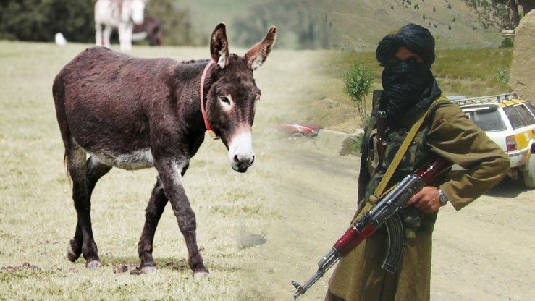
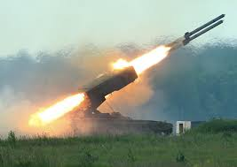
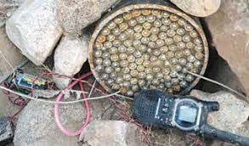
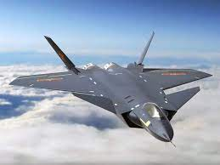
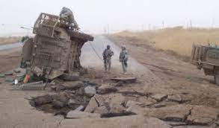
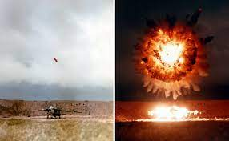
Changing Adversaries → Changing Battlefield Medical Challenges
Afghanistan / Iraq:
IEDs, small arms, mortars, RPGs →
Low casualty density, rapid evacuation to surgery
Russia / China:
Sophisticated / lethal weapons, contested air →
High casualty density, delayed evacuation to surgery

Slide 10
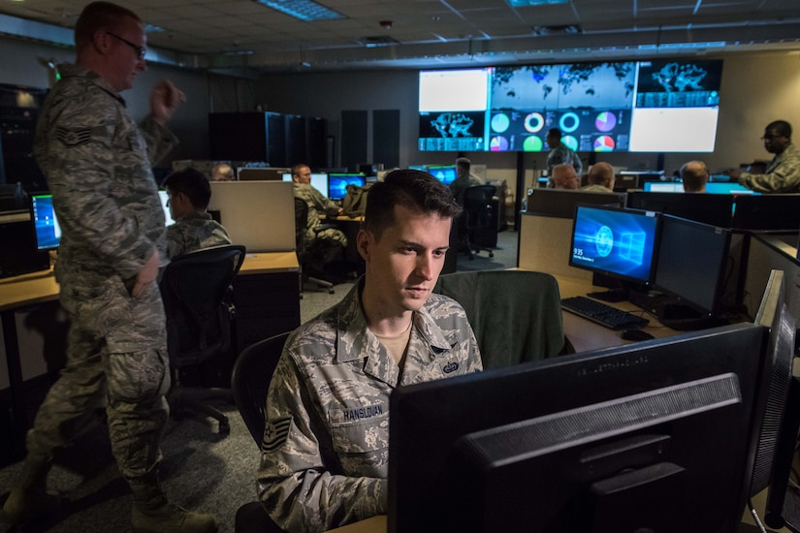
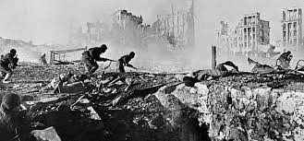
LSCO & MDO = Much larger challenge
MDO Challenges:
Cyber-attacks
Long range precision fires (70+ km)
Air defense, drones, MANPADs
IMPACT:
Dispersion of forces
Degraded communications
Air evacuation difficult/impossible
Long evacuation to Role 2/3
Casualties may take hours to days to reach surgical care

Slide 11
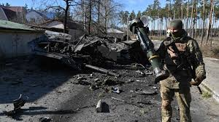
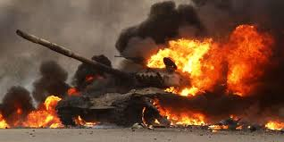
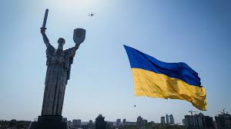
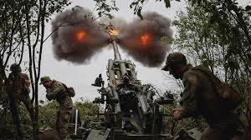
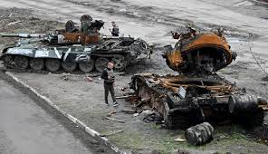
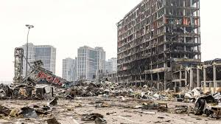
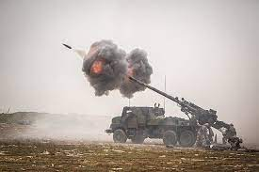
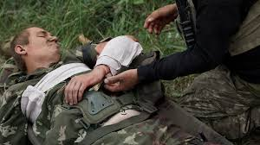
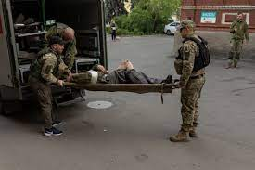
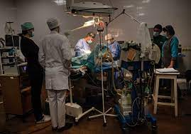
LSCO & MDO = Ukraine today

Slide 12
So, with a trauma system, early evac, blood transfusion & surgery, we reduced mortality 50%
But, if we don’t have evac/blood/surgery…
Best case scenario is early AFG with 15% mortality…
Worst case with higher weapons lethality/slower evac is easily 25-30%

Slide 13
We do not have everything figured out…

Slide 14
Resuscitation (lactate clearance) is slow

Slide 15
Resuscitation doesn’t fix coagulation early

Slide 16
What if we don’t have enough blood…?

Slide 17
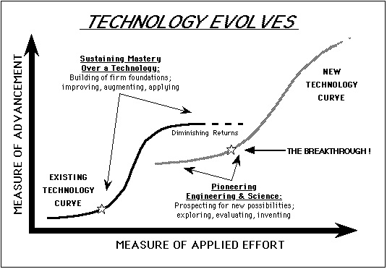
We need radical innovation to get onto a new technology curve
Where we need to be for MDO/LSCO
Combat Casualty Care 2021
What we need to do NOW!
Combat Casualty Care 2001

Slide 18
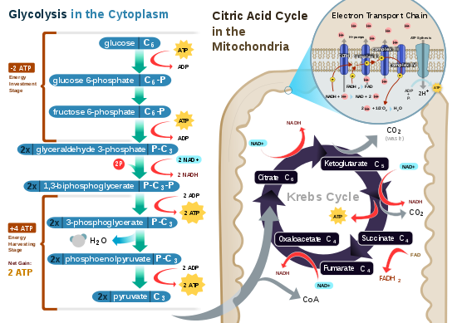
Perhaps we need to go back to basics…

Slide 19
No oxygen? Pyruvate shunted to lactate
Problem common to all shock states
PDHC inactivated
Anaerobic metabolism, mitochondrial dysfunction
Increase in citrate, succinate (proinflammatory)
Metabolic acidosis

Slide 20
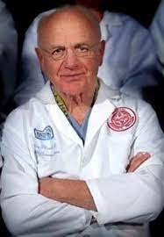
Lactic acidosis in shock associated with loss of high energy phosphates
HS→ acidosis
Resuscitation → reverses acidosis
HS: no effect on energy charge in skeletal muscle

Slide 21
Differential effects of shock & reperfusion by tissue
HS → all tissues drop energy charge
Resuscitation → kidney, lung, Intestine: drop in energy even greater (WB+NS, 1:1) [edema?]
Liver improves…

Slide 22
PDHC: Central metabolic switch of shock…
Druggable target?
Attractive candidates: DCA, thiamine

Slide 23
This has been tried…

Slide 24
DCA reduced lactate, but maybe treatment was too late…

Slide 25
Think about staying out of trouble instead of getting out of it…

Slide 26
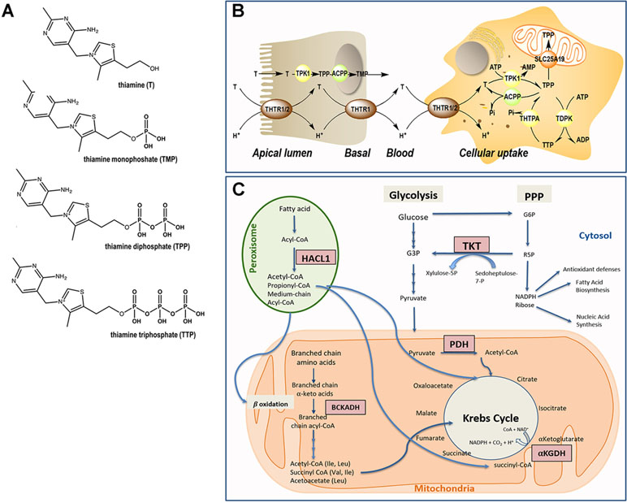
Think about staying out of trouble instead of getting out of it…

Slide 27
Replacing electron shuttles in TCA
Could also block NAD+ depletion by inhibiting PARP…

Slide 28
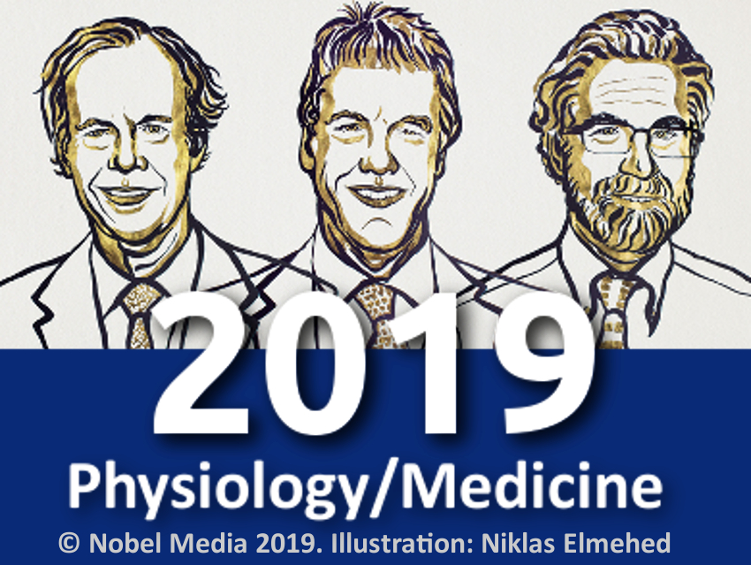
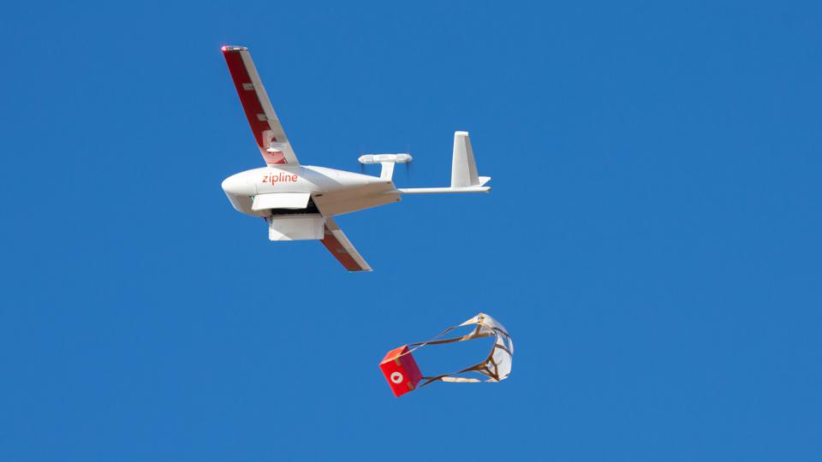
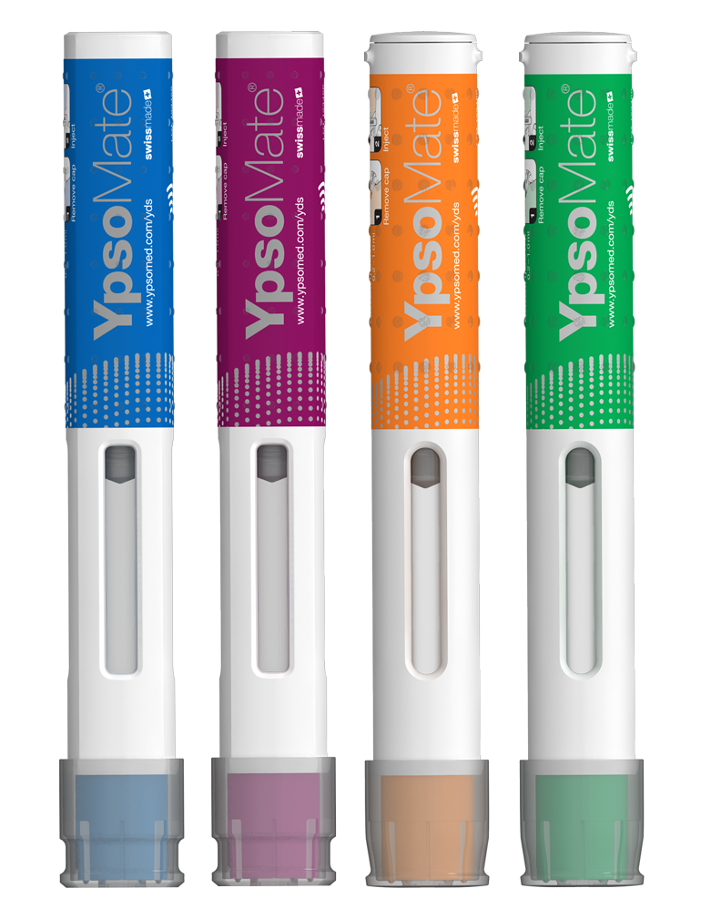
Team 1 –
Treat shock & metabolic failure
Pillar 1: Blood and Shock Resuscitation
  Anti-shock drug (prolyl hydroxylase inhibitors, pyruvate dehydrogenase kinase inhibitors, etc.)
  Engineered dried whole blood alternatives
  Next generation extended shelf-life platelets and whole blood
  Improved blood transport container system / support for drone delivery of blood products
Shock drug autoinjectors
6
Notes:
The 2019 Nobel Prize in Physiology or Medicine was awarded to a trio of scientists—William G. Kaelin Jr., Sir Peter J. Ratcliffe, and Gregg L. Semenza—who study a set of proteins that control how cells use oxygen, known as the hypoxia-inducible factor (HIF) system. Their collective discoveries have led to the development of treatments for anemia, cancer, and other blood-related diseases.

Slide 29
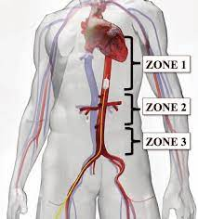
Team 2 –
Hemostasis, vascular stabilization
Pillar 2: Hemorrhage and Vascular Dysfunction
  Non-compressible hemorrhage control / expanded REBOA capability; hemostatic foams (mousse hemostatique)
  Microvascular endothelial stabilization
    ANG1-TIE2 agonist → preserve endothelial tight junctions
    bradykinin receptor antagonist
    Protein C
    inhibition of plasmin activation/activity
  Resuscitation with Enteral Fluids
6

Slide 30
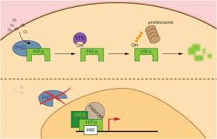
Harness the body’s hypoxia response:
Clear lactate via gluconeogenesis
Suhara PNAS 2015.
Under development in CKD to treat anemia
-- HIF stabilization → activation of Cori cycle
-- Acute timeframe of action

Slide 31
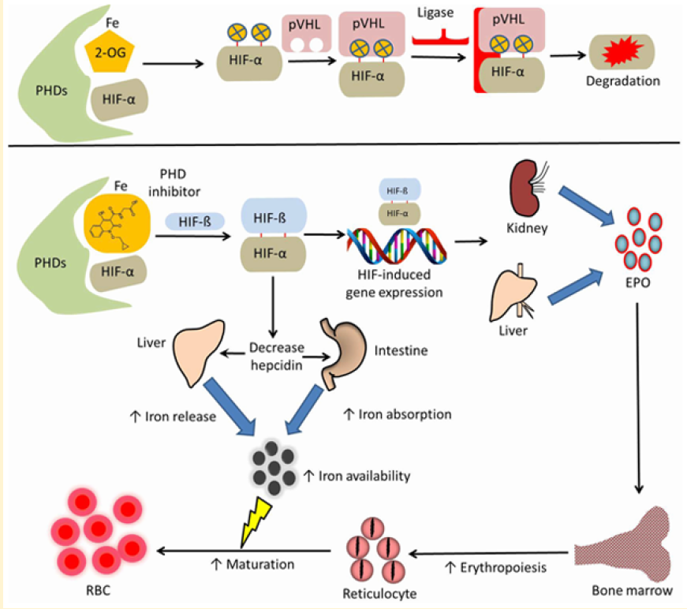
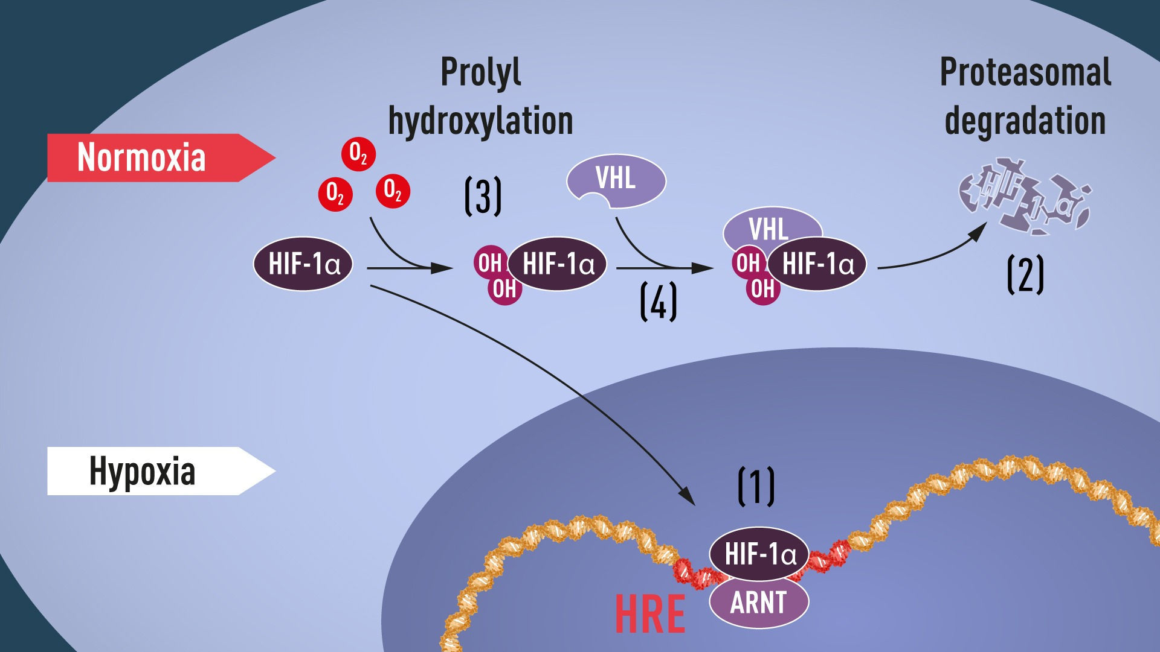
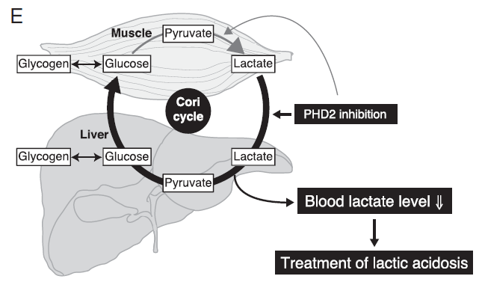
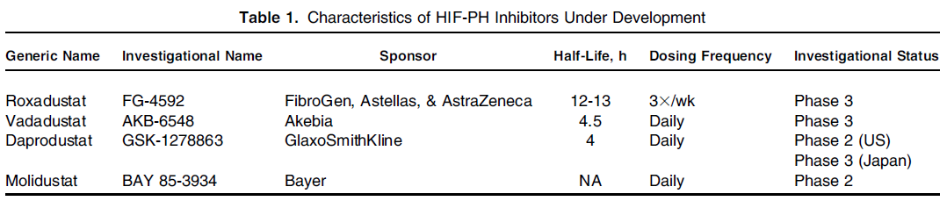
Prolyl Hydroxylase Domain Inhibitors (PHDi)
Improve Adaptation to Hypoxia
Erythropoietic Effects
Metabolic Reprogramming
nobelproze.org
Joharapurkar AA, et al, J Med Chem 2018
Suhara T, et al, PNAS, 2015
2019 Nobel Prize in Physiology/Medicine to William G. Kaelin Jr.
Sir Peter J. Ratcliffe
Gregg L. Semenza
for their discoveries of how cells sense and adapt to oxygen availability
Gupta N, AJKD 2017

Slide 32
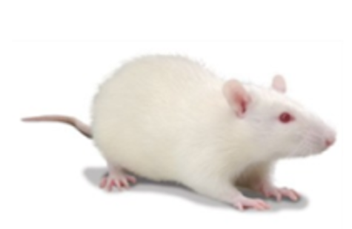
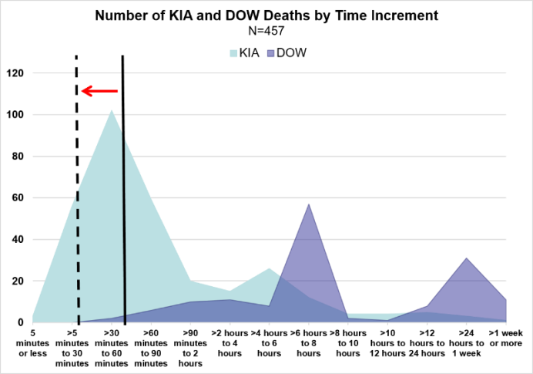
Lethal hemorrhagic shock model in rats
Fixed-Volume Hemorrhage at Fast-to-Slow Pattern
Sprague Dawley
Total Amount of Hemorrhage
Mortality at Battlefield:
40%
40%
20%
Isoflurane Anesthesia
0
2
4
6
8
10
13
16
19
22 min
30-60min
Shackelford, et al. JTS 2016.
90% preventable injury-related death is associated with hemorrhage
Time to Death: 60%EBV: 43±3min; 65%EBV: 30±4min
EBV: Estimated Blood Volume
32

Slide 33
Goals
“Golden Hour”
“Golden Day”
Single, or Bundled Drugs
WB (20% of Blood Volume)
FWB, or CSWB
or: Extended Time for Delayed WB Resuscitation
Anesthesia
Cannulation
240 (min)
24 Hours
0
20
60
120
180
Survivability
Improves Survivability and Outcome
Acute Lethal Hemorrhagic Shock (Fixed Volume or Uncontrolled by Major Tissue Injury)
Administration of Anti-Shock Drugs at 20min from Starting Hemorrhage or Tissue Injury
Whole Blood (WB) Resuscitation (20% of Blood Volume) at 60min (or >60min) Using Fresh Whole Blood (FWB) or Cold Stored Whole Blood (CSWB)
33

Slide 34
PHDi reduces lactate and reciprocally increases glucose in hemorrhagic shock

Slide 35
PHDi directly treats lactic acidosis

Slide 36
PHDi improves MAP in a dose-dependent fashion
IV Administration of PHDi at 20min from Starting Hemorrhage Followed by Fresh Whole Blood Resuscitation at 60min if Survived
MAP in survived animals at each time point
AT1: after PHDi; AT2: after FWB

Slide 37
PHDi improves indices of cardiac output
(↑CO→↓oxygen extraction→↑PvO2, SvO2)

Slide 38
PHDi improves indices of renal function

Slide 39
PHDi mitigates coagulopathy

Slide 40
PHDi improves survivability in lethal hemorrhagic shock model
Lack of difference between HI and LO doses despite physiologic improvements likely due to model limitations (e.g., experimental duration)

Slide 41
PHDi Future Directions
-- New candidate compound: vadadustat (Akebia)
-- Favorable data in ARDS/Covid RCT (critically ill population)
-- Testing in porcine model
-- IV formulations
→ IND-enabling proof-of-concept

Slide 42
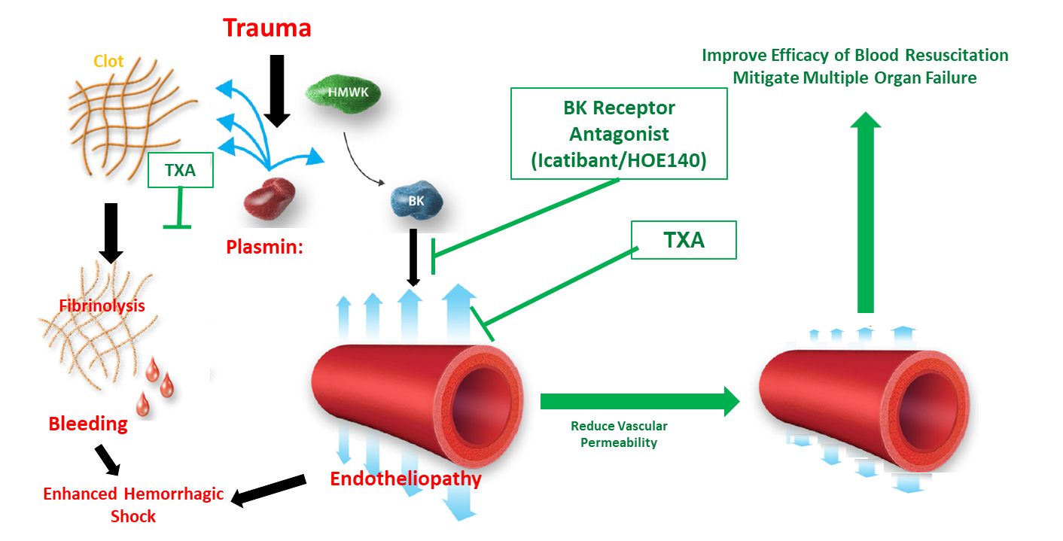
Icatibant and Tranexamic Acid: targeting plasmin (a driver for hemovascular dysfunction)
42

Slide 43
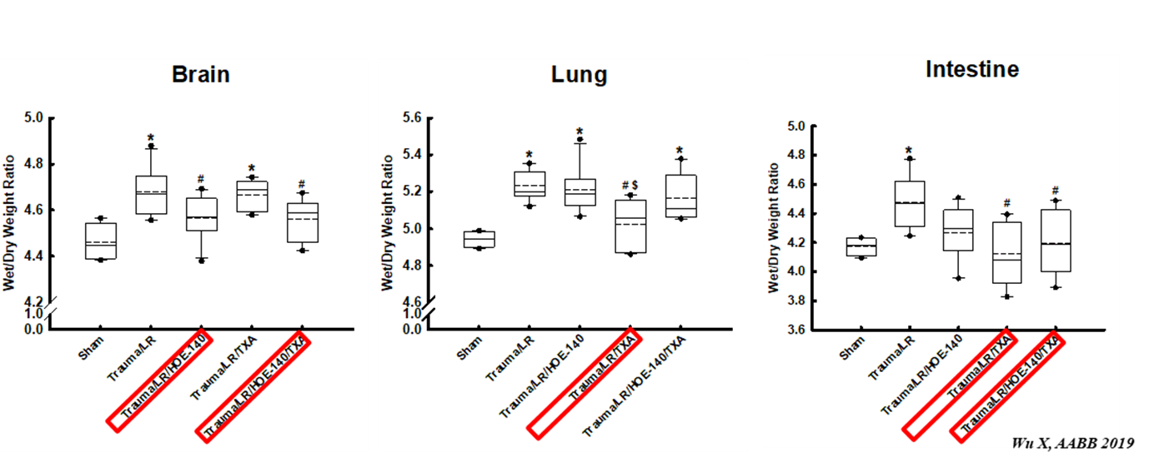
Icatibant, TXA mitigate vascular permeability differentially in different tissues
HOE140, or TXA, or
HOE140/TXA
LR
Resuscitation
Anesthesia
Cannulation
Trauma
Hemorrhage
BL
0
30
45
60
120
min
BKi effect
TXA effect
TXA effect

Slide 44
Icatibant improves survivability in lethal hemorrhagic shock model
IV Administration of Icatibant at 20min from Starting Hemorrhage Followed by Fresh Whole Blood Resuscitation at 60min if Survived
TXA does not affect survival in this model because it is a controlled hemorrhage model.

Slide 45
New target for evaluation in hemorrhagic shock: Angpt1/2 – Tie2
Angpt2 release from W-P bodies during inflammation → antagonizes Tie2 signaling
VE-PTP = Tie2 “off switch”
45

Slide 46
Turning off the “off switch” for Tie2: inhibition of VE-PTP preserves EC function
AKB-9778 restores EC anticoagulant phenotype
-- less consumptive coagulopathy?
-- less microvascular thrombosis & organ failure?
46

Slide 47
Metabolic & Vascular Resuscitation
-- Shock therapeutics: PHDi, PDHC activation (DCA, thiamine), replace/maintain NAD+ (NMN, PARPi)
-- Timing, phased
-- Vascular stabilization: bradykinin inhibition, TIE2 agonist, Protein C
-- “multi-agent chemotherapy for shock”

Slide 48
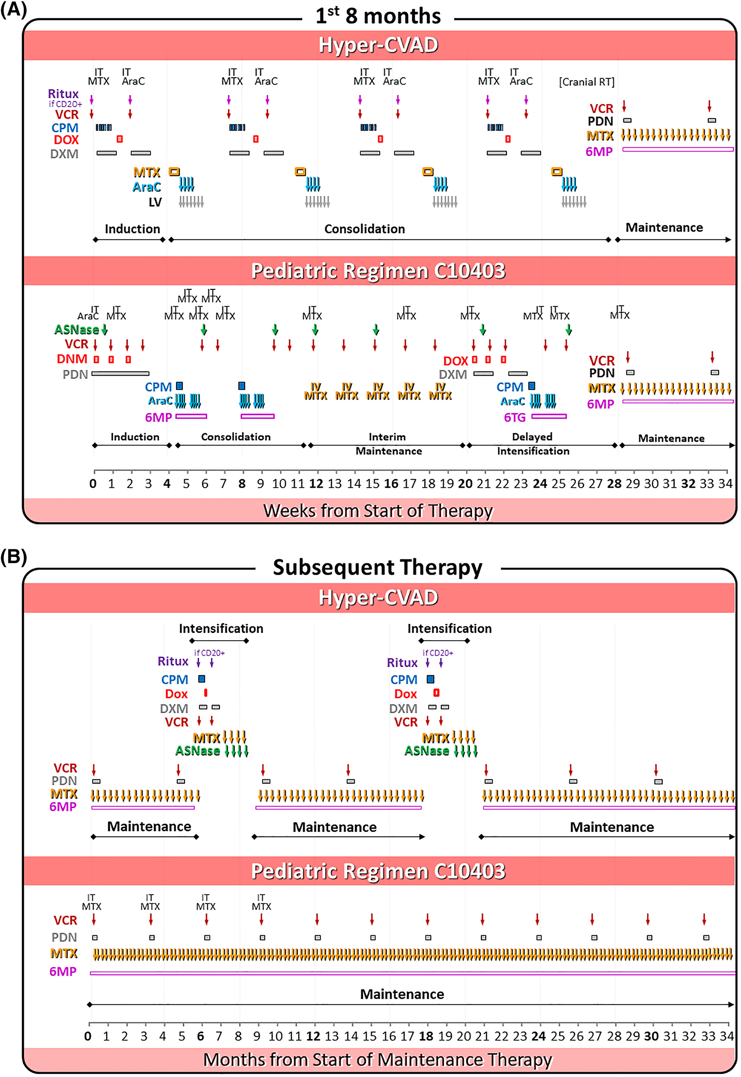
This could get complicated… you might need a hematologist to treat this!

Slide 49
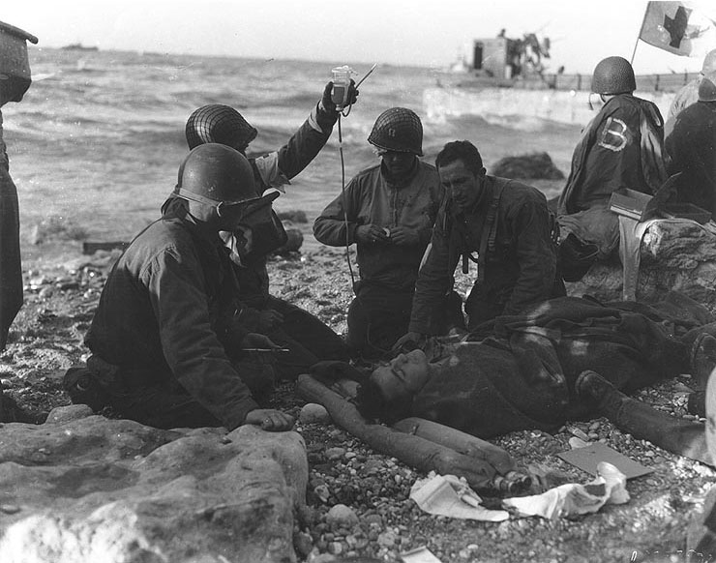
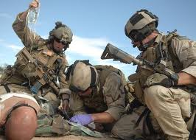
History of Combat Trauma
Resuscitation
Whole Blood is King!
Components are cool!
WW I
WW II
Korea
Vietnam
OIF/OEF
Back to the future!
60 years of Blood
30 years of Clear Fluids
WB+ dried plasma, TXA etc.
“Shock chemotherapy”

Slide 50
Questions?

