Slide 1
On scene – Interventions - 9 minutes:
Massive bleeding from axilla and possibly some bleeding from open femur fracture
Lots of cutting – leather suit
Manual compression in axilla
Tourniquet x 2 on left lower extremity
Airway/Breathing – “good enough”...
Circulation
Fast responder IO failed
IV line + Easy IO right tibia
TXA 1 g and CaCl 5mmol
WB
Forgot about SamSling…
No MILS
Trauma recovery postition

Slide 2
Evacuation 12min
Paramedic holds head inline in recovery position
Need at least one hand for hemorrhage control in axilla
Apnea for about 30sec during take off
Transfusion set disconnected..
Bolus of 300ml WB –
Shallow breathing
Request more blood at helipad, 2nd unit of WB empty en route

Slide 3
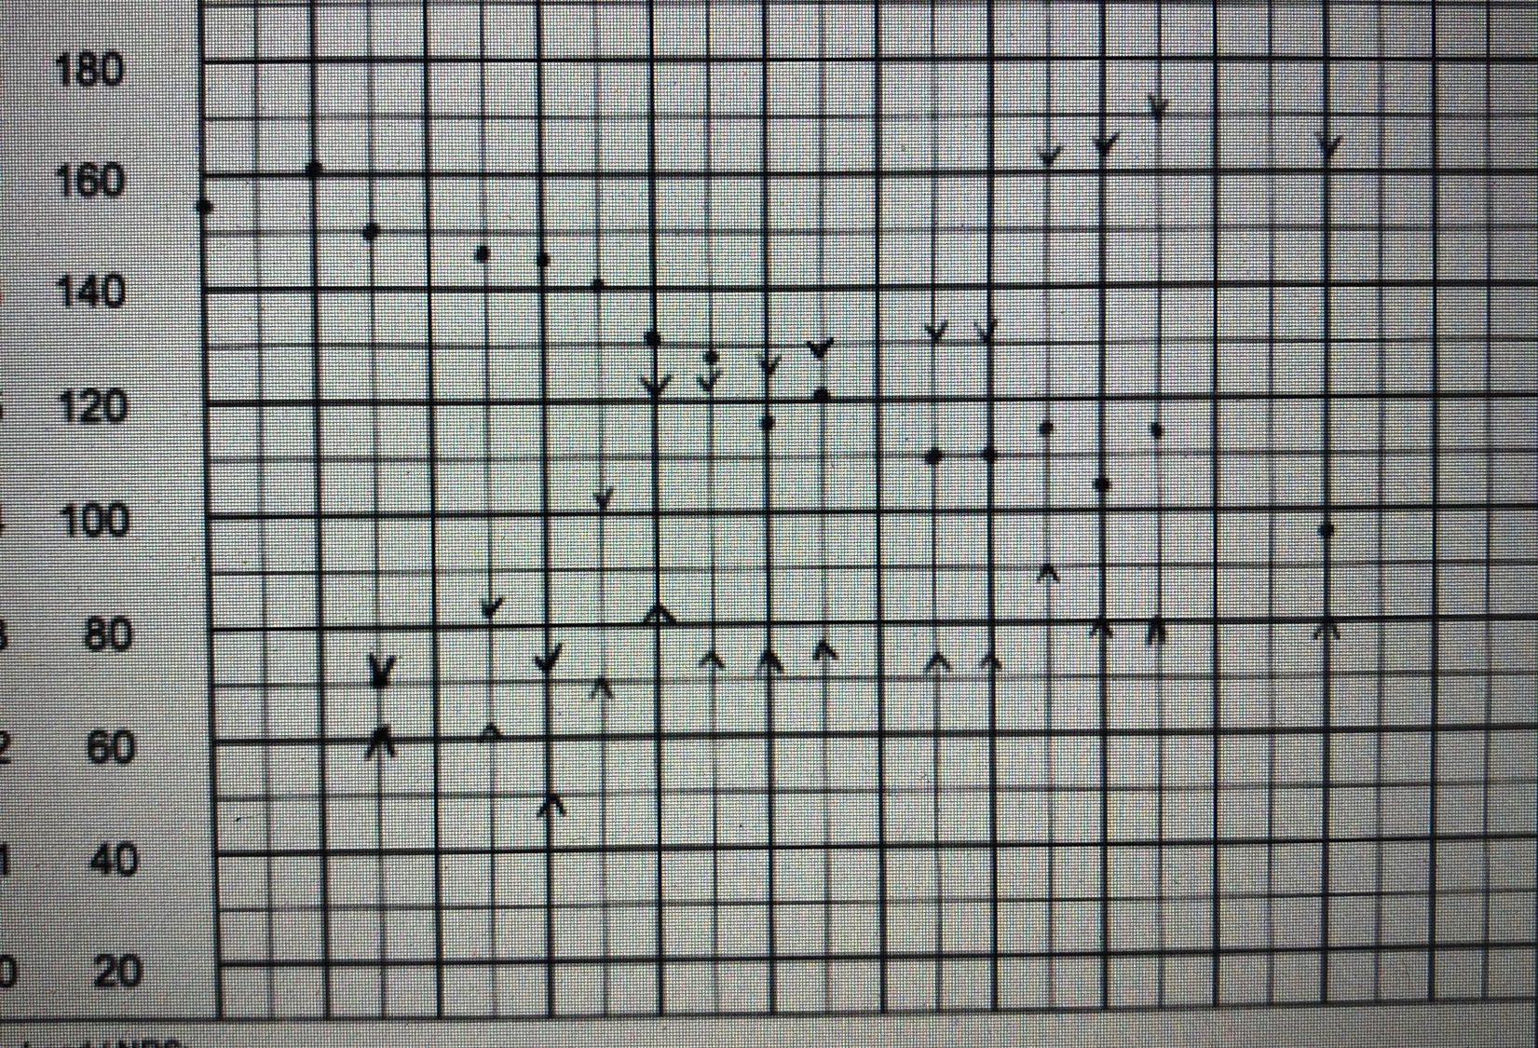
ED
1 u of red cells from helipad to ED
GCS 6 (E1V1M4)
Tp 36,9c
Sat 84%

Slide 4
Injuries CT Scan
Head/Cervical/Thorax
Extracranial hematoma
Periarotic hematoma
Bilateral pneumothorax
Bilateral sternoclavicular dislocation
Sternal fracture
AC joint dislocation
Bilateral lung contusions
Traumatic pneumatocele – lingula
Amputated left arm in axilla
Abdomen/Pelvis/Skeletal
Comminuted fractures
Left scapula
Left glenoid joint
Left femur
Intraarticular left knee
Left tibia
Later MRI:
DAI grade 2

