Slide 1
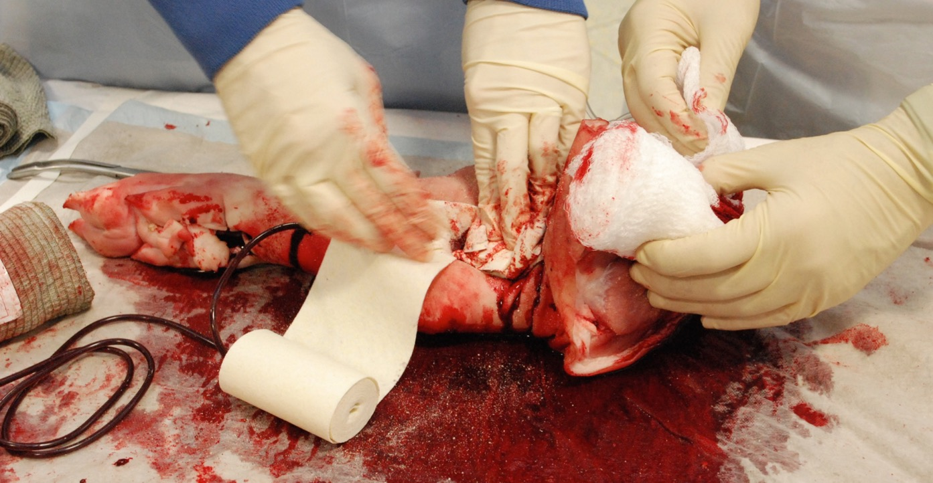
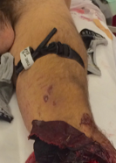
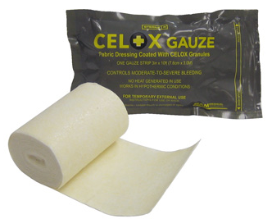
European Guidelines
<C>ABCDE
STOP THE BLEEDING
Packing axilla, hemostyptic agents (e.g. combat gauze, Celox GauzeⓇ, KerlixⓇ, trauma bandage etc.)
Tourniquet on femur
High flow oxygen via mask with reservoir

Slide 2
European Guidelines
Structured approach
Maintaining in-line immobilisation of c-spine & oxygen
i.v.-line, warmed balanced cristalloid 500ml, vasopressor
ET-intubation due to shock and GCS 5, e.g. S-Ketamin as induction agent
PCV, low tidal volume, low PEEP e.g. 5 (Re-evaluation for pneumothorax !!!)
Prevent hypothermia
Urgent transport – NOT stay & play, nor scoop & run, BUT PLAY & RUN
En route
Second i.v.-line, balanced cristalloid, TXA 1g over 10min
Continous monitoring (HR, BP, SpO₂, etCO₂, ECG,…), permissive hypotension?!
Reposition of femur, checking tourniquet, dressing on open wound
Re-evaluation

