Slide 1
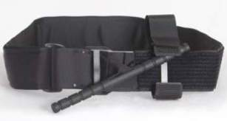
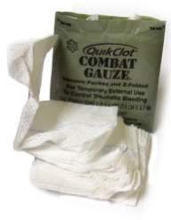
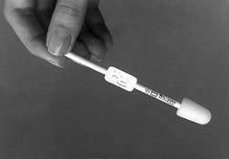
TCCC Battlefield Trauma Care
Phased care in TCCC
Aggressive use of tourniquets in CUF
Combat Gauze as hemostatic agent
Aggressive needle thoracostomy
Sit up and lean forward airway positioning
Extraglottic airways – i-gel
Surgical airways for maxillofacial trauma
Hypotensive resuscitation with blood products
IVs only when needed/IO access if required
PO meds, OTFC, ketamine as “Triple Option”
for battlefield analgesia
Hypothermia prevention; avoid NSAIDs
Battlefield antibiotics
Tranexamic acid – given ASAP when indicated
Junctional Tourniquets/XStat
1

Slide 2
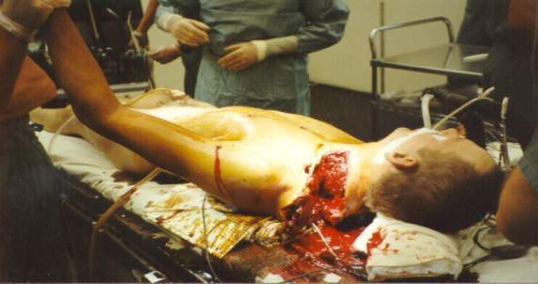
When You Can’t Use a Tourniquet
Groin, axilla
Neck
Photo: CAPT Barney Barendse
Use a hemostatic dressing!
2
Notes:
Injuries in these areas can result in bleeding from very large arteries and veins.

Slide 3
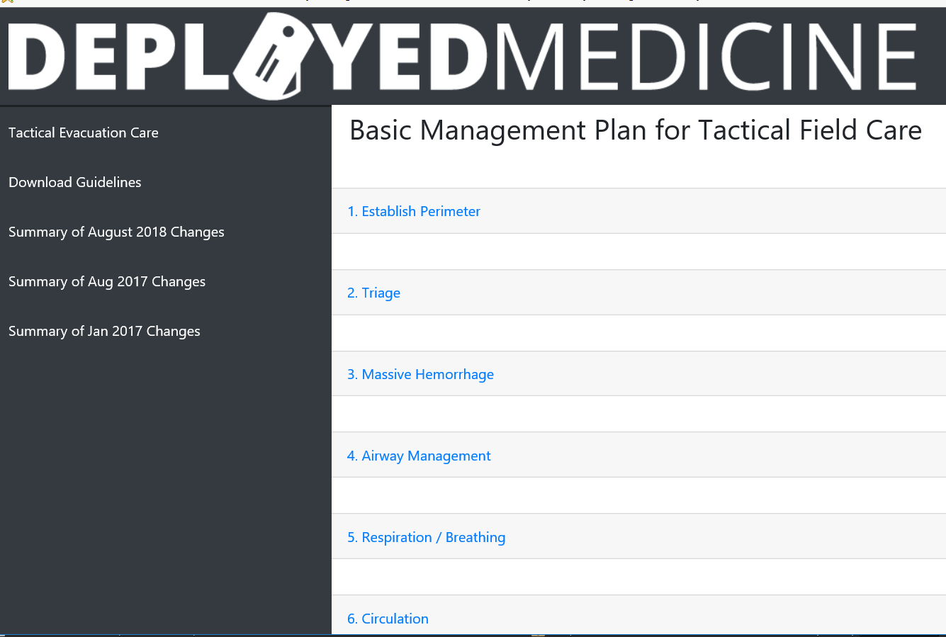
Care Under Fire
Tactical Field Care
Tactical Evacuation Care

