Slide 1
Case discussion RDCR -19 GUIDELINE CHALLENGE
Polytrauma

Slide 2
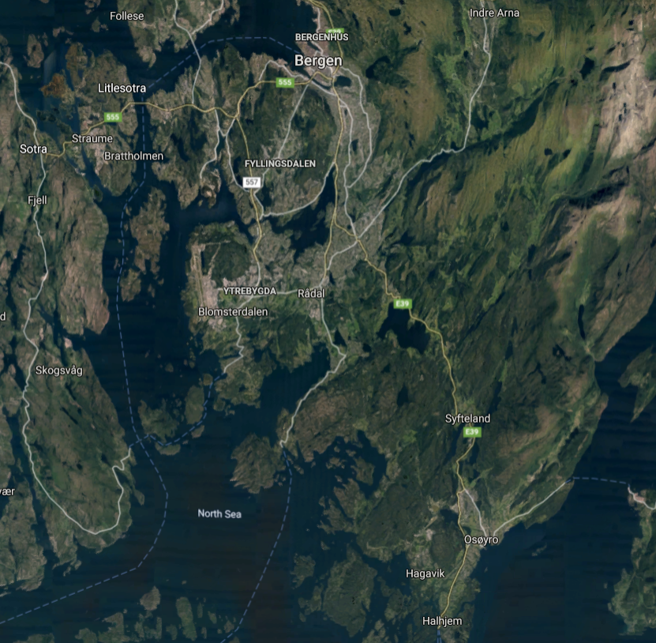
HEMS Bergen
Emergency dispatch:
21 year old male, high performance motorcycle.
Motorcycle accident – unknown MOI, may have hit lamp post at high speed
Initial report from lay person on scene:
«Unconscious – covered in blood. Breathing efforts are fast and shallow. Lots of blood under the body. The arm and leg is dislocated»
Local ambulance is not available until 25 minutes
Local firebrigade and GP is dispatched
HEMS ETA is 12 minutes

Slide 3
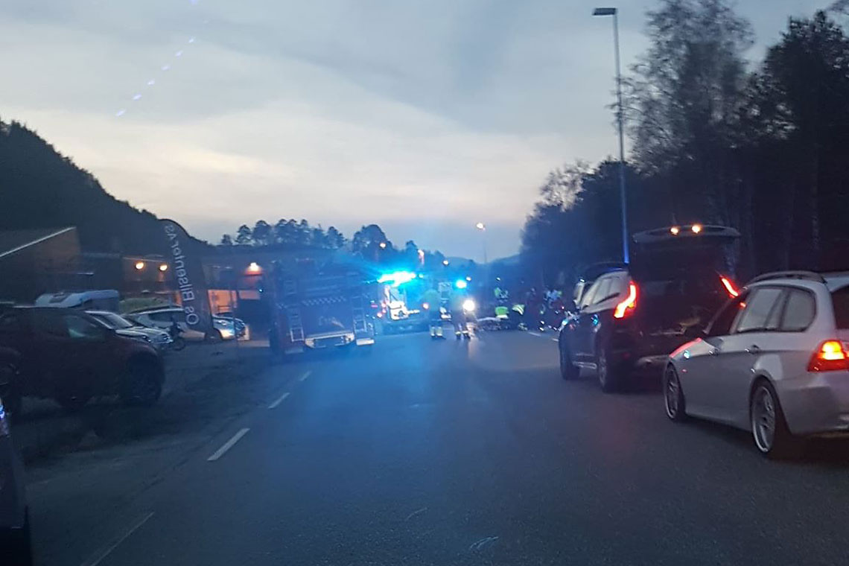
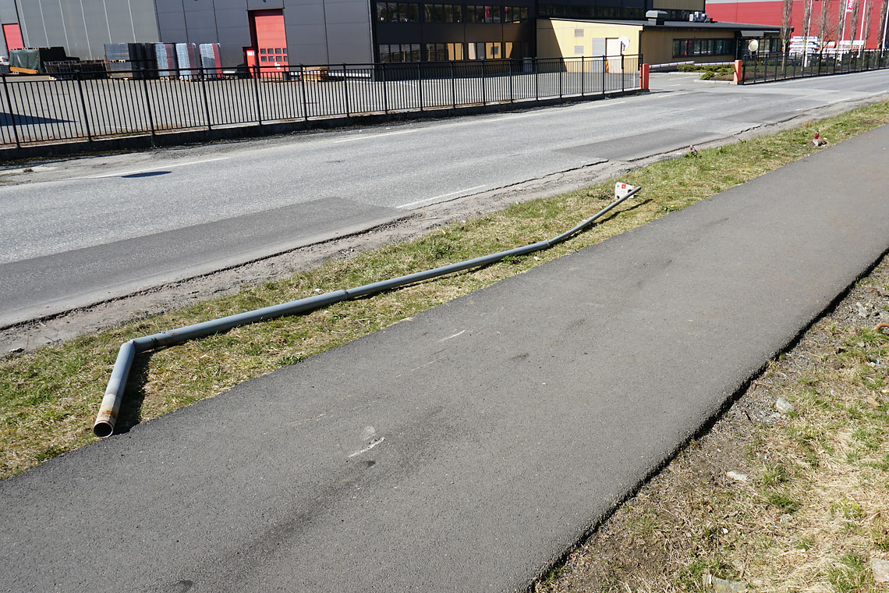
On scene: HEMS arrival 15 minutes post injury
Debris site – 100 m.
Motorcycle is unrecognisable.
Damage to lamp post.
Patient is situated about 20m from motorcycle
Lots of vehicles – fire trucks etc making noise.
Difficult to communicate
Ambulance still have 15 minutes response time

Slide 4
«Initial picture»:
Unconcious, eyes closed (GCS 5) – bloody face. GP has positioned the patient in the recovery position. Leather suit. Helmet is nowhere to be seen.
Policeman sitting behind the patient – desperate – wants attention. He is apparently holding his hands around the humerus and axilla on the left side. Misalignment of the left arm at several places. Blood on the surface by the axilla.
GP is holding patients head.
There is misalignment and blood by the left femur. Open femur fracture.
Patient is shallow rapid breathing ( 40/min)with occasional gasps .

Slide 5
Question 1:
At this time, what is your initial priorities/actions?

Slide 6
Assessment in recovery position
Lot of cutting to be done – leather suit.
Junctional massive bleeding in left axilla. Left arm almost completely amputated. Massive soft tissue damage in axilla/upper arm. Not ameanable by tournique
Patent airway in recovery position.
RR 40 – shallow/agonal pattern. Equal breath sounds. No subcutaneous emphysema.
No palpable radial pulse. Carotid pulse present – blunt – rate ~ 150
Abdomen - No distension/guarding. Rigid upon palpation
Pelvis – no signs of contusion/instability
Left lower extremity – multiple fractures, open femur fracture – severly dislocated – minor bleeding from site
GCS 5 – restless patient. Equal pupil size

Slide 7
Question 2
Transport by helicopter will take appr 13-15 minutes - to level 1 trauma facility. You are a team of 3. Paramedic/Pilot and Anesthesiologist (+ GP and Policeman)
Highlight your key intervention in your structured approach.
On the scene!
En route!
In prefered order.

