Slide 1
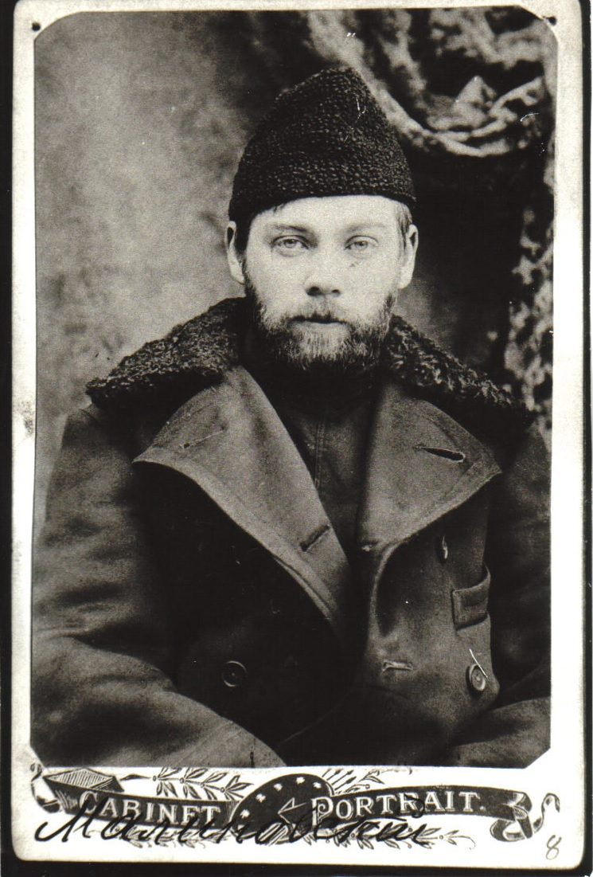
Alexander Bogdanov
1873 - 1928
Wrong, but still important.
“Bogdanov is one of the most complex and fascinating figures of the intellectual world at the beginning of the twentieth century.”
Carlo Rovelli, Helgoland
2021

Slide 2
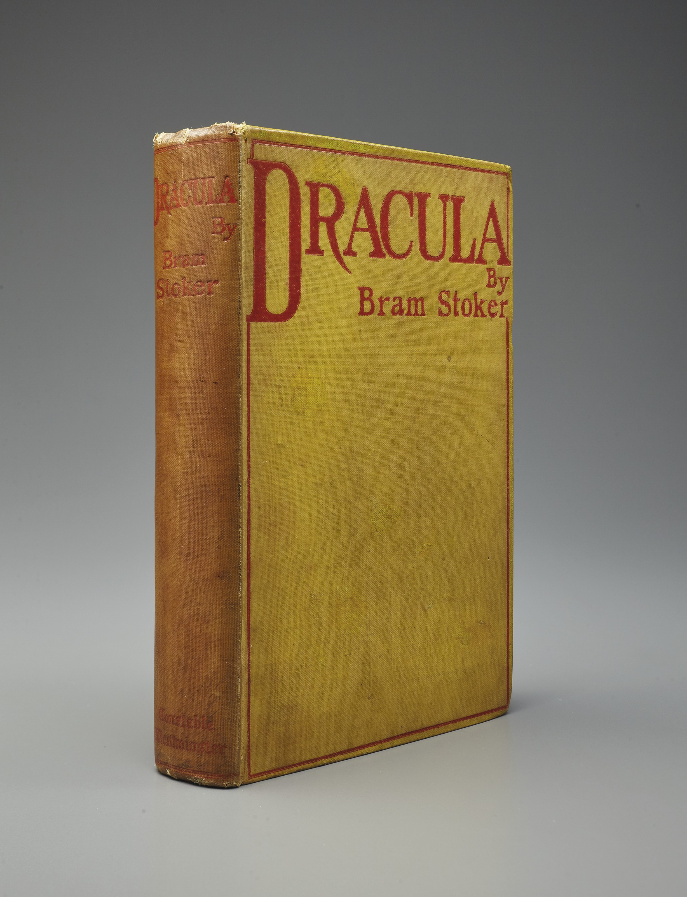
Or
Never underestimate the importance of Dracula in the history of haematology and transfusion medicine
Dracula published in English: 1897
(cost: six shillings)
Dracula published in translation in Russian: 1902
Bogdanov:
1891 - 1908
(Dracula is also wrong)

Slide 3


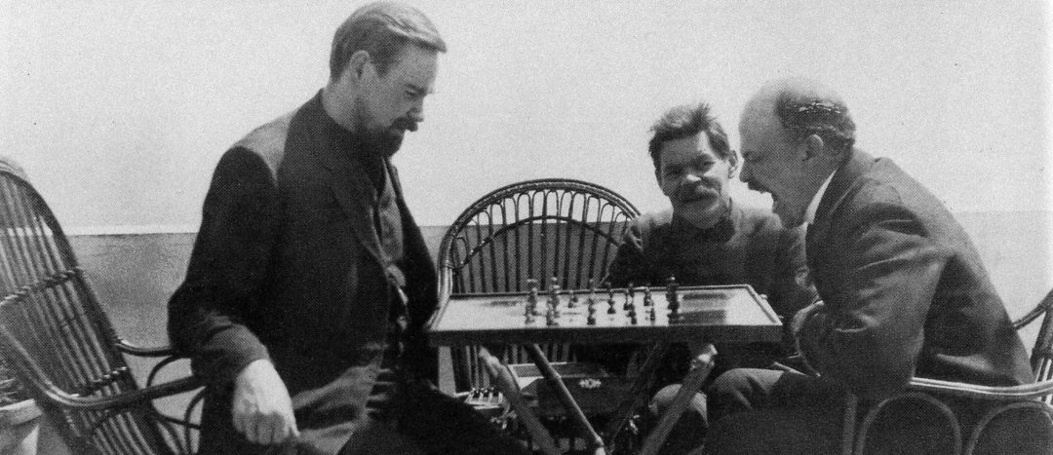
Bogdanov: 1908 - 1914
1908 is a big year for Bogdanov.
He publishes a science fiction novel, Red Star.
He beats Lenin at chess.
He is expelled from the Central Committee of the Communist Party
He gives up politics to focus on science and “blood as a universal tissue.”

Slide 4
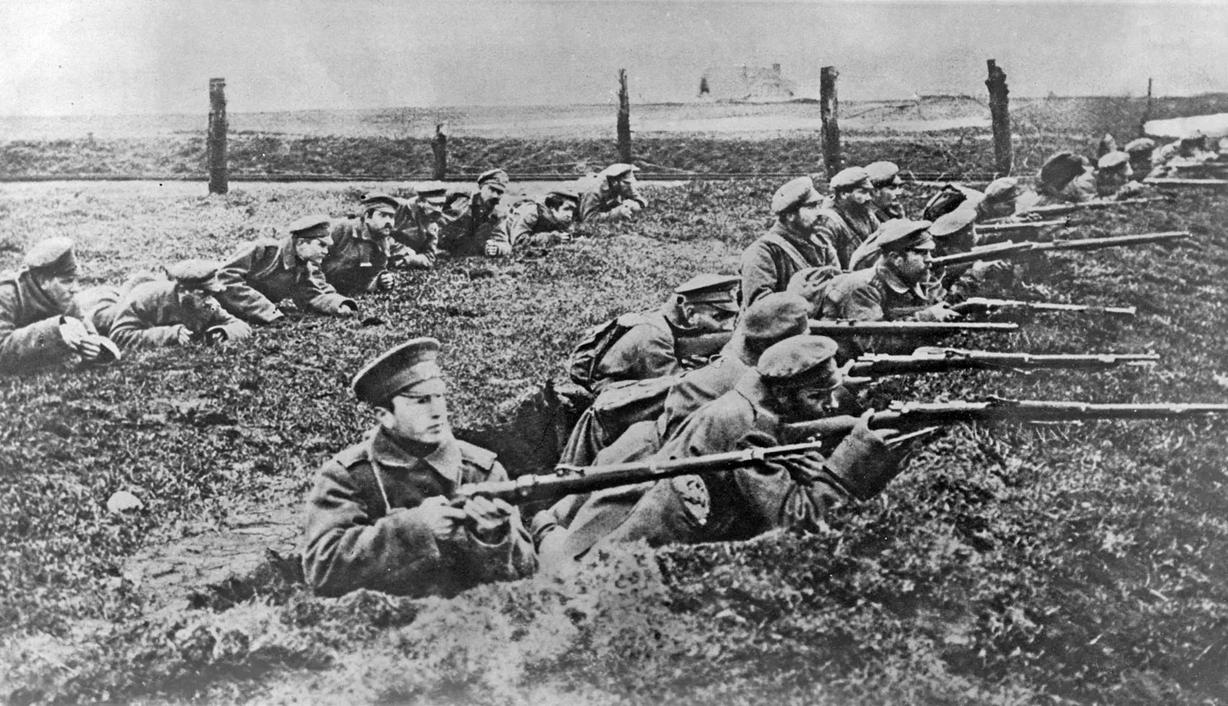
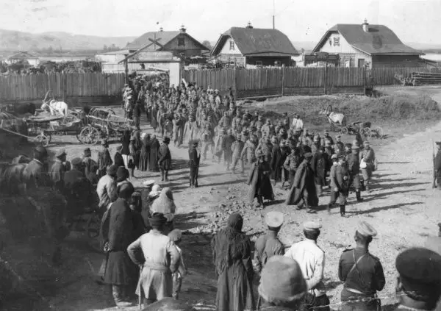
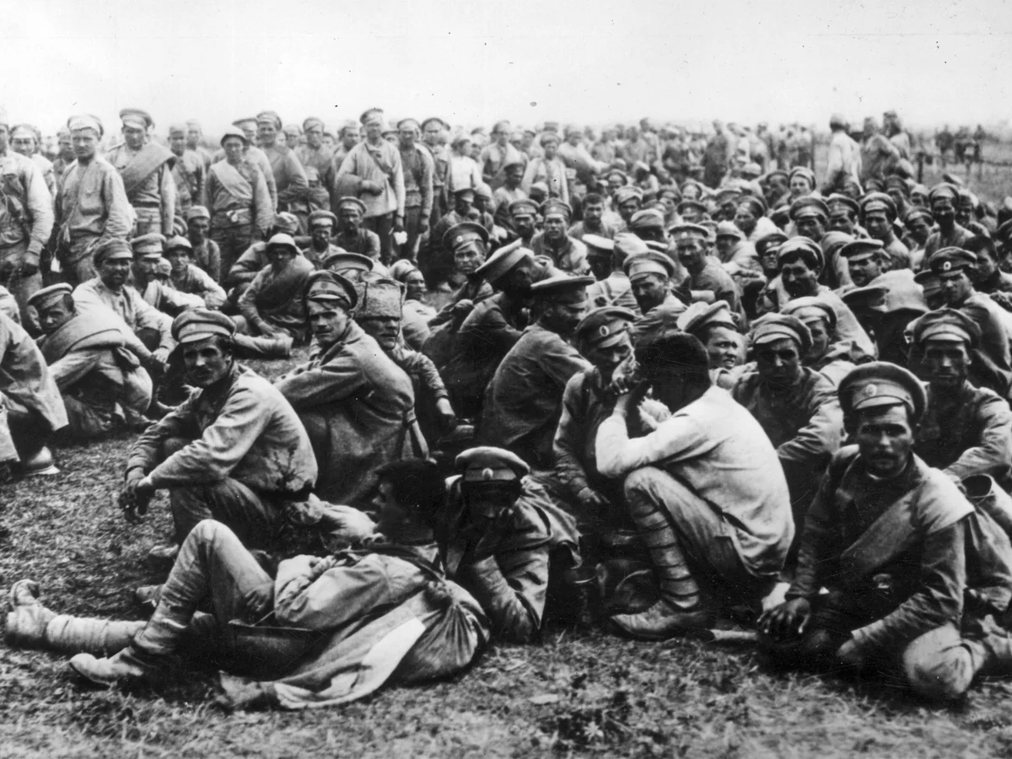
Russia’s First World War: 1914 - 1917
Bogdanov:
1914 - 1921
Bogdanov’s war as a medical officer
Austrian PoWs after
Brusilov offensive
1916
Russian PoWs after
Tannenberg, 1915

Slide 5
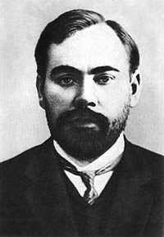
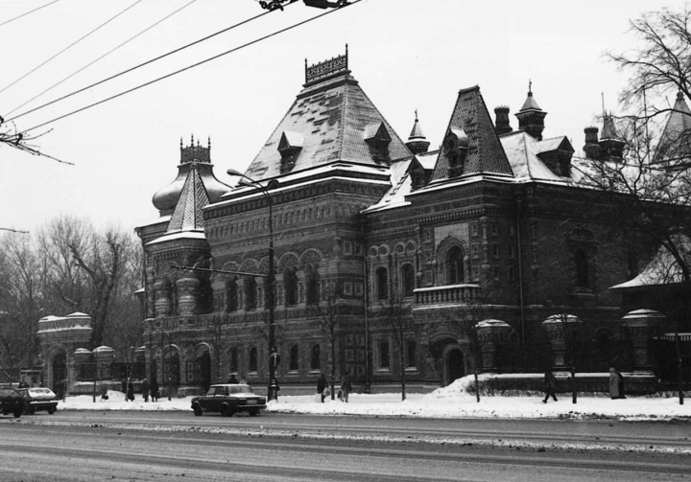
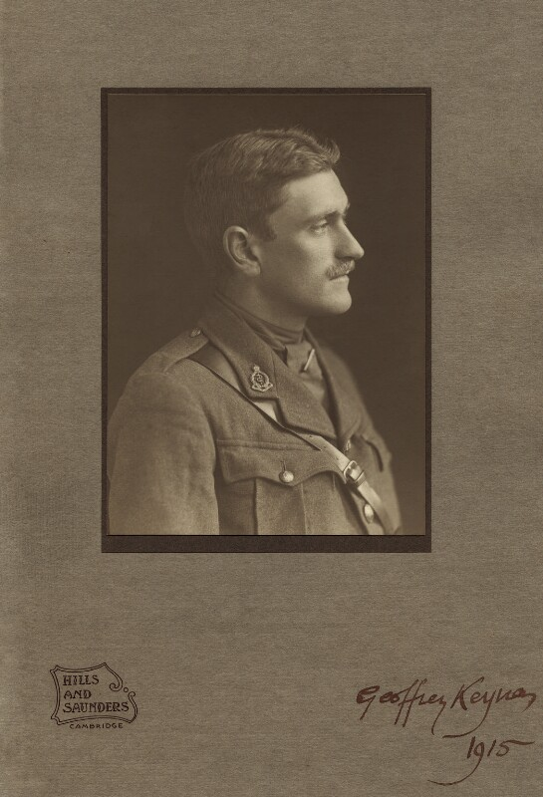
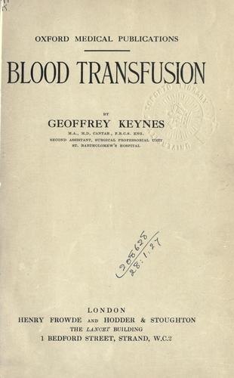
1921 is a dangerous but crucial year for Bogdanov
Bogdanov: 1921 - 1928
1926 is a great year for Bogdanov
1924
Lenin dies
1925
Stalin doesn’t.
The Institute of Blood Transfusions, one mile from the Kremlin.

Slide 6
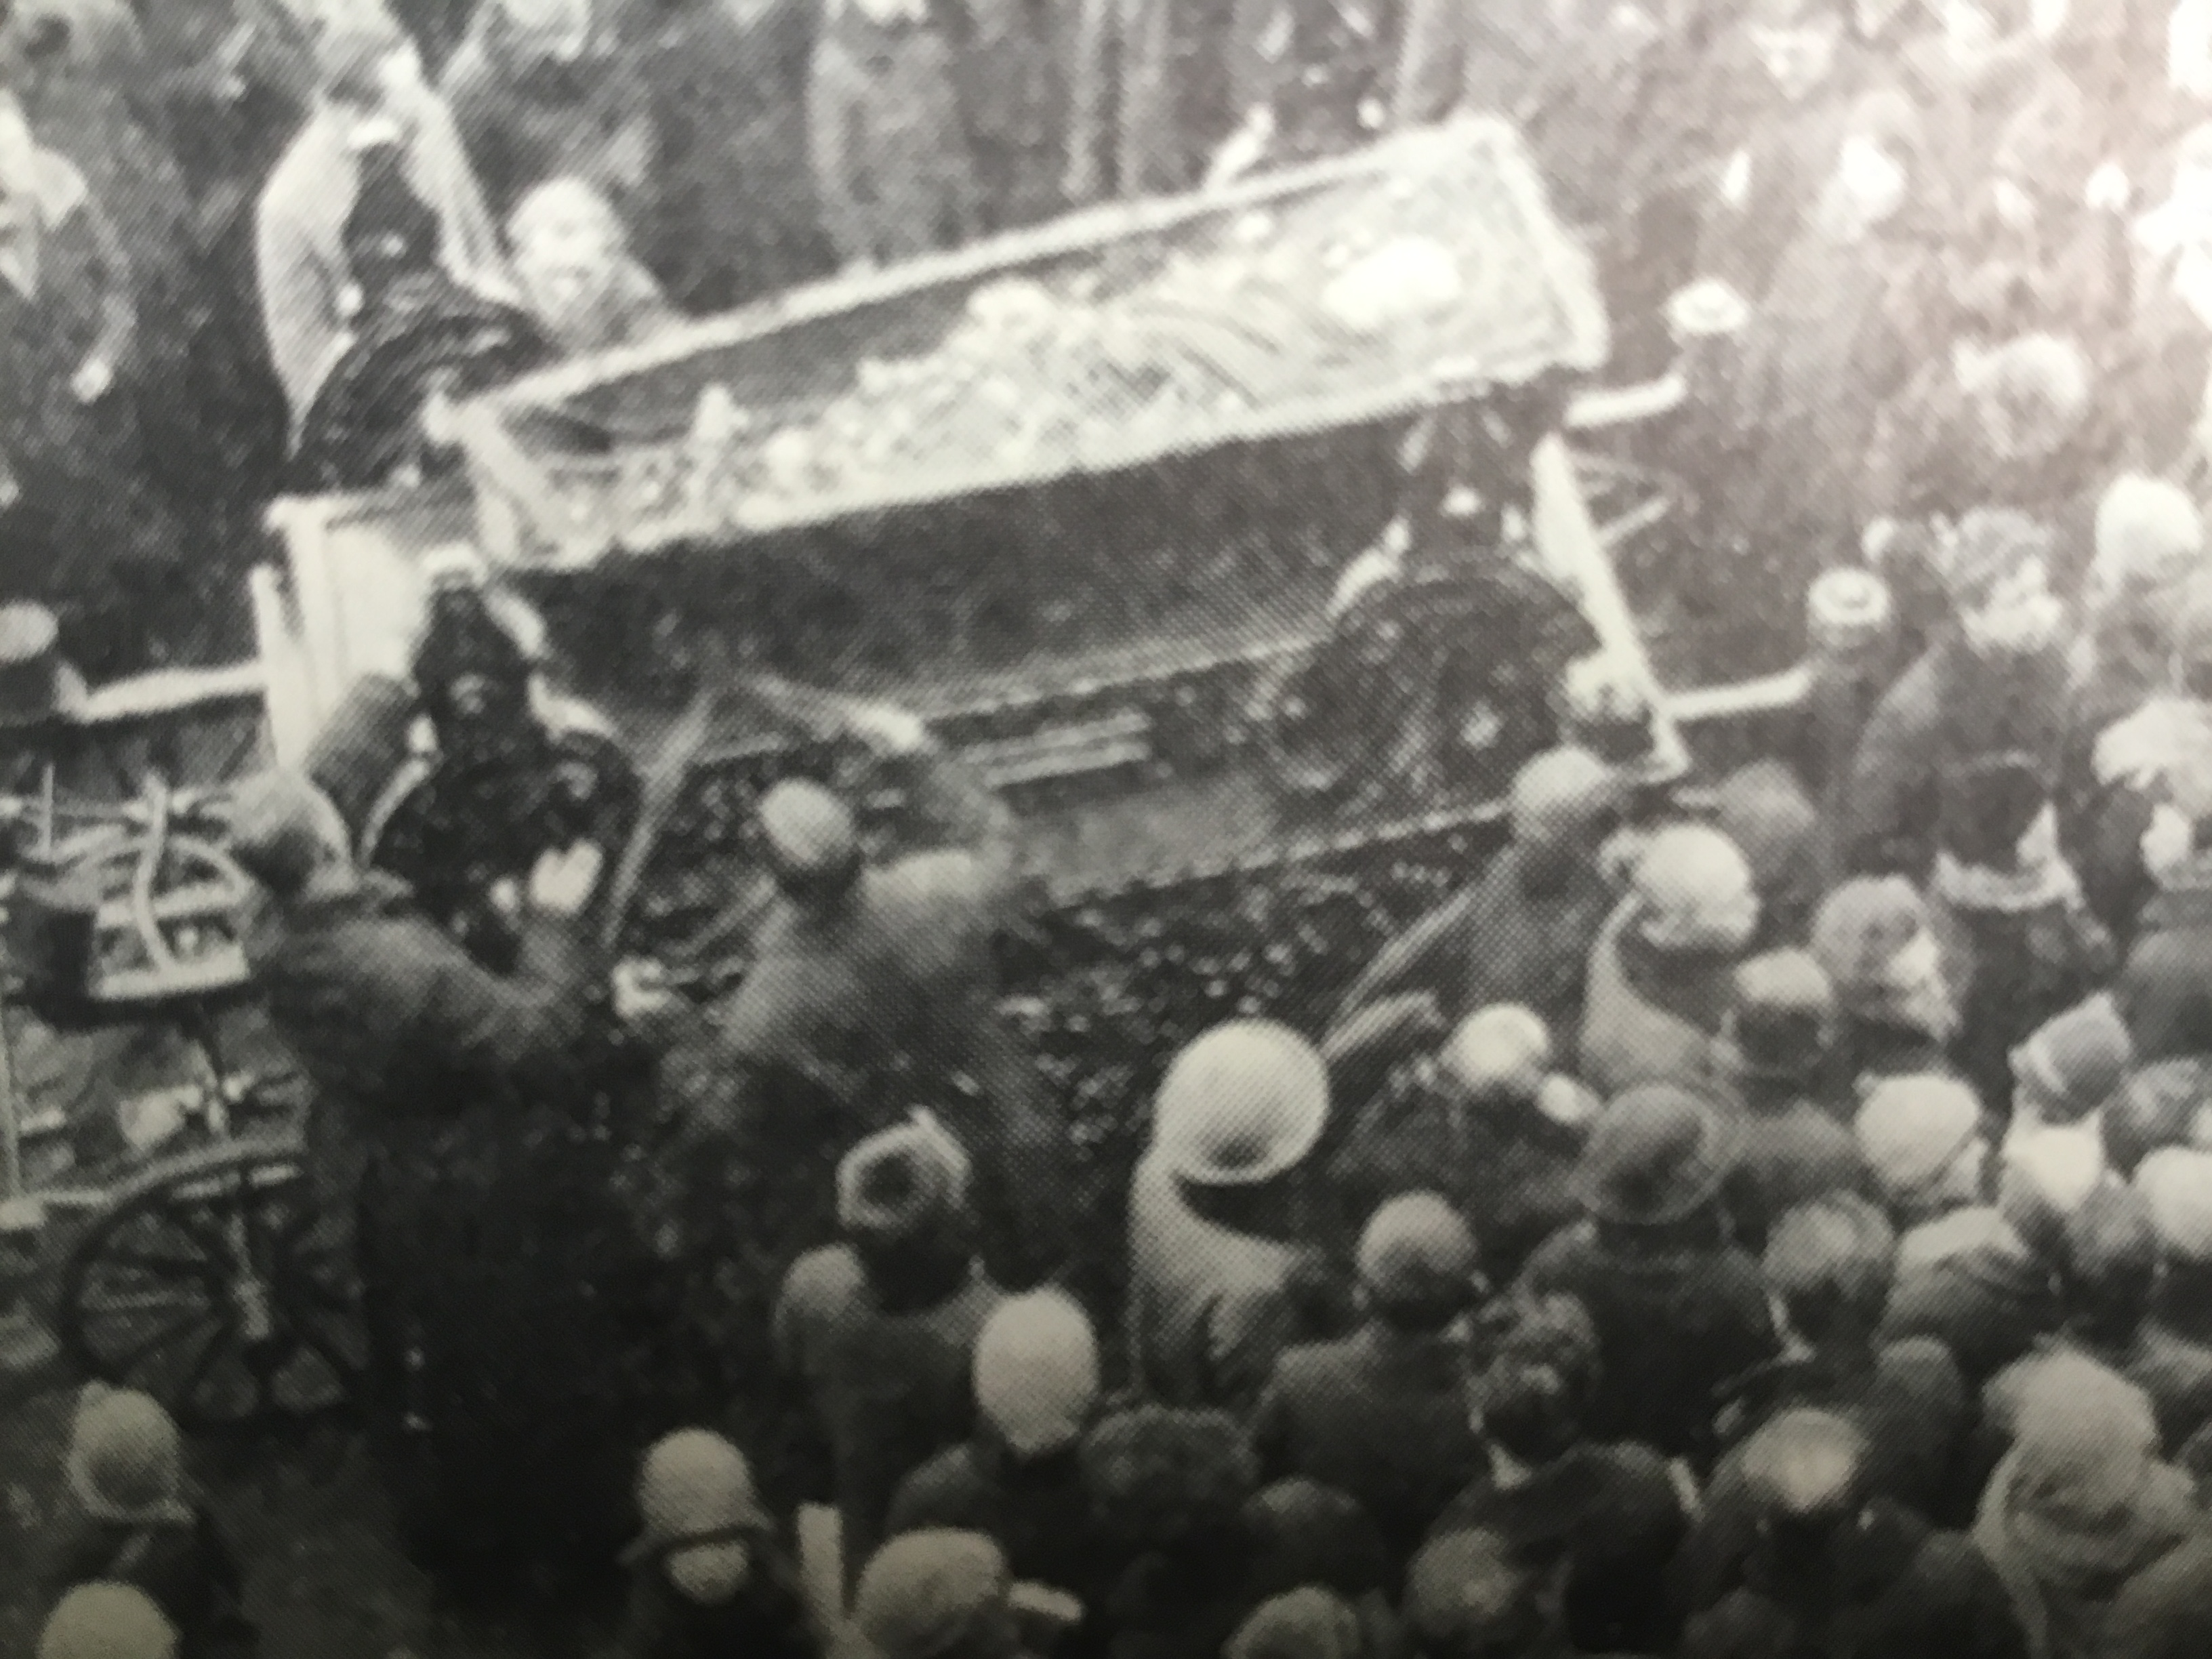
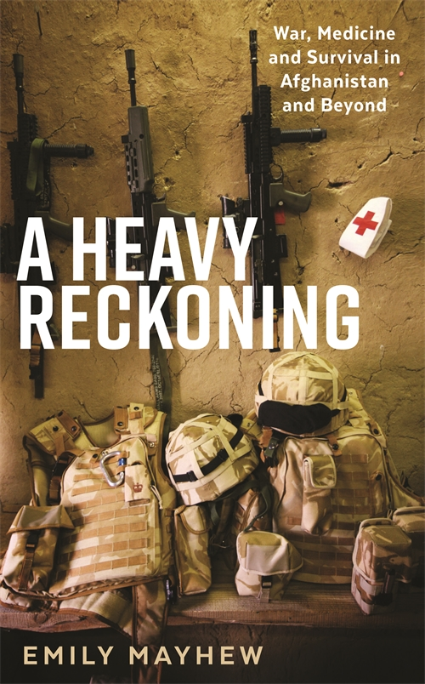

1928
Bogdanov proves conclusively that he is wrong about blood transplants.
Bogdanov’s state funeral, April 1928.
Today we are beginning to understand just how wrong Bogdanov and Dracula have been all along.
“…blood is their argument.”
William Shakespeare, Henry V, Act IV, scene i.

