Slide 1

Blood Products in Development
What have we accomplished, where do we need to go?
COL Andrew P. Cap, MS, MD, PhD, FACP, Division Chief, Acute Combat Casualty Care, U.S. Army Institute of Surgical Research, Hematology-Oncology Consultant to the U.S. Army Surgeon General, Associate Professor of Medicine, Uniformed Services University, andrew.p.cap.mil@mail.mil
25 June 2019

Slide 2
Disclaimer:
The opinions or assertions contained herein are the private views of the author and are not to be construed as official or as reflecting the views of the Department of the Army or the Department of Defense.
Disclosures:
I have no relevant conflicts of interest.
I am an active duty officer in the U.S. Army.

Slide 3
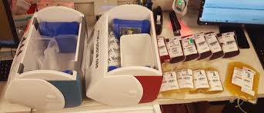

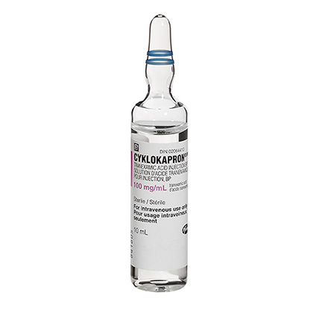
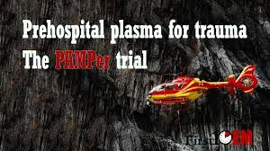
DCR evolution over past 10 years
MTP & 1:1:1
  Remember waiting 45 min for plasma?
  You want PLATELETS with that?!?
  Holcomb JAMA 2015 PROPPR
TXA
  CRASH-2 Lancet 2010 – RCT of use in ED for trauma
  2019 – routine prehospital use
Prehospital Plasma as a bridge to WB or 1:1:1
  WWII concept
  French FDP fielded (USASOC) 2012
  Sperry NEJM 2018 PAMPer

Slide 4

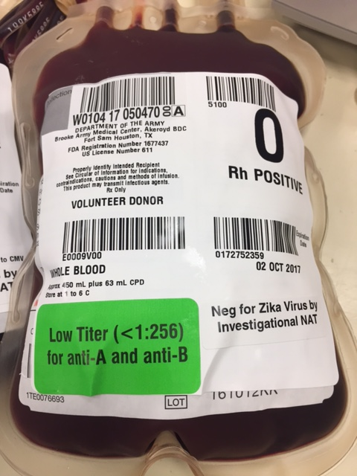
First DCR, now RDCR
Blood Far Forward (BFF): Blood @ POI, not just in hospital
Shackelford JAMA 2017 prehospital blood
Low Titer O Whole Blood: ideal resuscitation for bleeding
Walking Blood Bank as THE contingency blood supply
→ Remote Damage Control Resuscitation (RDCR)

Slide 5
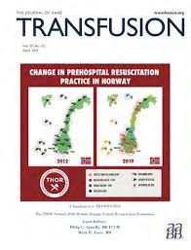

International Change of Practice: Whole Blood
US trauma centers using LTOWB
Plus:
-- Bergen LTOWB/ WBB @ Haukeland U. Hospital, HEMS
-- San Antonio, TX Brothers in Arms LTOWB (air/ground, WBB soon)
-- London HEMS (no PLT)
NATO/Allied militaries: Norway, US, UK, Canada, France, Czech Republic, Israel

Slide 6
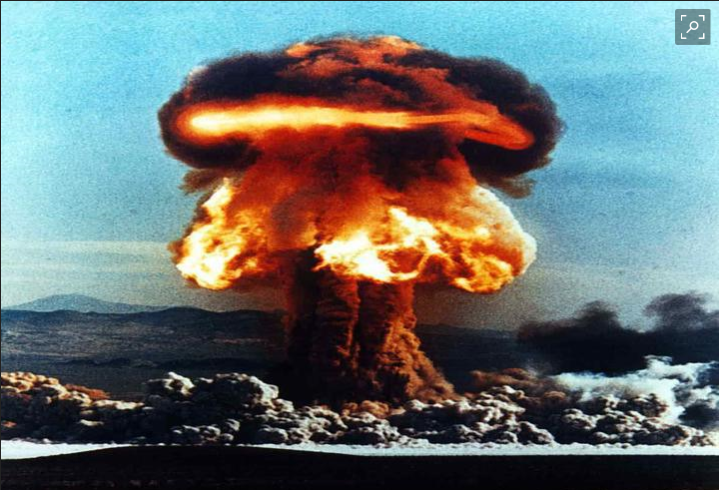
So, are we done?
COL Elon Glassberg: “Can you imagine using 100 year old technology to treat cancer?”
Col. Michael Davis: Prepare for near-peer, multi-domain operations, dense urban environment, lack of air superiority/evacuation.
Dr. Mary Homer:
THOR 2019
WE ARE NOT DONE!

Slide 7
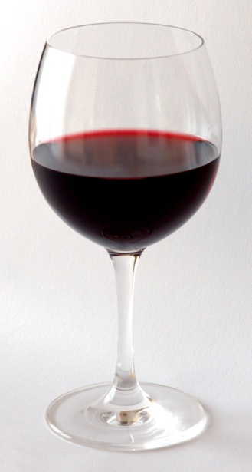

PHYSIOLOGY: what have we learned?
Must replace lost functions of WB at the same time:
  -- oxygen delivery
  -- plasma coagulation function
  -- platelet primary hemostatic function
  -- volume/ oncotic pressure/ electrolytes
So, avoid hemodilution! Treat BLOOD FAILURE!
THIS, not that!
Need all parts of blood to replace lost organ function

Slide 8
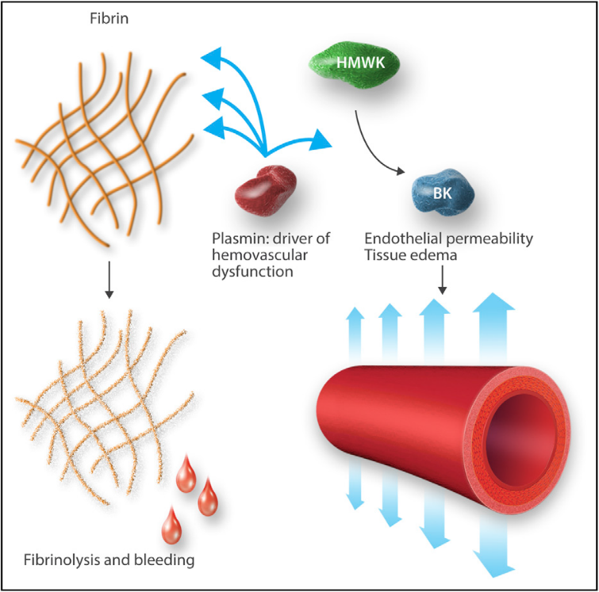
PHYSIOLOGY: what have we learned?
Coagulopathy not as simple as low thrombin
  -- time X factor consumption: hyper → hypo; fibrinogen first
  -- in vitro vs. in vivo reality: long PT vs. ↑ thrombin in vivo
  -- cell-based coagulation: 1000X on surfaces (PLT, EC, WBC)
  -- fibrinolysis: depth/duration of shock
  -- platelet consumption & dysfunction over time
  -- plasmin nexus: immune activation, vascular dysfunction
Darlington et al. Shock 2019.
Cap Blood 2017.

Slide 9

Hemostatic Resuscitation? What are we treating?
Clinical vs. Lab Coagulopathy: (n>1000)
noC 61% (9% mortality)
LC 39% (22% mortality)
→ CC 4% (59% mortality) [INR>1.5, PLT<150, MA<55]
Fibrinolysis vs. Shutdown: (n>547, PROPPR)
“TEG shutdown” = mod lysis, FGN consumption, PLT dysfxn → poor outcome (17% dead vs. 12% nrl lysis)
“TEG lysis” → game over… (51% dead)
Chang SURGERY 2018.
Cardenas SHOCK 2019.

Slide 10
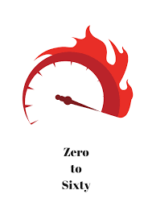

Fight Tonight? Need full armamentarium…
Phase Zero: no blood use, frozen RBCs???
    -- not enough plasma/thawers, slow process, training, disposables, slow throughput → Frozen Blood not going to work in an emergency!
TTH: need lots, no blood available → WBB
Cavalry arrives: lots of options (WB, components, etc.)
Forced Entry: bring WB, CT, have a big WBB
THIS!
NOT THIS!

Slide 11
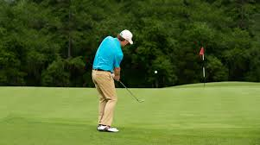
Near Term (Still Based on Old Technology)
Need to move the needle to address logistical concerns, but no radically new technologies.
“Chip shots?” FDA approval?
-- CPP 1972 – still not licensed in US!!!!!!!
-- CSP 1960s – working on shelf life extension 10 years?!
-- FDP… (see Elon’s comments)

Slide 12
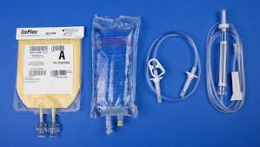
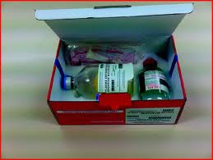
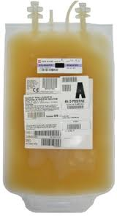
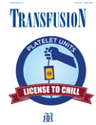
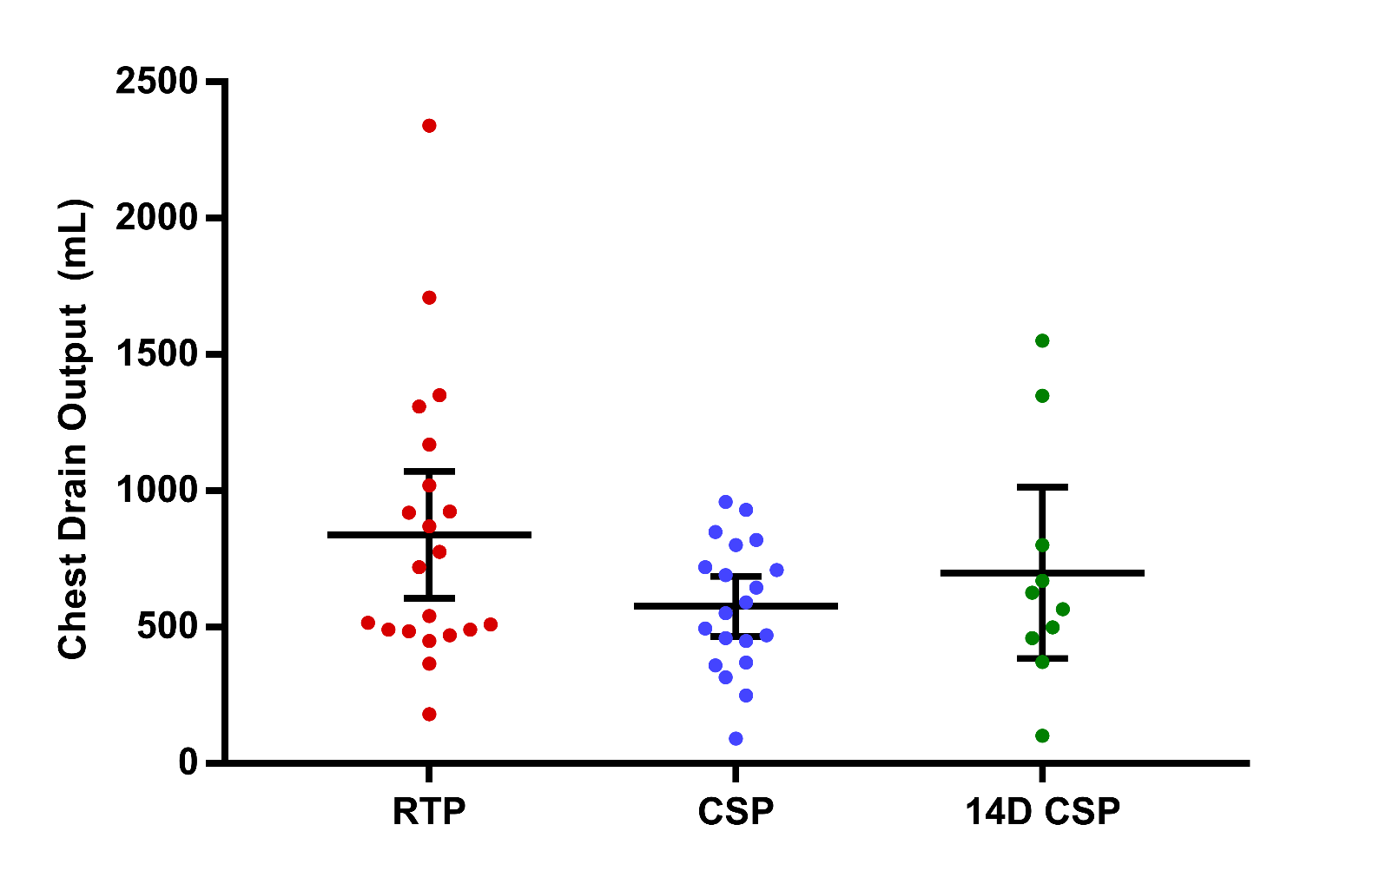
What is just over the horizon?
Dried Plasma
Cold Stored Platelets

Slide 13
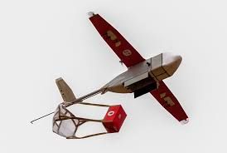
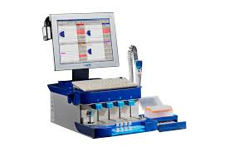
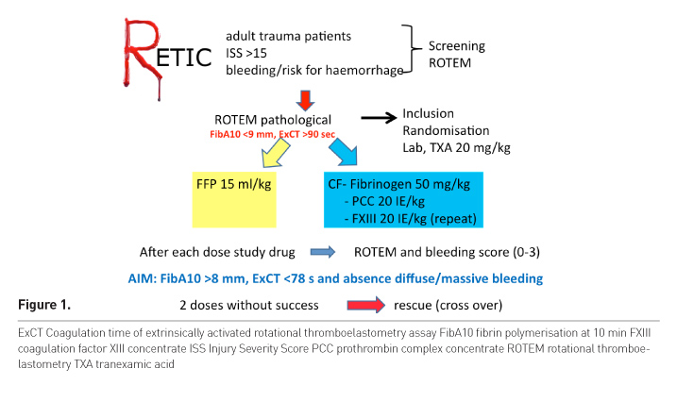
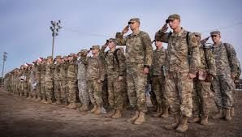
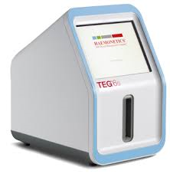
More just over the horizon?
CPP: REALLY Cold Platelets!
Drone JIT Blood Delivery
Really BIG WBB!
Goal-Directed Therapy?

Slide 14
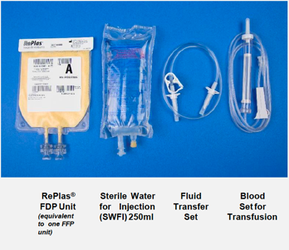
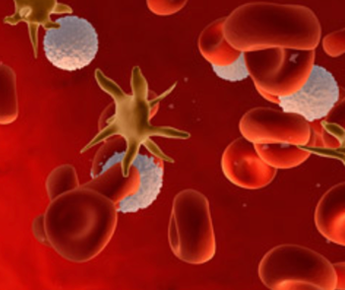
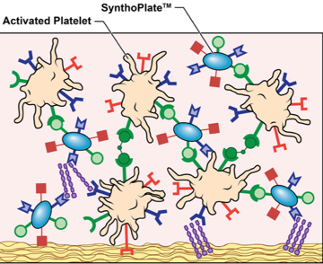




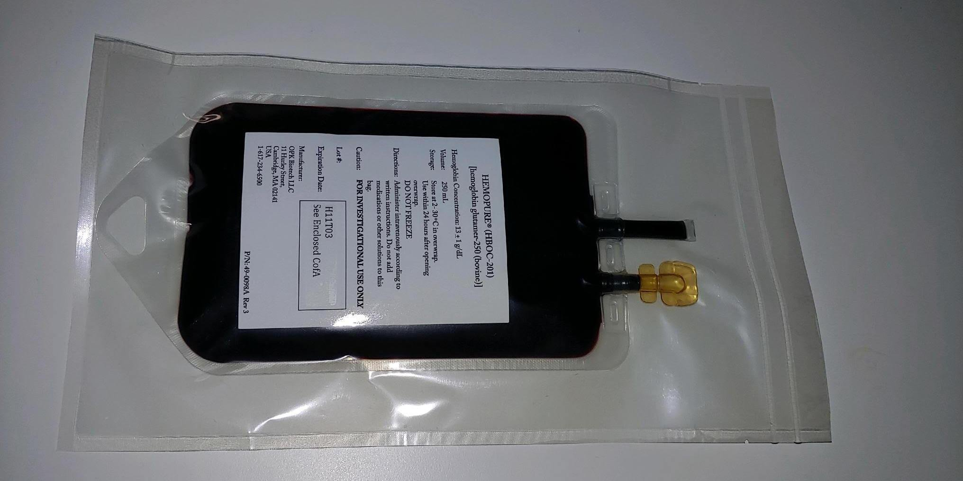

The Logistician’s Dream: “artificial WB”

Slide 15

WB (semi) synthetic replacements?
Oxygen delivery potential?
Coagulation potential?
Clot lysis?
Rheology?
Interaction with native platelets?
Full replacement vs. fixed dose bridge?
Volume/ oncotic pressure/ electrolytes?
Regulatory factors????
What about radiation?
Is this enough?
GF support?
Holy Grail?

Slide 16
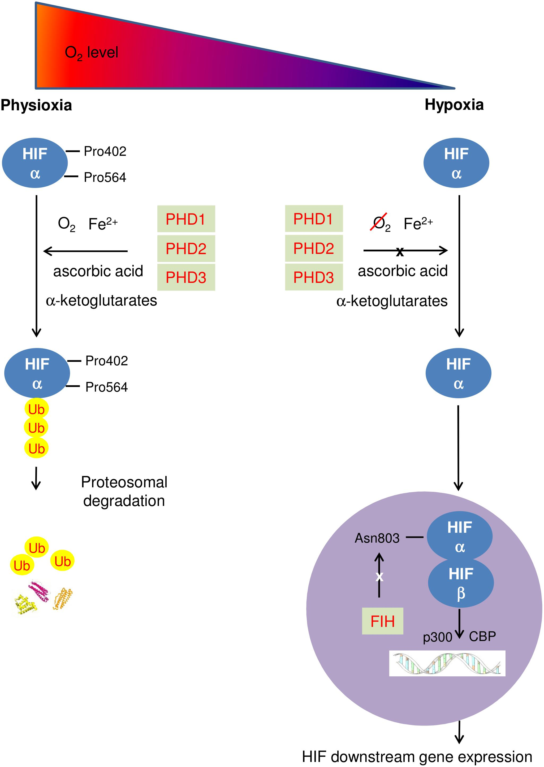
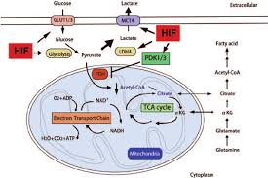
Game Changers: Adapt Cells to Hypoxia
PHDi → ↑HIF1α
“Shock Drug”
Radioprotectant?

Slide 17
USAISR Future Directions on Acute Combat Casualty Care
Right team & resources to address:
  Vision preservation
  Triage/monitoring
  Hemorrhage control
  IV/IO Access
  Blood & Resuscitation
  Organ support
  Pain management
  Trauma/ARS
GOAL: Reduce combat mortality

Slide 18











Cold
Platelets
LTOWB
Questions?
TXA
FDP

