Slide 1
Translational Approaches to Thromoinflammation:
Addressing Threat X With Big Science:
Mitchell Jay Cohen, MD, FACS
Professor and Vice Chair of Surgery
University of Colorado School of Medicine

Slide 2
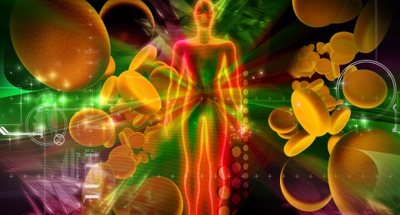
THREAT X:
COMMON BIOLOGY UNDERLYING AGNOSTIC THREAT
Threat X research needs to examine the common biology and solutions that drive critical illness and injury.
Fundamental Investigation
Outcomes
Causal Inference SOAR
COMBAT
Basic
Science
THREAT X
Translational
Science
Clinical Trials Infrastructure
Policy, Advocacy Prevention, DEI, Outreach
Big Data
Artificial Intelligence Bioengineering
Device Design
Innovation
Big Data
Clinical
Trials
Health
Services

Slide 3
So how can we address this?
We have to better understand the phenotypes of injury across clinical, in vitro, in vitro and in vivo models.
In the era of big data and personalized medicine experimentation across the cohort/dataset is key.
This can then be supervised by clinicians and experts to drive inference.

Slide 4
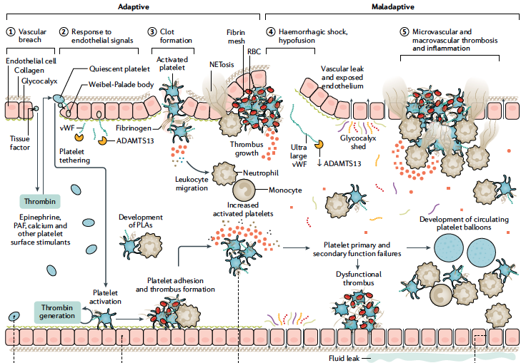
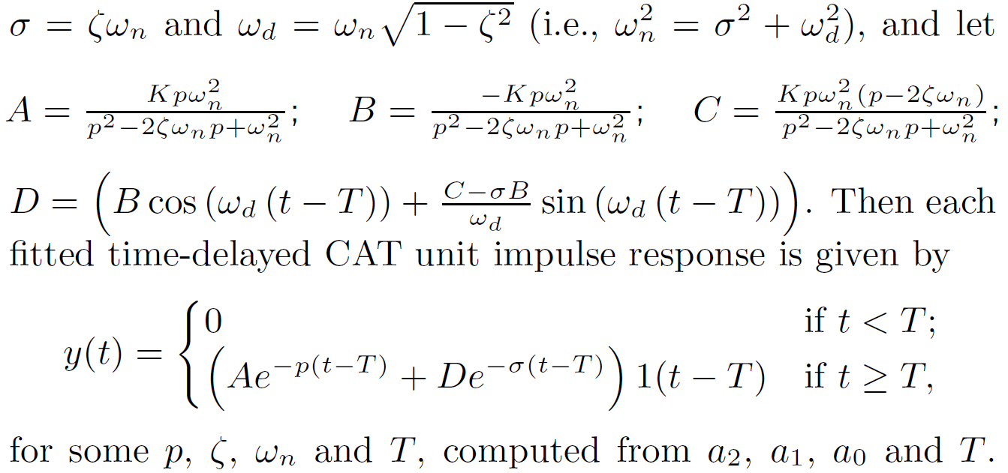
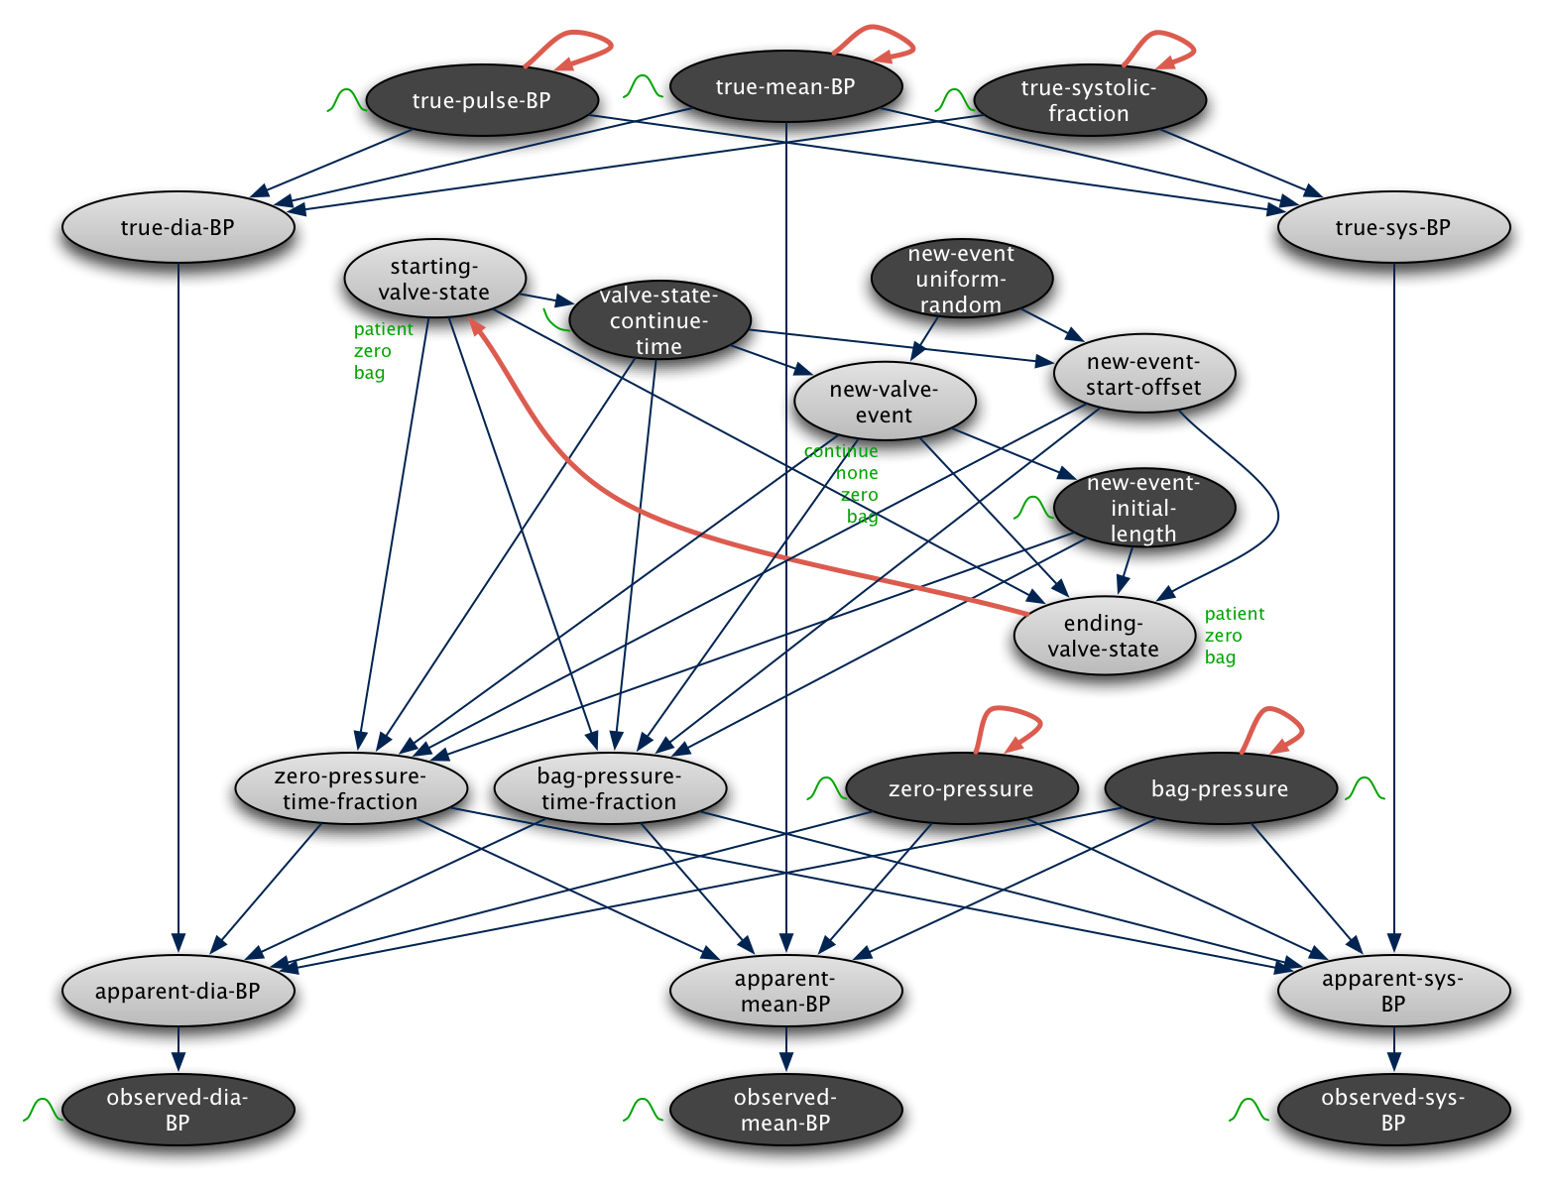

Slide 7
Threat X
Agnostic multiple threats.
A common immunothromboinflammatoendotheliopathy response?
A individualized immunothromboinflammatoendotheliopathy response?

Slide 8
We have pretty good clinical insight of how and why Threat X patients die.
Anatomic injury.
Coagulopathy.
Endotheliopathy.
Perturbed inflammation/immune response
Infection
Clinical supervision of these patients and underlying data should not be discounted.

Slide 9
Models of Threat X
There are no current relevant models of threat X.
There are good trauma models but…
There are good radiation models but…
There are good chemical exposure models but…
All of these models suffer from limitations, inadequate development and the lack of combined injury models.

Slide 10
Clinical models
Get as much data as possible (trans omics).
Trauma is pretty good.
Radiation is fortunately sparse but not unheard of and there is much we can bidirectionally extrapolate.
Chem is fortunately sparse but not unheard of
Threat X will likely be coming and we need to be ready to collect that data (and treat).

Slide 11
Clinical Insight
Requires a common data structure and ontology.
Fortunately limited data in radiation but some.
Lots of trauma data which is less integrated and difficult to fund.
Some chemical data.
Pandemic and infectious and other inflammatory data is pervasive but not standardized.
There is a place for synthetic data.

Slide 12
So how can we address this?
We have to better understand the phenotypes of injury across clinical, in vitro, in vitro and in vivo models.
In the era of big data and personalized medicine experimentation is key including broad diverse data and synthetic data..
This can then be supervised by clinicians and experts to drive inference.

Slide 13
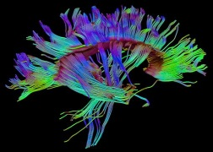
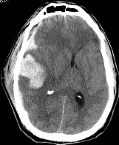
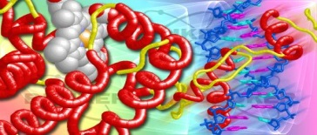
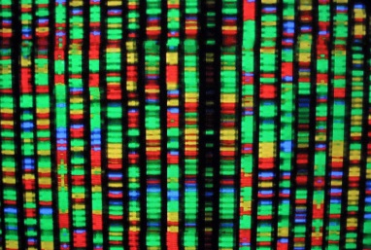
Threat X: a Precision Medicine Approach
Physiology
Bleeding
Fatigue
Injury
Demographic/Injury
GCS
Imaging
Agitated
SBP < 90mmHg
Clinical Data/Physiology
EtOH > 300
Na = 128
S100B
Proteome
UCH-L1
GFAP
Genome
Notes:
This approach embraces the complexity of TBI and integrates the multiple layers

Slide 14
Mitchell.cohen@cuanschutz.edu

